Slide 1



Trends in Children’s Literature at the Seattle Public Library
R. M. Edgerton
January 2026 Capstone presentation
Nashville Software School Full-Time Data Analytics Bootcamp

Slide 2
Introduction
“There are those who say that life is like a book […]
I prefer to think that a book is like life, particularly a good one, which is well worth staying up all night to finish.”
LEMONY SNICKET
Horseradish
I read a lot now, and I read a lot as a child – if I got in trouble in elementary school, it was usually for staying up past my bedtime trying to read or paying more attention to a book hidden under my desk than whatever was going on in class.
I also have a deep appreciation for public libraries, which have always gifted me with books I wouldn’t have thought to look for, and which make reading a much more accessible habit than if I had to buy everything I only read once!
One day, when reminiscing with other bookish friends about our favorite childhood series, I grew curious about which series from my youth are still popular, and which series current children will be nostalgic about in 20 years.
Using book checkout data from the Seattle Public Library, I analyzed popular titles in children’s literature from 2005 through 2025.

Slide 3

Data Acquisition & Cleaning
  The Seattle Public Library (SPL) makes monthly checkout data by title available through Seattle’s Open Data Portal at data.seattle.gov.
  After downloading the full dataset, I filtered for children’s literature by searching for titles tagged as “juvenile fiction” or “juvenile nonfiction”.
  Like many libraries, SPL’s collection also includes music and videos – so I also filtered my results to only books and audiobooks in both physical and digital formats.
  This left me with 127,254 unique titles and their checkout data from April 2005 through November 2025.

Slide 4
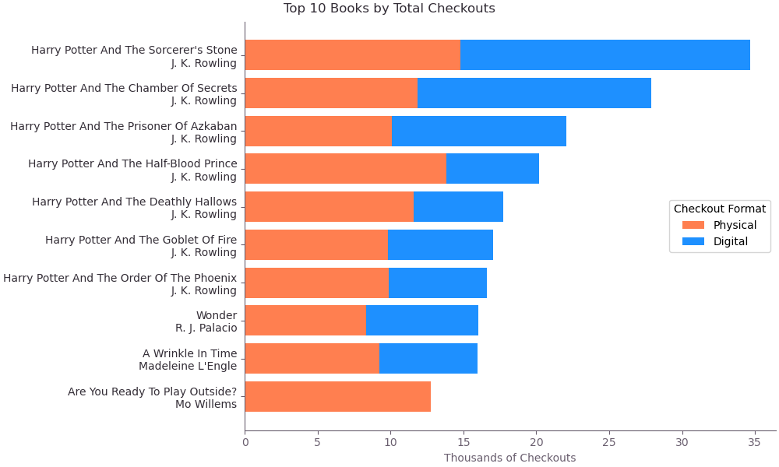
Most Popular Titles
The top ten most checked-out children’s books were dominated by the Harry Potter series.
In addition to readers’ preferences, these most popular titles may benefit from being available during the entirety of the covered time period, or from having more copies available in the library system.
Mo Willems’ Are You Ready to Play Outside? is an interesting outlier in this top ten – it’s the only picture book, and the only one with no digital checkouts!
Notes:
First I looked at which titles were the most popular (by number of checkouts) over the entire timespan, and including both physical books (and audiobooks on CD) as well as e-book and digital audiobook lending.
The Harry Potter series, perhaps unsurprisingly, have been top performers for the Seattle Public Library, and all seven of them are in this top 10 list.
Many of the Harry Potter books, as well as A Wrinkle in Time (which placed 9th) may benefit from being available during the entire time period covered by the data, while a book like Wonder (in 8th), was only published in 2012 and therefore has almost half as many years to build up checkouts in.
Also, this data is not corrected for the number of copies available at the library – and a book having more copies is going to mean it can be checked out more often.
One title I’d like to draw attention to is Mo Willems’ Are You Ready To Play Outside?, which is the tenth most-popular book overall, but the only picture book on the list, and the only book to make the top 10 with only physical checkouts.
In fact, Mo Willems’ pictures books are 5 of the top 10 books with the most physical checkouts.
The first two Harry Potter books are the only titles to appear in the top 10 by both physical and digital checkouts.

Slide 5

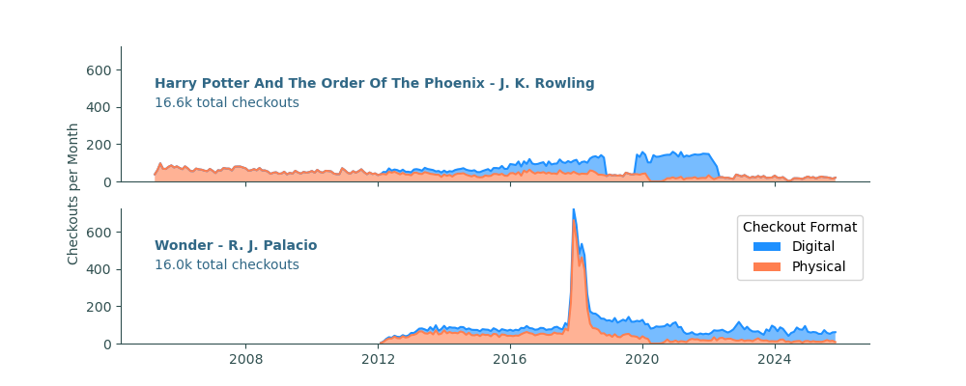
Different Demand Patterns
Looking at checkout numbers over time for a few of the top titles reveal that despite similar overall checkout numbers, titles can experience very different patterns in checkouts.
Harry Potter and the Order of the Phoenix, the seventh most popular book overall, has had steady checkouts for the entire time frame except for periods where the library did not have digital copies available.
Wonder, the eighth most popular, appears after its publication in 2012 and then experiences a dramatic spike in checkouts after the movie adaptation in 2017.

Slide 6
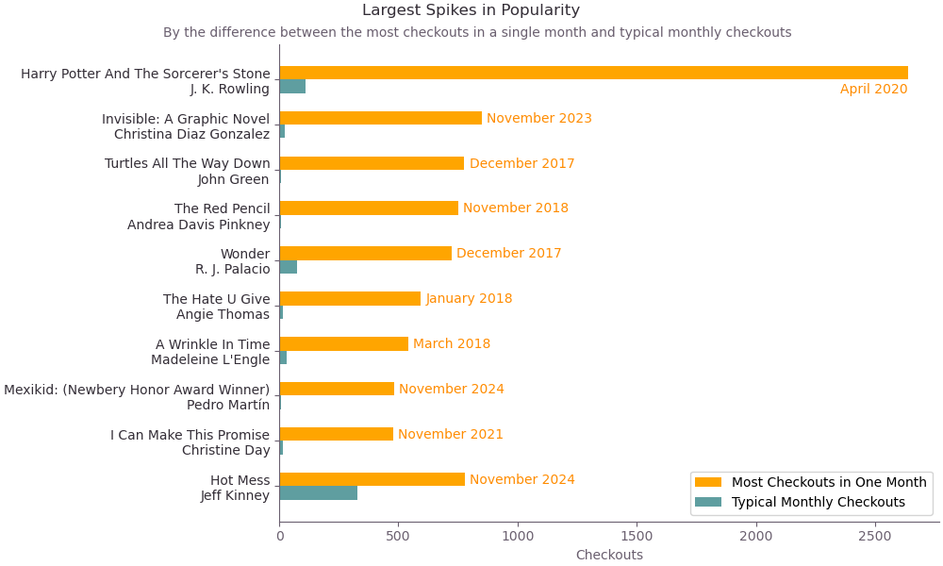
Possible Fads
Without the spike following the film adaptation’s release, Wonder would’ve likely had around 4,000 fewer total checkouts, knocking it out of the top ten. While it would still be pretty popular even then, looking for the largest spikes in checkouts may identify books that had brief moments of popularity that didn’t last.
Some titles with large spikes still maintain popularity, while others (like Turtles All the Way Down, The Red Pencil, and Mexikid)
are checked out fewer than ten times
most months.
Notes:
Spike correlations:
Harry Potter – SPL re-acquires digital versions of the HP books; digital borrowing rises during COVID-19 lockdowns
Invisible – Unsure
Turtles All The Way Down – initial book release
The Red Pencil – unsure
Wonder – film release in 2017
The Hate U Give – unsure (spike is pre-movie release but well after book release, maybe correlates with awards?)
A Wrinkle in Time – 2018 film adaptation
Mexikid – Newberry Honor winner
I Can Make This Promise – unsure
Hot Mess – initial release

Slide 7
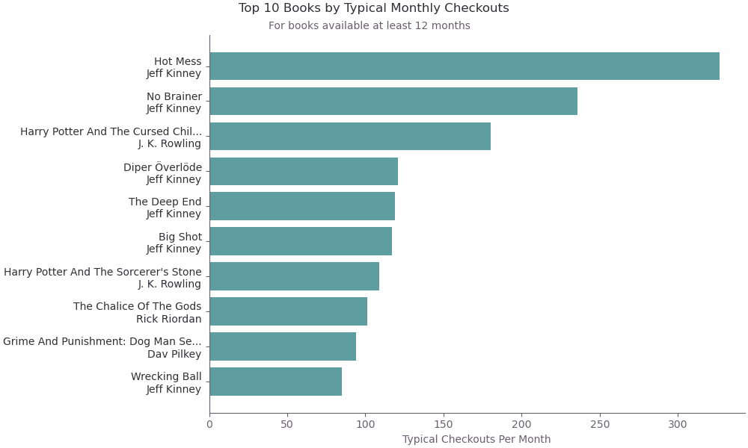

Consistent Popularity
Looking at books with the highest levels of typical monthly checkouts can help correct for both short-lived fads and books that have simply been around for a long time. Jeff Kinney’s Diary of a Wimpy Kid series outperforms, making up six of the top ten titles.
While this method favors newer titles, nine of the ten were available for over two years and consistently popular for that entire time.

Slide 8
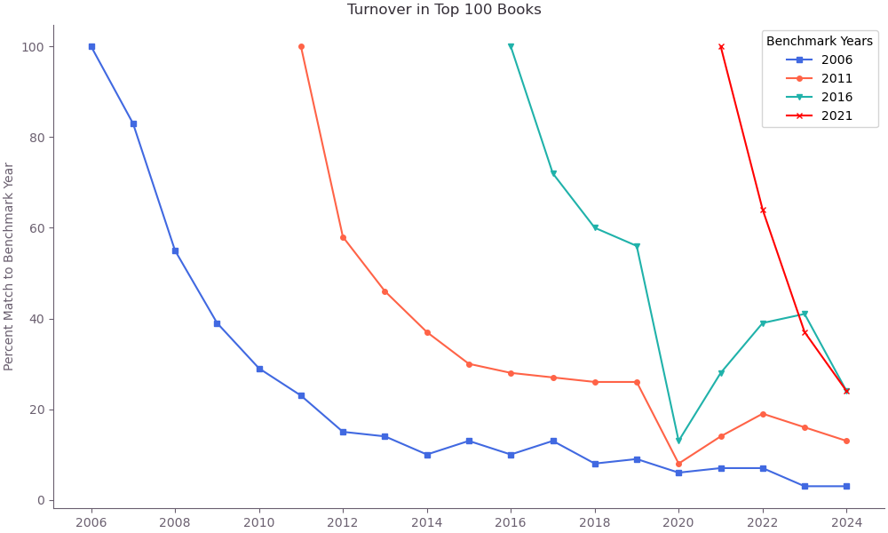
Turnover in Popular Books
A final consideration for considering which books remain popular is to look at which titles remain in the Top 100 over time. This list experiences pretty dramatic turnover – each year, one third of top titles were not on the list the previous year, and the number of matches continues to drop off, going down to under half within just a few years.
This indicates that across the two decades of the data set, the most popular books each year are overwhelmingly newer titles.

Slide 9

Conclusion
The seven Harry Potter books were a defining children’s fiction series for millennials, but they are the only books published pre-2008 to be in the top 100 more than 75% of the time. Otherwise, new readers in the twenty-first century have overwhelming preferred books written and published for their generation, not their older siblings or parents. Jeff Kinney’s Diary of a Wimpy Kid and Dav Pilkey’s Dog Man dominate checkouts by 2025 and represent a shift towards graphic novels for middle grade fiction that has also been typified by adaptations of older series like Magic Tree House, The Baby-Sitter’s Club, and Goosebumps.
While today’s kids might engage with some of my favorite children’s stories in new ways, I shouldn’t be surprised to learn that they are reading as well as making their own.

Slide 10

Questions?

Slide 11
Challenge: What’s in a name?
  One of the biggest challenges with this project was attempting to standardize what I meant when I talk about a specific “book”. If we want to know how popular A Wrinkle in Time was in a particular month, we might not care whether it was checked out digitally or physically, whether it was an audiobook or print, or if it was a large-print edition. But we probably would want to distinguish it from the graphic novel adaptation released in 2012.
  For maximum fidelity, I cleaned up titles and author names to identify unique works – in the case of A Wrinkle in Time, this brought the number of variations from 13 unique “books” down to just two (one of which is the graphic novel!)
  Series where I noticed consistent patterns could be manually cleaned up, but there may remain titles for which different versions of the same book continued to be counted separately.
WHAT ABOUT ISBN?
  International Standard Book Numbers (ISBNs) are exactly what they sound like, internationally standardized codes for identifying books. Unfortunately, they are unique to different formats of books and not a solution to this situation.
  As the world becomes increasingly dependent on big data, it may be worthwhile for the library and publishing communities to consider adopting identifiers for overarching works as well as for each format.

