Slide 1

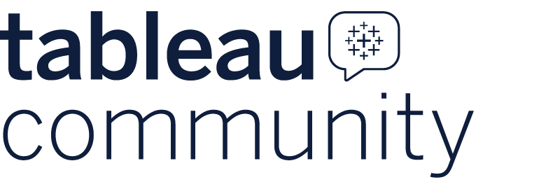
Session: Tableau MCP Server in Enterprise
Welcome, everyone!!
June 27, 2026

Slide 2

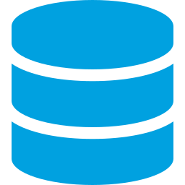

PROBLEM STATEMENT
The Problem We Are Solving
Business users spend hours context-switching between AI chat tools and Tableau dashboards — there is a better way.
Disconnected AI Tools
Data Duplication
User Friction
AI tools are widely available but cannot directly access Tableau data — users copy-paste numbers by hand
Analysts duplicate datasets in external tools, leading to inconsistency and increased storage cost
Business users want natural language answers, not SQL queries or manual dashboard filters
Ritesh Mishra | Bengaluru Tableau User Group | June 2026

Slide 3




WHAT IS TABLEAU MCP?
What Is Tableau MCP?
An open-source bridge that allows MCP-compatible AI tools to query live Tableau data using natural language.
Key Concepts
Architecture Overview
MCP = Model Context Protocol — the standard for AI-tool integration
Exposes: VizQL Data Service, Metadata API, Tableau REST APIs
AI Client
MCP Server
Tableau Cloud
Claude / Copilot
Node.js on VM
Live Data
Works with: Claude Desktop, MCP Inspector, VS Code Copilot, Copilot Studio
Ritesh Mishra | Bengaluru Tableau User Group | June 2026

Slide 4



BUSINESS VALUE
Why It Matters — Business Value
Turns Tableau data into AI-queryable assets without new pipelines.
Cost Efficiency
Consistency
Accessibility
Reuse existing datasets, avoid duplication across tools
Same data as dashboards — single source of truth
Plain English queries, no SQL or dashboard training
Security
Enterprise Scale
RBAC + row-level access fully preserved end-to-end
Works on top of your existing Tableau investment
Ritesh Mishra | Bengaluru Tableau User Group | June 2026

Slide 5
ARCHITECTURE
Architecture — How It All Connects
MCP Client
MCP Server
Tableau Cloud
Claude / Copilot
Studio / VS Code
Node.js
GCP VM
VizQL / Metadata
REST APIs
Transport & Auth
Deployment Patterns
Transport:
Streamable HTTP
POC Pattern:
Single VM + Public DNS
Auth (POC):
Personal Access Token (PAT)
Enterprise Pattern:
VPC + Load Balancer
Auth (Enterprise):
JWT + RBAC
Runtime:
Node.js 18+
Ritesh Mishra | Bengaluru Tableau User Group | June 2026

Slide 6
END-TO-END FLOW
End-to-End Integration Flow
1
2
3
4
User asks question
LLM interprets request
Request sent via HTTPS
Token validated
↩ Return Path: MCP → Load Balancer → AI Agent → User
5
6
7
Query forwarded to Tableau
Data retrieved
Response returned
Ritesh Mishra | Bengaluru Tableau User Group | June 2026

Slide 7


ENTERPRISE SECURITY
Enterprise Security & Guardrails
User Access
Governance
Authenticated identity passed across all layers — Tableau permissions respected at every level
Respects Tableau permissions and role-based access control
Network Security
Read-only access — no data modification possible via MCP
Clear segregation between public-facing endpoints and private internal resources
Every query is logged for audit and compliance
Credential Safety
All credentials stored in secure vault — never hardcoded in source code or config files
Ritesh Mishra | Bengaluru Tableau User Group | June 2026

Slide 8
SETUP STORY
My Setup — Local and GCP VM Deployments
Full setup completed in a single afternoon using open-source tools.
1
Clone Repo
2
Install & Build
git clone https://github.com/tableau/tableau-mcp.git
npm install && npm install dotenv && npm run build
3
Configure .env
4
Start Server
TRANSPORT · AUTH · SERVER · SITE_NAME · PAT_NAME · PAT_VALUE
node -r dotenv/config build/index.js --config config.http.json
5
Expose Endpoint: Map DNS → Open firewall → Public endpoint ready!
Ritesh Mishra | Bengaluru Tableau User Group | June 2026

Slide 9
Demo

Slide 10
TESTING
Testing — MCP Inspector
What We Did
Sample Tools Discovered
Connected MCP Inspector via HTTP transport
list-datasources
Hit the public DNS endpoint from external browser
query-datasource
Authenticated with PAT credentials
Key Insight
Discovered available tools automatically
PAT authentication controls access — expired or revoked PATs immediately block access without code changes.
Ritesh Mishra | Bengaluru Tableau User Group | June 2026

Slide 11
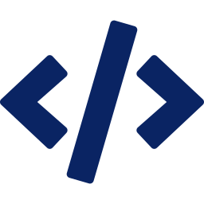
RESULTS
What We Proved
Connectivity
Security
Consistency
AI tools can access Tableau via a single endpoint — no proprietary connectors needed
Tableau permissions remain intact — RBAC and row-level security fully honored
Data returned by MCP matches dashboards exactly — one source of truth maintained
For Developers
For Business
Working POC deployable in a single afternoon with open-source tools and a public endpoint.
No new data pipelines required — existing Tableau investment becomes AI-ready.
Ritesh Mishra | Bengaluru Tableau User Group | June 2026

Slide 12
ROADMAP
How We Can Extend This
Phase 1
Phase 2
Phase 3
POC
Enterprise
Advanced
Single VM deployment
JWT / OAuth authentication
Copilot Studio integration
PAT authentication
Full RBAC integration
Multi-agent workflows
Validate using MCP Inspector
TLS + secrets manager
Multi-environment MCP
Connect AI tools
Load balancer + containers
Advanced analytics
Ritesh Mishra | Bengaluru Tableau User Group | June 2026

Slide 13




GET STARTED
Resources & Next Steps
Everything you need to try this yourself today
Resources
Tableau MCP Repo
github.com/tableau/tableau-mcp
MCP Inspector
modelcontextprotocol.io/docs/tools/inspector
Prerequisites
Node.js 18+
Tableau Cloud account
Personal Access Token (PAT)
Bengaluru Tableau User Group | June 2026

