Slide 1

7COM1079-2022 Student Group No:A172 Names of Student Attendees (all group should attend to get feedback): 1) Jaya raju Vangapati
2) Ranpal Reddy Mula
3) Sai Teja Talasila
4) Srikanth Reddy Poreddy
5) S N Venkata Lakshmikanth Lankalapalli
1
Group Id: A172 Name of Student Presenting: Srikanth Reddy Poreddy
Visualization and Analysis – Tutorial Presentation for Feedback Date: 25-11-2024

Slide 2
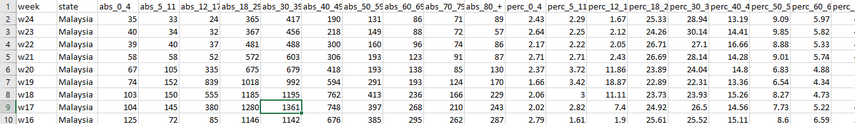
7COM1079-2022 Student Group ID:
We are using the dataset DS046 and cases_age.csv to answer our Research question: ‘Is there a significant correlation between the absolute number of COVID-19 cases in the age group 18-29 years (abs_18_29) and the population size of this age group (capita_18_29) across different states in Malaysia?’
2
The dataset has 450 rows
The dependent variable is abs_18_29
The independent variable is capita_18_29
Notes:
The research utilizes the dataset DS046 and the file cases_age.csv to investigate the correlation between the absolute number of COVID-19 cases in the 18-29 age group (abs_18_29) and the population size of this age group (capita_18_29) across various states in Malaysia. The dataset comprises 450 rows, with abs_18_29 serving as the dependent variable and capita_18_29 as the independent variable. The analysis aims to determine whether a significant relationship exists between these two variables, contributing to a better understanding of COVID-19's impact on younger populations in different regions.
2

Slide 3
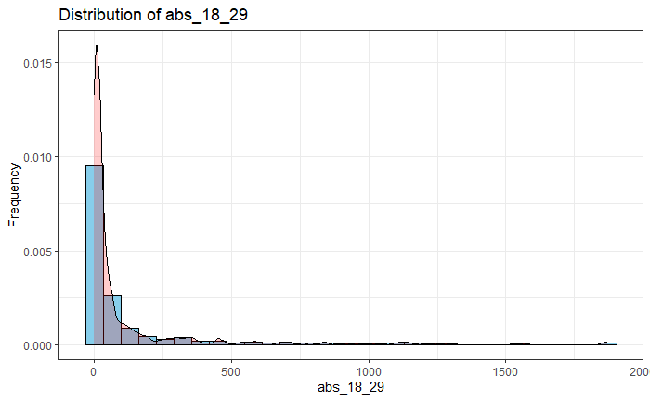
Here is a Histogram showing the frequencies of our dependent variable to include the normal curve overlay.
Our RQ asks about Correlation
The normal curve overlay does not follow the shape of the underlying data, so for our analysis we use the non-parametric test for correlation that does not assume normality: Spearman’s Rho or Kendal’s Tau
3
Notes:
The normal curve overlay does not align with the underlying data's shape, and the dependent variable is not equally distributed. Consequently, the analysis will utilize non-parametric correlation tests, specifically Spearman’s Rho and Kendall’s Tau, which do not assume normality, ensuring more accurate results in assessing the relationship between the variables.
3

Slide 4

R-Script for correlation test
Notes:
The purpose of the code is to conduct a Spearman correlation test between the absolute number of COVID-19 cases in the 18-29 age group (abs_18_29) and the population size of this age group (capita_18_29) using the dataset `df`. The results of the correlation test are then printed, providing insights into the strength and direction of the relationship between these two variables, while accounting for the non-parametric nature of the data distribution.

Slide 5
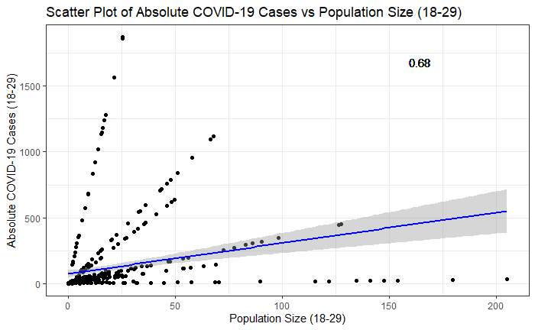
Results
The Spearman correlation coefficient (rho) is approximately 0.676, indicating a moderate to strong positive correlation between ‘abs_18_29’ and ‘capita_18_29’.
The test statistic (S) is 4,857,102, reflecting the rank-based assessment.
The p-value is less than 2.2e-16, significantly below the level of 0.05.
Notes:
The results of the Spearman correlation test reveal a moderate to strong positive correlation between the absolute number of COVID-19 cases in the 18-29 age group (abs_18_29) and the population size of this age group (capita_18_29), with a Spearman correlation coefficient (rho) of approximately 0.676. The test statistic (S) is recorded at 4,857,102, highlighting the rank-based nature of the analysis. Also, the p-value is less than 2.2e-16, which is significantly lower than the conventional alpha level of 0.05.

Slide 6
Significance of results
The Spearman correlation coefficient of approximately 0.676 indicates a strong link between the number of COVID-19 cases and the population size of the 18-29 age group, highlighting how demographic factors influence virus spread.
The significant p-value (< 2.2e-16) suggests that public health strategies can be tailored to effectively address the needs of this age group, enhancing vaccination and awareness efforts.
Findings can guide healthcare resource allocation, ensuring that areas with larger young adult populations are adequately prepared for potential case surges.
The correlation provides a basis for further studies to explore factors affecting COVID-19 transmission among young adults, aiding in the development of predictive models.
This can inform public health messaging aimed at educating young adults about COVID-19 risks and the importance of preventive measures in densely populated settings.
Notes:
The Spearman correlation coefficient of approximately 0.676 reveals a strong relationship between COVID-19 cases and the population size of the 18-29 age group, indicating that demographic factors significantly influence virus spread. With a highly significant p-value (< 2.2e-16), public health strategies can be effectively tailored to this demographic, enhancing vaccination and awareness efforts. These findings can guide resource allocation in areas with larger young adult populations and provide a foundation for future research into transmission dynamics. Then, they can inform public health messaging to educate young adults on COVID-19 risks and preventive measures.

Slide 7
Which hypothesis is accepted?
The null hypothesis (H0) is rejected, indicating a statistically significant correlation between the variables.
The alternative hypothesis (H1) is accepted, confirming a correlation exists between COVID-19 cases and population size in this age group.
Notes:
The low p-value which is less than 2.2e-16 leads to the rejection of the null hypothesis (H0), which specifies that there is no correlation between the two variables. So, the alternative hypothesis (H1) is accepted, confirming that a statistically significant correlation exists between the number of COVID-19 cases and the population size in the 18-29 age group across different states in Malaysia.

Slide 8
Further use of the results
Targeted Resource Allocation: Use the correlation to direct public health resources to areas with higher young adult populations during future pandemics.
Focused Interventions: Develop specific campaigns and preventive measures aimed at young adults to reduce transmission rates.
Enhanced Surveillance: Monitor young adult demographics closely to detect trends early and respond proactively in outbreaks.
Policy Development: Inform evidence-based policies that prioritize the health needs of young adults during public health crises.
Community Engagement: Foster engagement with young adults to improve compliance with health guidelines and encourage participation in vaccination and testing efforts.
Notes:
The significant correlation between young adult populations (ages 18-29) and COVID-19 case numbers can be leveraged in future pandemics to enhance public health responses. By directing resources to areas with higher young adult concentrations, targeted interventions can be developed to reduce transmission rates effectively. Enhanced surveillance of this demographic will allow for early detection of trends, while evidence-based policies can prioritize their specific health needs. ALso, fostering community engagement among young adults will improve compliance with health guidelines and encourage participation in vaccination and testing efforts, improving public health outcomes during outbreaks.

