Slide 1
Applications Analysis: 2022 vs 2025 (Pre vs Post LLM)
LinkedIn Applications – Volume, Tempo, and Patterns

Slide 2
Applications Analysis: 2022 vs 2025
Pre vs Post LLM

Slide 3
Objective & Data
Compare application intensity and cadence (2022 vs 2025)
Temporal patterns (month, weekday); company concentration
Method: pandas resampling; 7-day gap to define periods

Slide 4
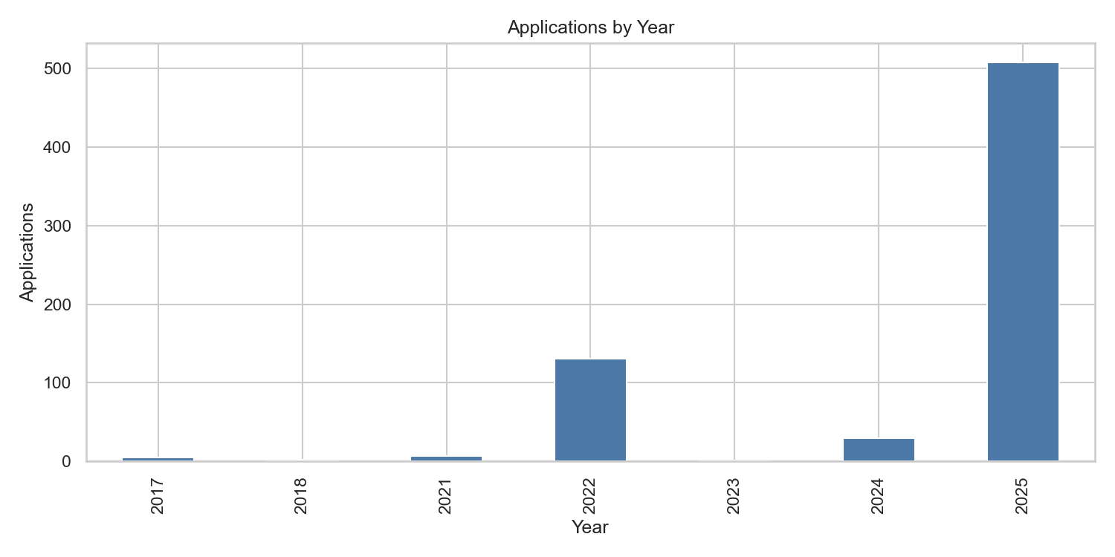
Yearly Volume Overview
2025 leads with 507 applications; 2022 shows 131 (pre-LLM baseline).

Slide 5
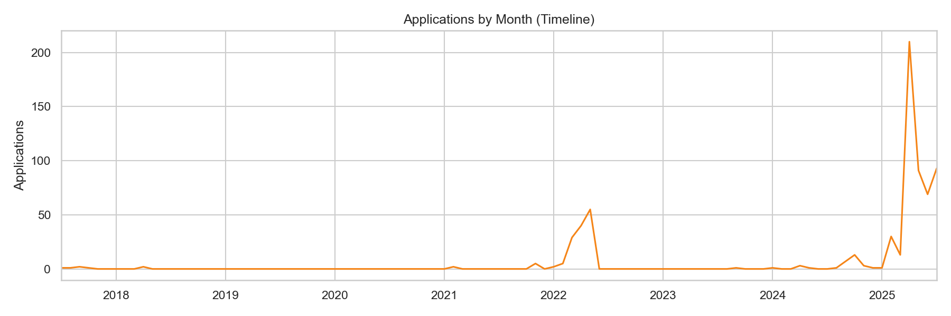
Monthly Trend (All Years)
Context across all years; activity spikes in 2022 and sustained run in 2025.

Slide 6
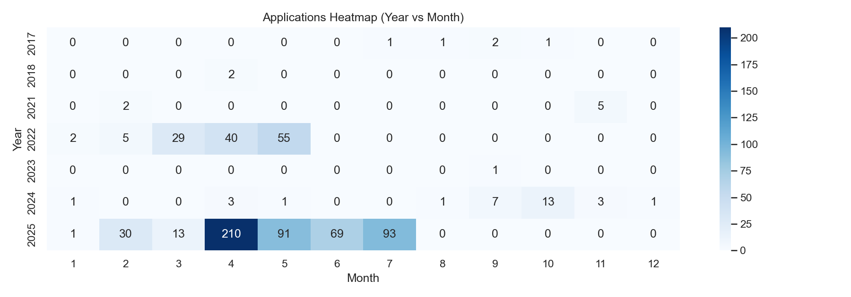
Heatmap: Year × Month
2022 concentrates Apr–May; 2025 sustains Mar–Jul with higher volume.

Slide 7
Monthly Overlay: 2022 vs 2025
[Chart missing: compare_2022_vs_2025_monthly.png]

Slide 8
Cumulative: 2022 vs 2025
[Chart missing: compare_2022_vs_2025_cumulative.png]

Slide 9
Weekday Distribution (Comparison)
[Chart missing: compare_2022_vs_2025_weekday.png]

Slide 10
Top Companies (2022 vs 2025)

Slide 11
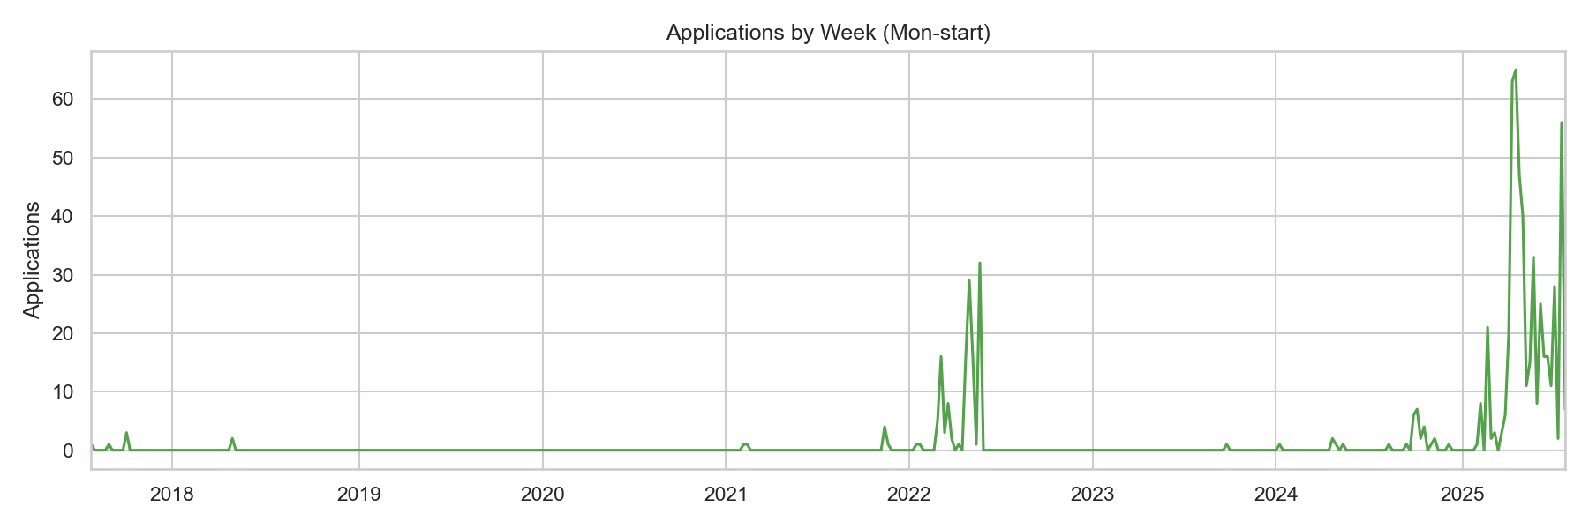
Application Periods (Bursts)
2025-03-19→07-24: 472 apps (3.72/day); 2022-04-22→05-20: 94 apps (3.36/day).

Slide 12
Rates & Capacity (Setup)
10-day sprint: ~2.3/day (~23 apps)
4-week run: ~3.3–3.7/day (~90–105 apps)
16–18 weeks: ~3.7/day (450+ apps)

Slide 13
Next: Response/Interest Layer (Gmail)
Ingest replies; compute response & interview rates
Segment by company and period; time-to-first-response

Slide 14
Data Quality & Cleaning
Date normalization; 7-day gap for periods
Company name normalization (to-do); recruiter labeling (to-do)

Slide 15
Summary & Takeaways
2025 sustained higher intensity vs 2022
Clear pre/post LLM distinction in pace and persistence
Funnel metrics pending email integration

