Slide 1
Applications Analysis: 2022 vs 2025
Pre vs Post LLM
LinkedIn Applications – Volume, Tempo, and Patterns
Notes:
Introduce objective and pre/post LLM framing.

Slide 2
Overview Map
Companies
Data Core
Overview
2022 vs 2025
Bursts
Gmail
Summary
Zoom path: Overview → Data Core → 2022 vs 2025 → Companies → Bursts → Gmail → Summary
Notes:
Map: explain zoom path and clusters.

Slide 3
Objective & Data
Compare application intensity and cadence (2022 vs 2025)
Temporal patterns (month, weekday); company concentration
Method: pandas resampling; 7-day gap to define periods
Notes:
Call out key insight and what-to-do-next.

Slide 4
Section: Data Core
Companies
Data Core
Overview
2022 vs 2025
Yearly → Monthly → Heatmap
Notes:
Call out key insight and what-to-do-next.

Slide 5
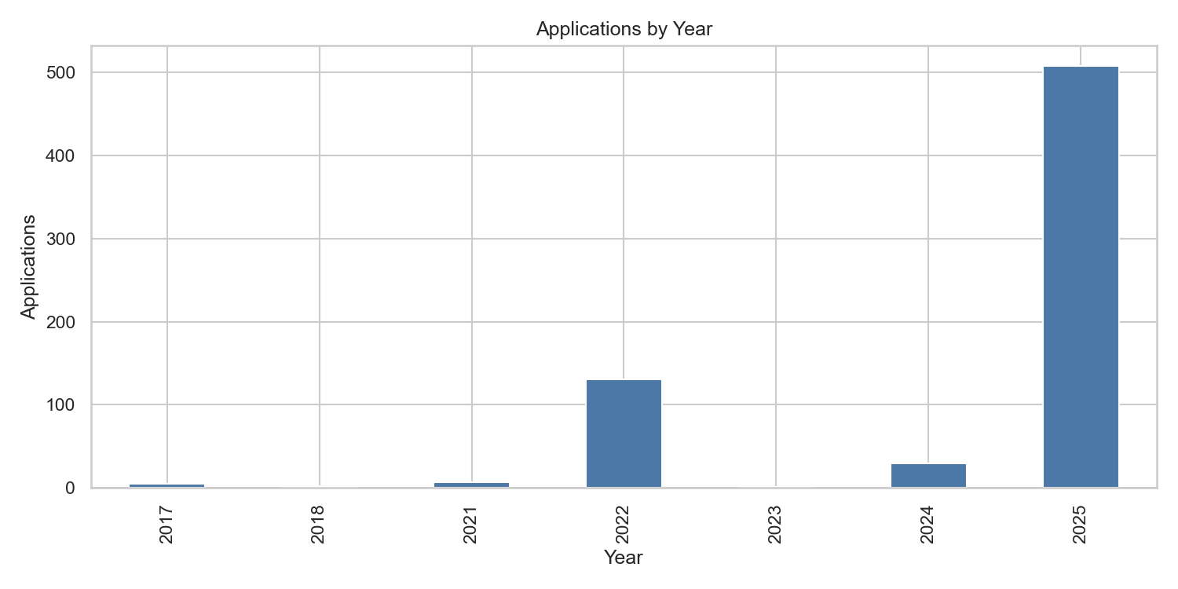
Yearly Volume Overview
2025 leads with 507 applications; 2022 shows 131 (pre-LLM baseline).
Notes:
Call out key insight and what-to-do-next.

Slide 6
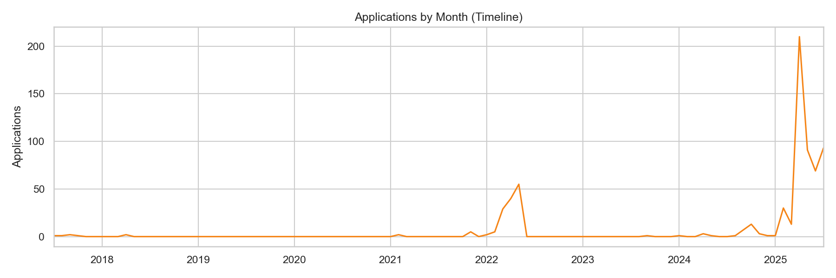
Monthly Trend (All Years)
Context across all years; activity spikes in 2022 and sustained run in 2025.
Notes:
Call out key insight and what-to-do-next.

Slide 7
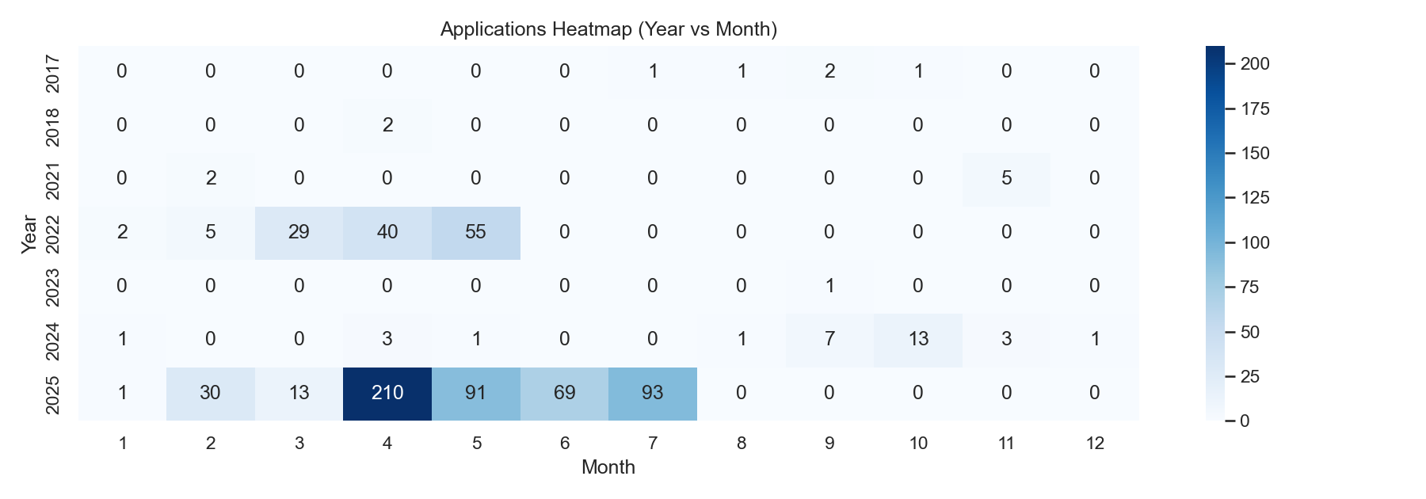
Heatmap: Year × Month
2022 concentrates Apr–May; 2025 sustains Mar–Jul with higher volume.
Notes:
Call out key insight and what-to-do-next.

Slide 8
Section: 2022 vs 2025
2022 2025
Companies
Data Core
2022 vs 2025
Monthly Overlay → Cumulative → Weekday
Notes:
Call out key insight and what-to-do-next.

Slide 9
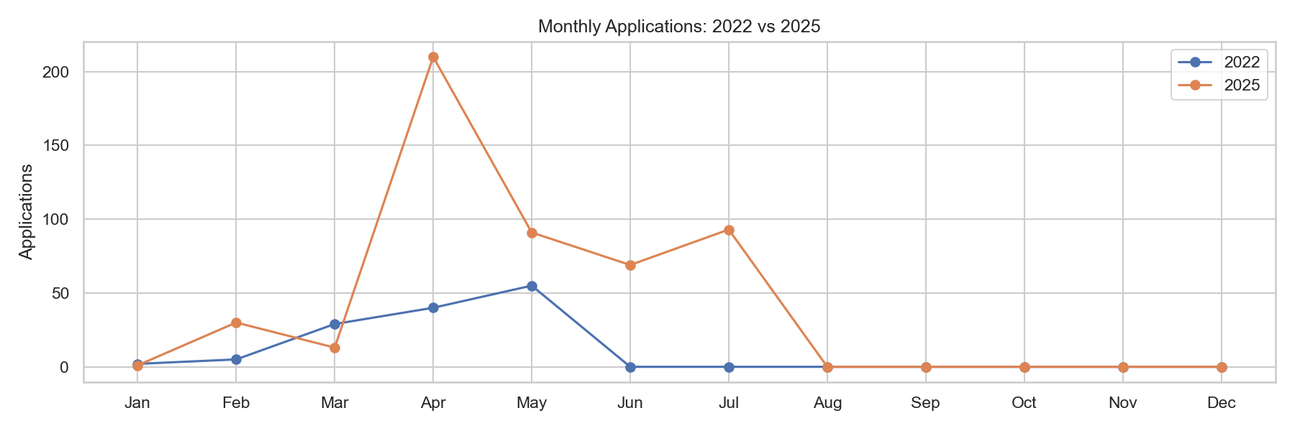
Monthly Overlay: 2022 vs 2025
2022 2025
2025 starts earlier and remains consistently higher month-to-month.
Notes:
Call out key insight and what-to-do-next.

Slide 10
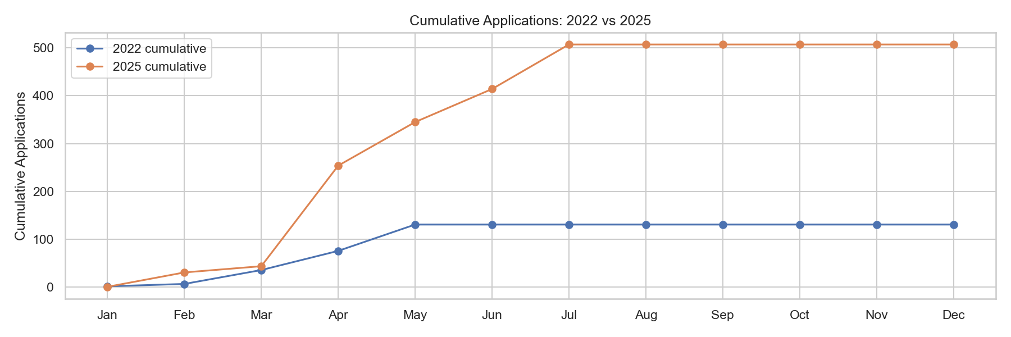
Cumulative: 2022 vs 2025
2022 2025
Cumulative pace in 2025 outstrips 2022 over the cycle.
Notes:
Call out key insight and what-to-do-next.

Slide 11
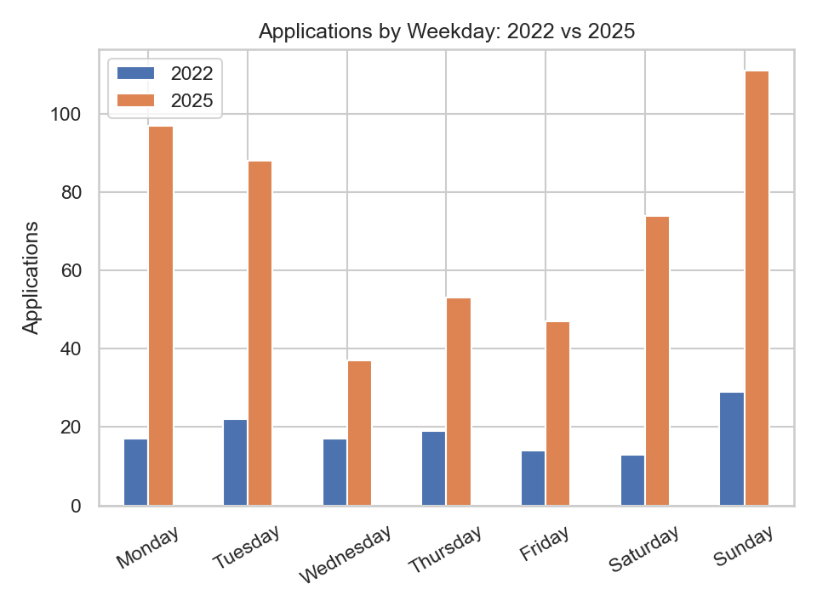
Weekday Distribution (Comparison)
2022 2025
Both skew to weekdays; 2025 dominates across all days.
Notes:
Call out key insight and what-to-do-next.

Slide 12
Section: Companies
Companies
2022 vs 2025
Top companies 2022 vs 2025
Notes:
Call out key insight and what-to-do-next.

Slide 13
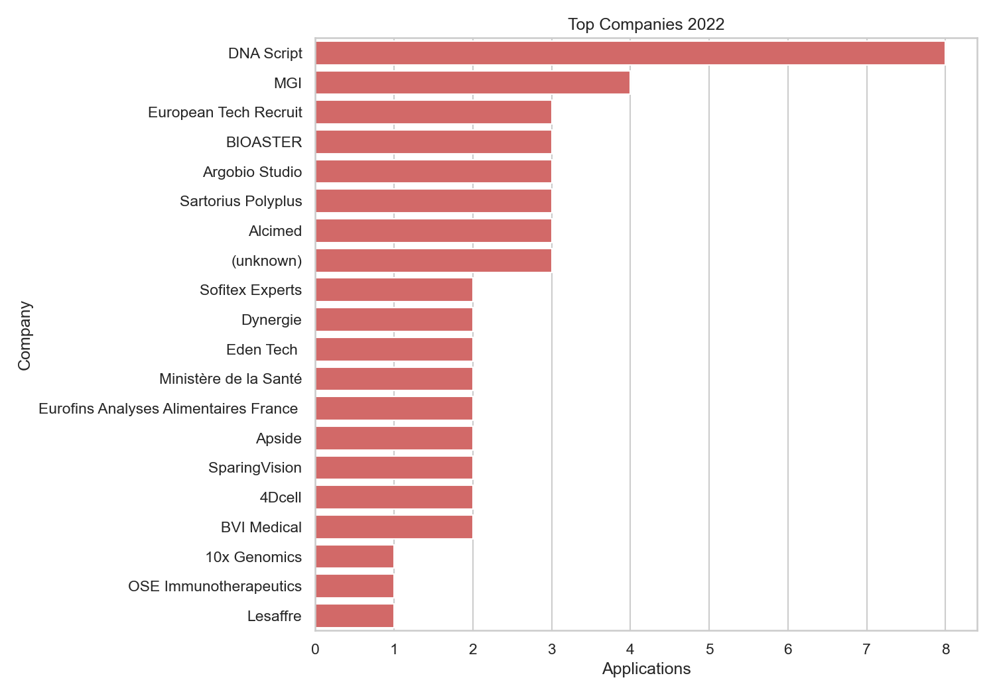
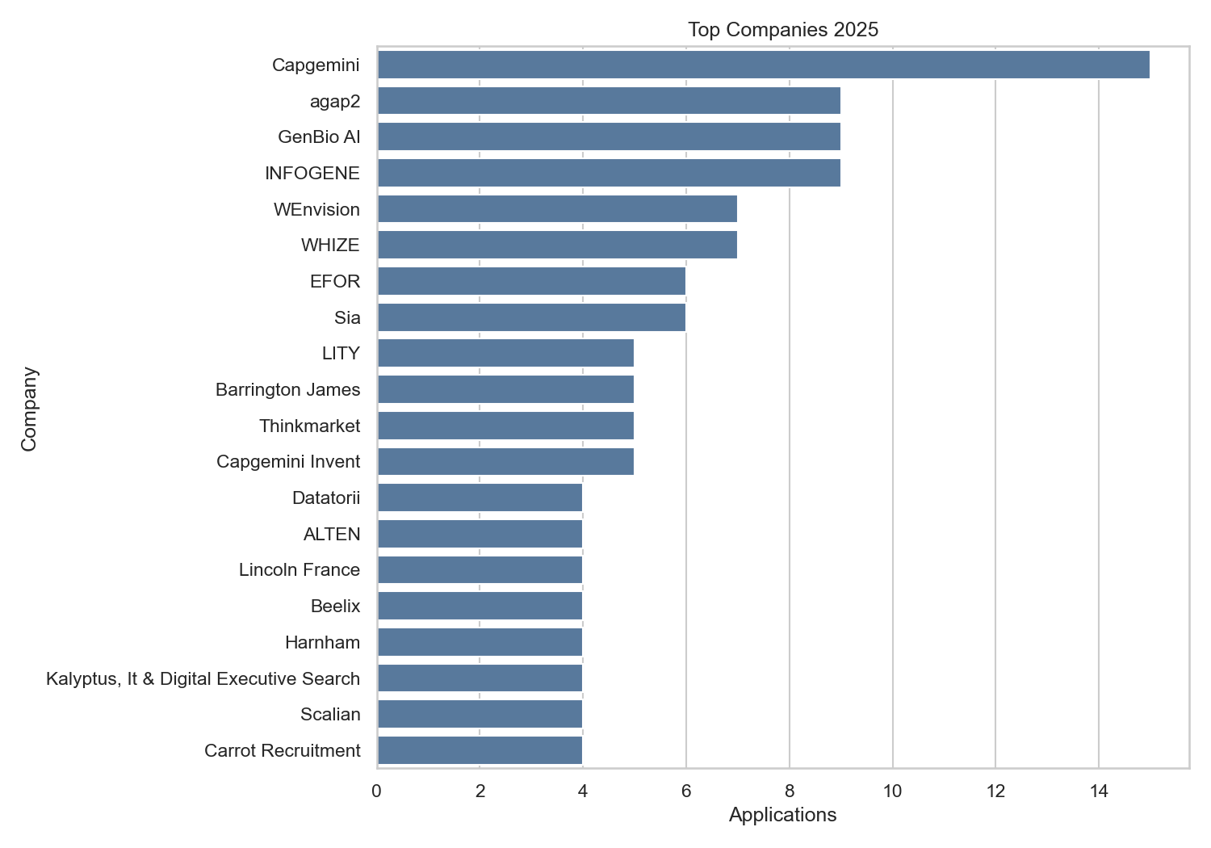
Top Companies (2022 vs 2025)
Top 2022 companies (recruiter-heavy)
Top 2025 companies (broader spread)
Notes:
Call out key insight and what-to-do-next.

Slide 14
Section: Bursts & Capacity
Bursts
Weekly timeline → capacity heuristics
Notes:
Call out key insight and what-to-do-next.

Slide 15
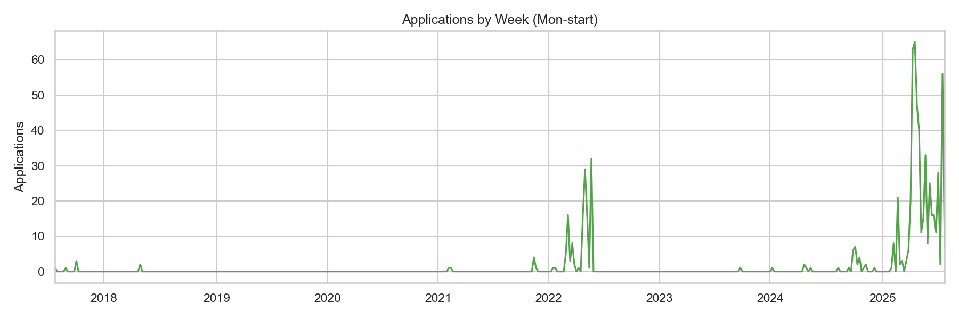
Application Periods (Bursts)
2025-03-19→07-24: 472 apps (3.72/day); 2022-04-22→05-20: 94 apps (3.36/day).
Notes:
Call out key insight and what-to-do-next.

Slide 16
Capacity Heuristics
10-day sprint: ~2.3/day → ~23 applications
4-week run: ~3.3–3.7/day → ~90–105 applications
16–18 weeks: ~3.7/day → 450+ applications
Notes:
Call out key insight and what-to-do-next.

Slide 17
Section: Gmail/ATS
Gmail
Response → Interview → TTFR
Notes:
Call out key insight and what-to-do-next.

Slide 18
Next Layer: Gmail/ATS Funnel
Response rate by year, period, company
Interview rate and onsite conversion
Time-to-first-response distributions
Notes:
Call out key insight and what-to-do-next.

Slide 19
Section: Summary
Summary
Post-LLM persistence and throughput; next: funnel metrics
Notes:
Call out key insight and what-to-do-next.

Slide 20
Summary & Takeaways
2025 sustained higher intensity vs 2022 (pre/post LLM distinction)
Clear monthly and cumulative dominance in 2025
Next: add Gmail replies for funnel metrics (response/interview rates)
Notes:
Call out key insight and what-to-do-next.

Slide 21
Key Metrics
-
-
Total Applications
Peak Rate (apps/day)
-
-
Median Daily Rate
# Periods
-
Top Company Count

Slide 22
Recruiters vs Employers
Top Recruiters
Top Employers

