Slide 1
Exploring C2: part 4 “Tell Me More”
Rick Matthews
CSC 842
Cycle 12
Blue Team

Slide 2
Status
Continued with same project from Cycles 3, 6, and 9 but wanted to get more information
Proof of Concept
Still very basic but I’m enjoying learning and using various concepts and techniques

Slide 3
Environment
Python
Ubuntu
IA Lab
Ubuntu VM
Twitter
Server

Slide 4
Tasks
Get System Information
Get Network Information
Geographic Location

Slide 5
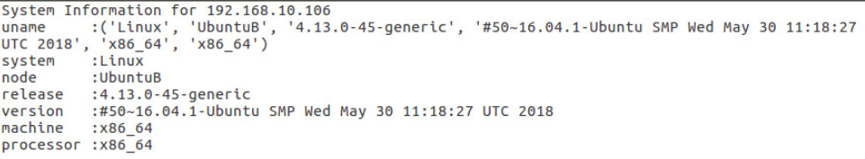
Get System Information

Slide 6
Get System Information - code
#get system info
elif command == "si37465":
print "Get this system's info ..."
sysinfo = 'System Information \n'\
'uname :%s \n' \
'system :%s \n' \
'node :%s \n' \
'release :%s \n' \
'version :%s \n' \
'machine :%s \n' \
'processor :%s \n' % (platform.uname(), platform.system(), platform.node(), platform.release(), platform.version(), platform.machine(), platform.processor())
file = open("sysinfo.txt","w")
file.write(sysinfo)
file.close()

Slide 7
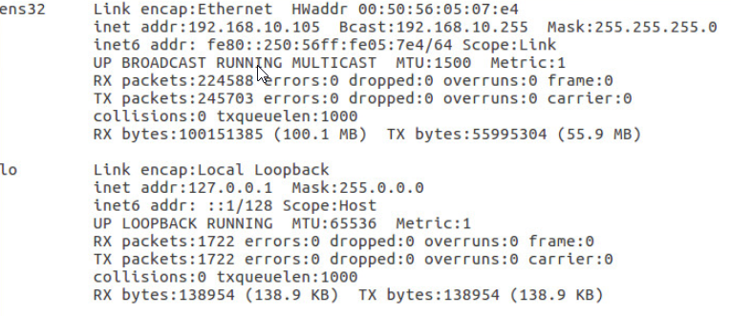
Get Network Information

Slide 8
Get Network Information - code
#get network info
elif command == "ni496320":
print "Get this system's network info ..."
netinfo = os.popen("ifconfig").read()
file = open("netinfo.txt","w")
file.write(netinfo)
file.close()

Slide 9
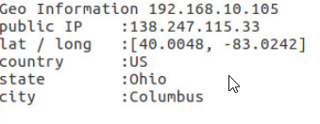
Get Geographic Location

Slide 10
Get Geographic Location - code
#get geolocation
elif command == "gi195456":
myIP = getMyIP()
geo = geocoder.ip('me')
print "get system's geo information"
sysinfo = 'Geo Information %s\n'\
'public IP :%s \n' \
'lat / long :%s \n' \
'country :%s \n' \
'state :%s \n' \
'city :%s \n' % (myIP, geo.ip, geo.latlng, geo.country, geo.state, geo.city)
file = open("geoinfo.txt","w")
file.write(sysinfo)
file.close()

Slide 11
Get Geographic Location - code
def getMyIP():
sck = socket.socket(socket.AF_INET, socket.SOCK_DGRAM)
sck.connect(("8.8.8.8",80))
return sck.getsockname()[0]

Slide 12
Future Work
Upload files / info to a server
Make malicious

