Slide 1
Simulation of A Quantum Computer
Roshenac Mitchell, Max Nolte, Martin Rüfenacht,
Mark Stringer, Justs Zariņš
š
LATIN SMALL LETTER Z WITH CARON
Unicode: U+017E, UTF-8: C5 BE

Slide 2
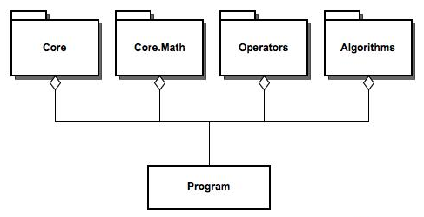
Design
Library Centric
Packages

Slide 3
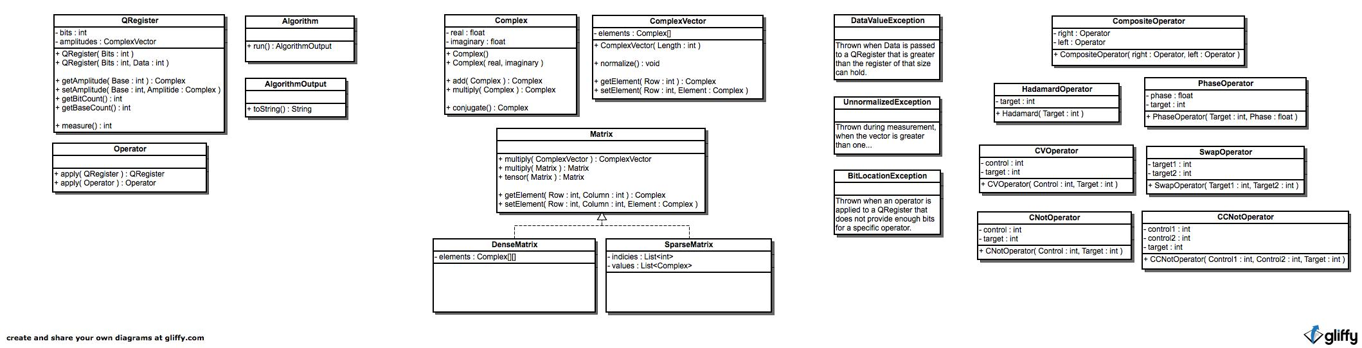
Core
Package
Data structure
Interfaces
Functional

Slide 4
Core.Math
Package
Mathematics needed

Slide 5
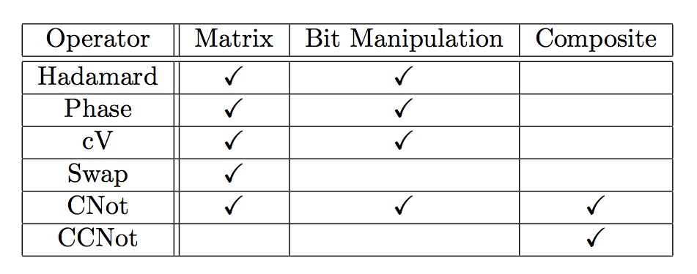
Operators
Package
Assignment?
Matrix
Bit Manipulation
Composite

Slide 6
Algorithms
Package
Deutsch-Josza
Grover’s Algorithm
Shor’s Algorithm

Slide 7
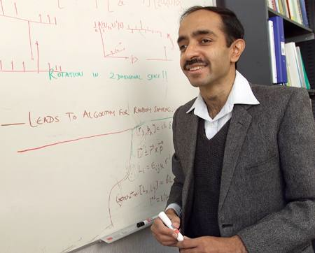
Grover Algorithm :
used for searching an unordered list for an element location
- Initialisation
Lov Grover
- Grover Iteration
- Measurement

Slide 8

Initialisation
creates a superposition of all basis states.
done by applying Hadamard operator to each qubit within the quantum register

Slide 9


Grover Iteration
Iterated x many times - cant do it in less time than this
Oracle - black box function represented by
Diffusion Operator - inversion about the mean values of the amplitudes of each state

Slide 10
Implementation
Points of interest
- GroverOracle
- GroverDiffusionAlgorithm
- GroverOpAlgortihm
- GroverDisplay

Slide 11
Diffusion Algorithm vs Op Algorithm
Diffusion Algorithm
- analytic approach using a matrix as a Diffusion operator
Op Algorithm
- combination of base-wise operators to act on the QRegister

Slide 12
Op Algorithm WINS!
More efficient - less memory usage of the operators
More sequential - less complex to understand

Slide 13
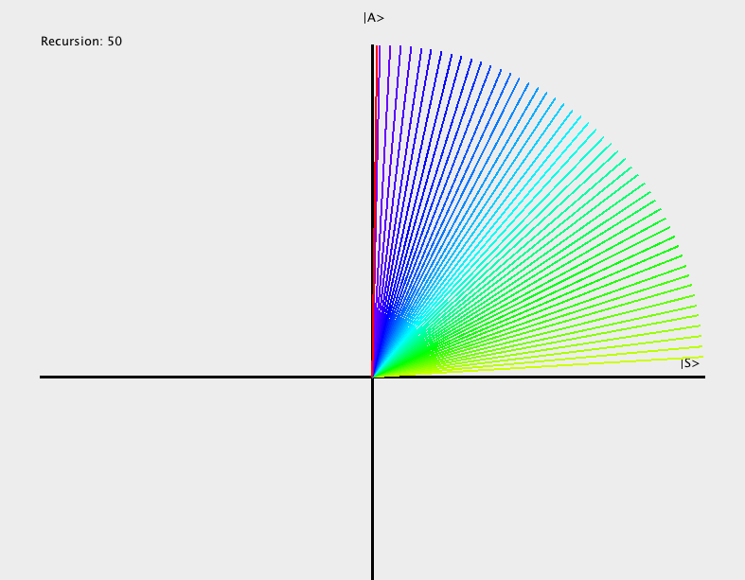
Display
generated by a Gram-Schmidt orthogonalisation of the answer base and initial zero base

Slide 14
Shor’s Algorithm
Factors a number into it’s prime factors
Much faster than classical algorithms
Does this by estimating the period

Slide 15
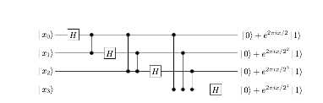
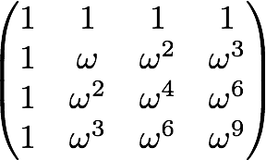
Shor’s Algorithm
Uses the quantum Fourier transform twice
First time to put quantum register in superposition of states
Second time to obtain an approximation to period

Slide 16


Shor’s Algorithm
Need 2 quantum registers
One to Store arguments, other to store values of function
First in state second in state
System in State

Slide 17
Shor’s Algorithm
Apply quantum Fourier transform to first register
Puts it in superposition of all states

Slide 18
Shor’s Algorithm
Then apply gate shown to the right on the system
This calculates all the values for the function simultaneously, faster than doing it classically

Slide 19
Shor’s Algorithm
Apply Quantum Fourier transform again to the first register
The probability amplitudes for the periods add up to give high probability of correct answer upon measurement
Other amplitudes cancel

Slide 20
Shor’s Algorithm
Now measure the quantum register.
This can then be used to find the period (in lowest terms) of the function by using a continued fraction expansion.

Slide 21
Shor’s Algorithm
How does the period help us find the factors
We know:
So the two components above are factors of some multiple of N

Slide 22
Shor’s Algorithm
Finding the greatest common devisor using Euclids algorithm for N and one of the components of the expression
You obtain a factor
The other can simply be found via division

Slide 23
Shor’s Implementation
Two gates used
Quantum Fourier transform
Unitary operator that applies the transform

Slide 24
Shor’s Implementation
Quantum Fourier transform
Implemented using a matrix representation
Much faster to construct
Same speed when applied to Register

Slide 25
Shor’s Implementation
Used bit manipulation for unitary transformation
Faster than matrix/gates
Conceptually easier to construct than a matrix/gates

