Slide 1
Multiplexer / Demultiplexer
This presentation will demonstrate
The basic function of the Multiplexer (MUX).
The typical application of a MUX.
A 4-to-1 MUX designed with Small Scale Integration (SSI).
A 4-to-1, 8-to-1, & 16-to-1 Medium Scale Integration (MSI) MUX.
The basic function of the Demultiplexer (DEMUX).
The typical application of a DEMUX.
A 1-to-4 DEMUX design with Small Scale Integration (SSI).
A 1-to-4, 1-to-8, & 1-to-16 Medium Scale Integration (MSI) DEMUX.
A 7-segment message display using MUX/DEMUX.
Notes:
Introductory Slide / Overview of Presentation
Multiplexers & Demultiplexers
Digital Electronics™
Lesson 2.4 – Specific Combo Circuits & Misc Topics
Project Lead The Way, Inc.
Copyright 2009

Slide 2
What is a Multiplexer (MUX)?
A MUX is a digital switch that has multiple inputs (sources) and a single output (destination).
The select lines determine which input is connected to the output.
MUX Types
  → 2-to-1 (1 select line)
  → 4-to-1 (2 select lines)
  → 8-to-1 (3 select lines)
  → 16-to-1 (4 select lines)
Multiplexer
Block Diagram
2^{N}
1
Inputs
(sources)
MUX
Output
(destination)
N
Select
Lines
Notes:
Multiplexers & Demultiplexers
Digital Electronics™
Lesson 2.4 – Specific Combo Circuits & Misc Topics
Project Lead The Way, Inc.
Copyright 2009

Slide 3
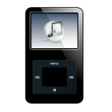
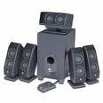


Typical Application of a MUX
Multiple Sources
Selector
Single Destination
MP3 Player
Docking Station
D0
D1
D2
D3
Laptop
Sound Card
MUX
Y
Surround Sound System
Digital
Satellite
B | A | Selected Source
0 | 0 | MP3
0 | 1 | Laptop
1 | 0 | Satellite
1 | 1 | Cable TV
Digital
Cable TV
Notes:
This slide shows a typical application of a multiplexer (in this case a 4-to-1 MUX). Have the students share other common applications of MUXs.
http://images.tigerdirect.ca/skuimages/large/Logitech-X-540-L23-7250-mai.jpg
Multiplexers & Demultiplexers
Digital Electronics™
Lesson 2.4 – Specific Combo Circuits & Misc Topics
Project Lead The Way, Inc.
Copyright 2009

Slide 4
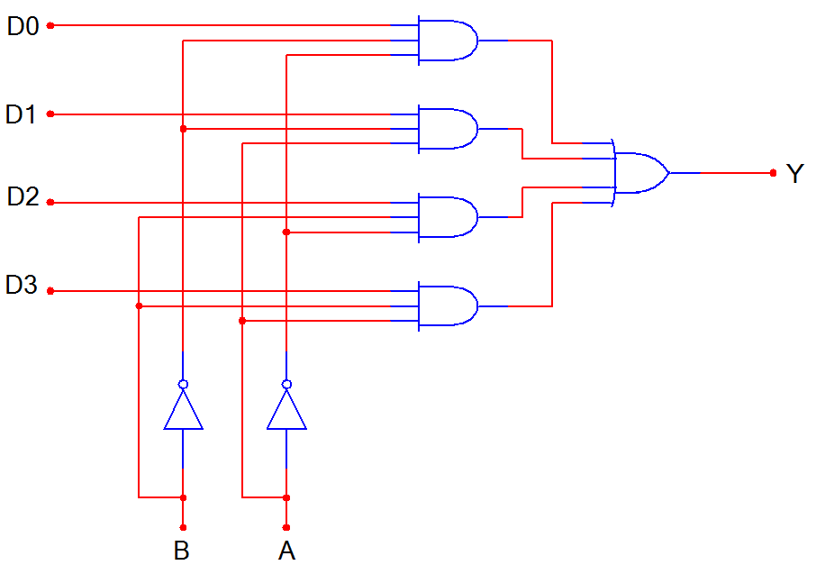
4-to-1 Multiplexer (MUX)
D0
D1
D2
D3
MUX
Y
B A
B | A | Y
0 | 0 | D0
0 | 1 | D1
1 | 0 | D2
1 | 1 | D3
Notes:
SSI logic diagram, block diagram, and truth table for a 4-to-1 MUX
Multiplexers & Demultiplexers
Digital Electronics™
Lesson 2.4 – Specific Combo Circuits & Misc Topics
Project Lead The Way, Inc.
Copyright 2009

Slide 5
4-to-1 Multiplexer Waveforms
D0
D1
D2
D3
A
B
Y
 | D0 | D1 | D2 | D3 | D0 | D1 | D2 | D3
Input
Data
Select
Line
Output
Data
Notes:
Waveform diagram for a 4-to-1 MUX. The input data signals (D0-D3) are colored RED to indicate when its is connected to the output Y. Note: There is no significance to the values of the four input data signals; they are intended solely to demonstrate that the select lines (A & B) will select what input data signal will be connected to the output.
Multiplexers & Demultiplexers
Digital Electronics™
Lesson 2.4 – Specific Combo Circuits & Misc Topics
Project Lead The Way, Inc.
Copyright 2009

Slide 6
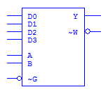
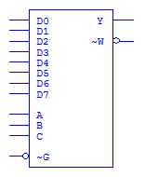
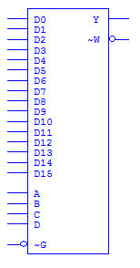
Medium Scale Integration MUX
4-to-1 MUX
8-to-1 MUX
16-to-1 MUX
Inputs
Output (Y)
(and inverted output)
Select
Enable
Notes:
Block diagrams for 4-to-1, 8-to-1, and 16-to-1 MSI Multiplexers.
Multiplexers & Demultiplexers
Digital Electronics™
Lesson 2.4 – Specific Combo Circuits & Misc Topics
Project Lead The Way, Inc.
Copyright 2009

Slide 7
What is a Demultiplexer (DEMUX)?
A DEMUX is a digital switch with a single input (source) and a multiple outputs (destinations).
The select lines determine which output the input is connected to.
DEMUX Types
  → 1-to-2 (1 select line)
  → 1-to-4 (2 select lines)
  → 1-to-8 (3 select lines)
  → 1-to-16 (4 select lines)
Demultiplexer
Block Diagram
1
2^{N}
Input
(source)
DEMUX
Outputs
(destinations)
N
Select
Lines
Notes:
This slide explains the function of a demultiplexer.
Multiplexers & Demultiplexers
Digital Electronics™
Lesson 2.4 – Specific Combo Circuits & Misc Topics
Project Lead The Way, Inc.
Copyright 2009

Slide 8
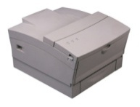
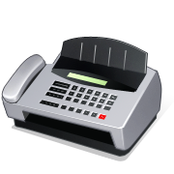



Typical Application of a DEMUX
Single Source
Selector
Multiple Destinations
B/W Laser
Printer
Fax
Machine
D0
D1
D2
D3
X
DEMUX
Color Inkjet
Printer
B | A | Selected Destination
0 | 0 | B/W Laser Printer
0 | 1 | Fax Machine
1 | 0 | Color Inkjet Printer
1 | 1 | Pen Plotter
Pen
Plotter
Notes:
This slide shows a typical application of a demultiplexer (in this case a 1-to-4 DEMUX). Ask students to share other common applications of DEMUXs.
Multiplexers & Demultiplexers
Digital Electronics™
Lesson 2.4 – Specific Combo Circuits & Misc Topics
Project Lead The Way, Inc.
Copyright 2009

Slide 9
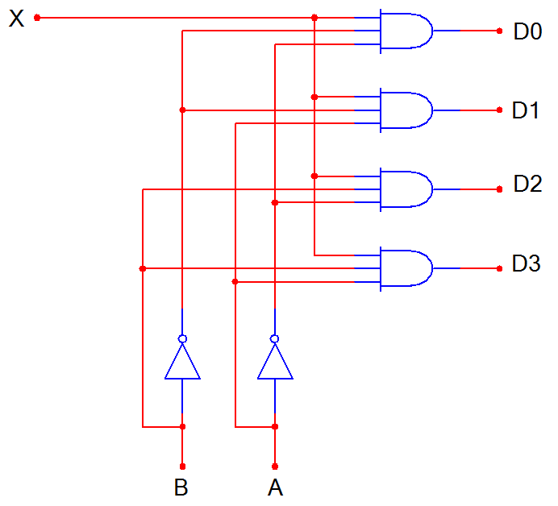
1-to-4 De-Multiplexer (DEMUX)
D0
D1
D2
D3
X
DEMUX
B A
B | A | D0 | D1 | D2 | D3
0 | 0 | X | 0 | 0 | 0
0 | 1 | 0 | X | 0 | 0
1 | 0 | 0 | 0 | X | 0
1 | 1 | 0 | 0 | 0 | X
Notes:
SSI logic diagram, block diagram, and truth table for a 1-to-4 De-MUX
Multiplexers & Demultiplexers
Digital Electronics™
Lesson 2.4 – Specific Combo Circuits & Misc Topics
Project Lead The Way, Inc.
Copyright 2009

Slide 10
1-to-4 De-Multiplexer Waveforms
X
S0
S1
D0
D1
D2
D3
Input
Data
0
1
0
1
Select
Line
0
0
1
1
Output
Data
Notes:
Waveform diagrams for a 1-to-4 De-MUX. The output signals (D0-D3) are colored RED to indicate when its is connected to the input X. Note: There is no significance to the value of the input data signal; it is intended solely to demonstrate that the select lines (A & B) will determine what output signal is connected to the input.
Multiplexers & Demultiplexers
Digital Electronics™
Lesson 2.4 – Specific Combo Circuits & Misc Topics
Project Lead The Way, Inc.
Copyright 2009

Slide 11
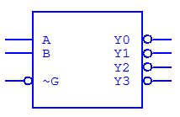
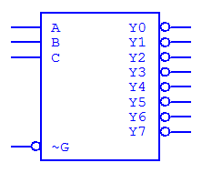
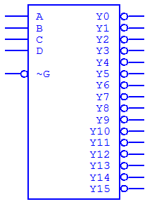
Medium Scale Integration DEMUX
1-to-4 DEMUX
1-to-8 DEMUX
1-to-16 DEMUX
Select
Outputs
(inverted)
Input
(inverted)
Notes:
Block diagrams for 1-to-4, 1-to-8, and 1-to-16 MSI Demultiplexers.
Multiplexers & Demultiplexers
Digital Electronics™
Lesson 2.4 – Specific Combo Circuits & Misc Topics
Project Lead The Way, Inc.
Copyright 2009

Slide 12
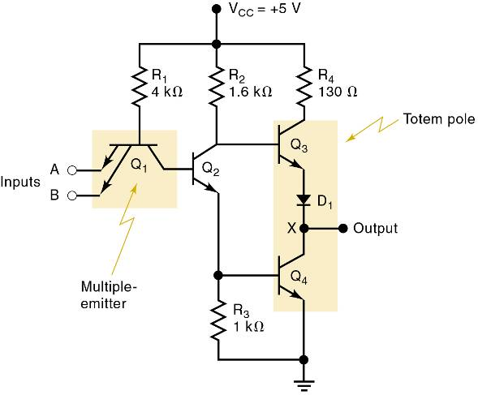
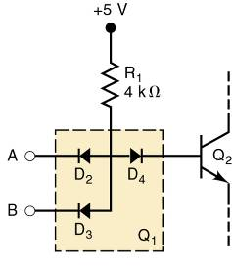
The TTL Logic Family
The basic TTL logic circuit is the NAND gate.
Diode equivalent for Q₁ .
Basic TTL
NAND gate.

Slide 13
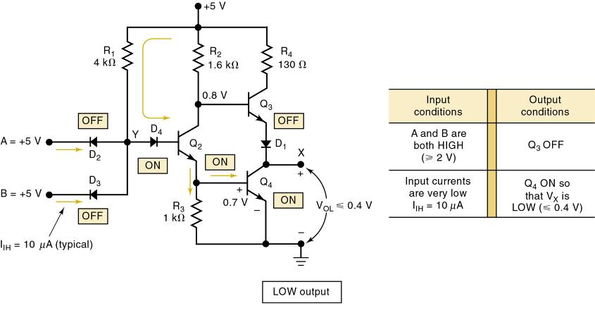
The TTL Logic Family
TTL NAND gate LOW output

Slide 14
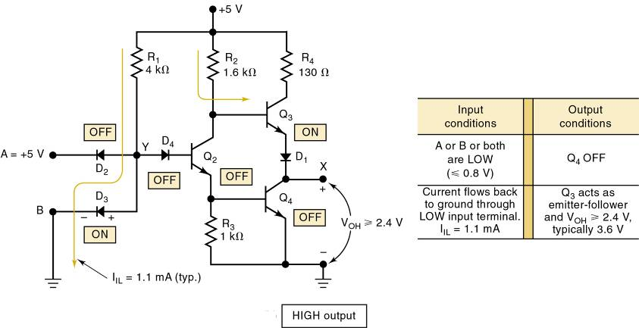
The TTL Logic Family
TTL NAND gate HIGH output

Slide 15
MOS Technology
MOS technology derives its name from the basic structure of a metal electrode, over an oxide insulator, over a semi-conductor substrate.
  Transistors of MOS technology are field-effect
  transistors—called MOSFETs.
The electric field on the metal electrode side of the oxide insulator has an effect on the resistance of the substrate.
Most of the MOS digital ICs are constructed entirely of MOSFETs and no other components.
  MOSFETs are relatively simple and inexpensive
  to fabricate, small, and consume very little power.

Slide 16
MOS Technology
The principal disadvantage of MOS devices is their susceptibility to static-electricity damage.
  Although minimized by proper handling, TTL is
  still more durable for laboratory experimentation.

Slide 17
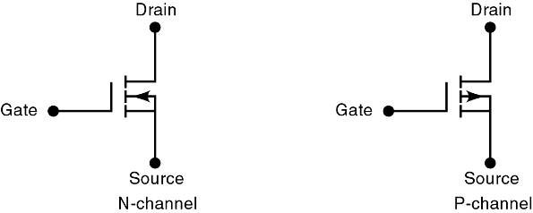
MOS Technology
There are presently two general types of MOSFETs—depletion and enhancement.
  MOS ICs use enhancement MOSFETs exclusively.
The direction of the arrow indicates either P- or N-channel. The symbols show a broken line between the source and the drain to indicate there is normally no conducting channel between these electrodes.
Notes:
Multiplexers & Demultiplexers
Digital Electronics™
Lesson 2.4 – Specific Combo Circuits & Misc Topics
Project Lead The Way, Inc.
Copyright 2009

Slide 18
MOS Technology – Basic MOSFET Switch
An N-channel MOSFET is the basic element in a family of devices known as N-MOS.
  Drain is always biased positive relative to the source.
The P-channel MOSFET—P-MOS—operates in the same manner as the N-channel.
  Except that it uses voltages of opposite polarity.
During this era, technology emerged that used P-MOS & N-MOS transistors in the same circuit.
  Complementary MOS, or CMOS, technology.

Slide 19
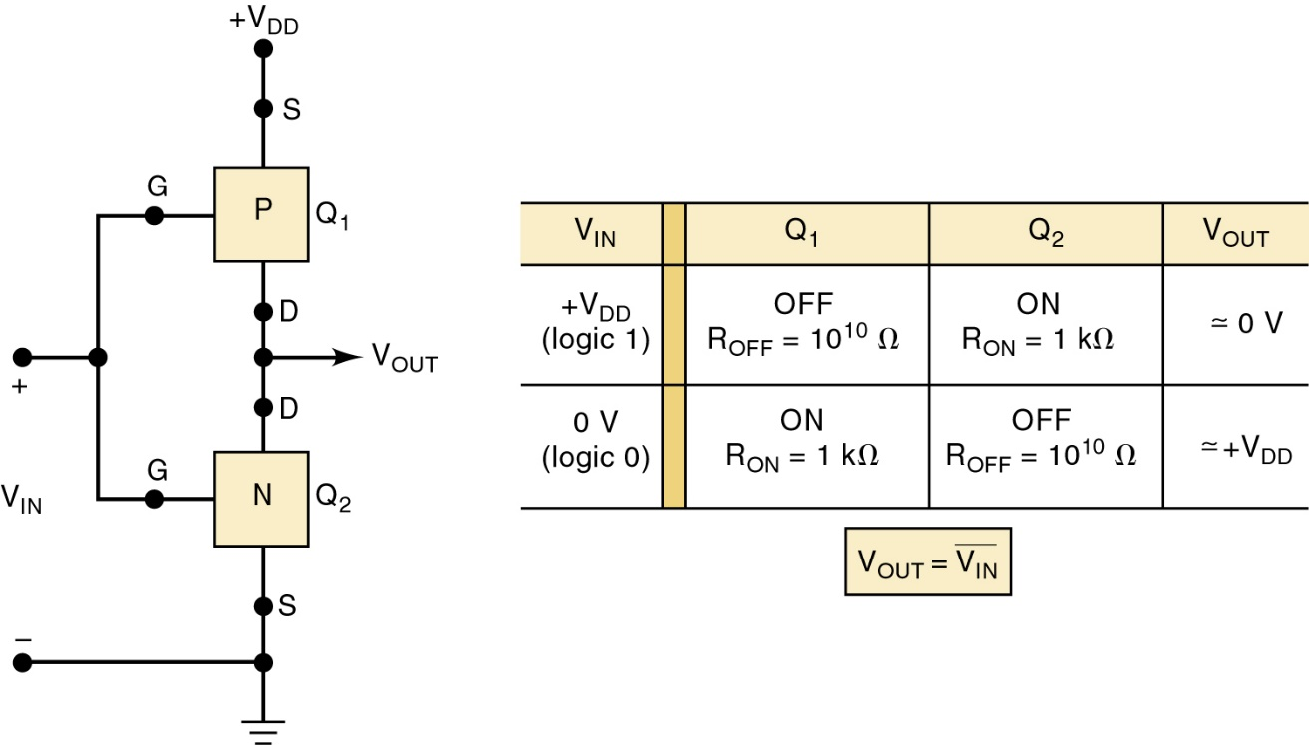
Complementary MOS Logic – CMOS Inverter
The CMOS INVERTER has two MOSFETs in series.
  Gates of the two devices are connected together
  as a common input.
  Drains are connected together as common output.
Basic CMOS INVERTER.

Slide 20
CSE 13A
Thanks for taking the stress
Time to say, Good Bye

