Slide 2
Virtualization
Rich Marino

Slide 3
Virtualization
Creating a virtual version of something.
Virtual Machines
Virtual Applications
Divides up the computer’s resources.
Mac users may be familiar with Virtualization to run Windows on top of OS X.

Slide 4
Uses
Allows running one system on top of another (e.g. Windows on a Mac, Linux on Windows)
Allows consolidation of many computers into one.
Cheaper Hardware
Saves Energy (and noise)
An Example is the ViAComp Cloud Computer at the engineering school.
Easier to manage, repair, and backup.
Run legacy (old) systems.
Sandboxing

Slide 5
Terminology
Virtualizer
Program that enables Virutalization (e.g. VMWare Fusion)
Host
The system that is running the Virtualizer (e.g. Mac OS X)
Guest
A system that is running inside the Virtualizer (e.g. Microsoft Windows)

Slide 6
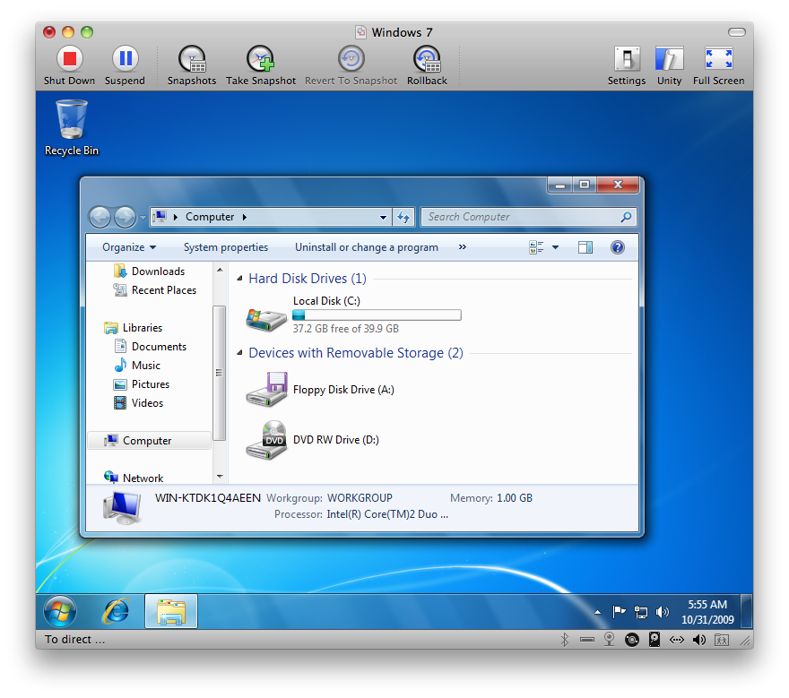
VMWare Fusion
Usually used to run Windows on Mac OS X.
Host: Mac OS X Leopard
Guest: Microsoft Windows 7
Virtualizer: VMWare Fusion

Slide 7
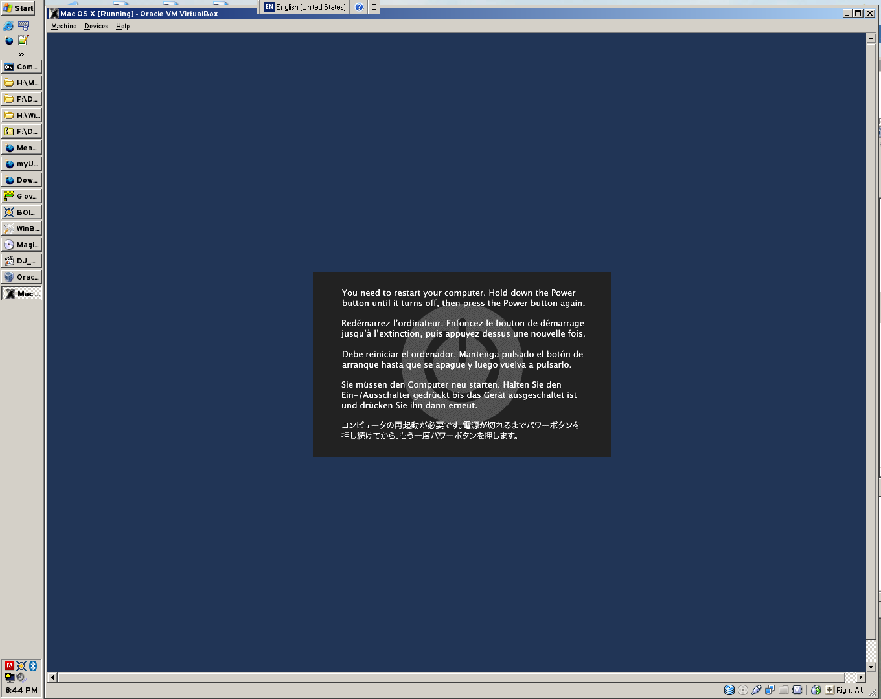
Mac OS on PCs
The reverse does not work so well right now...

Slide 8
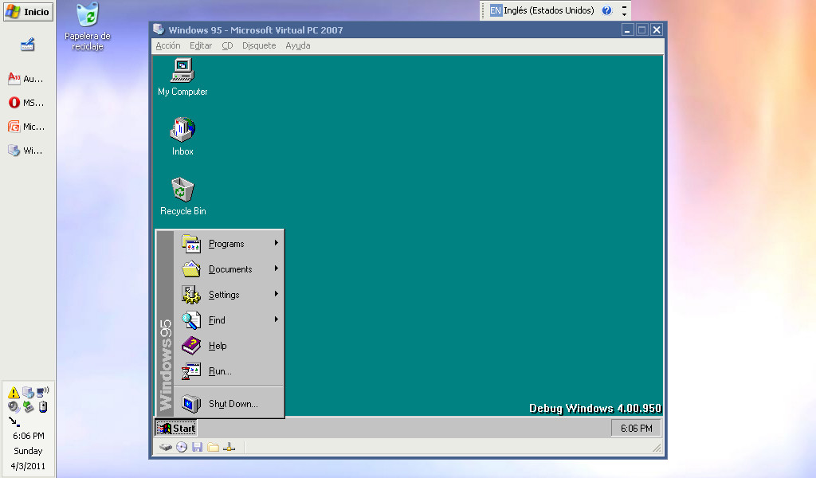
Legacy Systems
Old systems don’t run natively on modern hardware. They can be run in a Virtual Machine.
Host: Microsoft Windows Server 2003
Guest: Microsoft Windows 95 (checked)
Virtualizer: Microsoft Virtual PC 2007

Slide 9
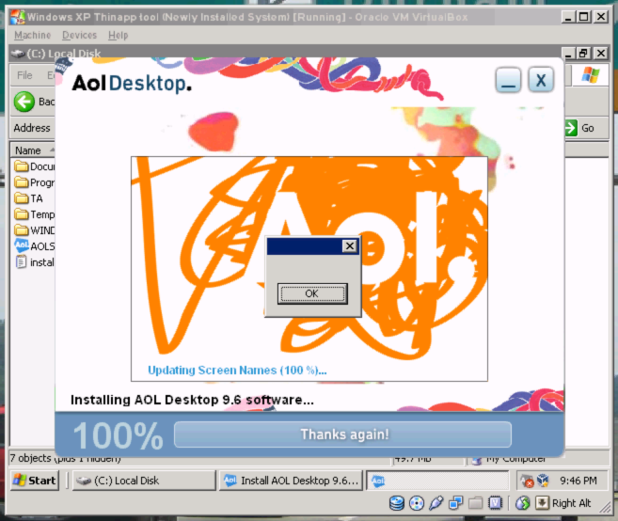
Sandboxing
Questionable programs (e.g. Viruses) can be contained to prevent damage to a computer system.
Host: Microsoft Windows Server 2003 x64
Guest: Windows XP Professional SP2
Virtualizer: VirtualBox

Slide 10
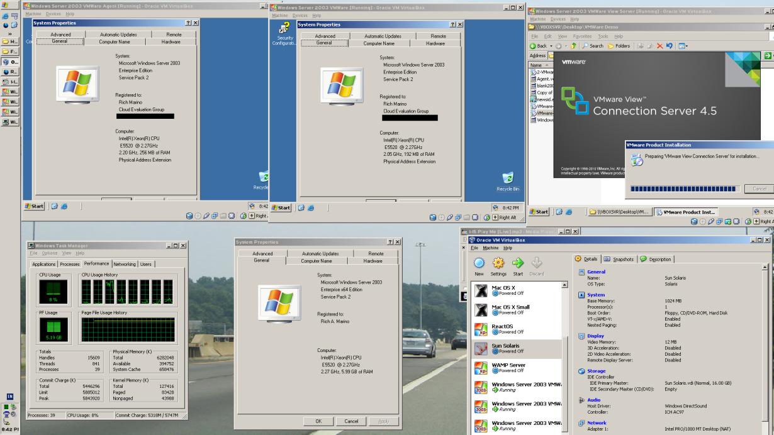
Consolidation
It is possible to have many virtual machines on one real machine.
Host: Windows Server 2003 x64
Guest: Windows Server 2003 (3 guests)
Virtualizer: VirtualBox

Slide 11
How It Works – Two Types
Hosted Virtualization
Virtual Machines run underneath another Operating System (previous examples)
VMWare Workstaion/Fusion/Server, VirtualBox
Bare-Metal Virtualizaiton
No Operating System, the virtualization software (called a Hypervisor) is the operating system.
VMWare ESX, Xen, Microsoft Hyper-V

Slide 12
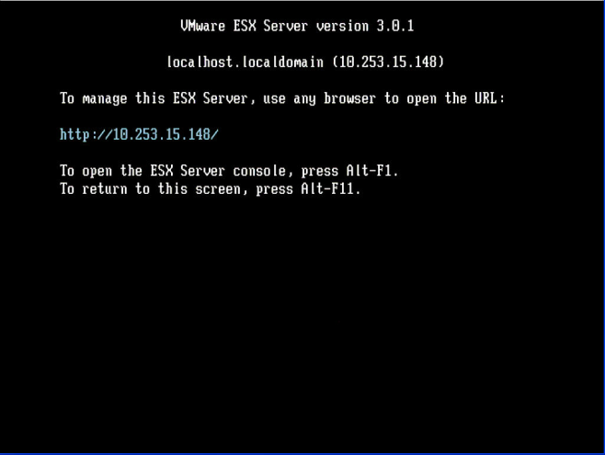
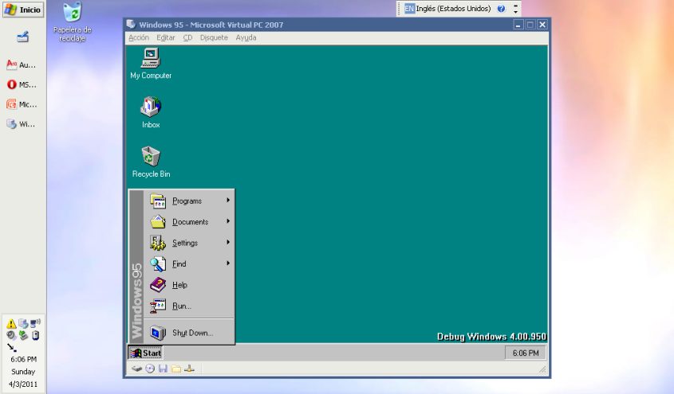
How It Works – Two Types
Hypervisors are usually accessed remotely (from other computers)
Hosted Virtualization may be used locally (e.g. on your computer screen) or remotely.
VMWare ESX Console – not very useful. It can be operated from another computer.
Microsoft Virtual PC running Windows 95 on my laptop, along with AutoCAD and Opera.

Slide 13












How it works
Virtualizer
Real Hardware
Server
Server1
Host OS – Windows Server 2003
OS 1
Windows Server 2003
Virtualizer – VMWare Server
OS 1
Windows Server 2003
Server2
OS 2
CentOS Linux
OS 2
CentOS Linux
Server3
OS 3
Windows Server 2008
OS 3
Windows Server 2008

Slide 14
How it works
Virtualizer
Real Hardware
Server
Server1
Hypervisor – VMWare ESX
OS 1
Windows Server 2003
Control Panel
OS 1
Windows Server 2003
Server2
OS 2
CentOS Linux
OS 2
CentOS Linux
Server3
OS 3
Windows Server 2008
OS 3
Windows Server 2008

Slide 15
Power Usage
Virtualizer
Real Hardware
500W
1200W
Server
Server1
Hypervisor – VMWare ESX
OS 1
Windows Server 2003
400W
Control Panel
OS 1
Windows Server 2003
Server2
OS 2
CentOS Linux
400W
OS 2
CentOS Linux
Server3
OS 3
Windows Server 2008
OS 3
Windows Server 2008
400W

Slide 16
The ViaComp Cloud
Virtualizer
Real Hardware
Server
PC1
Windows 7
Hypervisor – VMWare ESX
PC2
Windows 7
A server to keep track of
users’ data – Windows Server 2008
PC3
Windows 7 -1
Windows 7
Windows 7 -2
PC4
Windows 7
Windows 7 -3
PC5
Windows 7
Windows 7 -4
PC6
Windows 7
Windows 7 -5
PC7
Windows 7
Windows 7 -6
Disclaimer: Information on this slide is for example only, and is not completely accurate. Not endorsed by the University of Miami or VMWare.

Slide 17
Not to be confused with Emulation
Virtualizer
Emulator
Only allows dividing of one type of CPU architecture.
Has very little to almost no overhead compared to a native system.
Different types of CPU (called architectures) are not compatible. An Emulator can allow one type of CPU to act like (emulate) another.
Has about <20% the speed of a native system of the same spec. (average)

Slide 18
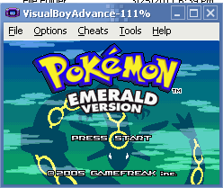
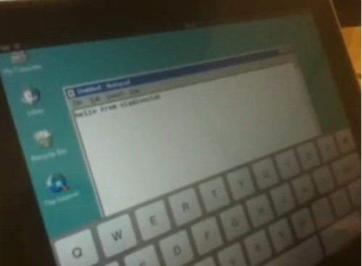
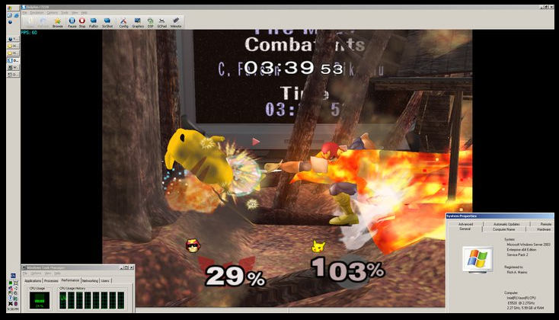
Examples of Emulators
Game Boy Advance Emulator (left) – ARM on Intel x86
Intel Emulator on iPad – Intel x86 on ARM
Wii Emulator on PC – PowerPC on Intel x86-64

Slide 19
Products
Operating System, Hosted
VMWare Workstation/Fusion/Player/Server
VirtualBox (Oracle/Sun)
Parallals (Workstaion/Desktop)
Microsoft Virtual PC
Operating System, Bare-metal Hypervisor
VMWare ESX
Microsoft Hyper-V

