Slide 1


Python Data Analysis
2023 – 2024
General informations
Louie Corpe
louie.corpe@cern.ch
Romain Madar
romain.madar@cern.ch

Slide 2
Material for the lecture
1. On moodle platform (ENT, UCA accout access required):
https://ent.uca.fr/moodle/course/view.php?id=26834
2. On github platform (free access):
https://github.com/rmadar/lecture-python

Slide 3
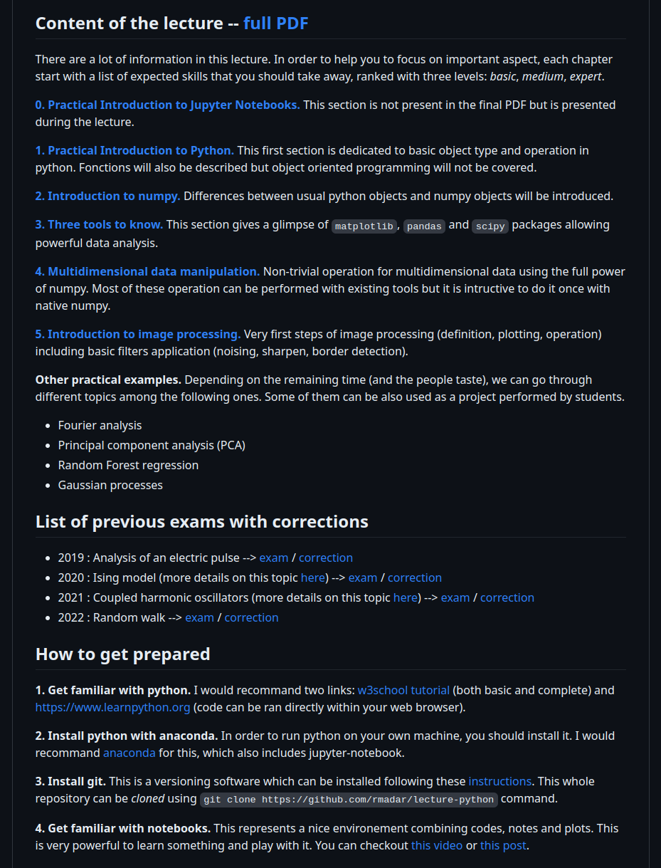
Material for the lecture
1. On moodle platform (ENT, UCA accout access required):
https://ent.uca.fr/moodle/course/view.php?id=26834
2. On github platform (free access):
https://github.com/rmadar/lecture-python

Slide 4
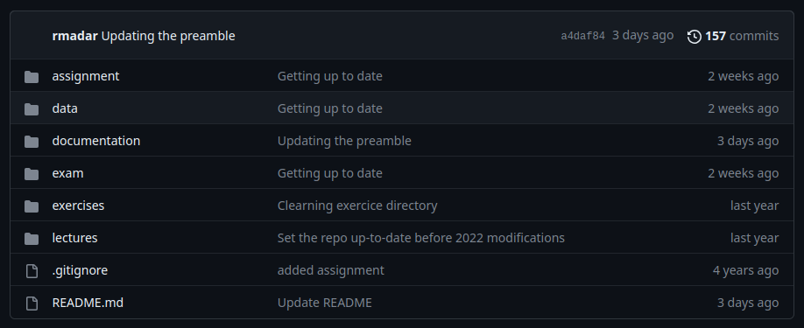
Material for the lecture
1. On moodle platform (ENT, UCA accout access required):
https://ent.uca.fr/moodle/course/view.php?id=26834
2. On github platform (free access):
https://github.com/rmadar/lecture-python

Slide 5
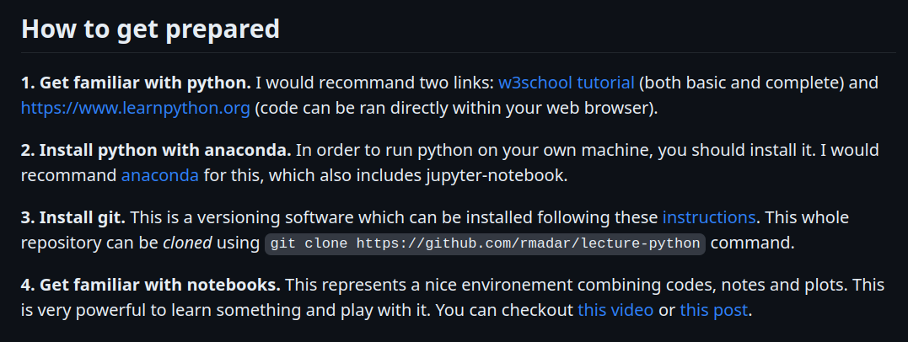
Lecture structure & technicals
A typical day:
→ presentation of a new chapter, with some little exercises for you to practice
→ practical sessions with larger exercises
You need to have a running notebook with a proper python environment
(2 options : UCA computer, your laptop)

Slide 6
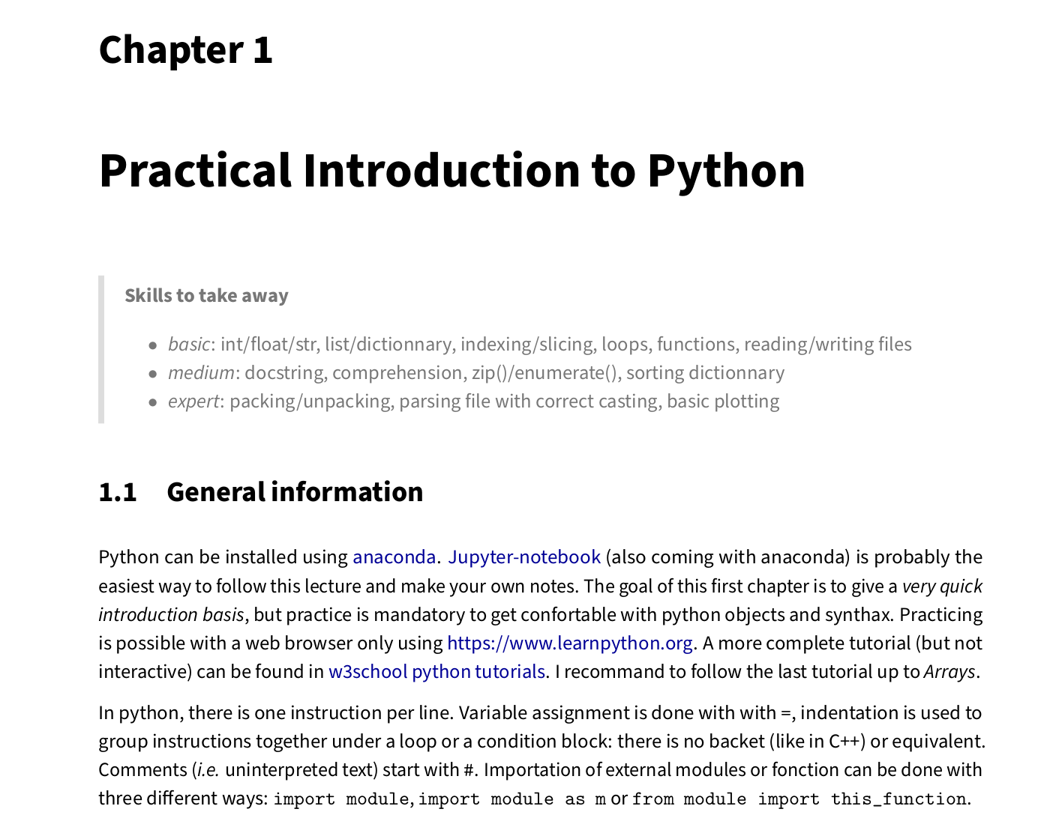
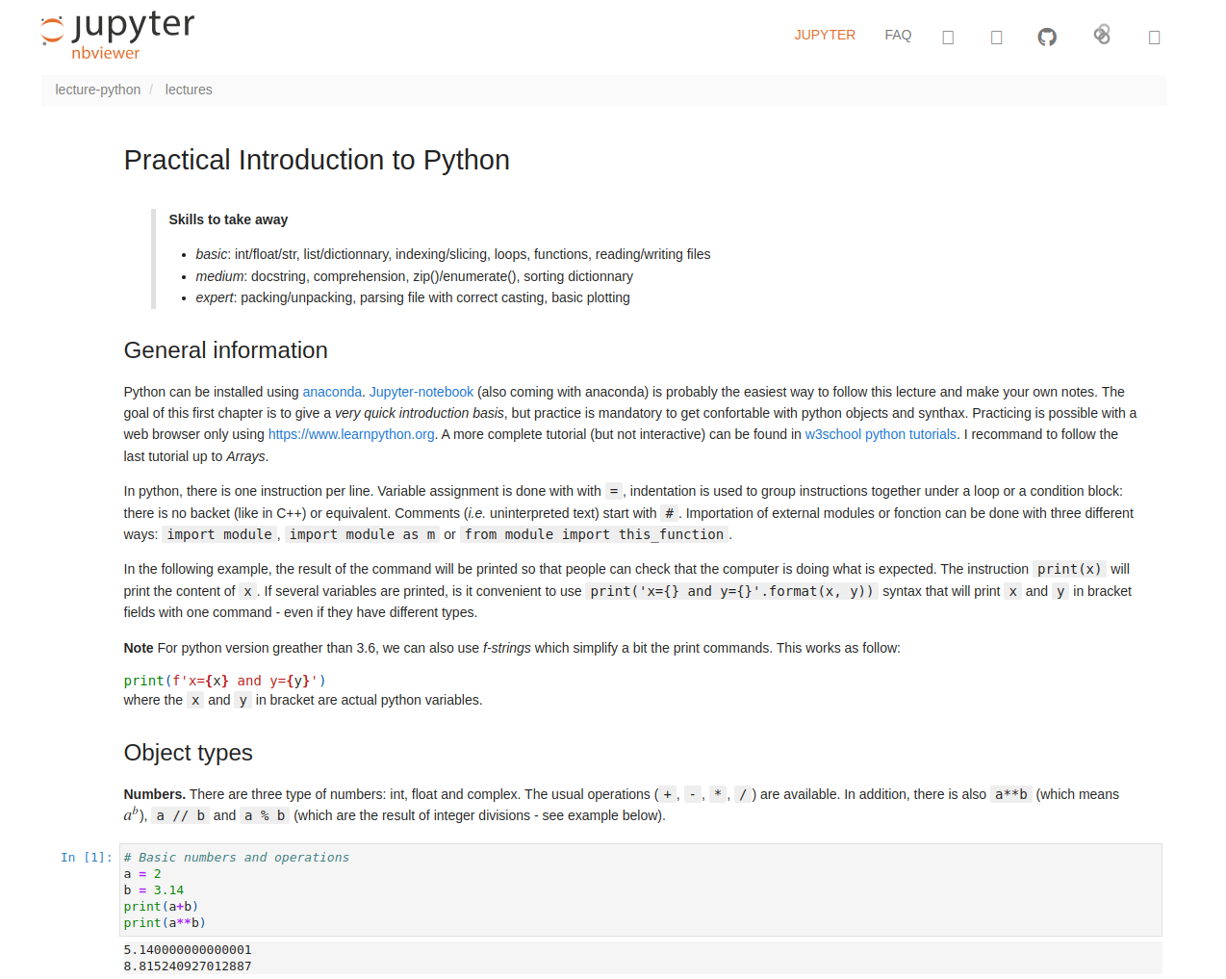
Skills and Evaluations
[lecture pdf]
[lecture notebook]
Evaluation : 2h exam on a computer in classroom (beginning of november for the masters, end of september for DUs).
Allowed material : offical python documentations of all tools (lecture material not allowed).

Slide 7
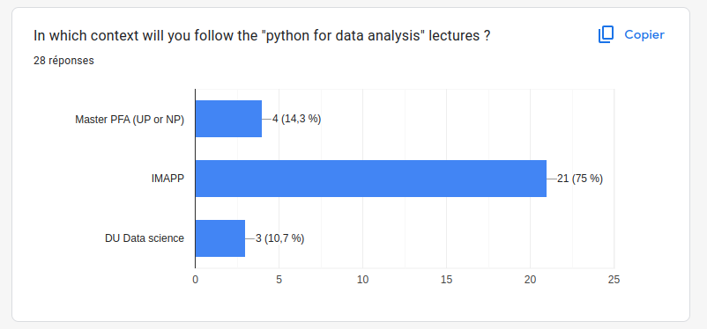
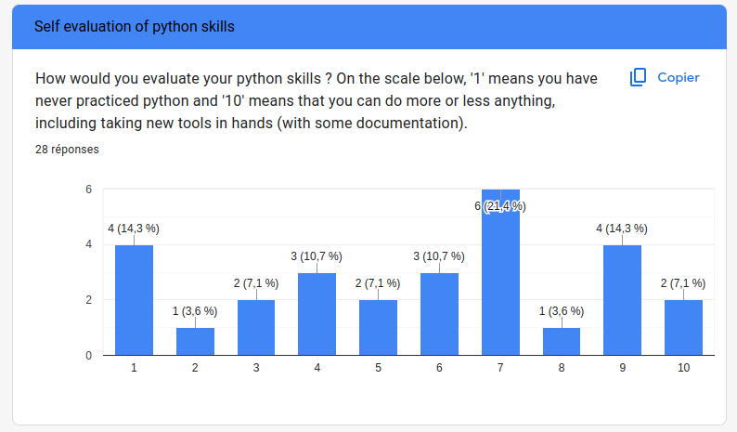
The group

Slide 8
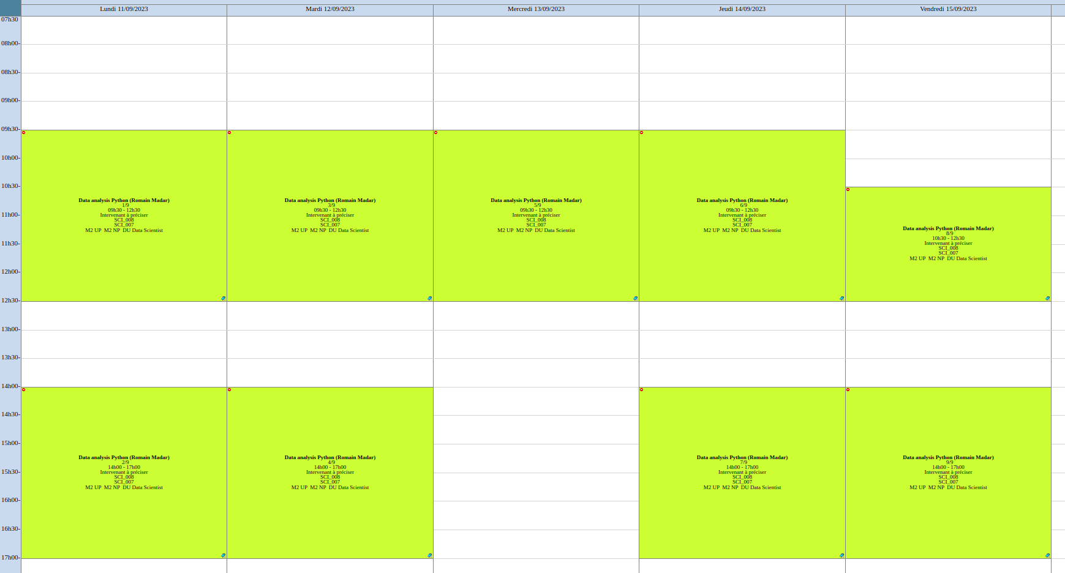
Free
Ends at 12h00

