Slide 1

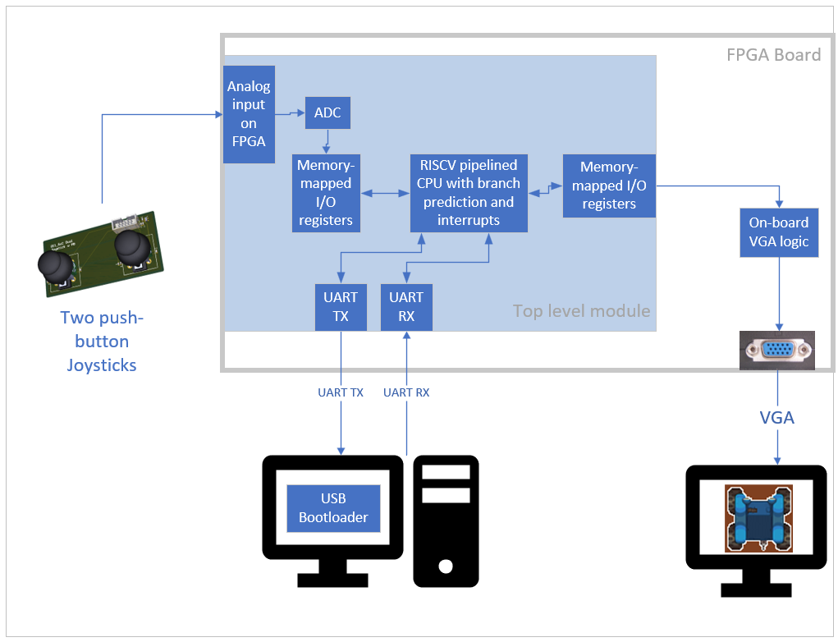
ECE 554
Team Tank
Ryan Dingle
Muthu Adithya Ramnarayanan
Eric Dubberstein
Vishnu Vemuri
ISA
CPU Architecture
Software
RISC-V 32 Bit base ISA
Hazard Detection Unit
Pipeline Registers
Instructions | Instructions (cont.)
LUI | SLTI
AUIPC | SLTIU
JAL | XORI
JALR | ORI
BEQ | ANDI
BNE | SLLI
BLT | SRLI
BGE | SRAI
BLTU | ADD
BGEU | SUB
LB | SLL
LH | SLT
LW | SLTU
LBU | XOR
LHU | SRL
SB | SRA
SH | OR
SW | AND
ADDI | ECALL
Fetch
Decode
Execute
Memory
Writeback
The ISA is the set of instructions that the CPU can execute
Completely open-sourced ISA
32 General Purpose Registers
32-bit fixed-width instructions
ECALL terminates execution
Branch Resolution
Memory Mapped I/O
Dynamic Branch Prediction
TODO: Muthu and Vishnu
Instruction
Decode
Data Memory Banks
PC
Register File
ALU
Instruction Memory
Forwarding Units
We implemented a pipelined processor in Verilog to realize this ISA
Branch Prediction
Sensors & Peripherals
CPU Validation
Our pipelined processor, which resolves branches in Decode, needs to flush one instruction on an incorrect branch prediction. To reduce the need to flush this instruction, we implemented dynamic branch prediction. Dynamic branch prediction “remembers” if a branch was previously taken or not.
Test assembly code
TODO: Ryan: Fill in statistic and complete diagrams.
After testing, our dynamic branch prediction resulted in a XXXX% improvement in the CPI (cycles per instruction) of our processor
Verilog Functional Simulation
(OUR CPU)
Python behavioral simulation
Valid Register
Strong Register
Strong Register
Instruction Trace
Instruction Trace
Compare instruction trace files to determine PASS or FAIL
== ?
ECE Capstone Open House 2024

