Slide 1
A QMC tutorial using G03 / Quantum Espresso & CASINO
Kenta Hongo¹⁾, Yutaka Uejima²⁾, Ryo Maezono²⁾
¹⁾ The Institute of Statistical Mathematics
²⁾ Japan Advanced Institute of Science and Technology
Notes:
Good morning, everyone. On the last Saturday, Professor Ryo Maezono explained theoretical aspects of QMC and presented his recent research achievement on Quantum Monte Carlo studies. Today, I will give you a QMC tutorial and Yutaka will help you with this tutorial.

Slide 2
Purpose of this tutorial
This tutorial will provide you with hands-on experience on SCF & QMC calculations for a molecule and solid.
You will understand what procedure is involved when you actually perform QMC calculations.
You should be able to run QMC calculations in most cases from the beginning by yourself.
Notes:
This tutorial aims to give you hands-on experience on SCF and QMC calculations for a simple molecule and solid. So, after this tutorial, I expect you to understand how QMC differs from SCF and how QMC is related to SCF. Also you will become a QMC master! OK, next I will explain our plan of this tutorial.

Slide 3
Contents:
Part 1: Preparation for hands-on trainings
  Connection to our Macintosh clusters
  Acquisition of a file for hands-on
  Setup
Part 2: Hands-on training for water molecule
  SCF calculation using G03
  QMC calculations using CASINO
Part 3: Hands-on training for bulk Silicon
  SCF calculation using Quantum Espresso (PWSCF)
  QMC calculations using CASINO
Notes:
First, we will setup a computational environment for this tutorial. After that, we will actually perform SCF and QMC calculations for a molecule and solid. We employ CASINO program suite for both cases, but SCF calculations are done with different programs, Gaussian 03 for the molecule and Quantum Espresso or sometime called PWSCF for the solid. Up to this point, any question? OK, let’s go to Part 1.

Slide 4
Part 1:
Preparation for hands-on trainings
Connection to our Mac clusters
Acquisition of a hands-on file
Setting up
Notes:
Here, we will first establish connection to computers in Japan from your own machine. After logging in, we will work on setting up.

Slide 5








Connection to our Mac clusters
Login a master node at your laboratory
    ① % ssh ryo@172.16.6.37
    password : 234and56
Login the “fep” server at JAIST
    ② [ryo@master ~]% ssh rmaezono@fep.jaist.ac.jp
    password : kayaa+nozoema
    % source .alias
Login the gate server
    ③ % macgate (aliased to ‘ssh maezono@150.65.180.162’)
    password : fujita0mit
Login a mac cluster assigned to you
    ④ linux08as02% rsh 192.168.0.XX
    (remember your number “XX”!）
①
Internet
②
③
④
…
Notes:
This shows the route to Macintosh clusters from your computer. Your goal is to connect to one of the clusters. We have 28 clusters named as m07sXX. All your calculations will be done on each cluster. So, clockwise, 01, 02, …. OK? Remember the assigned number. This looks so complicated, but we go step-by-step. First, login a master node with an account of YYY and Password of ZZZ. OK? Next, connect to a gate server at JAIST, like this. OK? Next, login the gate server. Here instead of typing “ssh …”, we use this command aliased to this. Setting up this kind of aliased commands is very helpful to prevent typos and save time. OK, next fileserver, and finally, your assigned cluster. Up to this point, any trouble?

Slide 6
Acquisition of a file for hands-on
Move on to a file server where the file is put
List files there
Copy “qmc_tutorial_2012.tar.gz” to your home directory
Go back to your home directory and make sure you have the copy
meiwaku07server01% hdd
meiwaku07server01% ls
meiwaku07server01% cp qmc_tutorial_2012.tar.gz ~
meiwaku07server01% cd
Notes:
Next, let’s get a file set for hands-on trainings. To do so, first go to a fileserver having the file. So show a list of files there. Here I alias command “l” to “ls –CF”. OK. you can find a tar.gz file and copy it to your home directory, like this. Then, go back to your home directory and make sure of the file. Up to here, any question or trouble?

Slide 7
Setup (1)
Expand the tar.gz file:
Go to the “qmc_tutorial_2012/environment” directory:
Setting up environmental variables, paths, etc.:
meiwaku07server01% tar xzf qmc_tutorial_2012.tar.gz
meiwaku07server01% cd qmc_tutorial_2012/environment
meiwaku07server01% source alias_tutorial
Notes:
Next, just to expand the file using this command. During this tutorial, next two steps are very important for performing calculations. Going to this directory, set up using this command. This file contains all environmental variables and paths necessary for calculations. When you login the cluster again, please do not forget to do this.

Slide 8
Setup (2)
Make sure of the G03 execution:
Make sure of the Quantum Espresso executions:
Make sure of programs for CASINO
meiwaku07server01% which g03
meiwaku07server01% which casino2upf.x pw.x
meiwaku07sever01% which gaussiantoqmc ve
Congratulation!!
You’re now In a position to do hands-on training.
Notes:
Let’s see if your operation is going well. The first is for gaussian, second for quantum espresso, and the last for CASINO. Typing these commands, you can find whereabouts of these executable programs. OK. Up to this point, any question or trouble? If no, that’s it all. You can run SCF and QMC calculations on your mac cluster.

Slide 9
QMC combined with SCF (MO/DFT)
Solids / Clusters / Molecules / Atoms…
Plain Wave basis/Gaussian basis
DFT
MO
- LDA
- GGA
All electron / Pseudo potential
- BLYP
- …
“Orbital Functions”
(Initial guess)
Fixed node QMC
VMC/DMC
Time evolution !
to get better Amplitude
More Accurate Energy
Notes:
Before starting hands-on, I will remark on SCF and QMC calculations.

Slide 10
Procedure of QMC calculations
SCF with G03 (molecule) / Quantum Espresso (solid)
  SCF to generate one-electron orbitals
QMC with CASINO
  HF-VMC calculation (optional for experts)
  Optimization of the many-electron wavefunction
  VMC calculation
  DMC calculation
    Generate configurations with VMC
    Equilibrate the distribution
    Accumulate statistics

Slide 11



Part 2: Hands-on for H₂O
Aims to evaluate the SCF, (HF-VMC), VMC, DMC energies for the water molecule.
0.96 Å
109.5 °
Notes:
OK. let’s start with a hands-on training for water molecule. Here we will run 4 calculations, SCF, HF-VMC, VMC, DMC.

Slide 12
Structure of working directories
Go into the parent directory for H2O:
Show a list of the working directories:
meiwaku07server01% cd qmc_tutorial_2012/molecule
meiwaku07server01% ls
qmc_tutorial_2012/molecule/
0_g03_gwfn/
1_hfvmc/
2_opt_jastrow/
3_vmc/
4_dmc_cio/ 5_dmc_eio/ 6_dmc_sio/
Notes:
First make sure where you are and go to the parent directory. Then, let’s see a tree structure of the working directories. You can find a list of numbered directories. Our calculations go in this order.

Slide 13
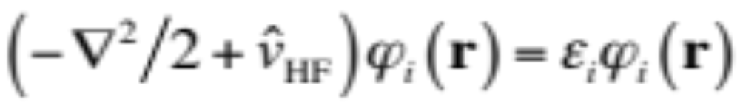
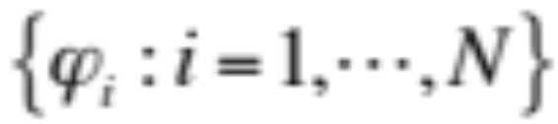
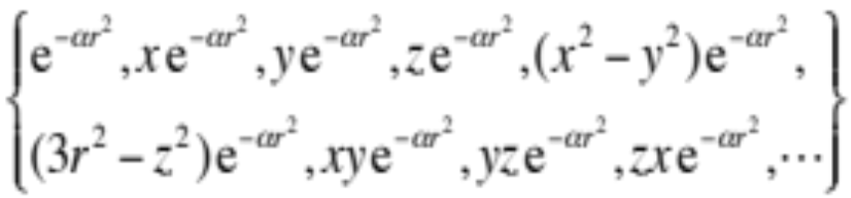
SCF with Gaussian 03
Hartree-Fock equation:
one-electron/molecular orbitals
Gaussian 03 (g03):
each one-electron orbital (molecular orbital; MO)
is expanded in terms of a Gaussian basis set.
Notes:
In the SCF calculation using G03, we perform hartree-fock and then get a set of one-electron orbitals. Note that each orbital is expanded in terms of a Gaussian basis set. The name of Gaussian program suite comes from using Gaussian basis set.

Slide 14
Generate molecular orbitals
Go to the working directory: molecule/0_g03_gwfn/
Input file: h2o.com
Run g03 with the input:
Output files: h2o.out & Test.FChk
meiwaku07server01% cd 0_g03_gwfn ; l
meiwaku 07server01% cat h2o.com
meiwaku07server01% g03 < h2o.com > h2o.out
meiwaku07server01% ls
Notes:
OK, let’s get started with SCF. First go to the working directory, following this command. Only this input file is necessary for G03. Let’s look into the input.
Well, let’s run g03. type this command. This run ends in a split second. Then make sure of these output files. This file with suffix .FChk is necessary for QMC.

Slide 15


G03 Input
#p hf/sto-3g scf=tight formcheck=(mo,basis)
H2O HF/STO-3G wfn for QMC
0 1
O
H 1 R1
H 1 R1 2 A1
R1 0.96000000
A1 109.50000006
R1
A1
Notes:
The Gaussian input consists of the three parts. The first line is named as root section which control the calculation. In this example, we run Hartree-Fock with STO-3G gaussian basis set. In this line, this keyword is needed to save orbital and basis set data for upcoming QMC calculations. Next just to put a blank, and the second part is only a title section for this calculation. The last part is a molecular specification. 0 indicates a charge of the system, 1 does a spin multiplicity of the system. Next are a molecular geometry of the water molecule.

Slide 16
Check the SCF energy
Extract the SCF (HF) energy from “h2o.out”:
Save the energy:
Move on to convert the MO data
meiwaku07server01% grep "E(RHF)" h2o.out
SCF Done: E(RHF) = -74.9607019408 A.U. after 4 cycles
meiwaku 07server01% grep "E(RHF)" h2o.out > ../results
Notes:
Before creating MO data for CASINO, let’s check out the SCF result and save it to a file. First use grep command and compare your result with this. Then, save it like this. Everything done?

Slide 17
Convert the MO data into
CASINO format
Rename “Test.FChk” to “h2o.Fchk”:
Run “gaussaintoqmc”:
Output file: h2o.qmc
Copy “h2o.qmc” as “gwfn.data” to ../files
meiwaku07server01% mv Test.FChk h2o.Fchk
meiwaku 07server01% gaussiantoqmc
meiwaku07server01% ls
meiwaku07server01% cp h2o.qmc ../files/gwfn.data
Notes:
OK, next is to create a MO data in CASINO format. First rename Test.FChk to h2o.Fchk. Note that “c” in the latter is a lowercase letter. Then, run this executable. Here answer “h2o”. Check outputs. you can find .qmc file generated. Finally, copy this to ../files directory as gwfn.data. This name is common to any CASINO calculation with Gaussian basis sets. Up to here, any question or trouble?

Slide 18
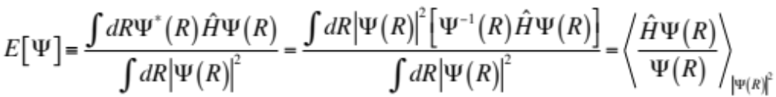
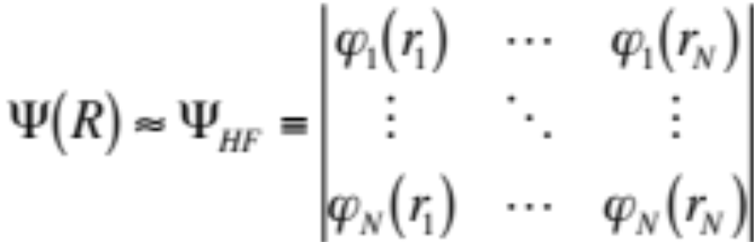

HF-VMC with CASINO
: HF-VMC
gwfn.data
+ input → casino
Notes:
OK. Next is HF-VMC. As Ryo explained before, QMC evaluate this expectation value using Monte Carlo. In HF-VMC, we assume the trial wavefunction to be a Slater determinant in which molecular orbitals are generated using SCF as done before. To do HF-VMC, we need one more input file to control the calculation.

Slide 19
Setup for HF-VMC
Move on to the working directory: molecule/1_hfvmc:
Link “casino” and “gwfn.data” from molecule/files:
Make sure the working directory has all the files requisite for HFVMC
meiwaku07server01% cd ../1_hfvmc
meiwaku07server01% ln -s ../files/* .
meiwaku07server01% ls
Notes:
HF-VMC is done at the 1_hfvmc directory. Here there is only an input file. We need casino executable and gwfn.data. Just to link them from the files directory. Setup is all set.

Slide 20
Run CASINO for HF-VMC
Run CASINO for HF-VMC with 4 CPUcores:
What on earth is “ccmd4” ?
This takes about 2 minutes.
meiwaku07server01% ccmd4
meiwaku07server01% alias ccmd4
mpiexec -np 4 ./casino < /dev/null >& err &
Notes:
OK. let’s run CASINO with 4 CPU-cores. To do so, jut type “ccmd4”. This command is aliased to this. This run takes about a few minutes. Then we look into the input file.

Slide 21
Key parameters for HF-VMC
#-------------------#
# CASINO input file #
#-------------------#
# Water molecule (Gaussian basis)
# SYSTEM
neu : 5 #*! Number of up electrons (Integer)
ned : 5 #*! Number of down electrons (Integer)
periodic : F #*! Periodic boundary conditions (Boolean)
atom_basis_type : gaussian #*! Basis set type (text)
# RUN
runtype : vmc #*! Type of calculation (Text)
newrun : T #*! New run or continue old (Boolean)
testrun : F #*! Test run flag (Boolean)

Slide 22
Key parameters (cont’d)
# VMC
vmc_equil_nstep : 10000 #*! Number of equilibration steps (Integer)
vmc_nstep : 1000000 #*! Number of steps (Integer)
vmc_nblock : 500 #*! Number of checkpoints (Integer)
vmc_nconfig_write : 0 #*! Number of configs to write (Integer)
vmc_decorr_period : 5 #*! Decorrelation loop length (Integer)
vmc_ave_period : 100 #*! vmc.hist reduction factor (Integer)
psi_s : slater #*! Type of [anti]symmetrizing wfn (Text)
complex_wf : F #*! Wave function real or complex (Boolean)
# GENERAL PARAMETERS
use_jastrow : F #*! Use a Jastrow function (Boolean)
backflow : F #*! Use backflow corrections (Boolean)

Slide 23
Check the HF-VMC result
Show a list of files:
Extract the HF-VMC energy from “out”:
Save the result:
meiwaku07server01% ls
meiwaku07server01% grep "VMC energy" out
Reblocked VMC energy: -75.589972213937+/- 0.026857909674
meiwaku07server01% grep "VMC energy" out >> ../results

Slide 24
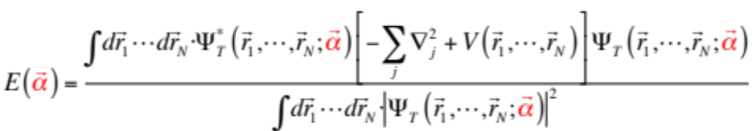
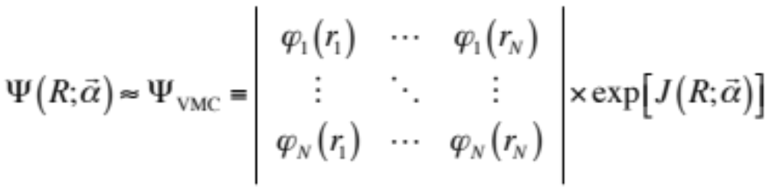


Optimization of the wavefunction
Monte Carlo evaluation
Jastrow factor
with parameters
Search minimum
Repeat MC evaluation and search….

Slide 25
Setup for optimization
Move on to the working directory: molecule/2_opt_jastrow:
Link “casino” and “gwfn.data” from molecule/files:
Make sure the working directory has all the files requisite for optimization
meiwaku07server01% cd ../2_opt_jastrow
meiwaku07server01% ln -s ../files/* .
meiwaku07server01% ls

Slide 26
Run CASINO for optimization
Input files: “input”, “correlation.data”, “gwfn.data”:
Run CASINO for optimization with 4 CPUcores:
This takes about 3 minutes.
meiwaku07server01% ls
meiwaku07server01% ccmd4

Slide 27
Key parameters for optimization
# RUN
runtype : vmc_opt #*! Type of calculation (Text)
newrun : T #*! New run or continue old (Boolean)
testrun : F #*! Test run flag (Boolean)
# VMC
vmc_equil_nstep : 10000 #*! Number of equilibration steps (Integer)
vmc_nstep : 100000 #*! Number of steps (Integer)
vmc_nblock : 1 #*! Number of checkpoints (Integer)
vmc_nconfig_write : 1024 #*! Number of configs to write (Integer)
psi_s : slater #*! Type of [anti]symmetrizing wfn (Text)
complex_wf : F #*! Wave function real or complex (Boolean)
vmc_decorr_period : 10 #*! Decorrelation loop length (Integer)
vmc_ave_period : 1000 #*! vmc.hist reduction factor (Integer)
vmc_method : 1 #*! Which VMC method (Integer)
opt_dtvmc : 1 #*! Optimize VMC timestep (Integer)

Slide 28
(cont’d)
# OPTIMIZATION
opt_method : emin #*! Opt method (varmin/madmin/emin/...)
opt_cycles : 3 #*! Number of optimization cycles (Integer)
opt_jastrow : T #*! Optimize Jastrow factor (Boolean)
opt_det_coeff : F #*! Optimize determinant coeffs (Boolean)
opt_backflow : F #*! Optimize backflow parameters (Boolean)
opt_orbitals : F #*! Optimize orbital parameters (Boolean)
emin_auto_varmin : T #*! Min variance in 1st emin cycle (Boolean)
# GENERAL PARAMETERS
use_jastrow : T #*! Use a Jastrow function (Boolean)
backflow : F #*! Use backflow corrections (Boolean)
expot : F #*! Use external potential (Boolean)

Slide 29
Check the results
meiwaku07server01% ve
VE v0.50: Script to extract VMC energies from CASINO output files.
Usage: ve [-kei] [-ti] [-fisq] [-pe] [-vee] [-vei] [-vnl] [-nc]
[-vr] [-rel] [-ct] [-nf <no-figures>] [files]
File: ./out
(energies in au, variances in au)
VMC #1: E = -75.56(4) ; var = 70(1) (correlation.out.0)
VMC #2: E = -74.94(4) ; var = 63.1(4) (correlation.out.1)
VMC #3: E = -75.57(3) ; var = 60.1(8) (correlation.out.2)
VMC #4: E = -75.70(3) ; var = 57.3(4) (correlation.out.3)
Total CASINO CPU time ::: 187.1300 seconds

Slide 30
(cont’d)
Save “correlation.out.3” as “correlation.data” to ../files:
Make sure of the data files at ../files:
meiwaku07server01% cp correlation.out.3 ../files/correlation.data
meiwaku07server01% ls ../files
Congratulation!!
You’re now in a position to do VMC and DMC.

Slide 31
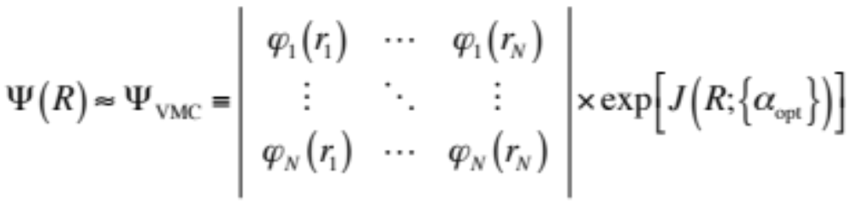


VMC calculation
: VMC
gwfn.data
correlation.data
+ input → casino

Slide 32
Setup for VMC
Move on to the working directory: molecule/3_vmc:
Link “casino”, “gwfn.data”, and “correlation.data” from molecule/files:
Make sure the working directory has all the files requisite for VMC
meiwaku07server01% cd ../3_vmc
meiwaku07server01% ln -s ../files/* .
meiwaku07server01% ls

Slide 33
Run CASINO for VMC
Run CASINO for optimization with 4 CPUcores:
This takes about 3 minutes.
meiwaku07server01% ccmd4

Slide 34
Check the VMC result
Show a list of files:
Extract the VMC energy from “out”:
Save the result:
meiwaku07server01% ls
meiwaku07server01% grep "VMC energy" out
Reblocked VMC energy: -75.686636892186 +/- 0.022510003390
meiwaku07server01% grep "VMC energy" out >> ../results

Slide 35
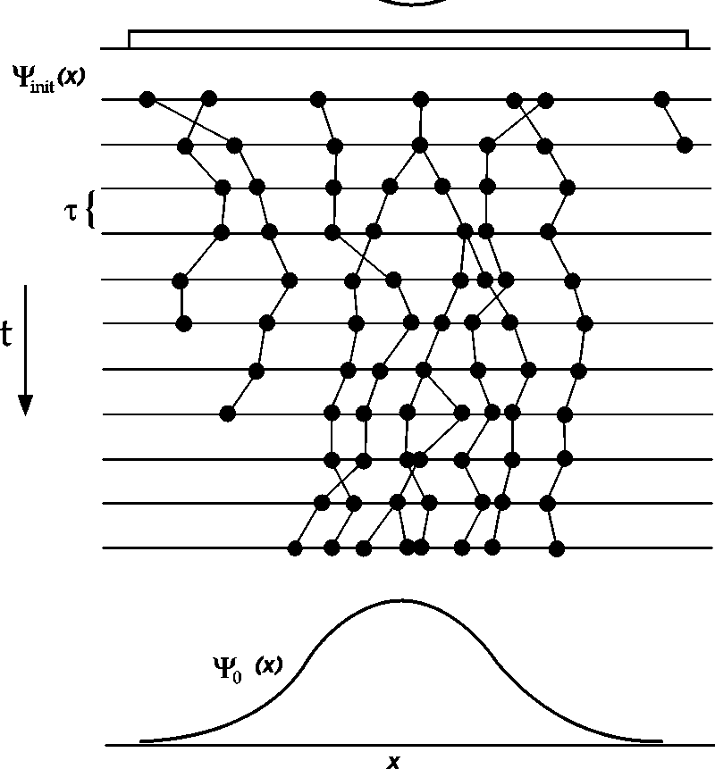
DMC calculation
dmc_cio (=vmc)
dmc_eio (=dmc_equil)
dmc_sio (=dmc_stats)

Slide 36

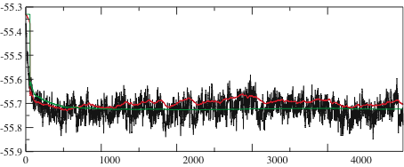
DMC calculation (cont’d)
dmc_cio
dmc_eio
dmc_sio

Slide 37
Setup for DMC_cio
Move on to the working directory: molecule/4_dmc_cio:
Link “casino”, “gwfn.data”, and “correlation.data” from molecule/files:
Make sure the working directory has all the files requisite for DMC_cio
meiwaku07server01% cd ../4_dmc_cio
meiwaku07server01% ln -s ../files/* .
meiwaku07server01% ls

Slide 38
Run CASINO for DMC_cio
Run CASINO for DMC-cio with 4 CPUcores:
This takes about 1 minute.
meiwaku07server01% ccmd4

Slide 39
Key parameters for DMC_cio
# RUN
runtype : vmc #*! Type of calculation (Text)
newrun : T #*! New run or continue old (Boolean)
testrun : F #*! Test run flag (Boolean)
# VMC
vmc_equil_nstep : 10000 #*! Number of equilibration steps (Integer)
vmc_nstep : 100000 #*! Number of steps (Integer)
vmc_nblock : 1 #*! Number of checkpoints (Integer)
vmc_nconfig_write : 1024 #*! Number of configs to write (Integer)
psi_s : slater #*! Type of [anti]symmetrizing wfn (Text)
complex_wf : F #*! Wave function real or complex (Boolean)
vmc_decorr_period : 10 #*! Decorrelation loop length (Integer)
vmc_ave_period : 1000 #*! vmc.hist reduction factor (Integer)
vmc_method : 1 #*! Which VMC method (Integer)
opt_dtvmc : 1 #*! Optimize VMC timestep (Integer)

Slide 40
Setup for DMC_eio
Copy “config.out” as “config.in” to ../5_dmc_eio
Move on to the working directory: molecule/5_dmc_eio:
Link “casino”, “gwfn.data”, and “correlation.data” from molecule/files:
Make sure the working directory has all the files requisite for DMC_eio
meiwaku07server01% cp config.out ../5_dmc_eio/config.in
meiwaku07server01% cd ../5_dmc_eio
meiwaku07server01% ln -s ../files/* .
meiwaku07server01% ls

Slide 41
Run CASINO for DMC_eio
Run CASINO for DMC-cio with 4 CPUcores:
This takes about 3 minutes.
meiwaku07server01% ccmd4

Slide 42
Key parameters for DMC_eio
# RUN
runtype : dmc_equil #*! Type of calculation (Text)
newrun : T #*! New run or continue old (Boolean)
testrun : F #*! Test run flag (Boolean)
# DMC
dmc_equil_nstep : 1000 #*! Number of steps (Integer)
dmc_equil_nblock : 100 #*! Number of checkpoints (Integer)
dmc_stats_nstep : 2000 #*! Number of steps (Integer)
dmc_stats_nblock : 500 #*! Number of checkpoints (Integer)
dmc_target_weight : 1024.d0 #*! Number of configs (DMC) (Integer)
dtdmc : 0.002 #*! DMC time step (Double Precision)
use_tmove : F #*! Casula nl pp for DMC (Boolean)

Slide 43
Setup for DMC_sio
Copy “config.out” as “config.in” to ../6_dmc_sio:
Copy “dmc.hist” to ../6_dmc_sio:
Move on to the working directory: molecule/6_dmc_sio:
Link “casino”, “gwfn.data”, and “correlation.data” from molecule/files:
meiwaku07server01% cp config.out ../6_dmc_sio/config.in
meiwaku07server01% cp dmc.hist ../6_dmc_sio/
meiwaku07server01% cd ../6_dmc-sio
meiwaku07server01% ln -s ../files/* .
meiwaku07server01% l

Slide 44
Run CASINO for DMC_sio
Run CASINO for DMC-cio with 4 CPUcores:
This takes about 5 minutes.
meiwaku07server01% ccmd4

Slide 45
Key parameters for DMC_sio
# RUN
runtype : dmc_stats #*! Type of calculation (Text)
newrun : F #*! New run or continue old (Boolean)
testrun : F #*! Test run flag (Boolean)
# DMC
dmc_equil_nstep : 1000 #*! Number of steps (Integer)
dmc_equil_nblock : 100 #*! Number of checkpoints (Integer)
dmc_stats_nstep : 2000 #*! Number of steps (Integer)
dmc_stats_nblock : 500 #*! Number of checkpoints (Integer)
dmc_target_weight : 1024.d0 #*! Number of configs (DMC) (Integer)
dtdmc : 0.002 #*! DMC time step (Double Precision)
use_tmove : F #*! Casula nl pp for DMC (Boolean)

Slide 46
Check the DMC result
Show a list of files:
Extract the DMC energy from “dmc.status”:
Save the result:
meiwaku07server01% ls
meiwaku07server01% grep ”Total energy" out
Total energy = -76.311864440160 +/- 0.013022006156
meiwaku07server01% grep ”Total energy" out >> ../results

Slide 47
Summarize the SCF and QMC results
meiwaku07server01% c
meiwaku07server01% cat results
SCF Done: E(RHF) = -74.9607025105 A.U. after 7 cycles
Reblocked VMC energy: -75.589972213937 +/- 0.026857909674
Reblocked VMC energy: -75.686636892186 +/- 0.022510003390
Total energy = -76.311864440160 +/- 0.013022006156
Congratulation!!
You master QMC for molecules

