Slide 1



Project Development Progress Report
This presentation details the progress made on the development of a Python-based Tetris game, including its login system and upcoming leaderboard features. We'll cover the completed stages, current progress, and future plans.

Slide 2

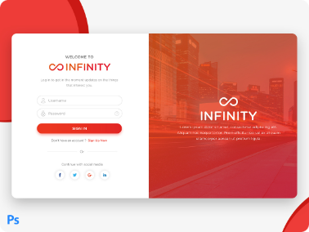

Login Page: Completed
User Authentication
User Profiles
Session Management
The login page is fully functional, handling user authentication securely. Users can enter their credentials, which are validated against a database. This ensures only authorized users can access the game.
Each user has a unique profile associated with their account. The login page allows users to manage their profiles, including updating their usernames, passwords, and other personal information.
The login page incorporates session management techniques to maintain user sessions. Once logged in, users are automatically recognized and authenticated for subsequent game interactions.

Slide 3

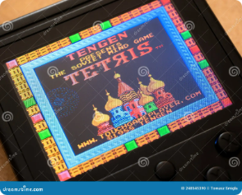


Python Tetris: In Progress
Gameplay Enhancements
Game Logic
We are working on adding features to enhance gameplay, such as different game modes (e.g., timed mode, marathon mode), level progression, and special power-ups.
The core game logic has been implemented. This includes the tetromino shapes, movement controls, and line clearing.
1
2
3
Graphical User Interface (GUI)
A GUI using a Python library like Pygame is being developed to provide a visually engaging experience for players. This includes displaying the game board, and tetrominos.

Slide 4

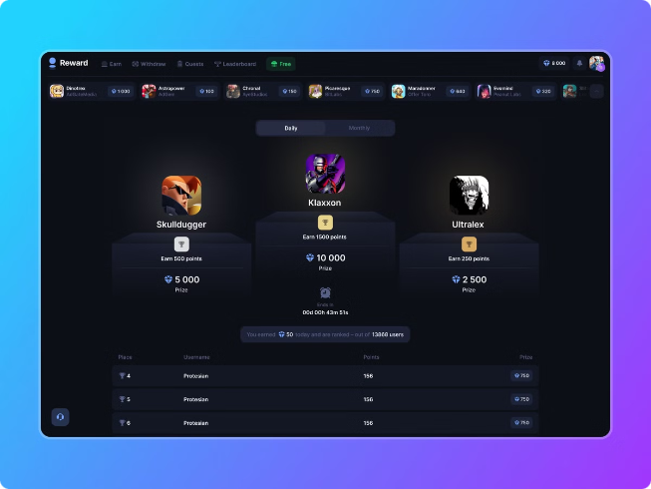

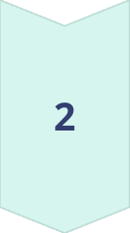
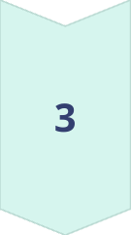

Leaderboard System: Next Step
Data Structure
The leaderboard system will be built using a suitable data structure, such as a database or a file system, to store player scores and rankings.
Score Retrieval
The game will retrieve player scores and update the leaderboard in real-time, ensuring that players can see their position and progress.
Display and Sorting
The leaderboard will be visually displayed within the game interface. Players can sort the leaderboard based on different criteria, such as score, level, or time taken.

Slide 5

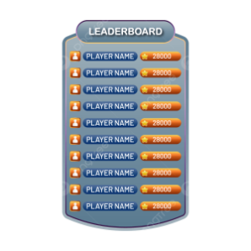

Leaderboard System Features
Real-Time Updates
The leaderboard will reflect changes in scores immediately, providing players with instant feedback on their progress.

Slide 6

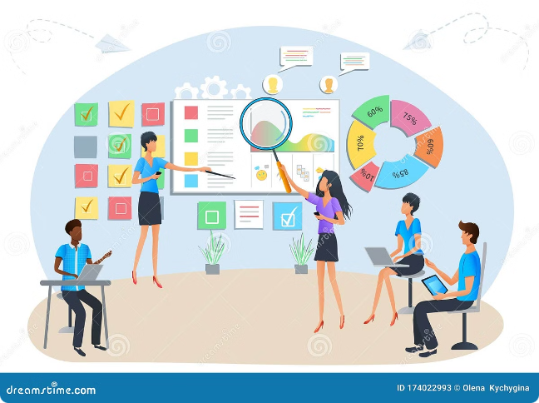
Challenges Faced and Overcome
Challenge
Solution
Efficiently handling user input and game logic.
Implemented a robust event handling system and a well-defined game loop.
Ensuring smooth game performance with complex graphics.
Optimized the game code for efficiency, reducing redundant calculations and using resource-efficient libraries.
Designing a user-friendly interface that is visually appealing and easy to navigate.
Utilized a design library with pre-built UI elements and conducted user testing to gather feedback.

Slide 7

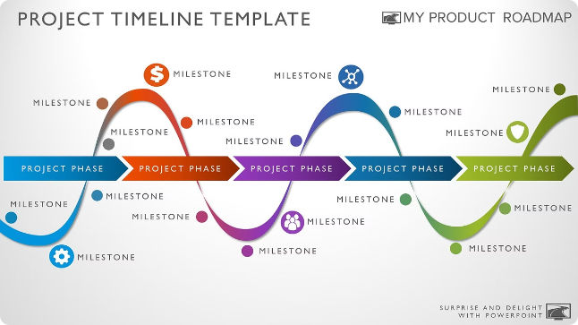


Next Steps and Timeline
1
Leaderboard Development
Complete the development of the leaderboard system, including data storage, retrieval, and display logic. This is expected to be completed within the next two weeks.
2
Game Testing and Refinement
Conduct thorough testing of the completed Tetris game and leaderboard system. This includes testing various game scenarios, bug fixing, and user feedback. This phase is expected to take three weeks.

Slide 8









Conclusion and Takeaways
Progress Made
Significant progress has been made on the Tetris game development, with the login system completed and the core game logic implemented. The leaderboard system is the next major focus.
Teamwork
The success of this project hinges on collaborative teamwork, effective communication, and the dedication of everyone involved.
Future Goals
We aim to deliver a high-quality Tetris game with an engaging gameplay experience and a functional leaderboard system that encourages competition and social interaction.

