Slide 1
Hangman game
Parul Institute of Computer Applications
Semester 2 Project -1
2022-23
Team members
1. 2205101100152 Dipesh Rauniyar Division: G
2. 2205101100103 Raghav Mahajan Division: G
3. 2205101100104 Rahul Singh Division: G

Slide 2
INDEX
Abstract
Tools and Technology Used
Features of Proposed System
Limitation of Proposed System
Users and their role description
System Flow Diagram
Data Flow Diagram ( All Levels)
Use Case Diagram
Data Dictionary
Screenshots of Development Phase 1 ( Designing of your Project)
Screenshots of Development Phase 2 ( Features Implementation)

Slide 3
Abstract
The Hangman game project is an engaging and interactive game that is designed to help users improve their language skills, vocabulary, and spelling. The game can be built using the Python programming language and it’s some libraries, which provide a range of features and tools to create an immersive and visually appealing game experience.
The game offers multiple levels of difficulty, word categories, and game modes to cater to the diverse needs and preferences of the users. The game's hint system, high score tracking, and user profiles provide motivation and feedback to the users, keeping them engaged and challenged.

Slide 4
Tools and Technology Used
Python programming language: Python is a popular programming language used for developing games, web applications, and other software projects. It's easy to learn and use, has a large and active developer community, and offers a wide range of libraries and modules that can be used to create various game features.
Integrated Development Environment (IDE): An IDE is a software application that provides a comprehensive environment for developing and testing software projects.
Database Management System: A database management system can be used to store and manage game data, such as player scores, game progress, and high scores.
Git Hub: It is simply used for group contribution for the hangman game system.

Slide 5
Features of Proposed System
User-friendly interface: The game should have a simple and intuitive interface that allows users to navigate and play the game easily.
Registration : Data of the player or user is saved from registration page to use it as user authentication while logging to the game.
Login :Only the authenticate user are allowed to login and play the game
Score System: Scores are obtained on the basis of right guess and there is also a negative scoring system provided in it.
2D Animation: The game is implemented in a 2d format so that the user won’t be bored as many 1d animation games or console games are very boring for user to play.

Slide 6
Limitation of Proposed System
Limited Word Database: One of the main limitations of the Hangman game project is the size of the word database. Depending on how many words are included in the game, users may find themselves repeating the same words or running out of new words to guess. Expanding the word database would require additional time and effort to gather and curate new words.
Lack of Sound Effects and Visuals: The Hangman game project may lack engaging sound effects or visually appealing graphics, which could limit the user's engagement and enjoyment of the game.
Difficulty Level may not be Appropriate for all Users: The game's difficulty level might be too high for some users, which could lead to frustration and a lack of motivation to continue playing. At the same time, the difficulty level may be too easy for more advanced users, which could limit the challenge and entertainment value of the game.

Slide 7
Limited Multiplayer Functionality: If the game only allows one player to play at a time, this can limit the enjoyment of who want to play together. Additionally, players may not be able to play against each other online, which could be a drawback for users who want to compete with others remotely.
Lack of Customization Options: The game may not offer many options for customization, such as the ability to change the background or add additional game modes. This could limit the game's replay value and user engagement.

Slide 8
Users and their role description
User/Player
The player's role in this system is to guess the hidden word by suggesting letters that might be part of the word. The player is also expected to keep track of how many wrong guesses they have made, so they can avoid getting the hangman drawn and losing the game.

Slide 9
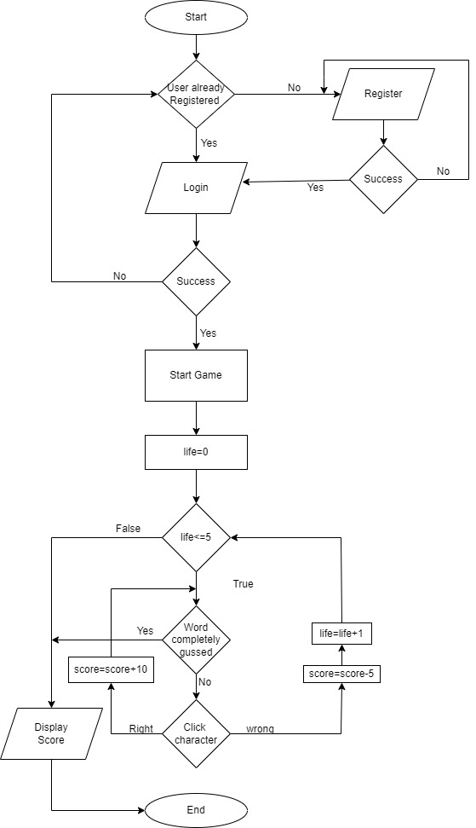
System Flow Diagram
Figure 1. System Flow Diagram of Hangman Game

Slide 10
The above figure shows that the applications start and primary it goes for conditional checking It checks it the user is registered or not. If not registered then the user need to register for accessing .If user is registered then they go for login. If the login is successful then it goes to the start game page. If not then they need to check the credentials if wrongly typed. After start page of the game the game runs and the life the player has total would be smaller then and equal to 5. Now according to guessed characters the user gain points or losses the pointes. After losing or winning the score is displayed .

Slide 11
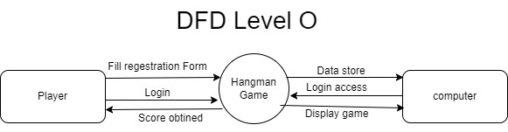
Data Flow Diagram ( All levels of DFDs)
Figure 2. Data Flow Diagram level 0 of Hangman Game
The above figure shows the DFD level 0. Where the player can register, login and obtain score from the system hangman game. The data obtained from user or player is stored in the external entity called computer. The login access and display shown is also carried out by it.

Slide 12
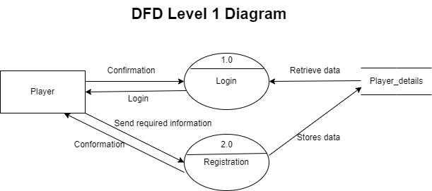
Figure 3. Data Flow Diagram level 1 of Hangman Game
The above diagram show the DFD level 1 diagram where the player request for login and the process is carried out by the login process which retrieves the data from database which is stored in Player_details. The player can also register for the system by simply sending required information to the system process and the information is saved in Player_detail database. If every then is correct in this process then the process called registeration request for conformation to the player.

Slide 13
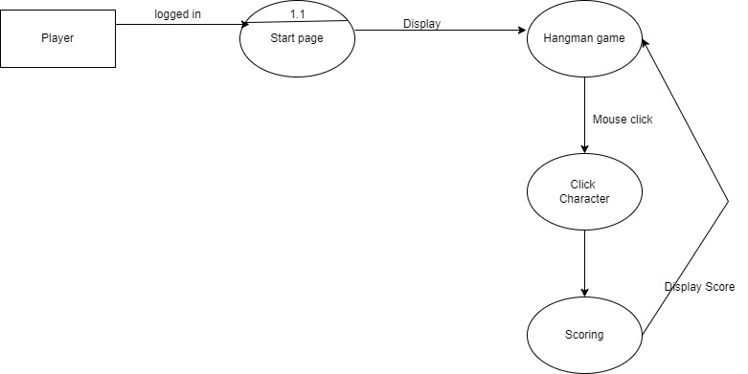
DFD Level 2 Diagram
Figure 4. Data Flow Diagram level 2 of Hangman Game
The above figure shows DFD level 2 diagram of the hangman game. Here the player is logged in to the system and the hangman game is shown where the player need to click the character to obtain score. The score is displayed by the hangman game.

Slide 14

Figure 5. Data Flow Diagram level 2 of Hangman Game
The above figure shows us the player entity can add new user and if every information is correct or not . After conformation the data is stored in the database named Player_details.

Slide 15
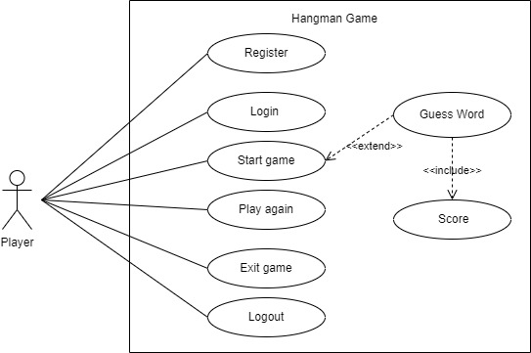
Use Case Diagram
Figure 6. Use Case Diagram of Hangman Game
The above figure shows that the player actor can register, login ,start the game, play again, exit the game and logout. And the start game includes guessing of words and the guessed words includes scores.

Slide 16
Data Dictionary
1. Player_details
Sr.no | Column | Data type | Size | KEY | Constrain | Description | example
1 | Player_id | Int | - | PK | Al | Primary key of table | 1
2 | First_name | Varchar | 20 |  | Not Null | First name of user | James
3 | Last_name | Varchar | 20 |  | Not Null | Last name of user | Bond
4 | Contact_no | Varchar | 13 |  | Not Null | Contact Number with Country Code | +91 9876543210
5 | Email | Varchar | 30 |  | Not Null | Email of player | James123@gmail.com
6 | User_name | Varchar | 20 |  | Not Null | User Name | champion
7 | Password | Varchar | 10 |  | Not Null | Password | ******
Table 1 : Player_details

Slide 17
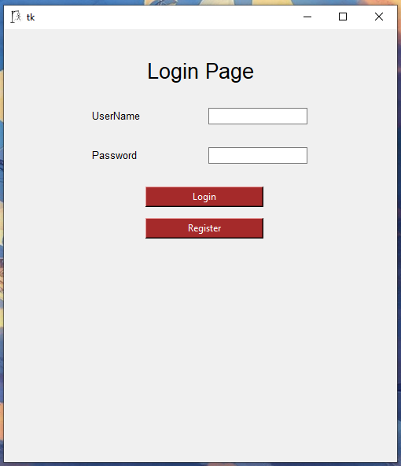
Screenshots of Development Phase 1
1. Login Page Design
Figure 7 Login Page Design

Slide 18
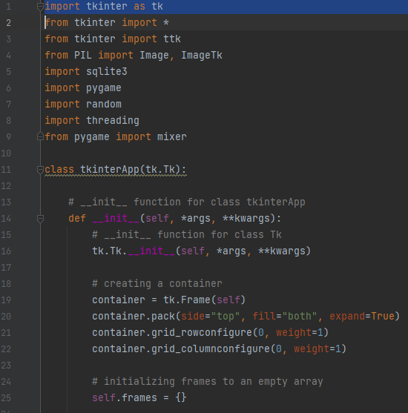
2. Code of Login Page
Figure 8 Code of Login Page

Slide 19
In this section we imported various modules / libraries for different purpose. The module tkinter are used for GUI (Graphical User Interface), were as PIL /Pillow library is used for inserting images into the frames of software, Sqlite3 is used for storing the information obtained from players/users to further use it for authentication processs. Pygame modules are simply used to create 2d games .random module is used to choose random items. Threading is used for creating some time based intervals takes to be done. To Switch from different frames in tkinter we created a class called tkinterApp and as argument we provided tk.Tk which is used to create custom commands to create and manipulate GUL widgets. After that in tkinterApp class we created an __inti__ function which is used to take values for the user and store it in identifiers. In it we also created containers and provided different parameters for the container. The frames are we created a empty array so that we can iterate the frames one by one.

Slide 20
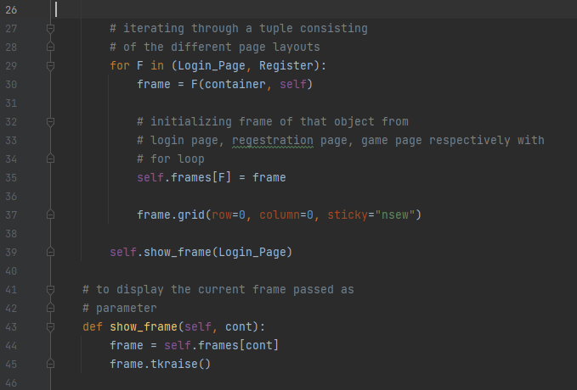
Figure 9 Code of Login Page
The frames are iterated using for loop and another function called show_frame was created so that the frames would be raised / displayed according to given commands. The code in line 39 shows that which page to show while first opening the software which is login page.

Slide 21
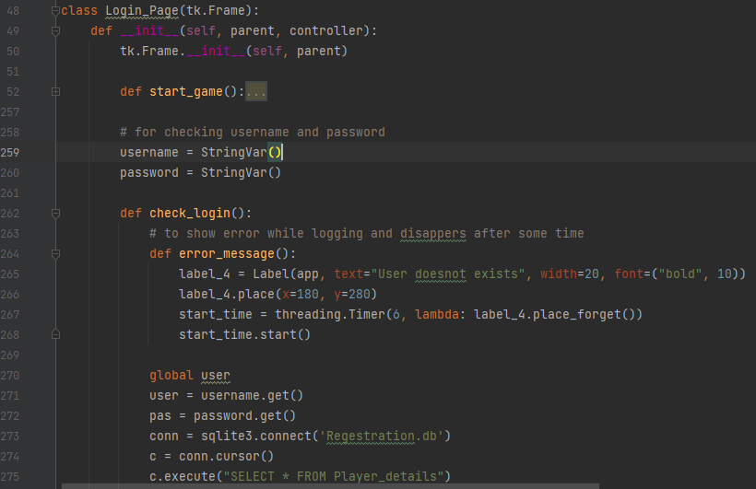
Figure 10 Code of Login Page
For Login Page we create a class called Login_Page for frame. In it we created a function to check the logging authentication so for that we first connected to the existing database called Registration.db and compare it with the existing data from the database for username and password. In the figure we also create function for error message to show error if the user entered wrong credentials and the error message is removed after 6 sec of showing which was implemented with the help of threading library.

Slide 22
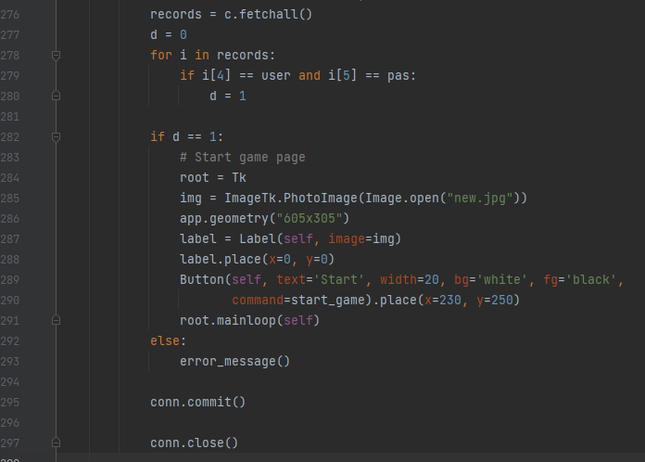
Figure 11 Code of Login Page
If the user has entered correct credentials then the program will go to start page

Slide 23
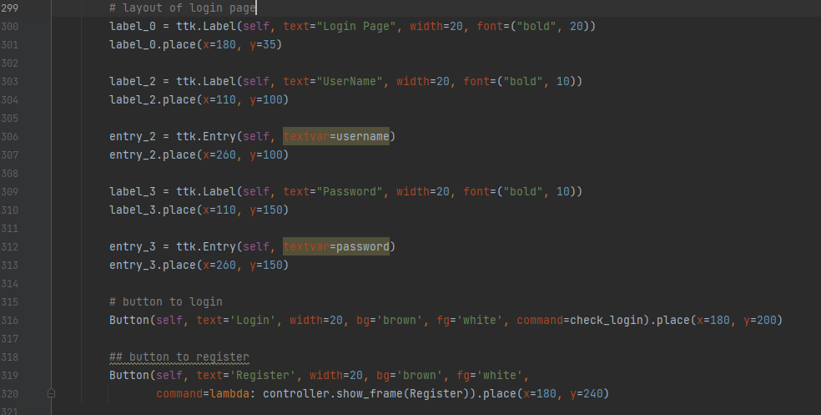
Figure 12 Code of Login Page
This image shows the codes used for creating logging page layout.

Slide 24
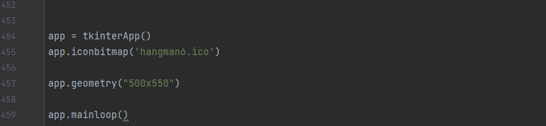
Figure 13 Code of Login Page
This is the last part for creating a frame and display it simply show that we have implemented icon to the system and it also includes the frame size .

Slide 25
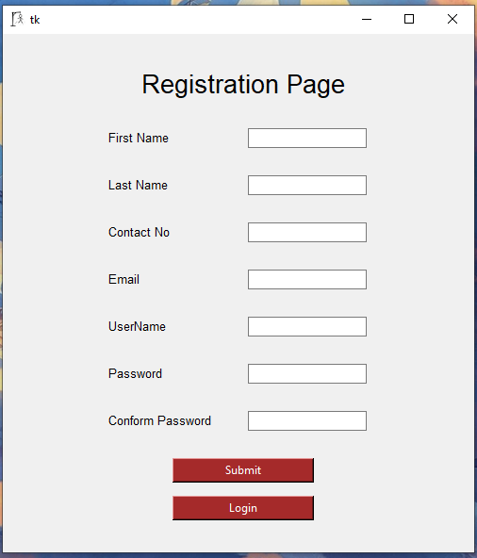
Screenshots of Development Phase 2
1. Registration Page Design
Figure 14 Registration Page Design

Slide 26
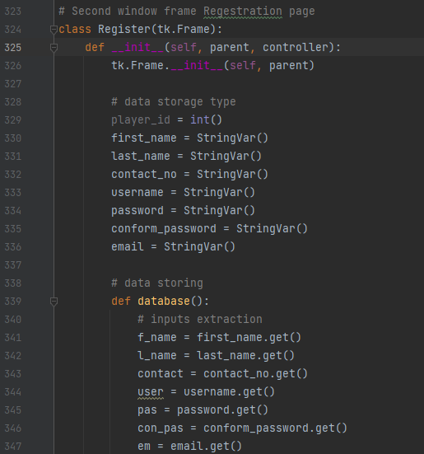
2. Code of Registration Page
Figure 15 Code of Registration Page

Slide 27
Figure 16 Code of Registration Page

Slide 28
The above images show that for creating a registration page we created a function called register where we first start with creation of database if doesn’t exist. After that we declared the variable data type which will be further be used for storing it in sql database. To store the data in sql we created another function called database where we declared another variables that will be used to store the information obtained from entry widget. In this function we connected our database called registration.db and started to create table called Player_details and required table headers if not previously created along with its data type and constrains. If the database and table is already created then if fetches all data for further use. Then we created another function called error_message_repage which simply returns error messages case the user didn’t fill a box or the user and email already exist.

Slide 29
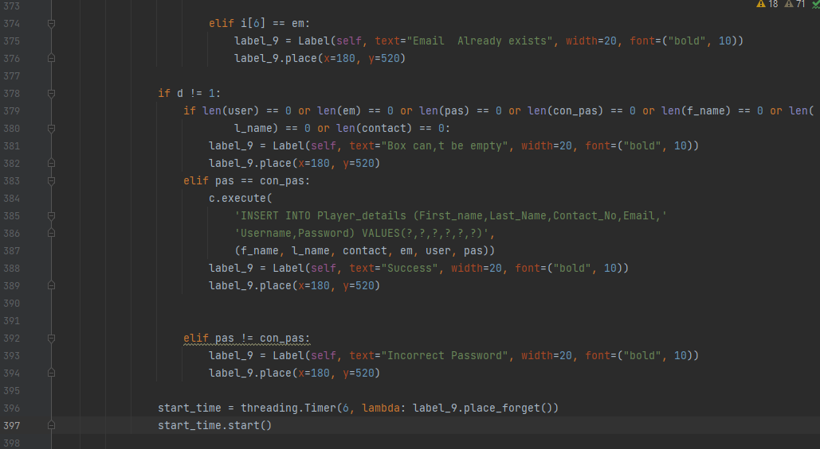
Figure 17 Code of Registration Page
If all fields are correctly typed then the data is now stored in table Player_details and shows message success. The error or success messages are disappears after some interval

Slide 30
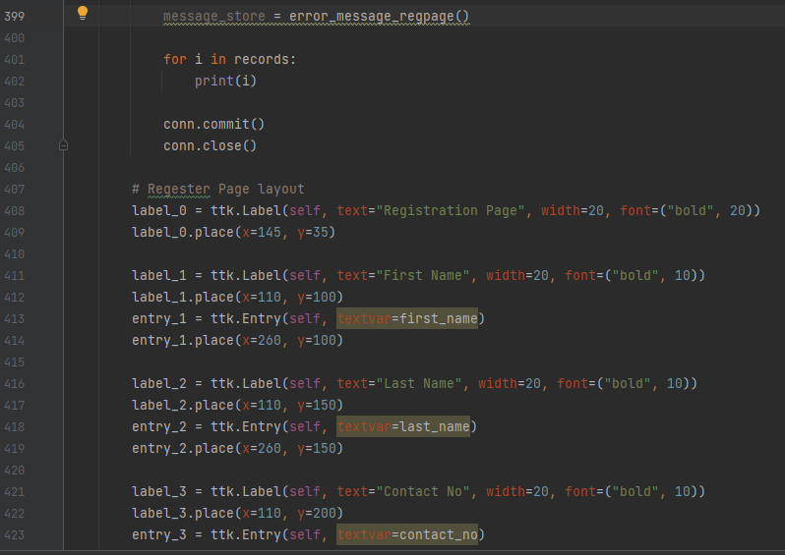
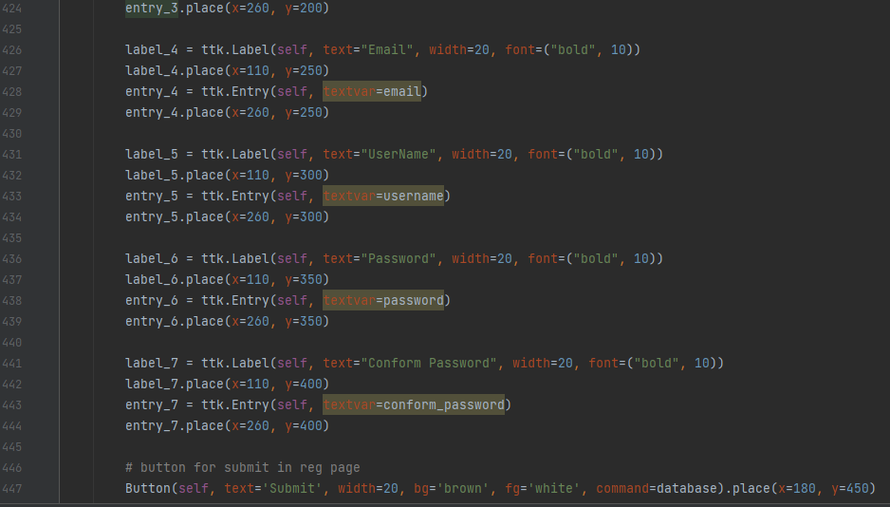

Slide 31

Figure 18 Code of Registration Page
The database if finally closed at last and after that all the codes are about the layout of registration page.

Slide 32
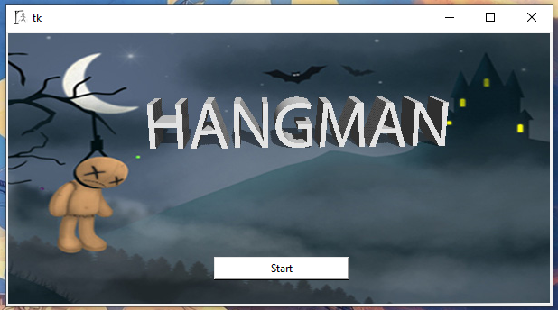
3. Game Design
Figure 19 Game Design

Slide 33
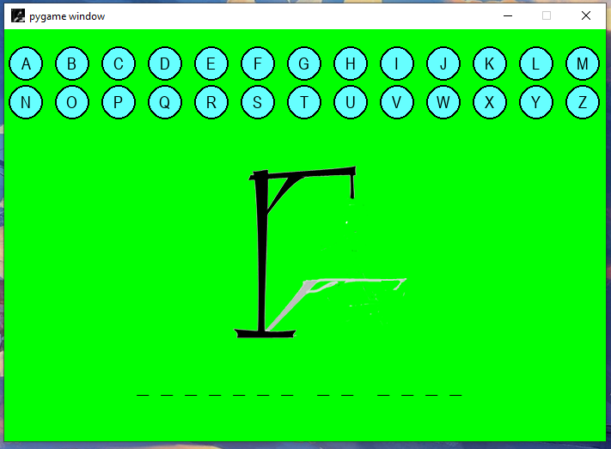
Figure 20 Game Design

Slide 34
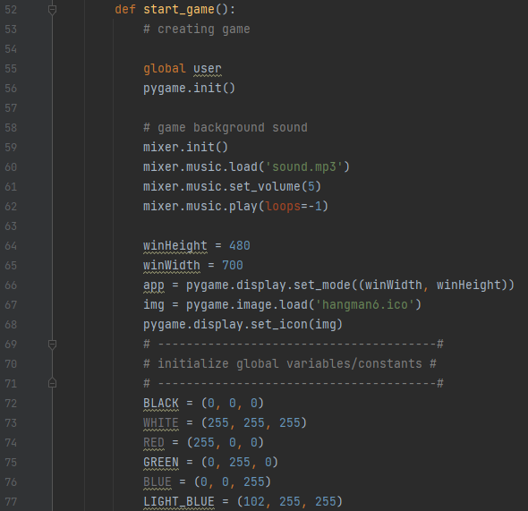
4. Code of Game
Figure 21 Code of Game

Slide 35
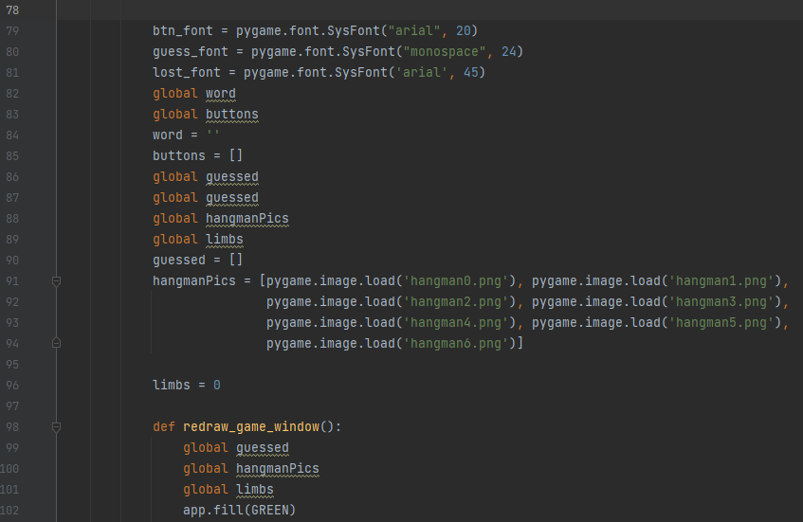
We have created a function called called start_game so that the game can be called again and again if required. For game windows we have used init function of pygame which simply creates a window for game after that we have implemented background sound for that we used the mixer.music module. And for continuous playing of music we just loop if giving value -1 which does the same work. We then provided the windows display size and icon for the game. After that we provided different color variable to be used in the game
Figure 22 Code of Game

Slide 36
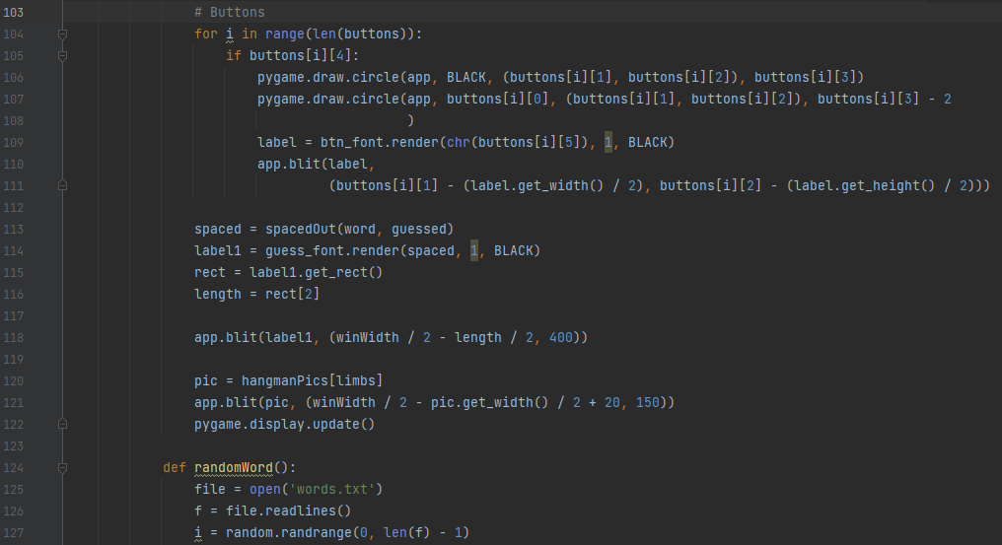
After that we gave the font type to the button and font going to be displayed in the game windows. We stored all the hangman image in an array for iterating it according to requirement in logic section. Then we created a function called redraw_game_window so that the window of the game can be updated time to time and set the background color green
Figure 23 Code of Game

Slide 37
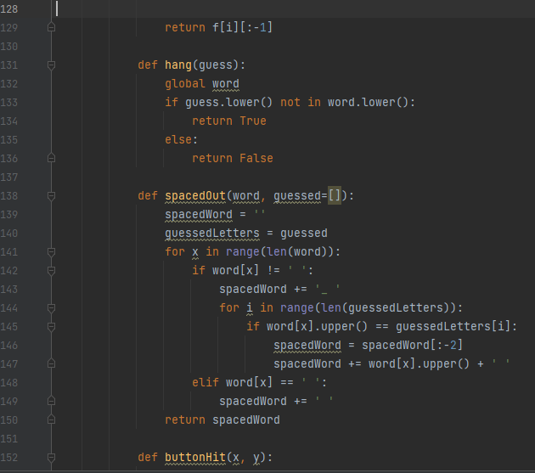
After that we started to create the button for the game for that we used for loop for creation of the button. Bellow the button we created a area for the hangman image to be shown. Then for words guessing we created another function called randomWord which consist of file handling operation where we created a dot txt file called word.txt and store the words we need to be used in the game.

Slide 38
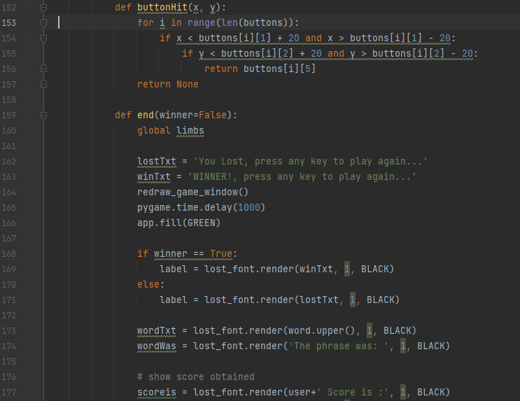
We created a hang function where we gave an argument called guess where we check if the guessed word matches with the work clicked and returns true if right guess. The another function called spacedOut is created for storing the guessed words for that we gave empty array as argument
Figure 25 Code of Game

Slide 39
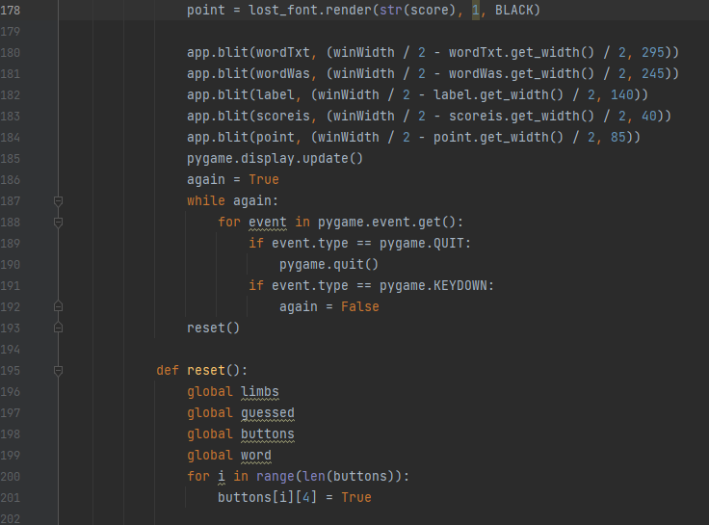
Figure 26 Code of Game
Next function is buttonHit which simply tracks which buttons are clicked and return that button. The function end simply is for showing the Winning or loosing text with the scores obtained along with username used for logging in and to play gain the user need to press any key. The reset function simply empties the array or makes the required variables null.

Slide 40
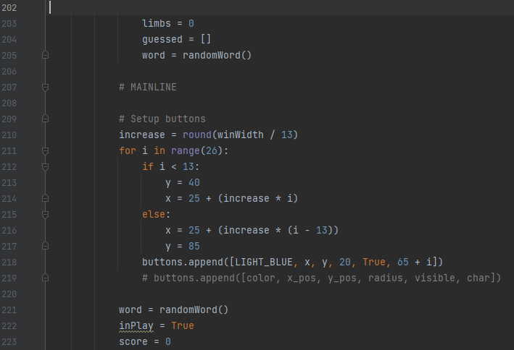
Figure 27 Code of Game
Not only the variable and array are made null but also resets the buttons that were clicked for guess and after all required objects are reset the game can be played again

Slide 41
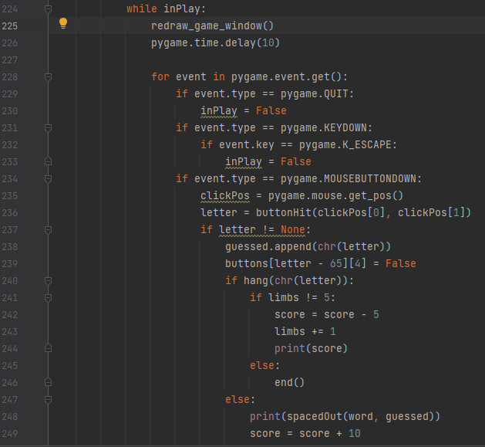
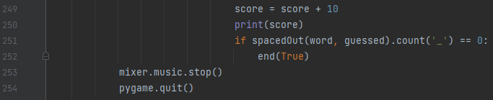
Figure 28 Code of Game

Slide 42
The while loop is implemented until the game is going on all game events are checked one by one using for loop and at last background music is stopped and game quits.

Slide 43
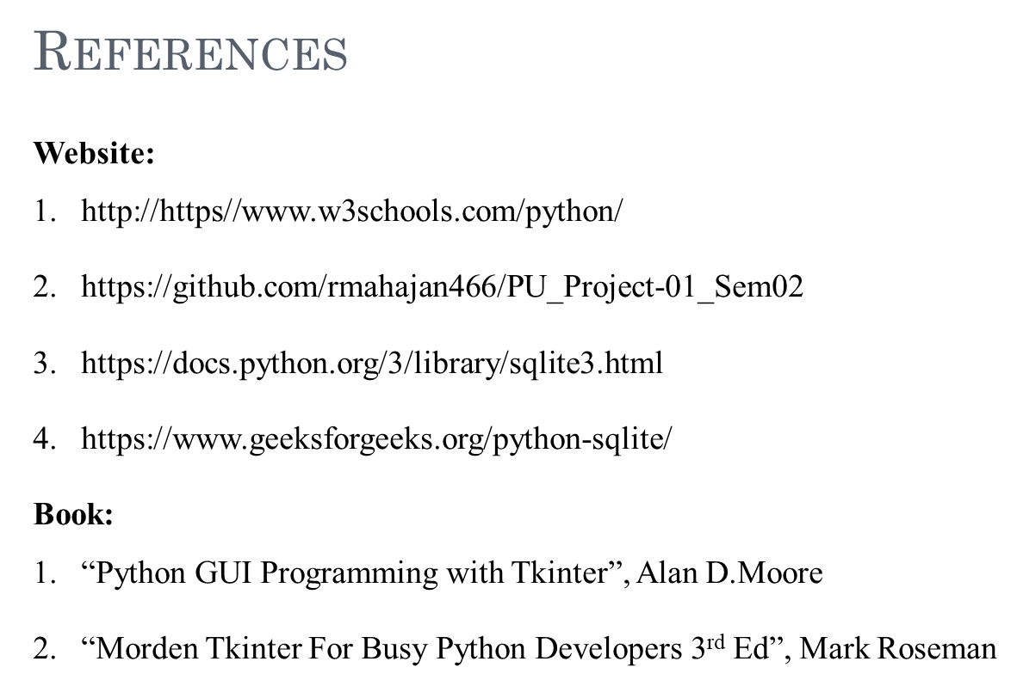

Slide 44
Thank You

