Slide 1
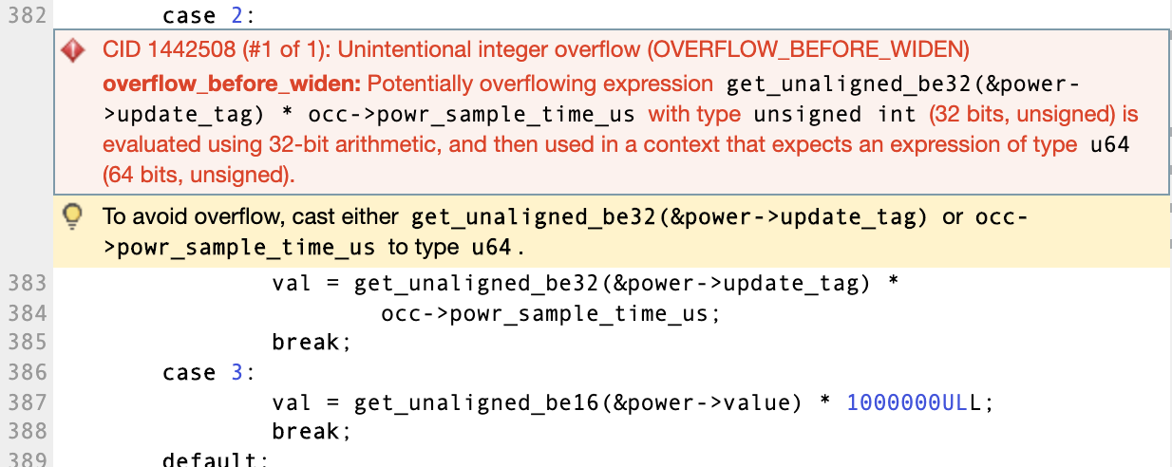
A Synopsis of Static Analysis Alerts On Open Source Software
Nasif Imtiaz, Laurie Williams
{simtiaz, lawilli3}@ncsu.edu Department of Computer Science, North Carolina State University
How Do Developers Respond to Static Application Security Testing (SAST) Tool Alerts?
Half of the state-of-the-art open source projects use SAST¹
Alerts are often not actionable² (important to developers to act upon)
The goal of this research is to aid researchers in improving the usability of static application security testing tools by looking at what type of static analysis alerts are most likely to be acted on by OSS developers.
Research Questions
Findings
What are the alert types that are most often introduced, triaged, and eliminated?
What are the alert types that are most likely to be unactionable?
What is the median lifespan of each alert type?
Are security alerts more likely to be triaged and eliminated than non-security alerts?
Most Introduced → Control Flow Issues ← Mostly Intentional
Most Triaged → Memory Illegal Access ← Mostly False Positive
Most Eliminated → Performance Inefficiency ← Shortest Lifespan
Most Likely Bug → Null Pointer Dereferences ← Short Lifespan
Our cross-project comparison indicates that an alert being marked as a security issue by the tool does not affect its likelihood of getting fixed or its lifespan.
Dataset
5 projects – Linux, Firefox, Qt, Samba, Kodi
Projects use a free SAST service – Coverity Scan
Written in C/C++
At least 100 analysis reports over last 5 year
24 alert categories
Developers’ triage history on Coverity Scan defect database
References
[1] Moritz Beller, Radjino Bholanath, Shane McIntosh, and Andy Zaidman. 2016. Analyzing the state of static analysis: A large-scale evaluation in open source software. In 2016 IEEE 23rd International Conference on Software Analysis, Evolution, and Reengineering (SANER), Vol. 1. IEEE, 470–481.
[2] C. Sadowski, E. Aftandilian, A. Eagle, L. Miller-Cushon, and C. Jaspan. Lessons from building static analysis tools at Google. CACM, 2018.

