Slide 1
How Do Developers Act On Static Analysis Alerts? An Empirical Study of Coverity Usage
Notes:
Hello, thank you everybody for coming here. I am Nasif Imtiaz. And the title of my work for this presentation is “…”. This work has been accepted at ISSRE 2019 which is a software engineering conference focused on software security and reliability and the conference is to be held in October.

Slide 2
Presentation outline
Problem background
Research questions
Related work
Dataset and methodology
Findings
Threats to validity
Key Takeaways
Notes:
So a quick look at the presentation outline. I will start with talking about the background and then will move on to the actual analysis and the findings.

Slide 3
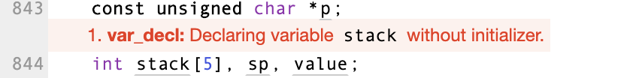
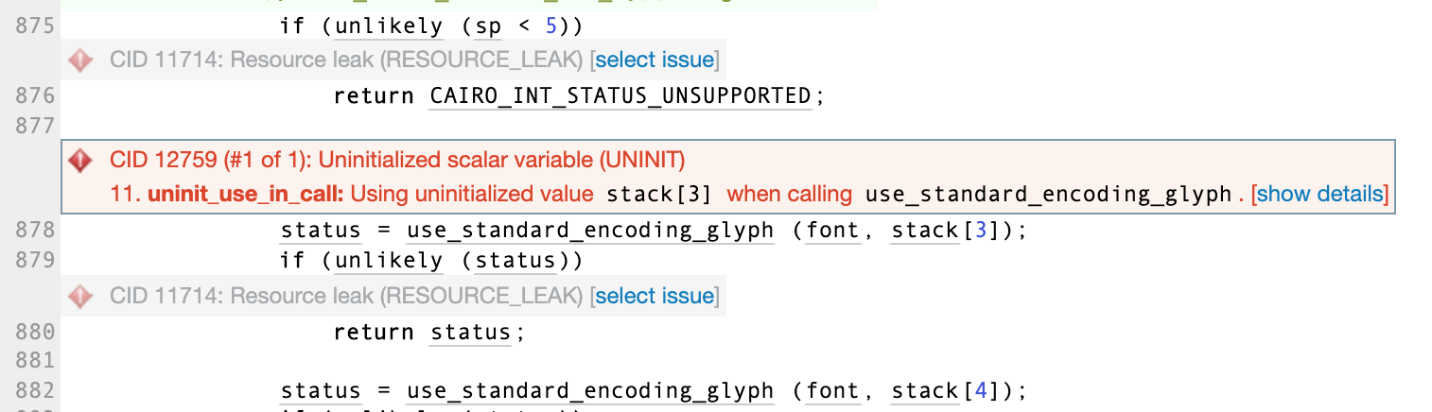
Static analysis tool
Analyzes the code without running it
Commonly includes data-flow, control-flow analysis, pattern matching etc.
Finds potential security, performance, and reliability errors (alerts)
Used alongside other testing methods (e.g. dynamic analysis, code review)
Find defects early in the development process (a part of shift-left testing)
Notes:
So, let us first look at what is static analysis alert? It theoretically means analyzing the code without actually executing it and identifying code defects. So, you might have some linters in your IDE that warns you about style issues, and there are syntax errors that the compiler will catch. Those are static analysis as well by definition. But in the industry and the research community, when we actually say SATs, we normally mean tools that do more sophisticated analysis. Can be by looking at the syntax free, or the data flow analysis, or pattern matching of the text in the code. And these tools find defects like memory leak or dereferencing null pointers which can range from performance bottlenecks to serious security concerns.
So here is an example of a static analysis alert from our data set.

Slide 4
Downsides of static analysis tools
False positives
Trivial issues
Large volume of alerts

Slide 5
How do developers act on static analysis alerts?
Do developers care to fix?
Which alerts do they fix?
How much time they take to fix?
How complex are the fixes?
How do the developers prioritize the alerts?

Slide 6
The goal of this paper is to aid researchers and tool makers in improving the utility of static analysis tools through an empirical study of developer action on the static analysis alerts.

Slide 7
What data do we need?
Historical data
Developers working in the real-world
Developers actively using a static analysis tool

Slide 8
Our dataset
Coverity
State-of-the-art static analysis tool
Maintains alert history in a database for individual projects
Five open source projects
Linux, Firefox, Samba, Kodi, and Ovirt-engine
Four C/C++, one Java project
Maintainers confirmed they monitor Coverity alerts

Slide 9
Research questions
(Actionability) Which Coverity alerts are fixed by the developers through code change?
(Lifespan) How long do Coverity alerts remain in the code before being fixed?
(Fix complexity) What is the complexity of the code changes that fix a Coverity alert?
(Prioritization)
Do Coverity alerts with higher severity have shorter lifespan?
Do Coverity alerts with lower fix complexity have shorter lifespan?

Slide 10
Actionable alert: An alert that developers fix through code changes
Actionability: The rate of actionable alerts over total alerts

Slide 11
Related work
Researchers run static analysis tools on historical code versions of a project and measure actionability of alerts:
Liu et al. find actionability to be < 1% [TSE2018]
FindBugs on 730 Java projects
Kim et al. find actionability to be 6% to 9% [FSE2007]
3 tools on 3 programs
When developers are using a static analysis tool:
Marcillo et al. studied 248 Java projects from SonarQube database and find actionability to be 13% and lifespan 19 days [ICPC2019]

Slide 12
What do we add?
Current actionability scenario
Historical data from large-scale projects when developers are actively using the tool
C/C++ projects
Map alert history to code change history
An analysis of fix complexity

Slide 13
Our dataset
Coverity
State-of-the-art static analysis tool
Maintains alert history in a database for individual projects
Five open source projects
Linux, Firefox, Samba, Kodi, and Ovirt-engine
Four C/C++, one Java project
Maintainers confirmed they monitor Coverity alerts
Data from at least past five years:
Alert history
Code history

Slide 14
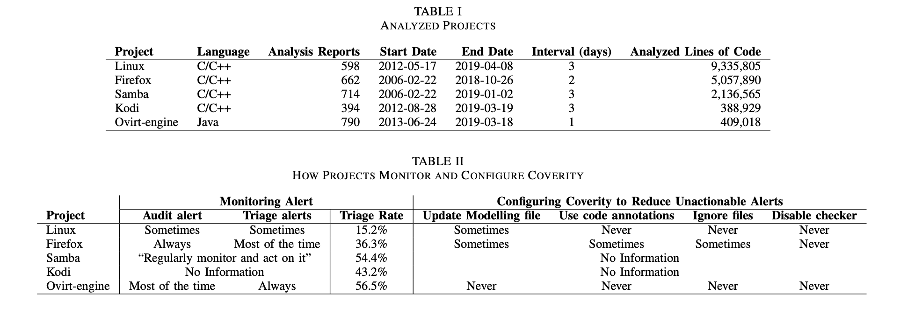
Open source projects using Coverity

Slide 15
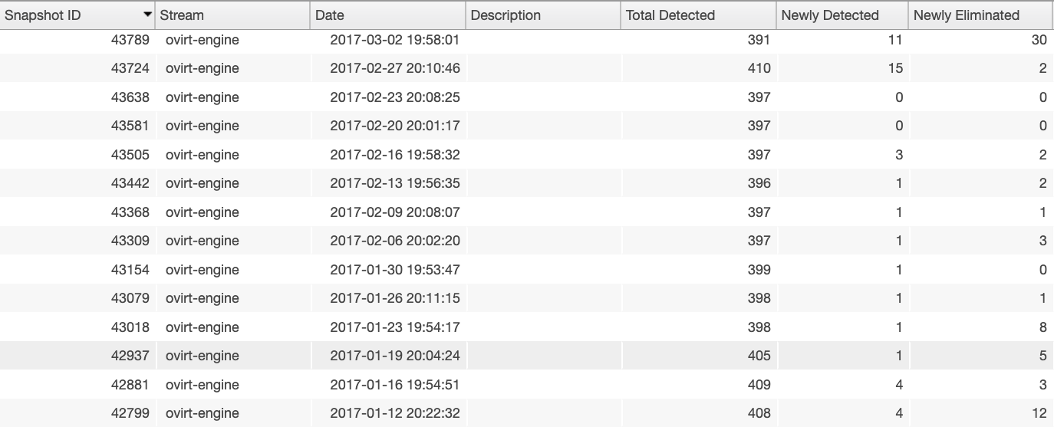
Analysis history on Coverity database

Slide 16
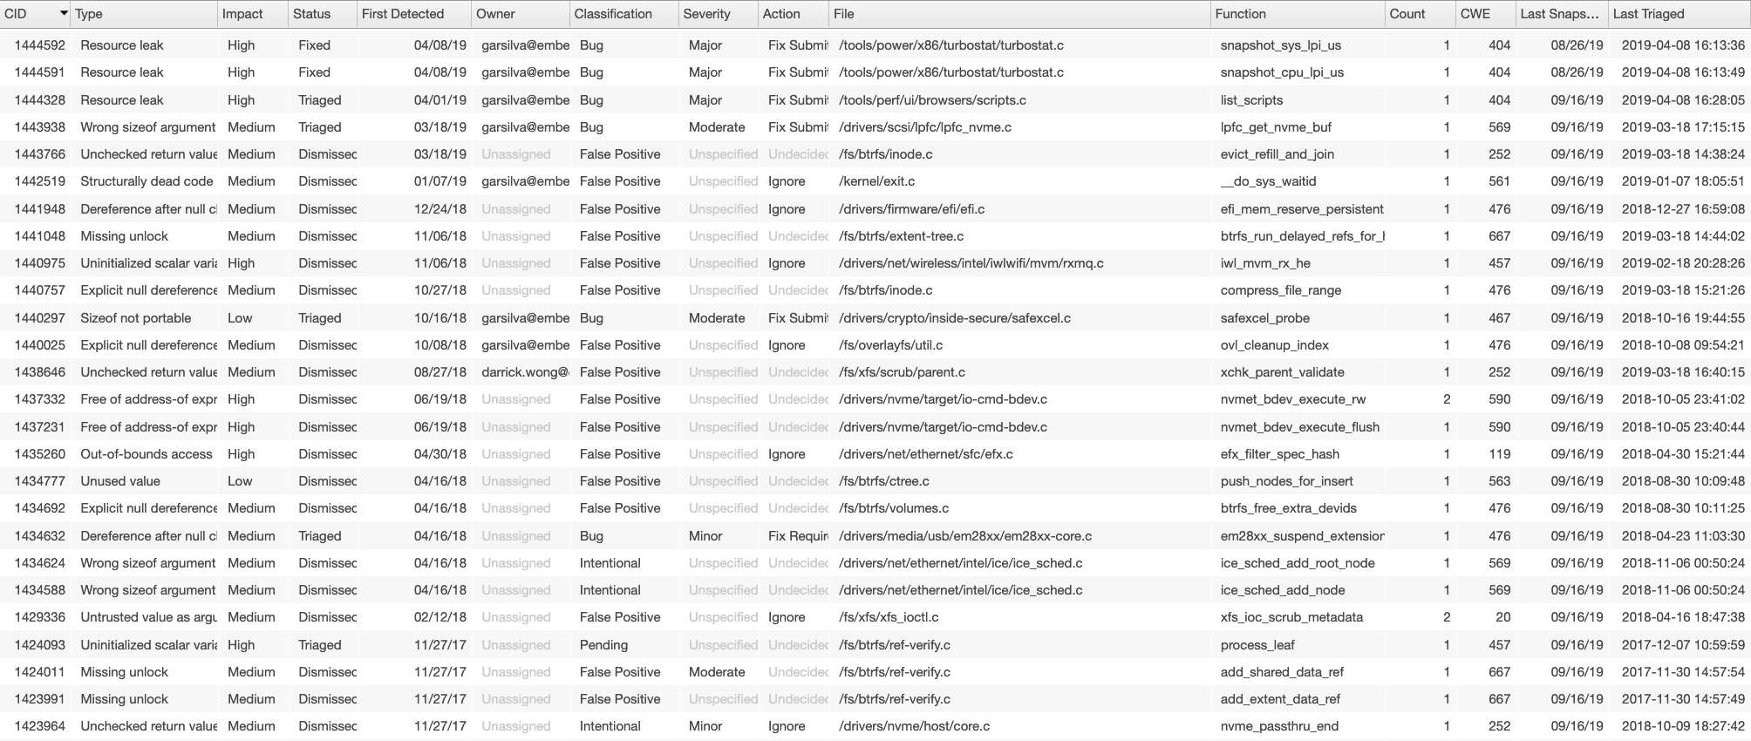
Alert history on Coverity database
Unique alert id, alert type, severity, status (fixed/dismissed/new), date when first detected, a classification given by the developers (e.g. bug/false positive or unclassified by default), file location, date when last detected

Slide 17
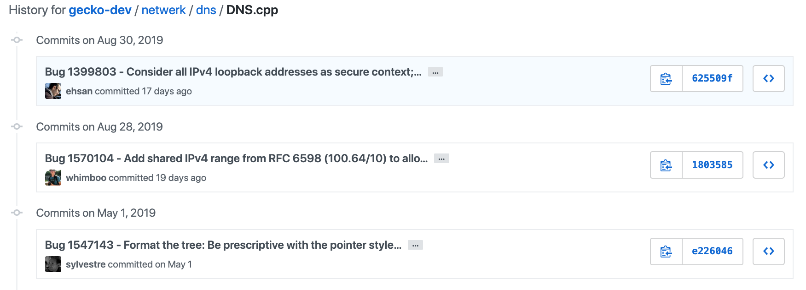
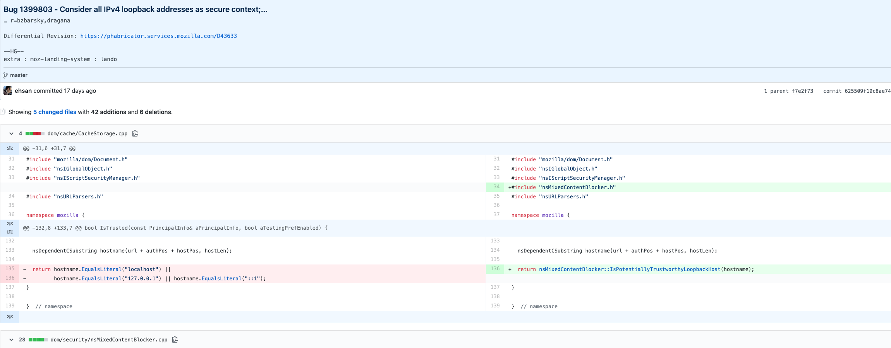
Code change history of a file

Slide 18
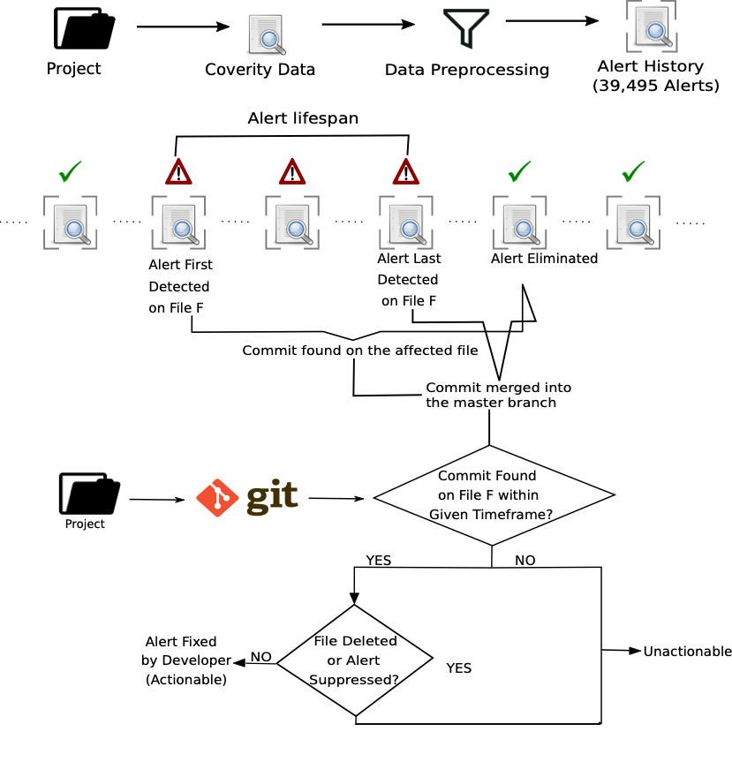
How do we determine actionability and lifespan?

Slide 19
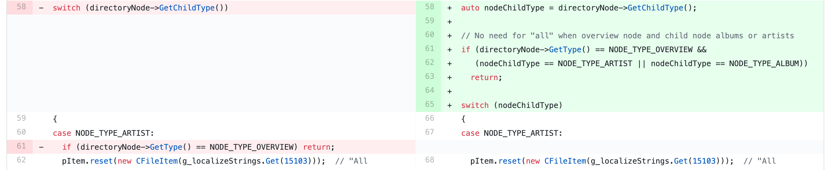
How do we determine fix complexity?
Track “fix commit”
If only one commit found on the affected file when the alert gets fixed
Metrics (adopted from Li et al. [CCS2017]):
No. of affected files
Total lines of code (LOC) change
Total logical change
In-file lines of code (LOC) change
In-file logical change
One logical change

Slide 20
Findings

Slide 21
Findings: Actionability
Project | Total Alerts | Eliminated Alerts | Actionable Alerts | Triaged as Bug
Linux | 17,133 | 60.3% | 36.7% | 3.6%
Firefox | 12,945 | 73.6% | 48.4% | 8.2%
Samba | 4,186 | 73.0% | 27.4% | 2.4%
Kodi | 2,325 | 66.2% | 49.5% | 15.9%
Ovirt-engine | 2,906 | 44.8% | 31.3% | 2.6%
Triaged as bug $⊂$ Actionable alerts $⊂$ Eliminated alerts $⊂$ Total alerts

Slide 22
Unactionable alerts
Project | Total Alerts | Unacti-onable Alerts | Alive alerts | Triaged as false positive | Triaged as intenti-onal | File deleted | Suppres-sed in code | Eliminated through undeterm-ined ways
Linux | 17,133 | 61.0% | 26.4% | 4.3% | 4.6% | 2.0% | 0.9% | 22.8%
Firefox | 12,945 | 50.9% | 9.7% | 7.4% | 7.6% | 1.7% | 0.7% | 23.8%
Samba | 4,186 | 72.6% | 21.6% | 2.5% | 1.7% | 1.9% | 0.1% | 44.7%
Kodi | 2,325 | 50.2% | 16.0% | 3.6% | 13.7% | 4.1% | 0.0% | 12.8%
Ovirt-engine | 2,906 | 68.4% | 3.7% | 44.0% | 7.0% | 0.9% | 0.3% | 12.5%
For many unactionable alerts that were eliminated, we do not know how exactly they were eliminated
Recent alerts which are alive for less time than the median lifespan of the project, we do not classify them as either actionable or unactionable

Slide 23
Findings: Lifespan (days)
Project | Actionable Alerts | Alerts Marked as Bug | Unactionable Eliminated
Linux | 245.0 | 184.0 | 231.0
Firefox | 124.0 | 64.0 | 174.0
Samba | 39.5 | 200.0 | 46.0
Kodi | 36.0 | 2.0 | 56.0
Ovirt-engine | 96.0 | 43.0 | 152.0
For Linux, Firefox, and Kodi, alerts marked as bug get fixed significantly faster than other alerts

Slide 24
Findings: Fix complexity
Project | Fix commit tracked | Affected Files | Net LOC change | Net logical change | In-file LOC change | In-file logical change
All Alerts
Linux | 2299 | 1.0 | 4.0 | 1.5 | 3.0 | 1.0
Firefox | 1835 | 3.0 | 40.7 | 11.0 | 5.0 | 1.7
Samba | 639 | 1.0 | 3.0 | 1.0 | 2.0 | 1.0
Kodi | 469 | 1.0 | 6.2 | 2.0 | 4.0 | 1.0
Ovirt-engine | 666 | 1.5 | 24.9 | 5.5 | 7.0 | 2.0
Alerts Marked as Bug
Linux | 294 | 1.0 | 2.0 | 1.0 | 2.0 | 1.0
Firefox | 345 | 1.0 | 9.5 | 3.0 | 4.0 | 1.5
Samba | 27 | 1.0 | 5.0 | 1.0 | 4.0 | 1.0
Kodi | 46 | 1.5 | 6.7 | 3.0 | 2.0 | 1.0
Ovirt-engine | 68 | 1.0 | 4.0 | 2.0 | 4.0 | 1.0

Slide 25
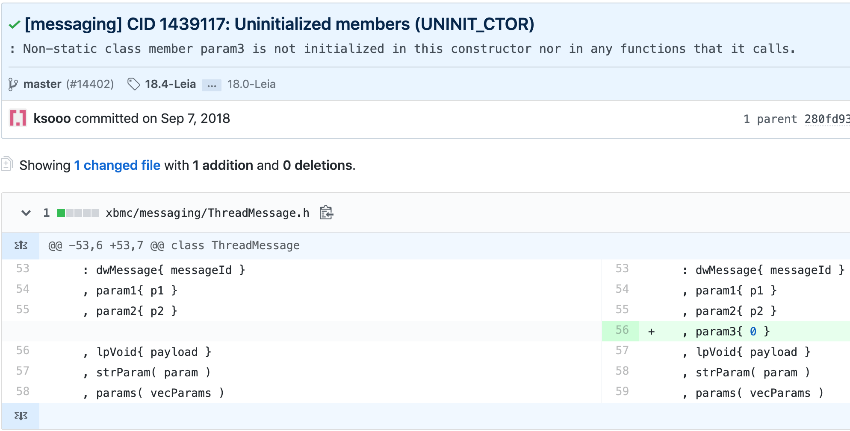
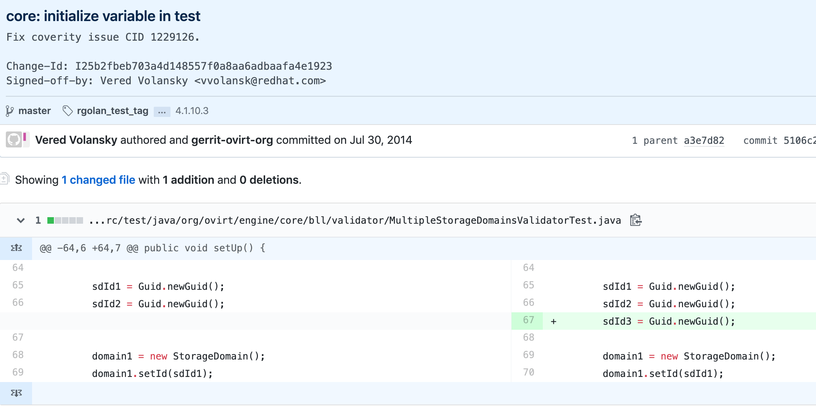
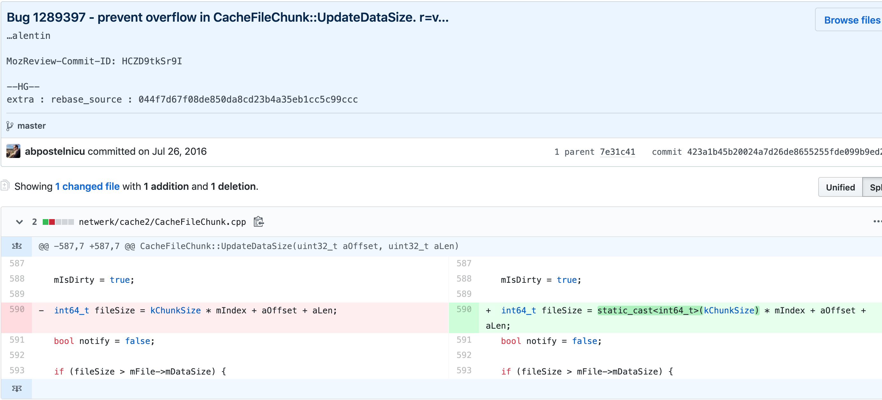
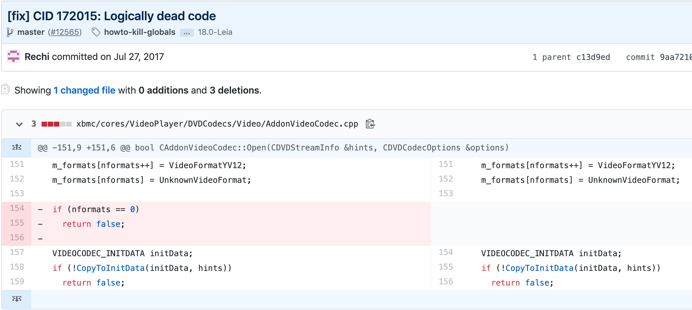
Example Coverity fixes from the developers

Slide 26

Findings: Do developers prioritize based on severity? (Spearman’s rank correlation for severity with lifespan)
Project | Correlation Coefficient ( r ) | High Alert Lifespan | Medium Alert Lifespan | Low Alert Lifespan
Linux | -0.02 | 217.0 | 248.0 | 206.0
Firefox | 0.0 | 154.0 | 89.0 | 105.5
Samba | -0.01 | 36.0 | 56.0 | 18.0
Kodi* | -0.29 | 2.0 | 26.5 | 416.0
Ovirt-engine | -0.03 | 89.0 | 77.0 | 129.0
* denotes statistically significant correlation

Slide 27
Findings: Do developers prioritize based on fix complexity? (Spearman’s rank correlation for fix complexity with lifespan)
Project | Affected files | Net LOC change | Net logical change | In-file LOC change | In-file logical change
Linux | 0.05 | 0.09 | x | 0.06 | x
Firefox | 0.17 | 0.20 | 0.20 | 0.12 | 0.07
Samba | x | 0.16 | 0.12 | 0.11 | x
Kodi | x | 0.15 | 0.10 | 0.22 | 0.20
Ovirt-engine | 0.40 | 0.44 | 0.44 | 0.18 | 0.20
x denotes statistically insignificant correlation,
The rest of the correlations are statistically significant

Slide 28
Threats to validity
We assume that if there is a code change in the affected file when an alert gets eliminated, developers have fixed the alert:
Code change can be unrelated to the alert
Code change can be made elsewhere to fix the alert
Accurately tracking fix commit for an alert
We manually investigate 25 instances from each project to validate our method
Generalizability threat
Coverity applies common static analysis techniques and catches a broad range of security and reliability alerts
Coverity is widely used in the industry

Slide 29
Feedback from an involved developer
your number match my gut feelings :)
you should be also aware that only two people were looking at coverity results (Andi and myself). It creates a strong bias as we aren't expert of all aspects of the code.
an interesting research area is "how many security issues found in the wild (CVE) were discovered by static analysis but not addressed?” - Senior Engineering Manager, Mozilla

Slide 30
Key Takeaways:
The actionability rate of static analysis tool in the real word is around 36.7%, better than previously reported, but still lags behind the ideal.
Fixes for static analysis alerts are low in complexity: 1 to 2 units of logical changes in the affected file.
Future research can be on estimating fix effort, automated program repair for static analysis alerts
Developers take ~3 months to fix the alerts.
Future research can be on prioritizing security critical alerts, left-shifting static testing

Slide 31
Open source projects actively using Coverity

Slide 32
References
Eduardo Monteiro Edna Canedo Welder Luz Gustavo Pinto Diego Marcilio, Rodrigo Bonifcio. Are static analysis violations really fixed? a closer look at realistic usage of sonarqube. In the 27th IEEE/ACM International Conference on Program Comprehension (ICPC2019), 2019
Kui Liu, Dongsun Kim, Tegawende F Bissyand ´ e, Shin Yoo, and Yves ´ Le Traon. Mining fix patterns for findbugs violations. IEEE Transactions on Software Engineering, 2018
Sunghun Kim and Michael D Ernst. Which warnings should i fix first? In Proceedings of the the 6th joint meeting of the European software engineering conference and the ACM SIGSOFT symposium on The foundations of software engineering, pages 45–54. ACM, 2007
Frank Li and Vern Paxson. A large-scale empirical study of security patches. In Proceedings of the 2017 ACM SIGSAC Conference on Computer and Communications Security, pages 2201–2215. ACM, 2017.

Slide 33
L. D. Panjer, “Predicting eclipse bug lifetimes,” in Fourth International Workshop on Mining Software Repositories (MSR’07:ICSE Workshops 2007), May 2007, pp. 29–29. says Eclipse bug fixes normally takes ~2 months
Li et al. finds security vuln. To be 438 days

Slide 34
Li et al finds security patch – 7 loc, non-security 16 loc

