Slide 1
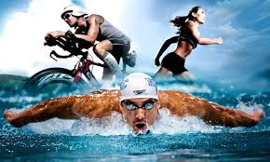
2019 Ironman World Championship Analysis
Presented by
Regan Maher, Cory Potter, Lance Weston, Melissa Memel

Slide 2
What’s Ironman ?
An Ironman Triathlon is one of a series of long-distance triathlon races
It is organized by the World Triathlon Corporation (WTC)
It consists of :
2.4-mile (3.86 km) swim
112-mile (180.25 km) bicycle ride
26.22-mile (42.20 km) run

Slide 3
Dataset: Kaggle CSV, and a countries CSV found on git hub.
Git Hub Location: https://github.com/rmaher314/Project2.git
Rationale of Project: This is where we can put in our data info
Project Track: Interactive dashboard with multiple charts that update from the same data.
Images of Visual Types: We can grab images once we have a firmed-up approach to the data.
Mapping the location of 2019 Participants
Looking at the three stages (Swim, Bike, Run)

Slide 4
Visualization 1: Mapping the location of 2019 Participants
The size of the dots are based on total participants by division from country
Color gradient are based on percentage ranked.

Slide 5
Visualization 2: Looking at the three stages (Swim, Bike, Run)
Stack bar chart of the selected division and compare with the averages of the other divisions.

Slide 6
Visualization 3:
Table Representing the top 10 from each division with their stats, country, ranking, leg times

