Slide 1

2019 Ironman World Championship Analysis
Presented by
Regan Maher, Cory Potter, Lance Weston, Melissa Memel
Notes:
Melissa – Intro up to slide 3

Slide 2


Content
Overview
Datasets Used
Programs
Data Transformation
Graphs, Maps and Charts Creation
Graphs, Maps and Charts Examples
Challenges
Further Potential Analysis
Questions
Notes:
Melissa

Slide 3
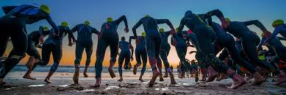
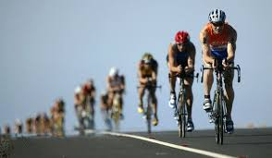

Overview
Ironman Triathlon Overview
2.4 mile swim
112 mile bike
26.2 mile run
Project looked at 2019 Ironman World Championship results.
Goal to be able to have an interactive dashboard that displayed results based on competition divisional classes.
Notes:
Melissa

Slide 4
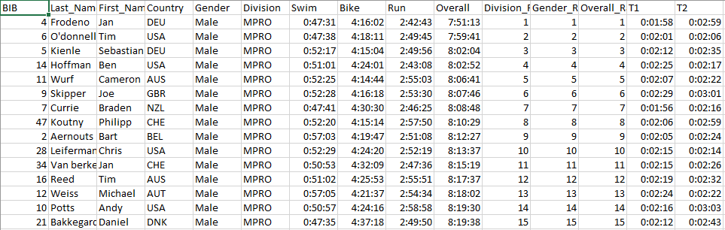
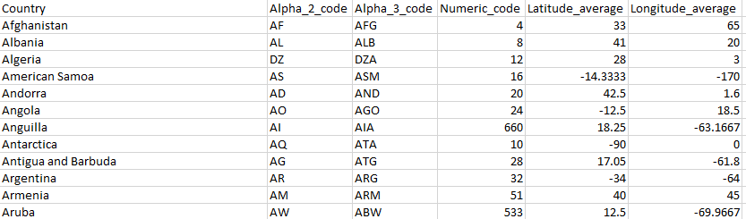
Datasets Used
2019 Ironman World Championship – Data Example
For this project we utilized two separate csv.
2019_Ironman_World_Championship_Results – This information was obtained form Kaggle
countries_codes_and_coordinates – This information was obtained from a git hub country reference.
The Kaggle document provided a 3 alpha code for the country, the second csv had that country code, the full country name and the average latitude and longitude for each country for additional analysis.
Country – Data Example
Notes:
Lance

Slide 5








Programs
Python – Used to create the sqlite databased with both tables.
Sqlite – To store and reference the dataset for visualizaitons.
DB Browser – To reference the completed sqlite database.
Javascript – To develop the code that would generate the data visualizations.
Html – To showcase the data in a visual way.
Pandas – For data review and analysis.
Popper – New JavaScript library.
Tippy.js – New JavaScript Library
Notes:
Lance

Slide 6
Data Transformation
The transformation of the data took the following steps.
Read CSVs In
CSV Joined on 3 Alpha Code
Removed Non Completed Racers
Removed Racer with Random Character (:)
Convert DateTime to Remove Year and Convert to Hours
Notes:
Cory

Slide 7
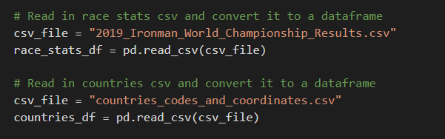
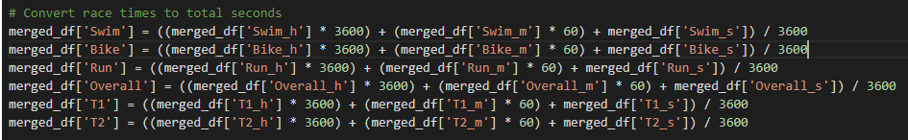
Data Transformation – Code Examples
Reading in the CSVs.
Merging CSVs based on country codes.
Time conversions.
Notes:
Cory

Slide 8

Graphs, Maps and Charts
Visuals for This Project Included
Top 10 Table
Stacked Bar Chart
World Map Reference
Notes:
Cory

Slide 9
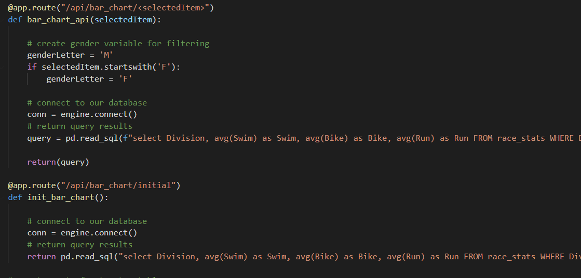
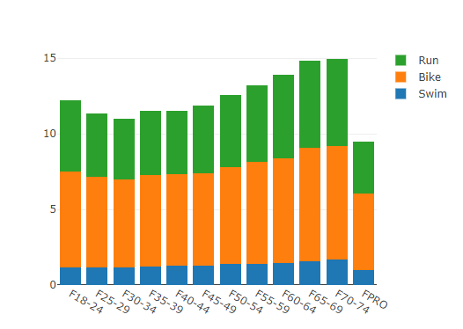
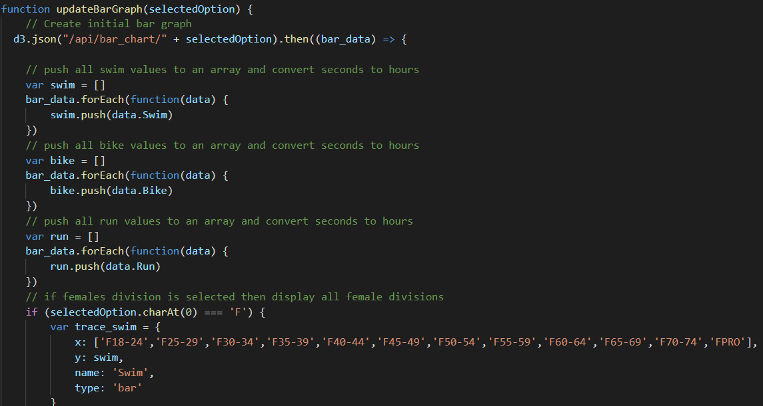
Graphs, Maps and Charts – Bar Chart Visuals
Notes:
Cory

Slide 10
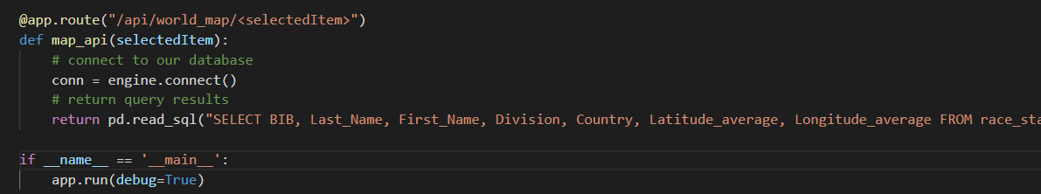
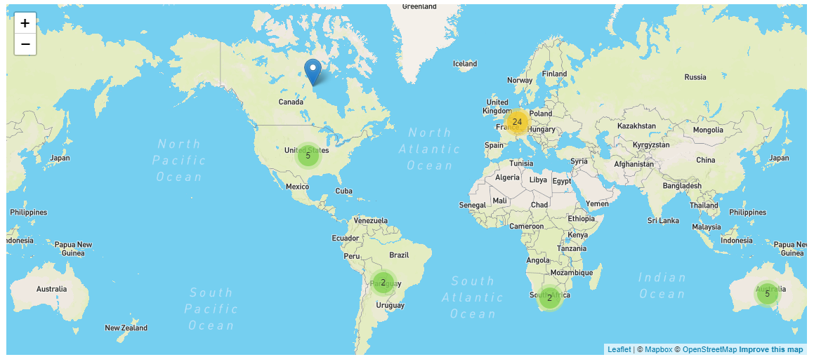
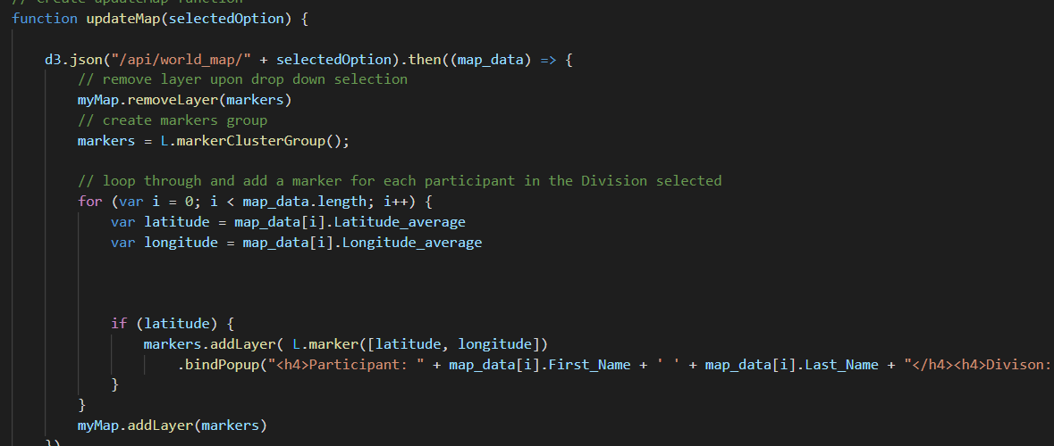
Graphs, Maps and Charts – World Map
Notes:
Lance/Cory

Slide 11
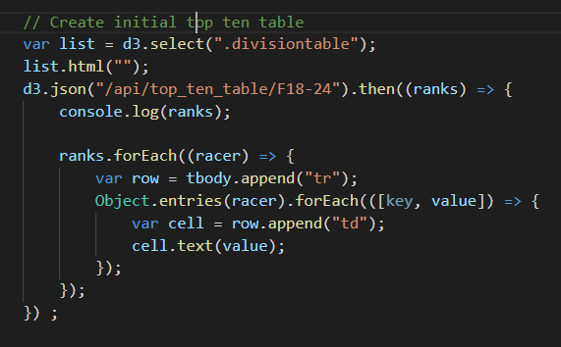
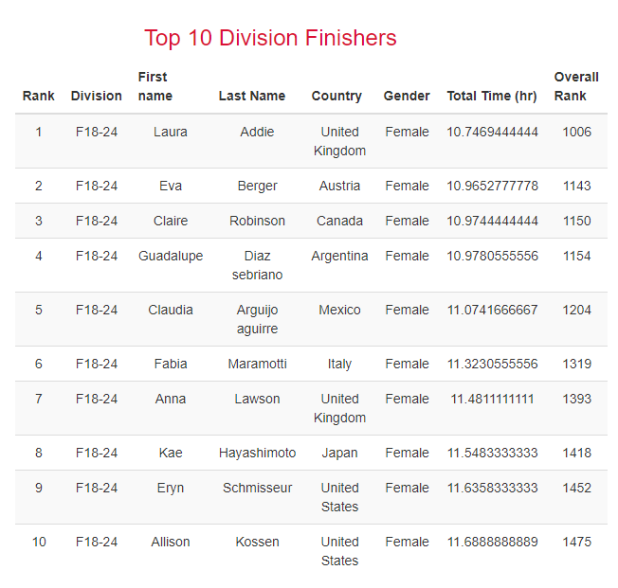

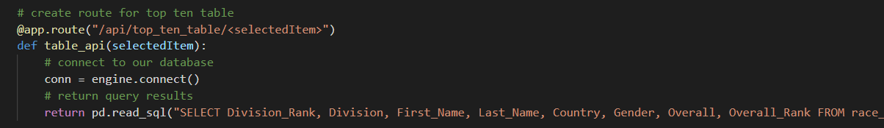
Graphs, Maps and Charts – Top 10 Visuals
Notes:
Regan

Slide 12

Challenges
Date Time Conversion
Multiple connections
Notes:
Regan – to show website after this and talk about challenges

Slide 13
Further Potential Analysis
Being able to show a graph of all 2000 + participants. This could have been showcased in a scatter plot or a group of scatter plots for each leg and overall.
Take into account the transition times. See if there was an impact to the overall racers performance.
Compare division averages over different years or range of years.
Look at the 2019 qualifying racing to see how those compared to the championship.
Notes:
Regan

Slide 14


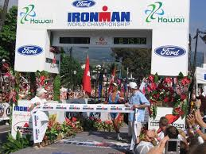
Questions
Notes:
Regan

