Slide 1


Unsupervised learning of Legal Summary Reports
Rushikesh Maheshwari
Vijaya Singh
Priyanka Sariya

Slide 2
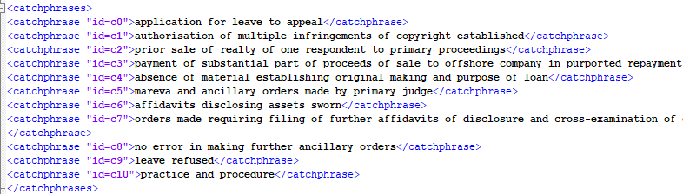
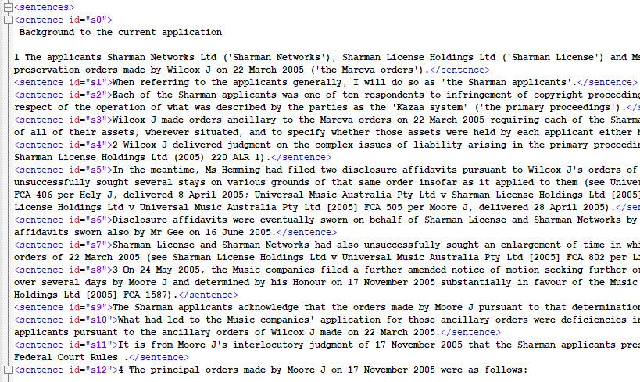
Data Walk-through

Slide 3
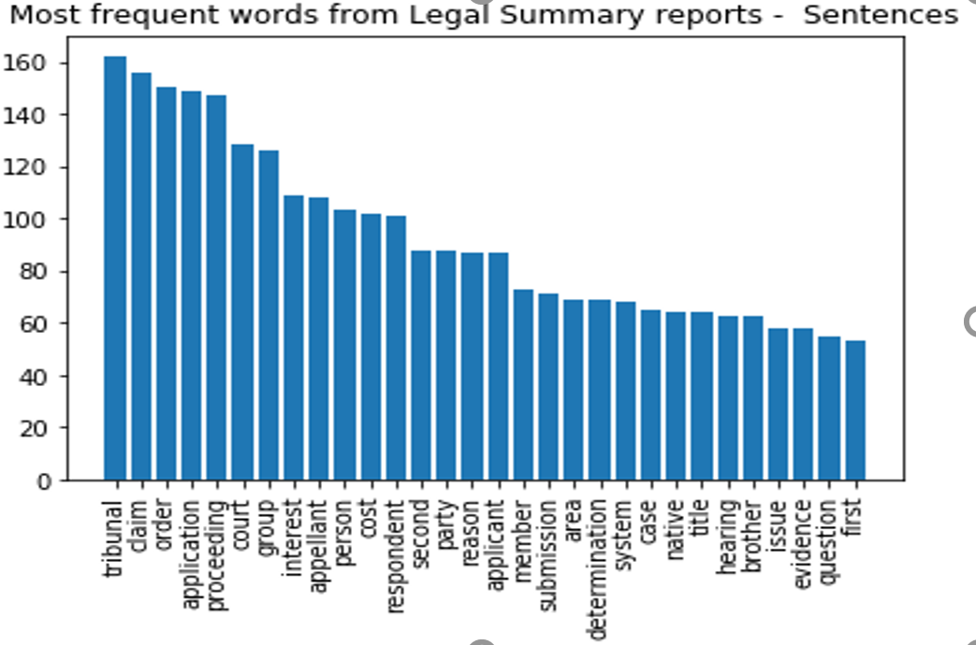
Exploratory Data Analysis – for “sentences”

Slide 4
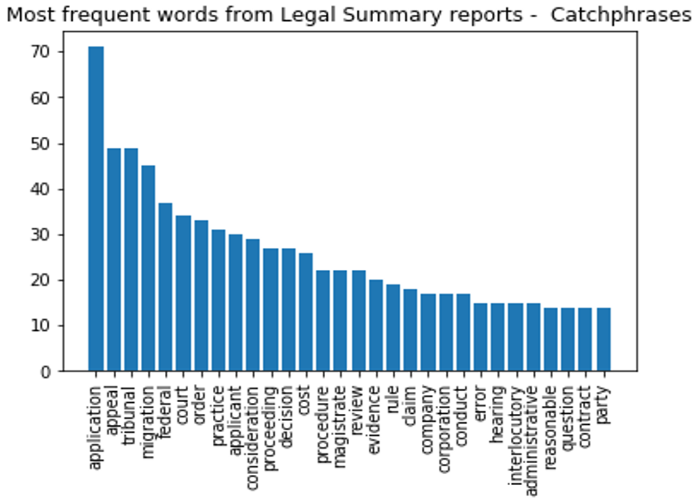
Exploratory Data Analysis – for “Catchphrases”

Slide 5
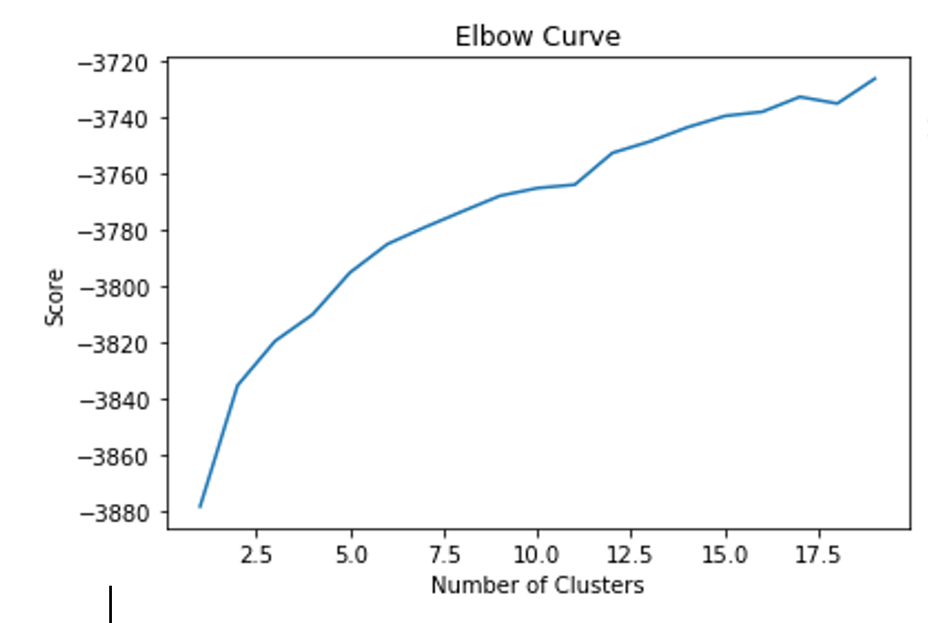
Document Clustering using TFIDF

Slide 6
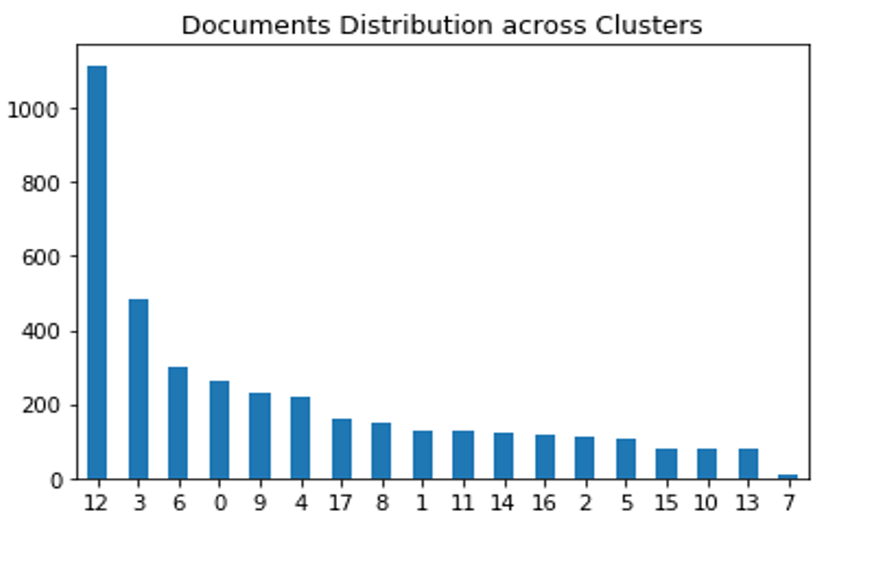
Document Clustering using TFIDF

Slide 7
Document Clustering using TFIDF

Slide 8
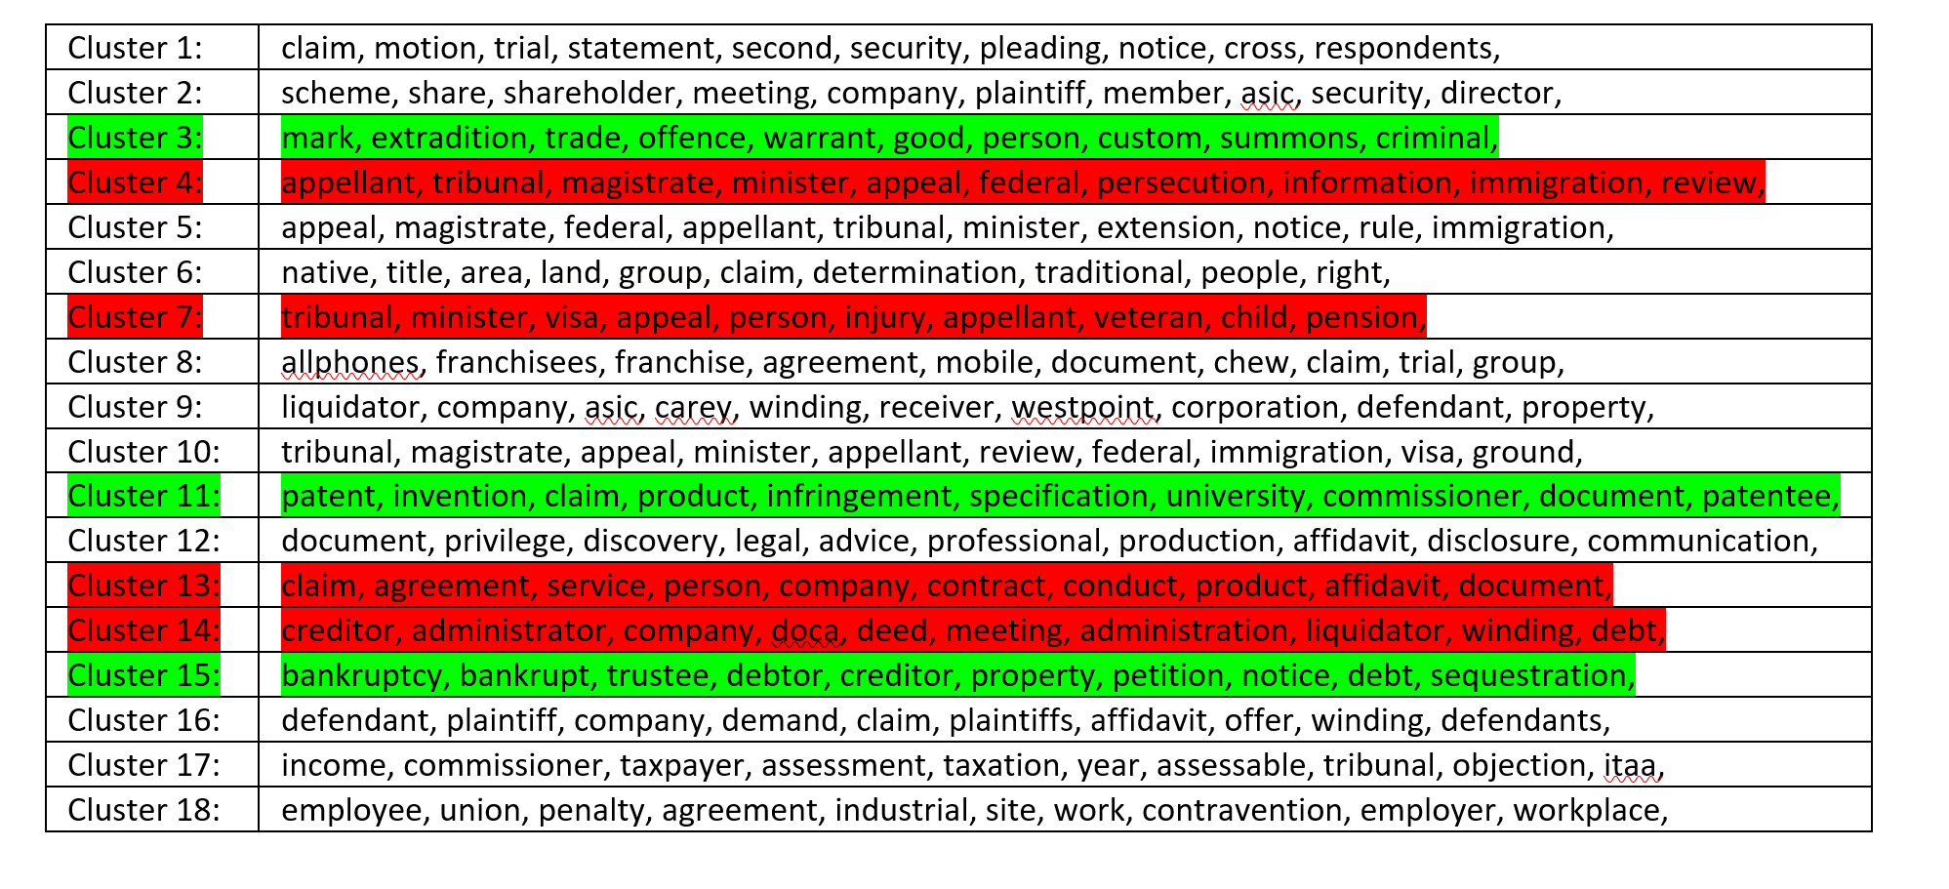
Document Clustering using TFIDF on Sentence Corpus

Slide 9
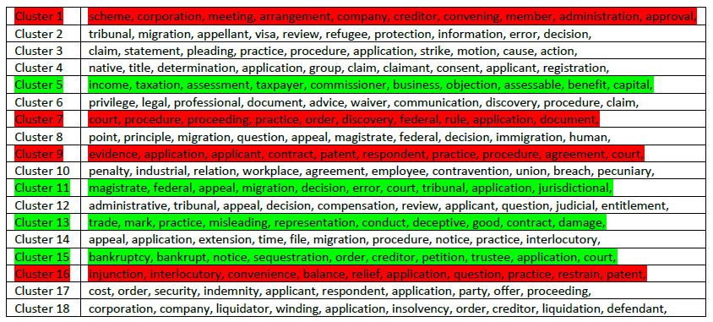
Document Clustering using TFIDF on Catchphrase Corpus

Slide 10
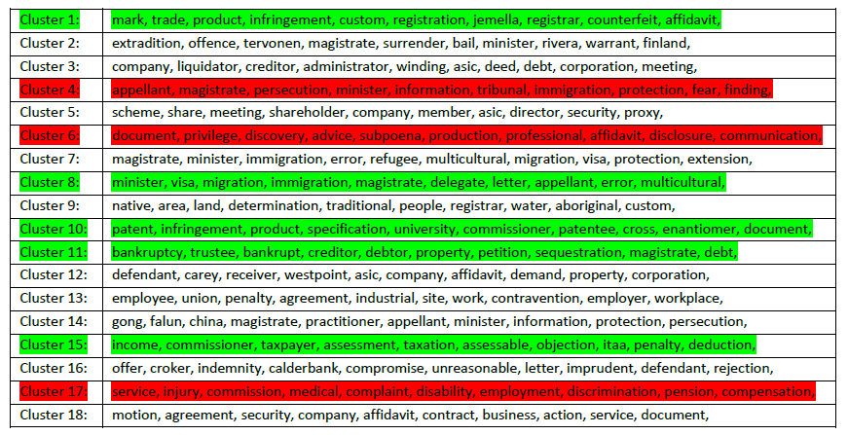
Document Clustering using TFIDF on Sentence Clean Corpus

Slide 11
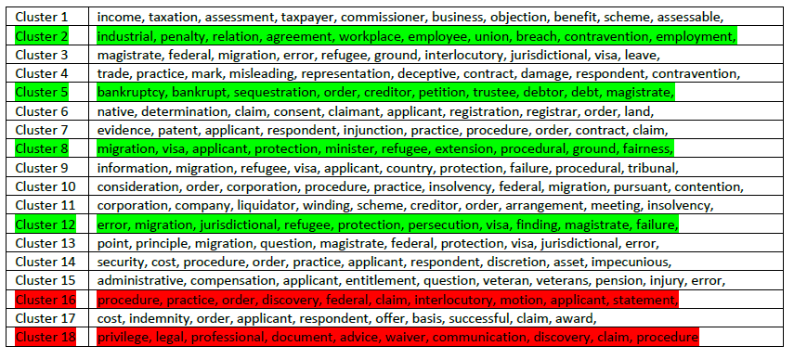
Document Clustering using TFIDF on Catchphrase Clean Corpus

Slide 12
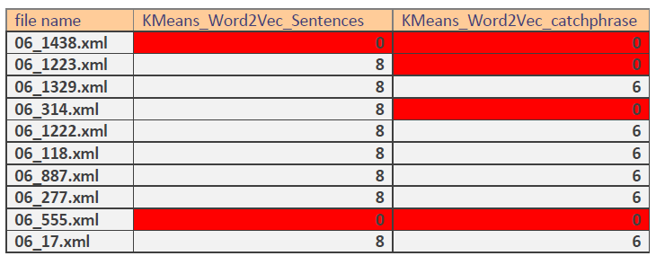
Evaluation of Results

Slide 13
Thank You !

