Slide 1
Real or Not? NLP with Disaster Tweets
[F23] PracticalMLandDL Project 2023
Roman Makarov & Adela Krylova

Slide 2
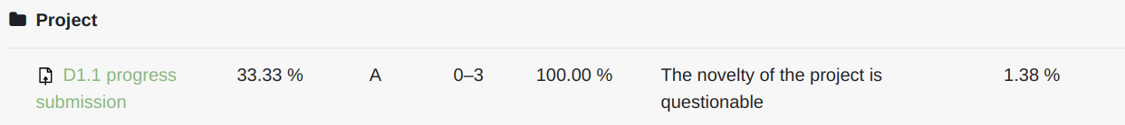

Slide 3
Real or Not? NLP with Disaster Tweets
[F23] PracticalMLandDL Project 2023
Roman Makarov & Adela Krylova

Slide 4
Disaster tweet Generation and Detection
[F23] PracticalMLandDL Project 2023
Roman Makarov & Adela Krylova

Slide 5
PROBLEM
BREAKING NEWS
19.4%
Of active Twitter accounts are fake or spam
38.2%
Americans have accidentaly shared fake news
Of Americans use Twitter as a main platform to read news
69%
https://www.statista.com/statistics/683938/

Slide 6
Fake tweets detection on Kaggle
Fake!
Competition on Kaggle “Natural Language Processing with Disaster Tweets”
10K of real and fake tweets dataset
Best solution has 96% accuracy
However, the dataset is quite limited and it contains low quality fake tweets.
Correct labels were leaked and utilized to mess up leaderboard

Slide 7

Our solution
Generator
Discriminator
GPT2 pre-trained on a few real tweets and fine-tuned along with Discriminator model
Small Bert fine-tuned on GPT-generated data and 300 real tweets.

Slide 8
Examples of generated Tweets
Tweet1
Tweet2
Tweet3
“0Zionist infiltrator may be preparing for Armageddon0Linux-based 'back doors' to Iran's major”
“A helicopter carrying miners from Myanmar to Bangladesh has collided with a boat off the Irian state's west coast.”
“I was in California and I saw a spaceship land on my front porch. How?? WHAT???”
Notes:
TODO tricked tweets

Slide 9
Examples of tweets which tricked the detector
Tweet1
Tweet2
Tweet3
Iranian nuclear weapon found: Iranian government officials said Thursday that they recovered two nuclear-capable ICBMs from a remote area of southwest Iran. http://t.co/rH6J3Wy1MtLpic
Emergency responders evacuate hostages from a Saudi Arabia-led coalition warring... https://t.co/lXoR1VXyKm8 #bbc0My heart goes out to all the families affected by this
I understand everyone is upset about the MH17 disaster but why not take a trip down memory lane and send the message that computers can be trusted? #TrustFund
Notes:
TODO tricked tweets

Slide 10

How good is our solution?
10%
Accuracy Increase
Was achieved after fine-tuning Discriminator and Generator

Slide 11
How good is our solution?
DistilBERT trained on 10000 samples: 0.84 accuracy
Discriminator trained on 300 real and 100 generated samples:
0.68 accuracy
With only 3% of data!
10%
Accuracy Increase
Was achieved after fine-tuning Discriminator and Generator

Slide 12
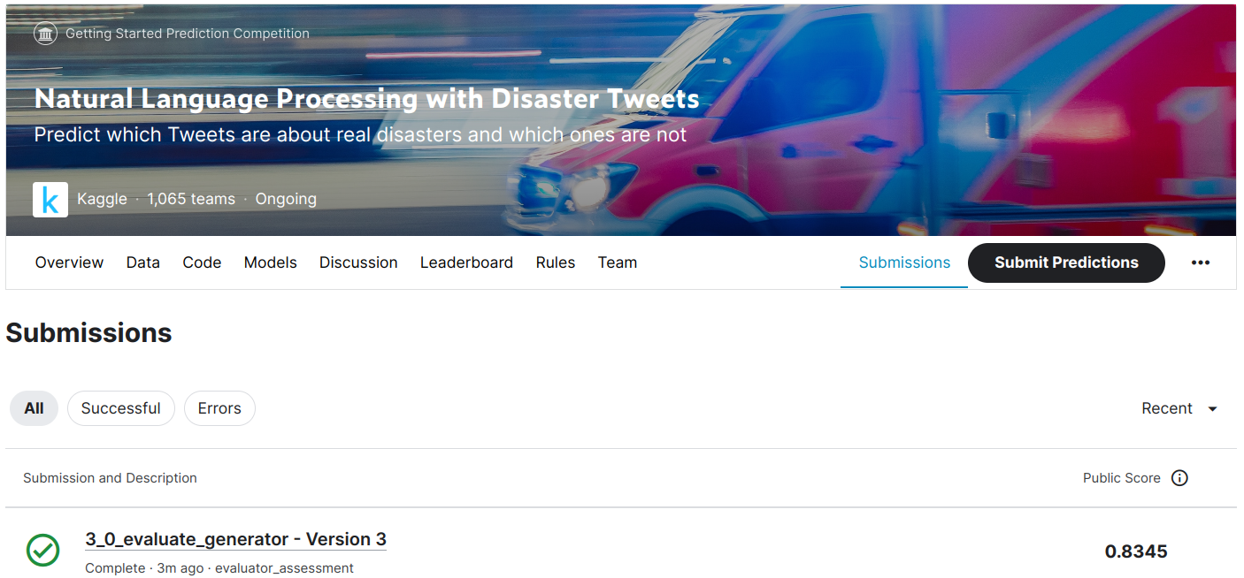

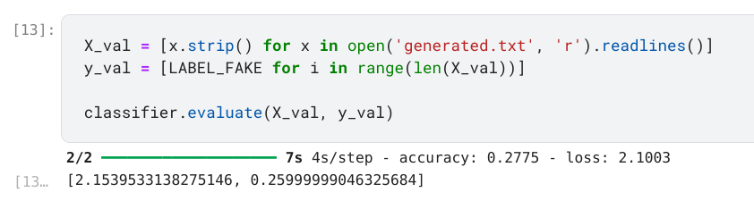


How good is our solution?
72%
Generations
Were able to fool one of the top Kaggle competition model

Slide 13
Limitations
Link generation
Unstable convergence
All generated links are not working; hence, the fakeness could be check by the links
Time and memory
Merged Tweets
The solution consume quite a large number of memory and time
Some generated Tweets comprise information of several disasters at the same time. This tricks the discriminator

Slide 14
Thank you for your attention
“Times change! Before, no one believed the weather forecast.
Today in the news only the weather forecast can be trusted.”
― Ljupka Cvetanova, Yet Another New Land
Notes:
Limitations

