Slide 1



DeepProbLog: Neural Probabilistic Logic Programming
Robin Manhaeve, Sebastijan Dumančić, Angelika Kimmig, Thomas Demeester*, Luc De Raedt*
* Joint last authors
Notes:
Joint work

Slide 2
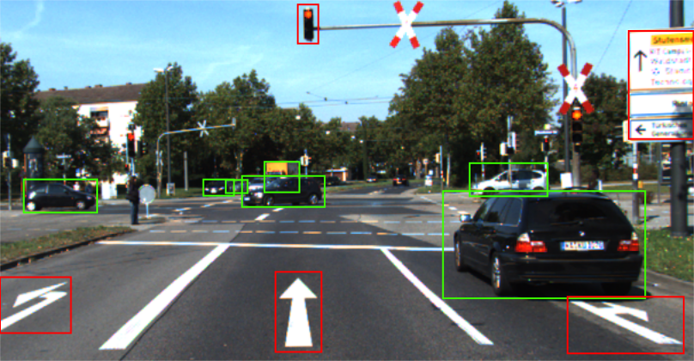
Real-life problems involve two important aspects.
Sub-symbolic perception
Reasoning
How should I drive?
Notes:
Herfocussen op DPL op het einde (oneliner), wat is de kracht?
Geen pipeline, maar combined
Meer reclame maken

Slide 3
Real-life problems involve two important aspects.
Sub-symbolic perception
Reasoning with knowledge
How should I drive, given:
Stop in front of a red light
Obey the speed limit
Be in the correct lane
…
Logic program
Deep Learning
Notes:
Herfocussen op DPL op het einde (oneliner), wat is de kracht?
Geen pipeline, maar combined
Meer reclame maken

Slide 4
Real-life problems involve two important aspects.
Sub-symbolic perception
Reasoning with knowledge under uncertainty
How should I drive, given:
Stop in front of a red light
Obey the speed limit
Be in the correct lane
…
P( light = red) = 0.9
P( obj1 = car ) = 0.8
P( obj1 turn right) = 0.7
Probabilistic logic program
Deep Learning
E.g.: ProbLog
Notes:
Herfocussen op DPL op het einde (oneliner), wat is de kracht?
Geen pipeline, maar combined
Meer reclame maken

Slide 5
Current state-of-the-art
The integration of perception and reasoning is still an open problem.
Main ideas: inject logic into neural networks
Encoding logic in the weights of neural networks
Learning embeddings for logical entities
Logical constraints as a regularizer during training
Templating neural networks
Building neural networks from functional programs
Building neural networks from backwards proving
Differentiable neural computers / program interpreters

Slide 6
Current state-of-the-art
Encoding logic in the weights of neural networks
Logic Tensor Networks (Serafini et al.)
A Semantic Loss Function for Deep Learning with Symbolic Knowledge (Xu et al.)
Ontology Reasoning with Deep Neural Networks (Hohenecker et al.)
Semantic Based Regularization (Diligenti et al.)
Templating neural networks
Lifted Relational Neural Networks (Šourek et al.)
Neural Theorem Prover (Rocktäschel et al.)
Neural Module Networks (Andreas et al.)
Differentiable neural computers / program interpreters
Differentiable Neural Computer (Graves et al.)
Neural Programmer-Interpreters (Reed et al.)
Differentiable Forth Interpreter (Bošnjak et al.)

Slide 7
Why DeepProbLog?
Common problems with the state-of-the-art
The logic is made less expressive
Unclear semantics
The logic is pushed into the neural network and disappears after training
No clear separation between the logic and the neural network
DeepProbLog
Fully expressive logic
Probabilistic logic with a well defined semantics
A clear separation between the logic and the neural network

Slide 8
DeepProbLog

Slide 9
What is DeepProbLog?
ProbLog
+ Neural Predicates

Slide 10
The neural predicate
The neural predicate represents the neural network in the logic program
NN Classifier with softmax
Uncertainty in predictions
Normalized output can be interpreted as probabilities

Slide 11
The neural predicate
The output of the neural network becomes probabilistic facts in DeepProbLog
Example:
nn(mnist_net, [X], Y, [0 ... 9] ) :: digit(X,Y).
Instantiated into a (neural) Annotated Disjunction:
0.04::digit( ,0) ; 0.35::digit( ,1) ; ... ; 0.53::digit( ,7) ; ... ; 0.014::digit( ,9).

Slide 12
Perception
Reasoning
Stop in front of a red light
Obey the speed limit
Be in the correct lane
P( light = red) = 0.9
P( obj1 = car ) = 0.8
P( obj1 turn right) = 0.7
ProbLog
Neural predicate
Notes:
animation

Slide 13
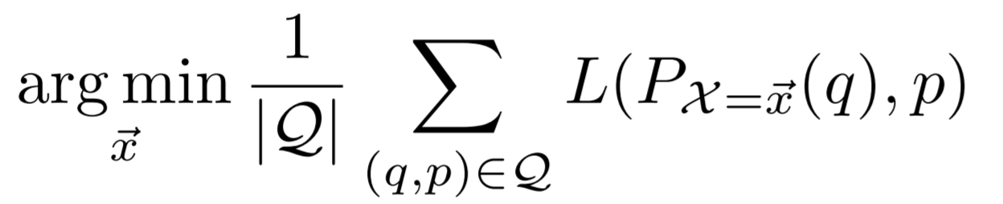
Optimization
PLP usually considers the inference settings
DeepProbLog focuses on optimization
We have a set of tuples (q,p)
q is a query and p its desired success probability

Slide 14
DeepProbLog exemplified: MNIST addition
Task: Classify pairs of MNIST digits with their sum
Benefit of DeepProbLog:
Encode the addition in logic
Separate the addition from digit classification
8
4
11
nn(mnist_net, [X], Y, [0 ... 9] ) :: digit(X,Y).
addition(X,Y,Z) :- digit(X,N1), digit(Y,N2), Z is N1+N2.
Examples:
addition( , ,8), addition( , ,4), addition( , ,11), …

Slide 15
DeepProbLog
Result of using DeepProbLog
Faster convergence than CNN baseline
Neural network can classify single digits
Generalizes to multi-digit numbers
+ = ?

Slide 16
The experiments

Slide 17
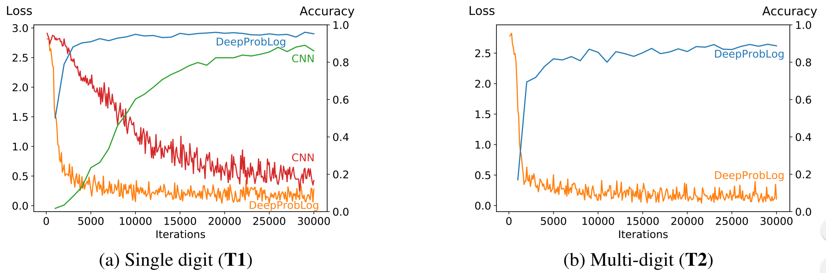
T1-T2: MNIST addition

Slide 18
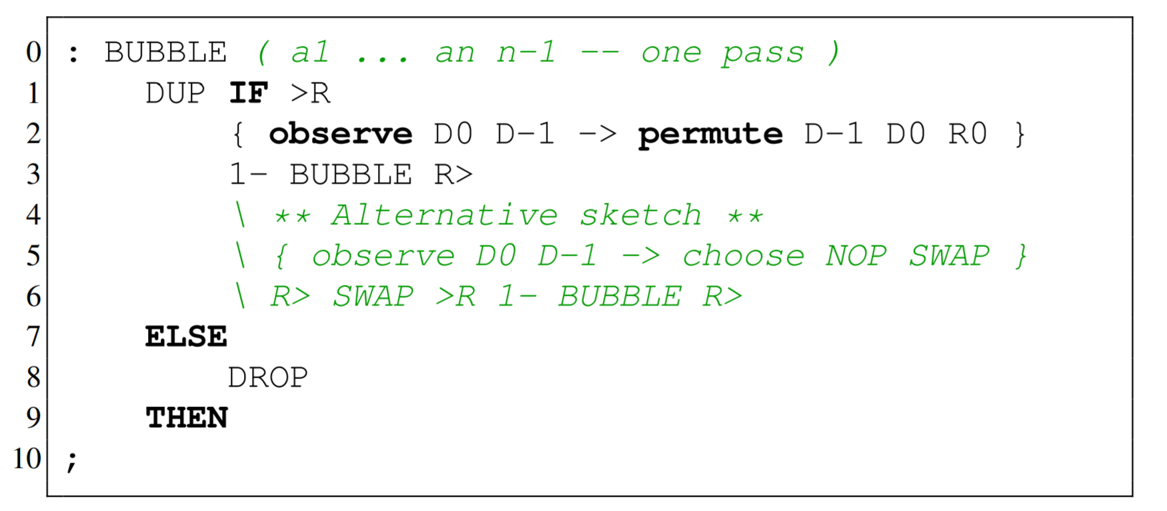
T3-T5: Program induction
Re-implemented experiments from Differentiable Forth ^{[1]}
Partial programs with holes
Behaviour in holes learned by small neural networks
nn(m_swap,[X,Y]) ::swap(X,Y).
hole(X,Y,Y,X) :- swap(X,Y).
hole(X,Y,X,Y) :- \+ swap(X,Y).
bubble([X],[],X).
bubble([H1,H2|T],[X1|T1],X) :- hole(H1,H2,X1,X2),
bubble([X2|T],T1,X).
bubblesort([],L,L).
bubblesort(L,L3,Sorted) :- bubble(L,L2,X),
bubblesort(L2,[X|L3],Sorted).
sort(L,L2) :- bubblesort(L,[],L2).
[1]
[1] Riedel, Sebastian, Matko Bosnjak, and Tim Rocktäschel. "Programming with a differentiable forth interpreter."

Slide 19
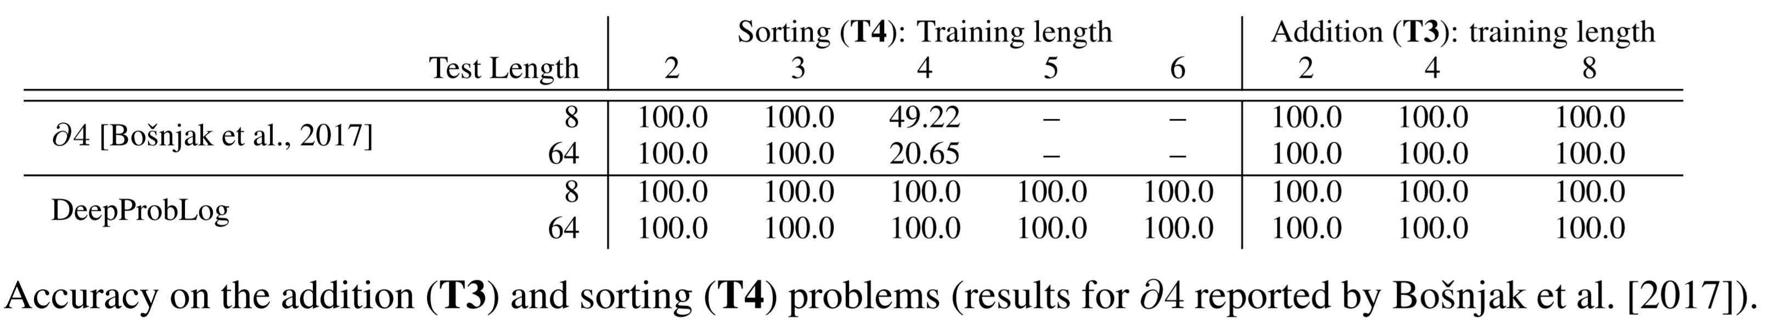
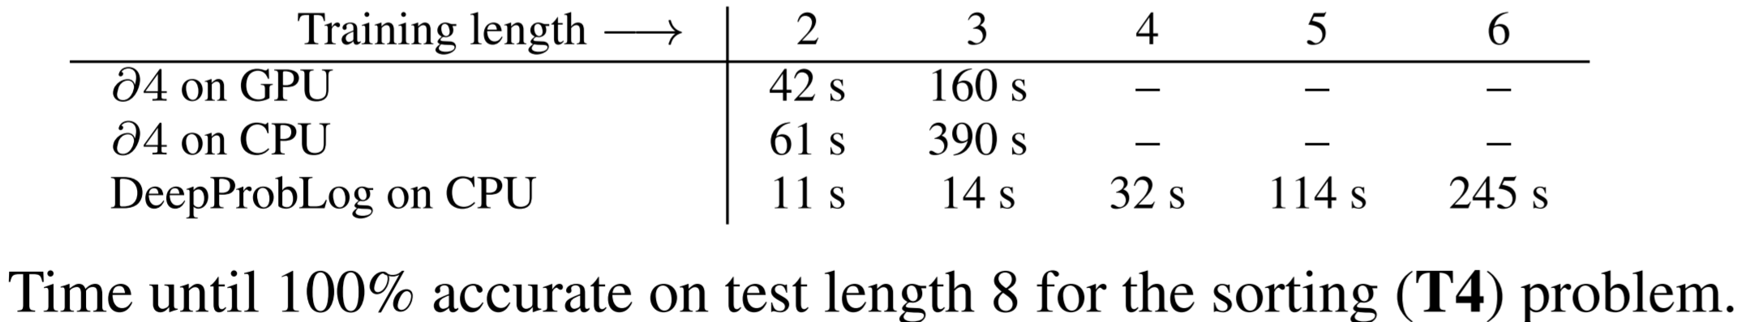
T3-T5: Program induction

Slide 20
T6: Coin-Urn experiment
We wanted to perform an experiment that showcased:
Training several neural networks
Perform probabilistic reasoning with background knowledge
Learning probabilistic parameters
DeepProbLog can do all of these simultaneously

Slide 21
T6: Coin-Urn experiment
Play a little lottery game where:
Flip a coin (MNIST image)
Pick a coloured ball out of two urns (RGB triplets)
Given rules determine win or loss
Examples are
A tuple of: an MNIST digit and two RGB-triples
Labeled with the outcome
DeepProbLog reached a 100% accuracy

Slide 22
Conclusion
Integration of Deep Learning and PLP
Probabilistic logic
Clean semantics, clear separation
Paper: DeepProbLog: Neural Probabilistic Logic Programming (NeurIPS 2018)
Code: https://bitbucket.org/problog/deepproblog
Contact: robin.manhaeve@cs.kuleuven.be

Slide 23
Questions?

Slide 24
DeepProbLog
Some more details

Slide 25
The ProbLog pipeline
Answering a query in a ProbLog program happens in four steps
Grounding the program w.r.t. the query
Rewrite the ground logic program into a propositional logic formula
Compile the formula into an arithmetic circuit
Evaluate the arithmetic circuit
someHeads
+
0.936
% Probabilistic facts:
0.6::heads(C) :- coin(C).
% Background information:
coin(c1).
coin(c2).
coin(c3).
% Rules:
someHeads :- heads(_).
0.6::heads(c1).
0.6::heads(c2).
0.6::heads(c3).
someHeads :- heads(c1).
someHeads :- heads(c2)
someHeads :- heads(c3).
0.336
x
someHeads <->
heads(c1) v
heads(c2) v
heads(c3)
0.84
+
0.24
x
0.6
0.4
0.6
0.4
0.6
heads(c1)
⌐heads(c1)
heads(c2)
⌐heads(c2)
heads(c3)

Slide 26
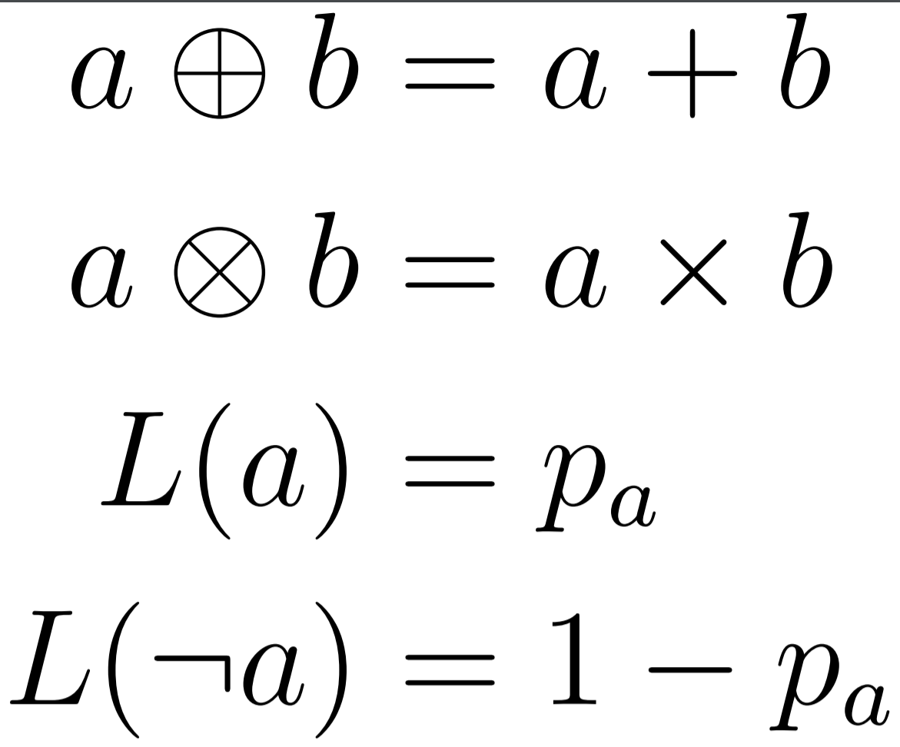
aProbLog^{[1]}
The last step in the ProbLog pipeline is correct for any commutative semiring
Commutative semiring
Addition is associative and commutative and has a neutral element
Multiplication is associative and commutative and has a neutral element
aProbLog
Define addition
Define multiplication
Define labeling function for literals
[1] Kimmig, Angelika, Guy Van den Broeck, and Luc De Raedt. "An Algebraic Prolog for Reasoning about Possible Worlds." AAAI. 2011.

Slide 27
Implementing DeepProbLog
Evaluating the neural networks:
Instantiate the neural annotated disjunction
Happens during grounding
ProbLog already had support for external functions
Perform backpropagation in the neural networks
No direct loss for neural networks
Loss defined on the logic level
Derive gradient in logic
Start backpropagation with derived gradient

Slide 28
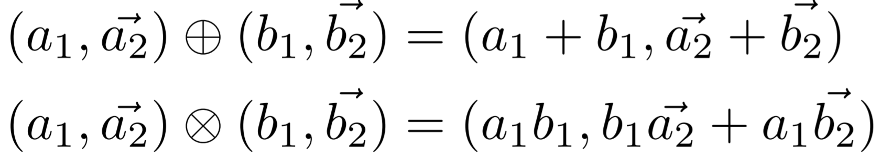
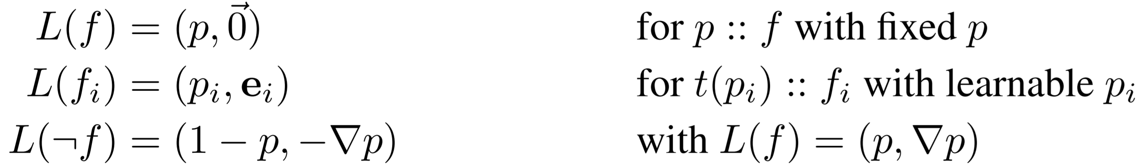
Deriving the gradient
The output of the neural network are probabilistic facts
Probabilistic facts are leaves in the AC
The AC is a differentiable structure
We can derive it in the forward pass along with the probability
aProbLog + gradient semiring

Slide 29
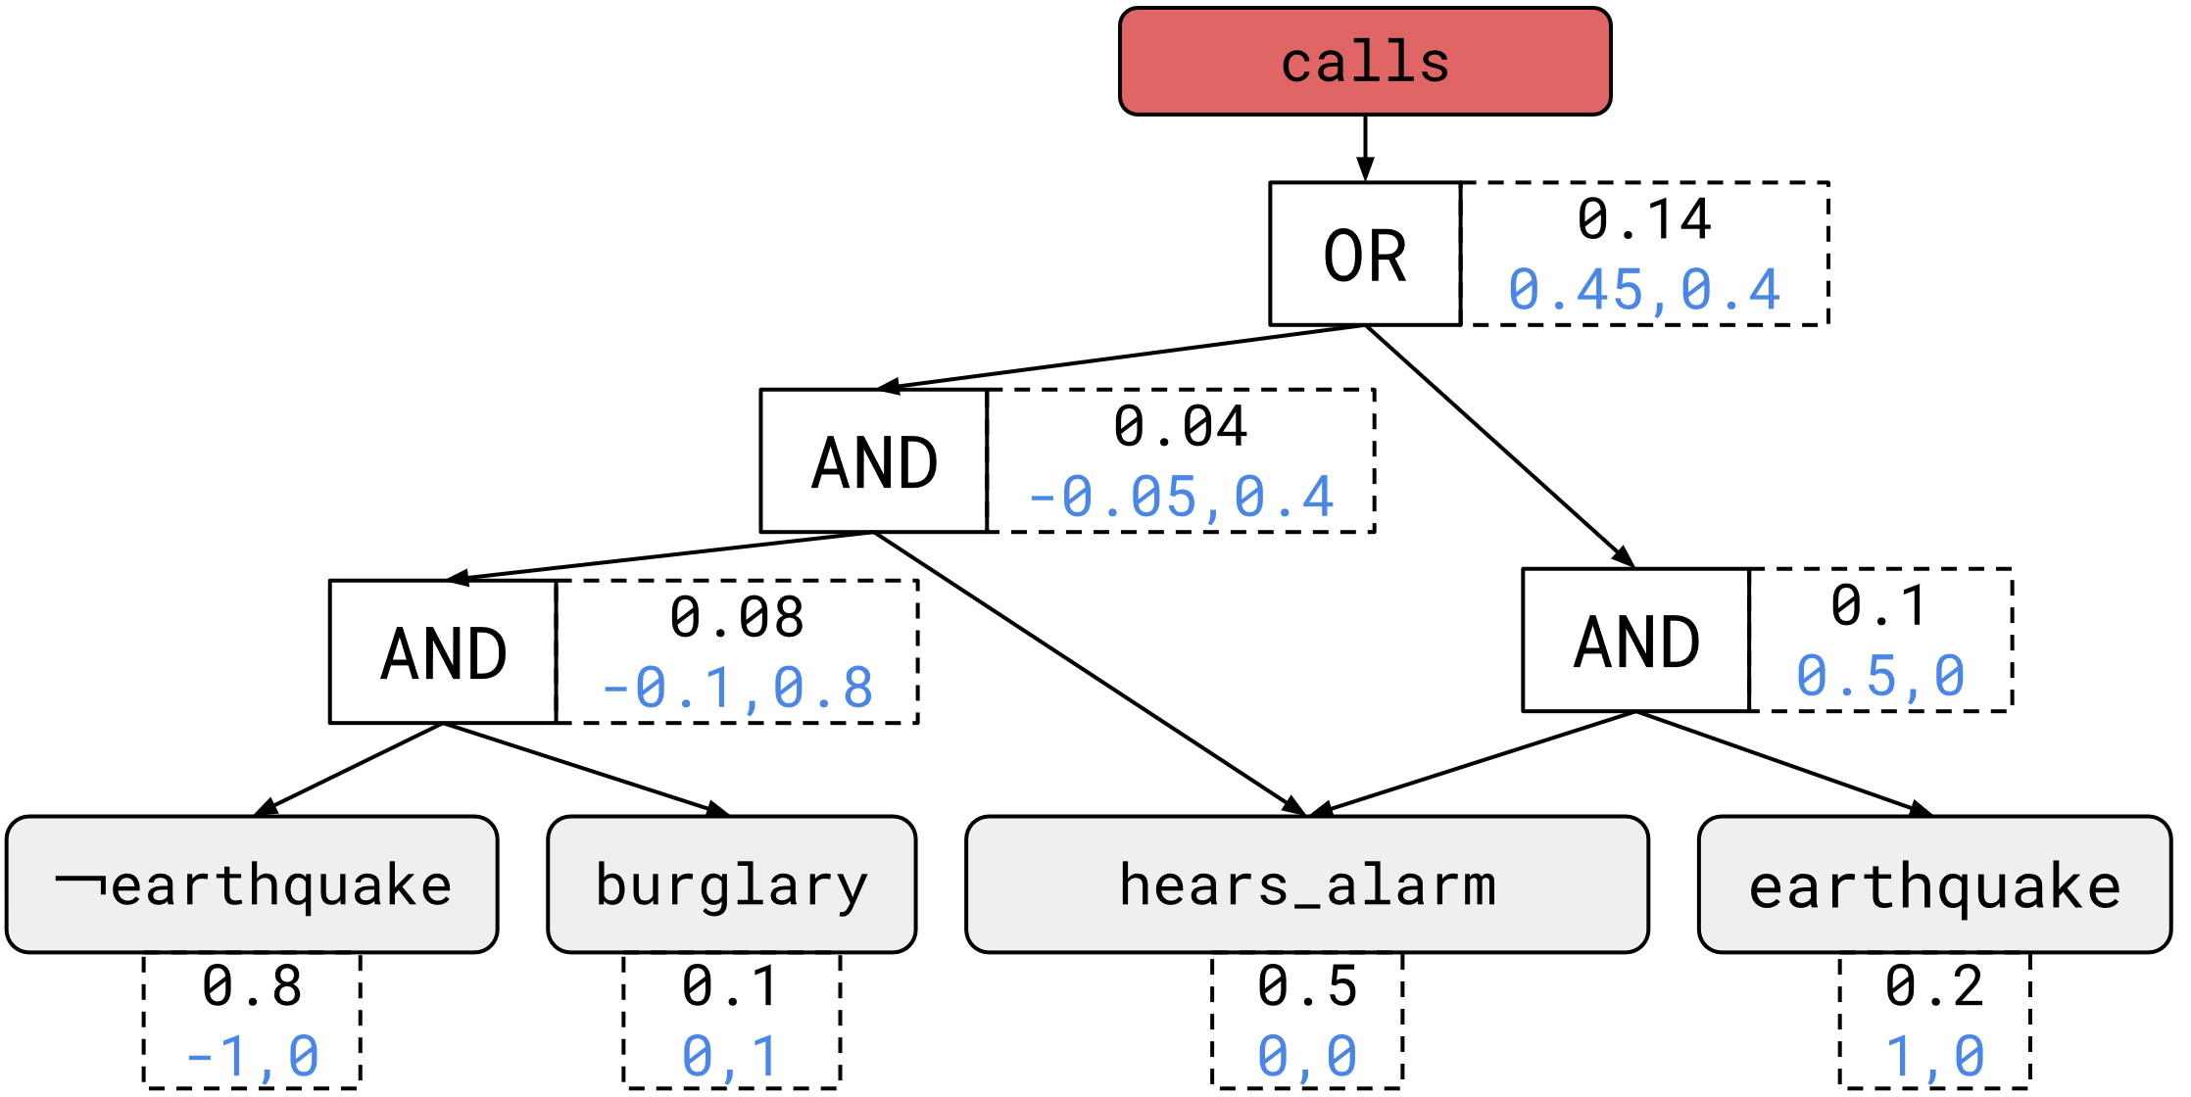
Gradient semiring
t(0.2) :: earthquake.
t(0.1) :: burglary.
0.5 :: hears_alarm.
alarm :- earthquake.
alarm :- burglary.
calls :- alarm, hears_alarm.

Slide 30
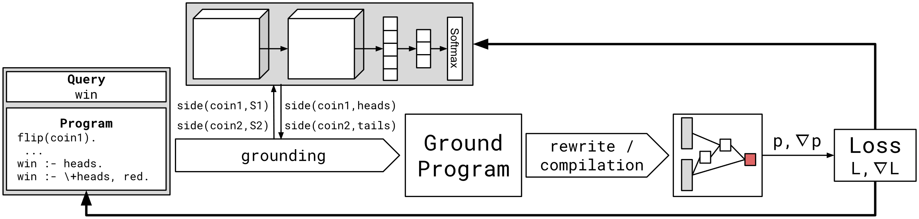
The DeepProbLog pipeline

Slide 31
ProbLog

Slide 32
Prolog syntax
Literals: a predicate with its correct number of terms (arity) parent(bob, X).
Terms:
constants (starts with lowercase)
variables (starts with uppercase)
structured terms (functor with a number of terms)
Rule: grandparent(X,Y) :- parent(X,Z), parent(Z,Y).
Fact: parent(bob, charlie).

Slide 33
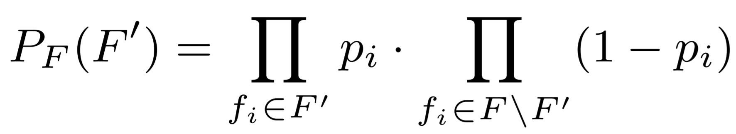
ProbLog: a probabilistic logic programming language
A probabilistic extension of Prolog
Main idea
Facts are annotated with probabilities p_{i} :: f_{i}
This defines a distribution over logic programs
Query for the probability of an atom being true (success probability)
% Probabilistic facts:
0.6::heads(C) :- coin(C).
% Background information:
coin(c1).
coin(c2).
coin(c3).
% Rules:
someHeads :- heads(_).
query(someHeads).
P(someHeads) = 0.936

Slide 34
Annotated Disjunction
Clause of the following form:
p₁ :: h₁ ; p₂ :: h₂ ; … ; p_{n} :: h_{n}.
p₁ … p_{n} are probabilities that sum to one
Exactly one of h₁ … h_{n} becomes true
Good way to model a caterogerical variable
ProbLog programs with ADs can be transformed to programs without ADs

