Slide 1
A comprehensive analysis of financial performance insights from leading banks

Slide 2
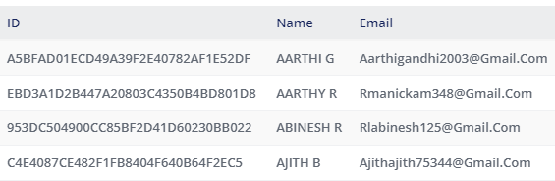
Team details

Slide 3
The global forces for change include technological innovation; the deregulation of financial services at the national level and opening-up to international competition; and - equally important - changes in corporate behavior, such as growing disintermediation and increased emphasis on shareholder value
Collection of data
This step includes collecting the data from dataset
Prepare the data for visualization
This process helps to make the data easily understandable and ready for creating visualizations to gain insights into the performance and efficiency.
Data visualization
Making the data as visual elements such as charts, maps and graphs
Definition

Slide 4
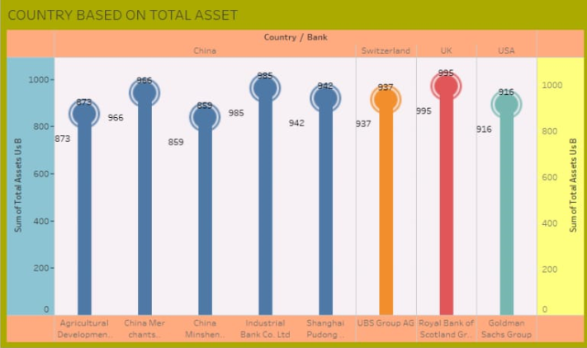
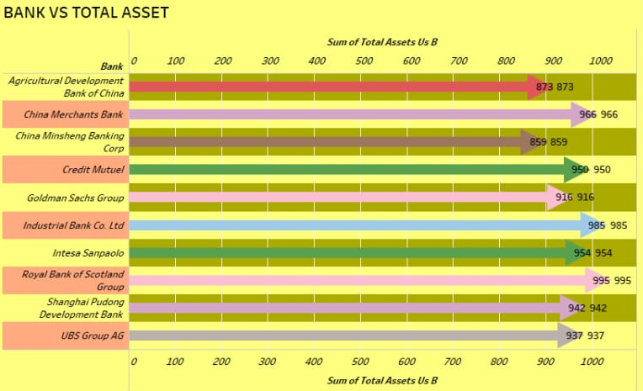
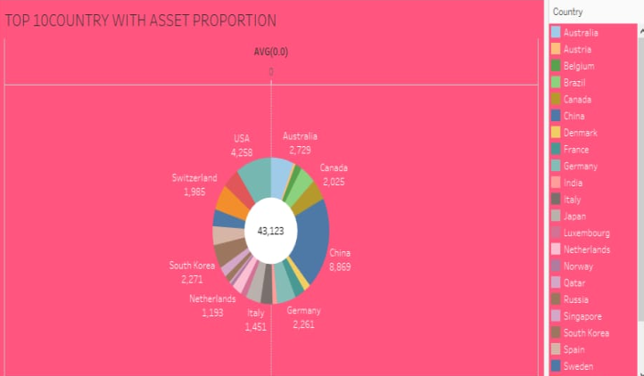
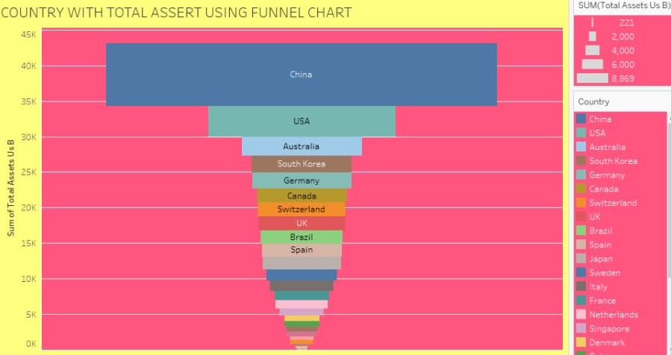
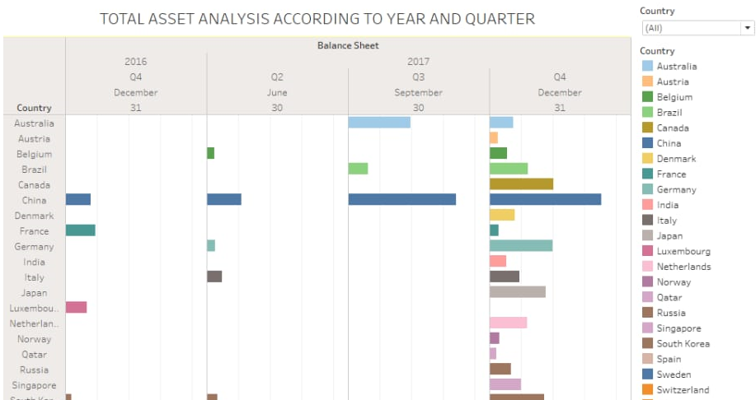
My visualizations
Top banks according to bank and assets
Top banks according to country based on total assets
Top 10 countries with assets preparation
Country With Total Assets Using Funnel Chart In Increasing Order
Total Assets Analysis According To Year And Quarter

Slide 5
Advantages
The Ability to Detect Patterns. Financial statements reveal how much a company earns per year in sales
Advantage: A Chance to Budget Outline
Disadvantages
Based on Market Patterns.
At-One-Time Analysis
Conclusion
Analysis of financial statements is extremely important for every business to grow and increase their revenue. It should not be compromised since it increases the efficiency of business operations It provides financial information such as the company's asset structure, asset liquidity, source of funds, debt level, and liability structure. Thus, according to financial tools to analyze each part of financial statements is useful for avoiding financial risks.

Slide 6
Thank you

