Slide 1
PET
Roberto Marabini

Slide 2
The Goal:
Understand How a PET Scanner Works
Notes:
Software developed for EM 3D reconstruction is used by default in the XR-field. Therefore researcher in x-ray field assume that the relation that exists between 3D structure and images in X-ray and electron microscopy is similar, in this talk we will claimthis claim.
2

Slide 3
PET: Positron Emission Tomography
Different from CT Scanner because the radiation is emitted from inside the body rather than being transmitted through the body.
PET is a functional imaging modality: This means it is used to observe where in the body a particular function ocurrs. For example, one might want to know where rapid tissue growth is takeng place (detect tumors). This is different from viewing the tissue
Notes:
For example one might want to know where rapid tissue growth is takeng place (detect tumors). This is different from viewing the tissue

Slide 4
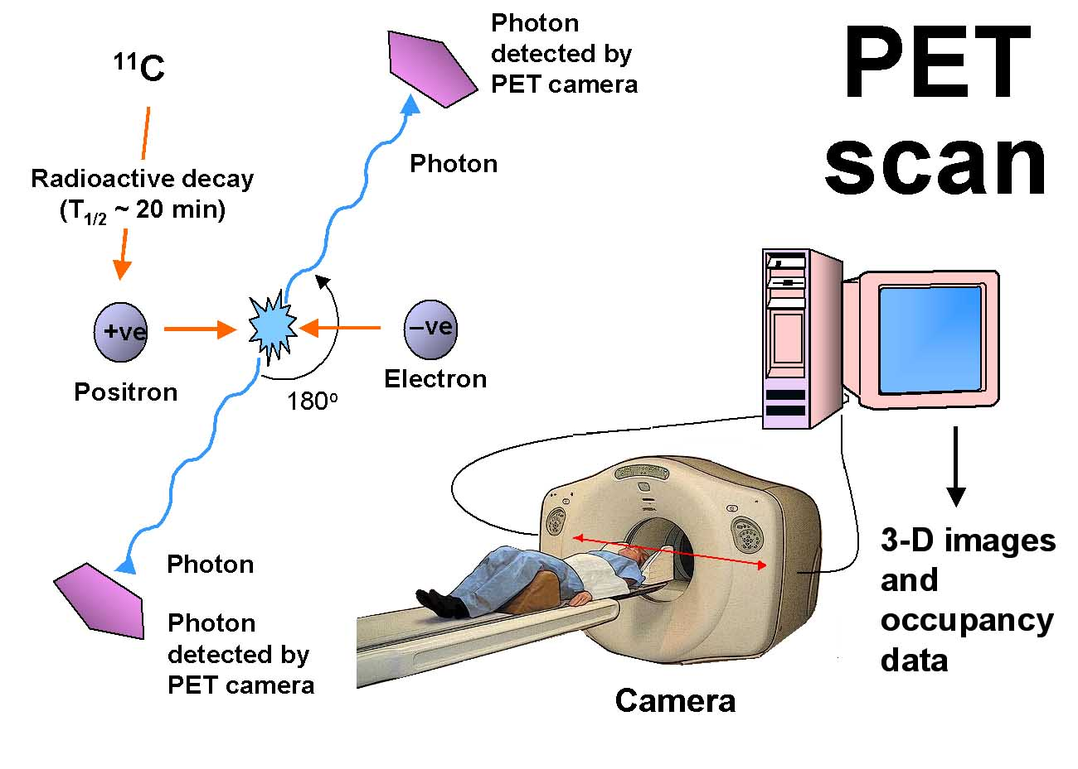
How does it works
Fluoro-2-deoxy-D-glucose(FDG) 511KeV
Notes:
1) Where are the detectors

Slide 5
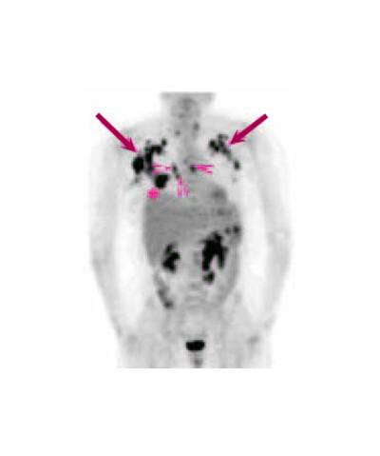
Raw Data: Radon Transforms
The FDG migrates to the site where glucose is being consumed. Malignat tumors require a lot of glucose to grow
Notes:
Blader, kidneys

Slide 6
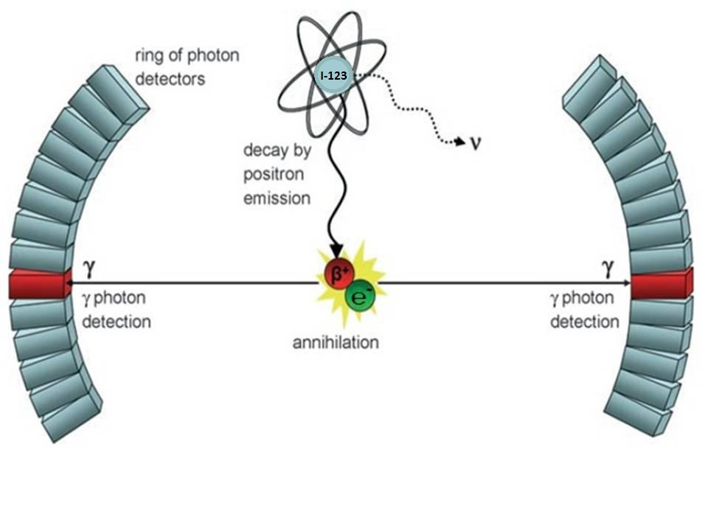
LORs: Lines of Response
If the scanner detects two gamma rays at the same time these 2 rays likely originated from the same annihilation event. Hence we know that the radioisotope was somewhere along the line connecting both detectors
Notes:
Define LORs

Slide 7
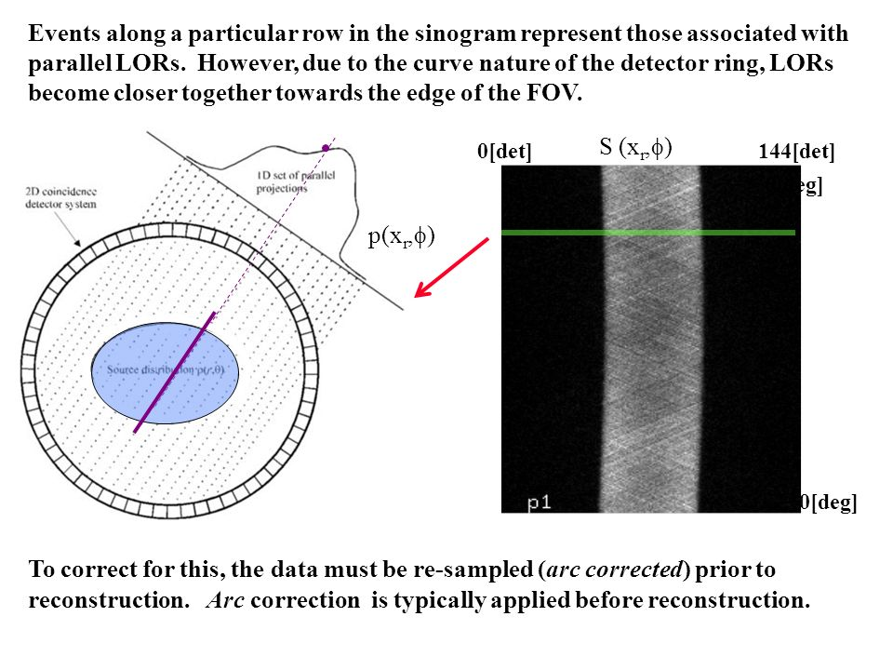

Slide 8
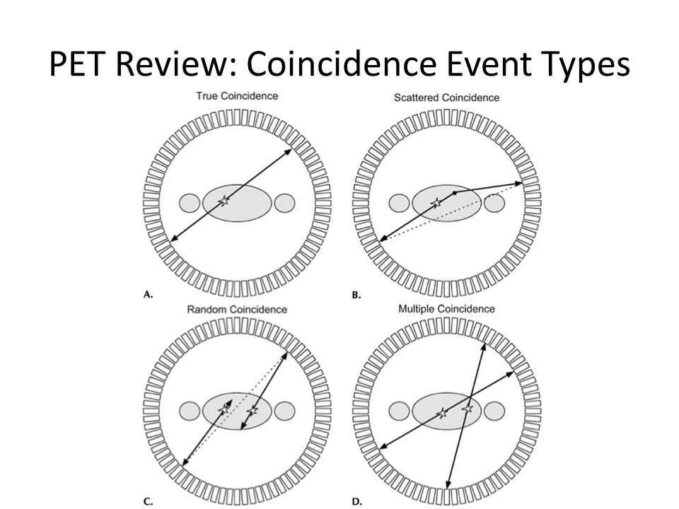

Slide 9
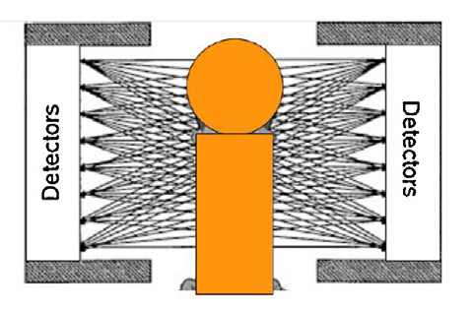
System Matrix

Slide 10
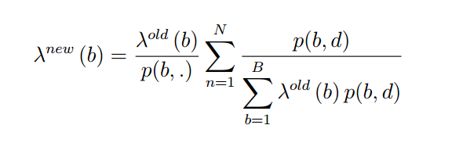
PET reconstruction (vardi 1985)
Notes:
N: total number of measured events
P(b,d) probability that an emission from a basis function b is detected along the LOR d defided in the n-th event
P(b,) probability of detecting an emission in the b basis function
Lamda: volume
Ignore time decay

