Slide 1
BIP
Roberto Marabini

Slide 2
The Goal.
Notes:
Software developed for EM 3D reconstruction is used by default in the XR-field. Therefore researcher in x-ray field assume that the relation that exists between 3D structure and images in X-ray and electron microscopy is similar, in this talk we will claimthis claim.
2

Slide 3
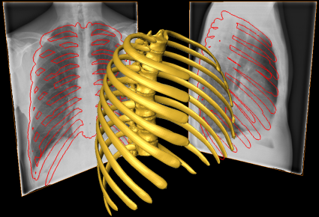
3D Reconstruction
Notes:
X-ray microscopy may be used to obtain structural 3D information from 2D images. Carolyn has just show some very nice examples. In this talk we will center in x-ray image formation model, that is, how the experimental data represented here by these two images is related with the
3D object.
WE are interested in the image formation process because is the first step in performing the inverse problem: reconstructing properly a real object
3

Slide 4
The Problem.
Notes:
Software developed for EM 3D reconstruction is used by default in the XR-field. Therefore researcher in x-ray field assume that the relation that exists between 3D structure and images in X-ray and electron microscopy is similar, in this talk we will claimthis claim.
4

Slide 5
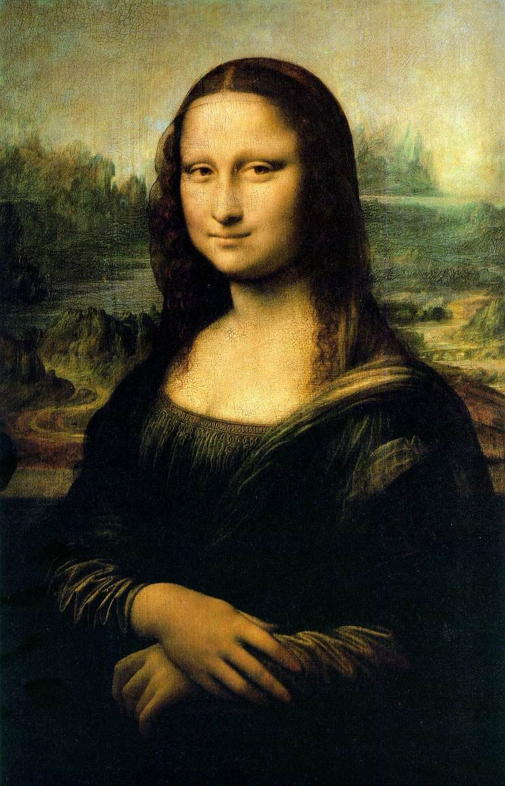

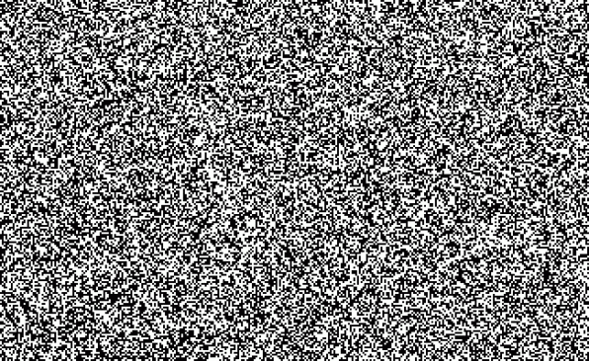
Notes:
5
This slide shows our claim in a graphical way. The well-known monalisa picture represents the ideal data, the data that the 3D reconstruction algorithms has been created for. This Mona Lisa represents the actual data. Understanding the difference between the ideal data and the experimental one will help us to design better 3D reconstruction algorithms

Slide 6
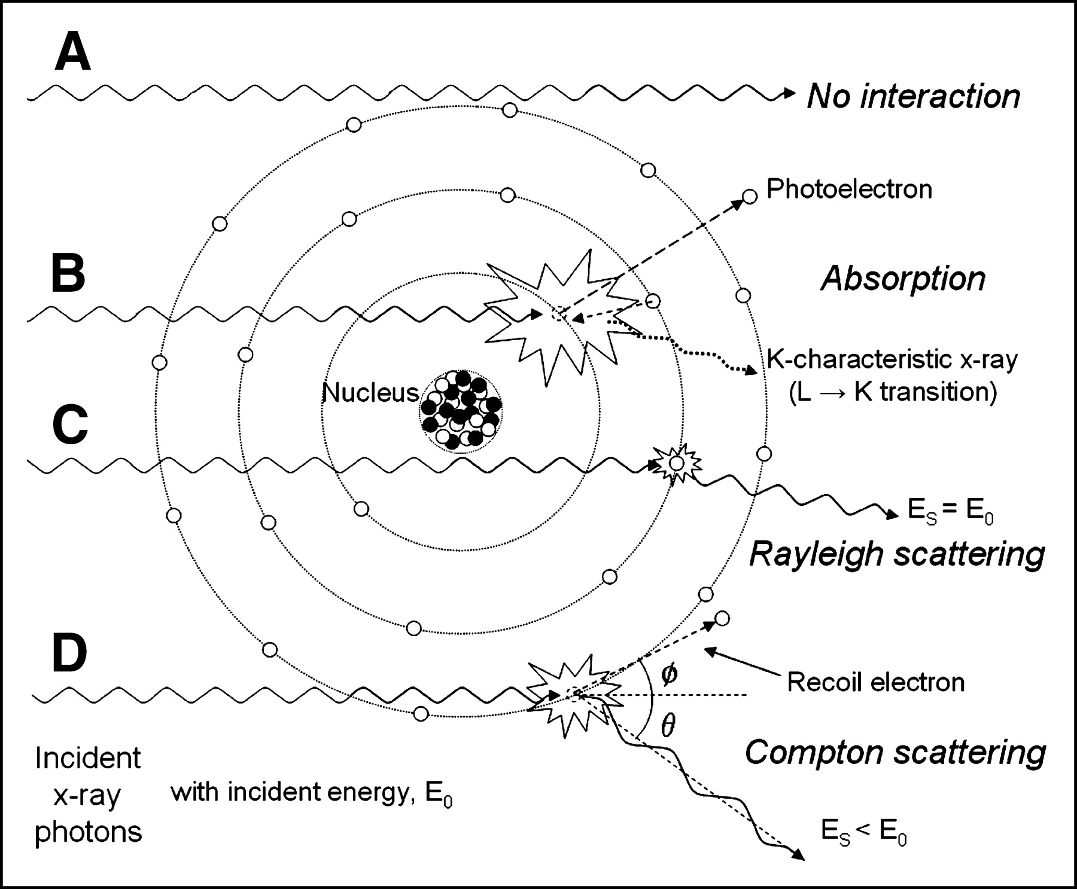

Slide 7
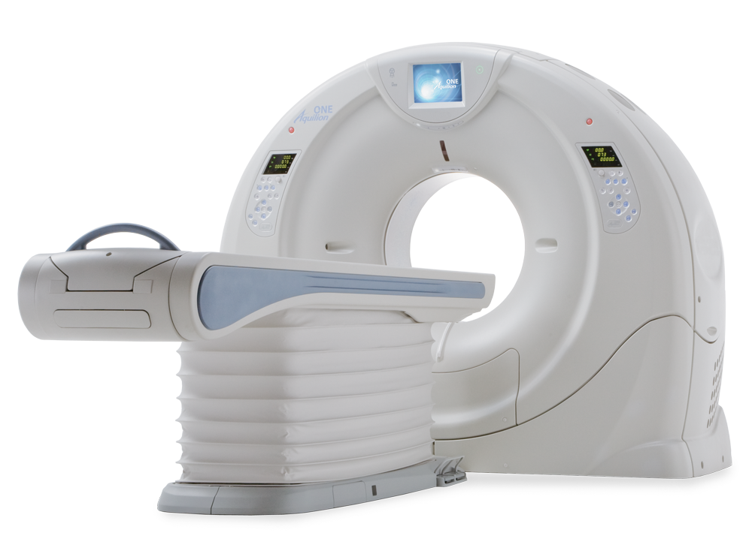
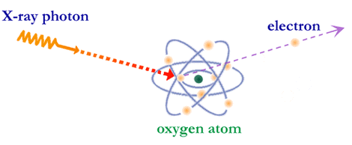
CT Scanner

Slide 8
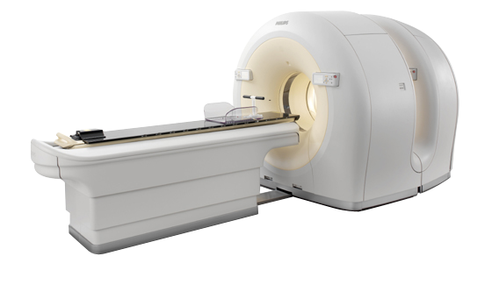
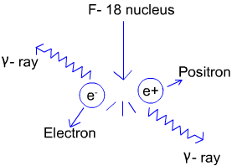
PET

Slide 9
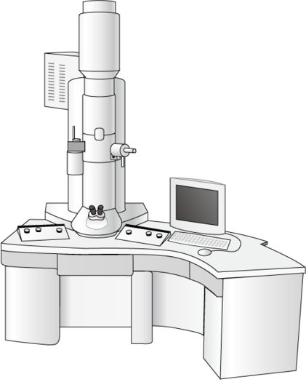
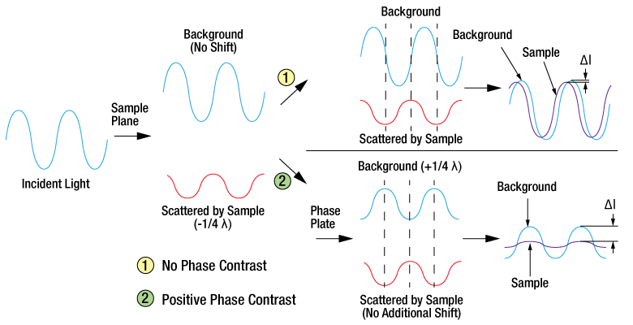
TEM

