Slide 1
CAT Scanner
Roberto Marabini

Slide 2
The Goal:
Understand How a CAT Scanner Works
Notes:
Software developed for EM 3D reconstruction is used by default in the XR-field. Therefore researcher in x-ray field assume that the relation that exists between 3D structure and images in X-ray and electron microscopy is similar, in this talk we will claimthis claim.
2

Slide 3
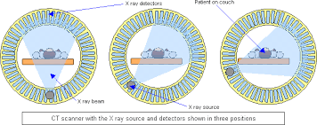
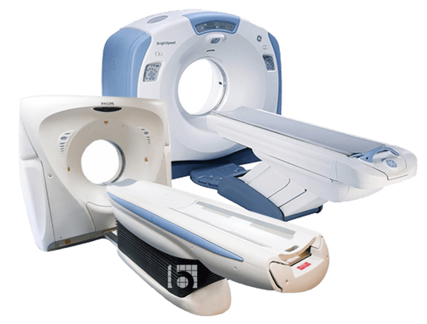
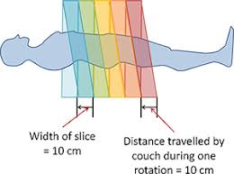
CAT Scanner
Reconstruct a single slice of an object using x-ray projections
Notes:
1) Where are the detectors

Slide 4
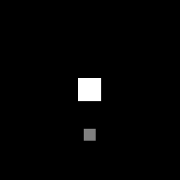

Raw Data: Radon Transforms
https://www.youtube.com/watch?v=q7Rt_OY_7tU
Notes:
Y = detector
X = angle

Slide 5
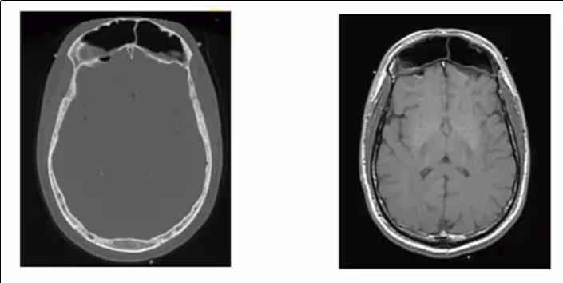
Properties of CT: Contrast
CT is great for distinguishing ____ from ___. Why?
Contrast agents
Notes:
Bone from soft tissue. Z^3
X-Ray vs NMR

Slide 6
TradeOFFs
Dose
Resolution
SNR
Notes:
We could achieve higher resolution & higher SNR if we increase X-ray dose. Scanner should try to minimize dose while still acquiring image that server for diagnostic

