Slide 1
X-Ray (CT)
Roberto Marabini

Slide 2
The Goal:
Physics behind CT
Notes:
Software developed for EM 3D reconstruction is used by default in the XR-field. Therefore researcher in x-ray field assume that the relation that exists between 3D structure and images in X-ray and electron microscopy is similar, in this talk we will claimthis claim.
2

Slide 3
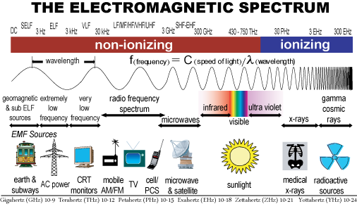
What are X-rays?
X-ray are electromagnetic radiation similar to visible light. (Phone)

Slide 4
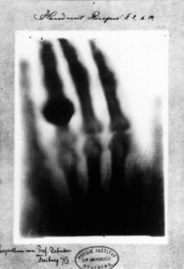
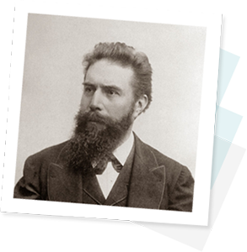
I’ve seem my death
In 1895 Röntgen discover this “light” that could pass through wood and tissues
He called it X-Rays. X stands for unknown, NP 1901
Died from carcinoma of the intestine

Slide 5
Physics: Produce X-rays
Like visible light x-rays can be seems either as __ or as __
Energy of a X-ray photon _________________
Produce X-rays: shoot electrons into matter
Bremsstrahlung (nucleus)
Characteristic X-ray (shell)
Notes:
Particle or wave
E = h* v [h= planck’s constant & v photon frecuency] = h * c /l [c speed of light, l wavelength] [Thanks to Einstein 1905]
Bremsstrahlung: an electron is decelerated by the charge of the nucleus (change direction). ray energy photon depends on Z and electron trajectory
Characteristic: knocks an electron out of its shell causing a cascade of electrons dropping shells || The energy of the photons depends on the binding energy of the electrons | discrete set of energies

Slide 6
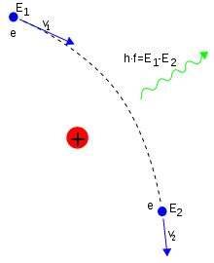
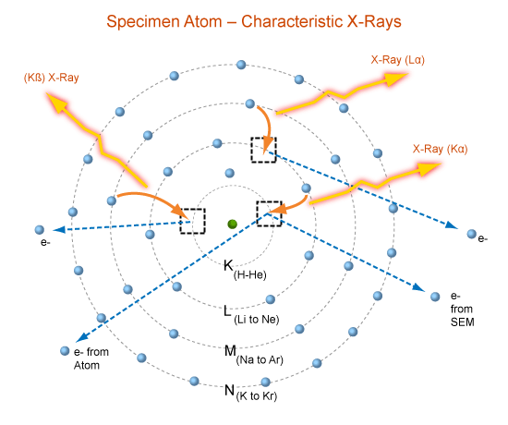

Slide 7
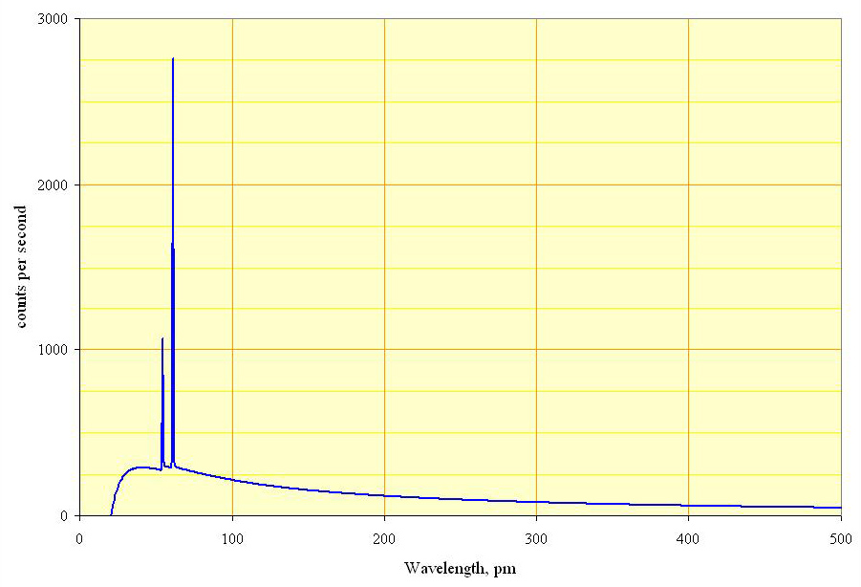
Resulting X-ray Spectrum
Notes:
X = energy
Y = number of photons
Draw first Bremsstrahlung (label it) then draw Characteristic label it

Slide 8
Resulting X-ray Spectrum
Notes:
Y= energy

Slide 9
Physics: Interaction between X-rays and Matter (produce images)
Three types:
Photoelectric absorption
Compton scattering
Rayleigh scattering

Slide 10
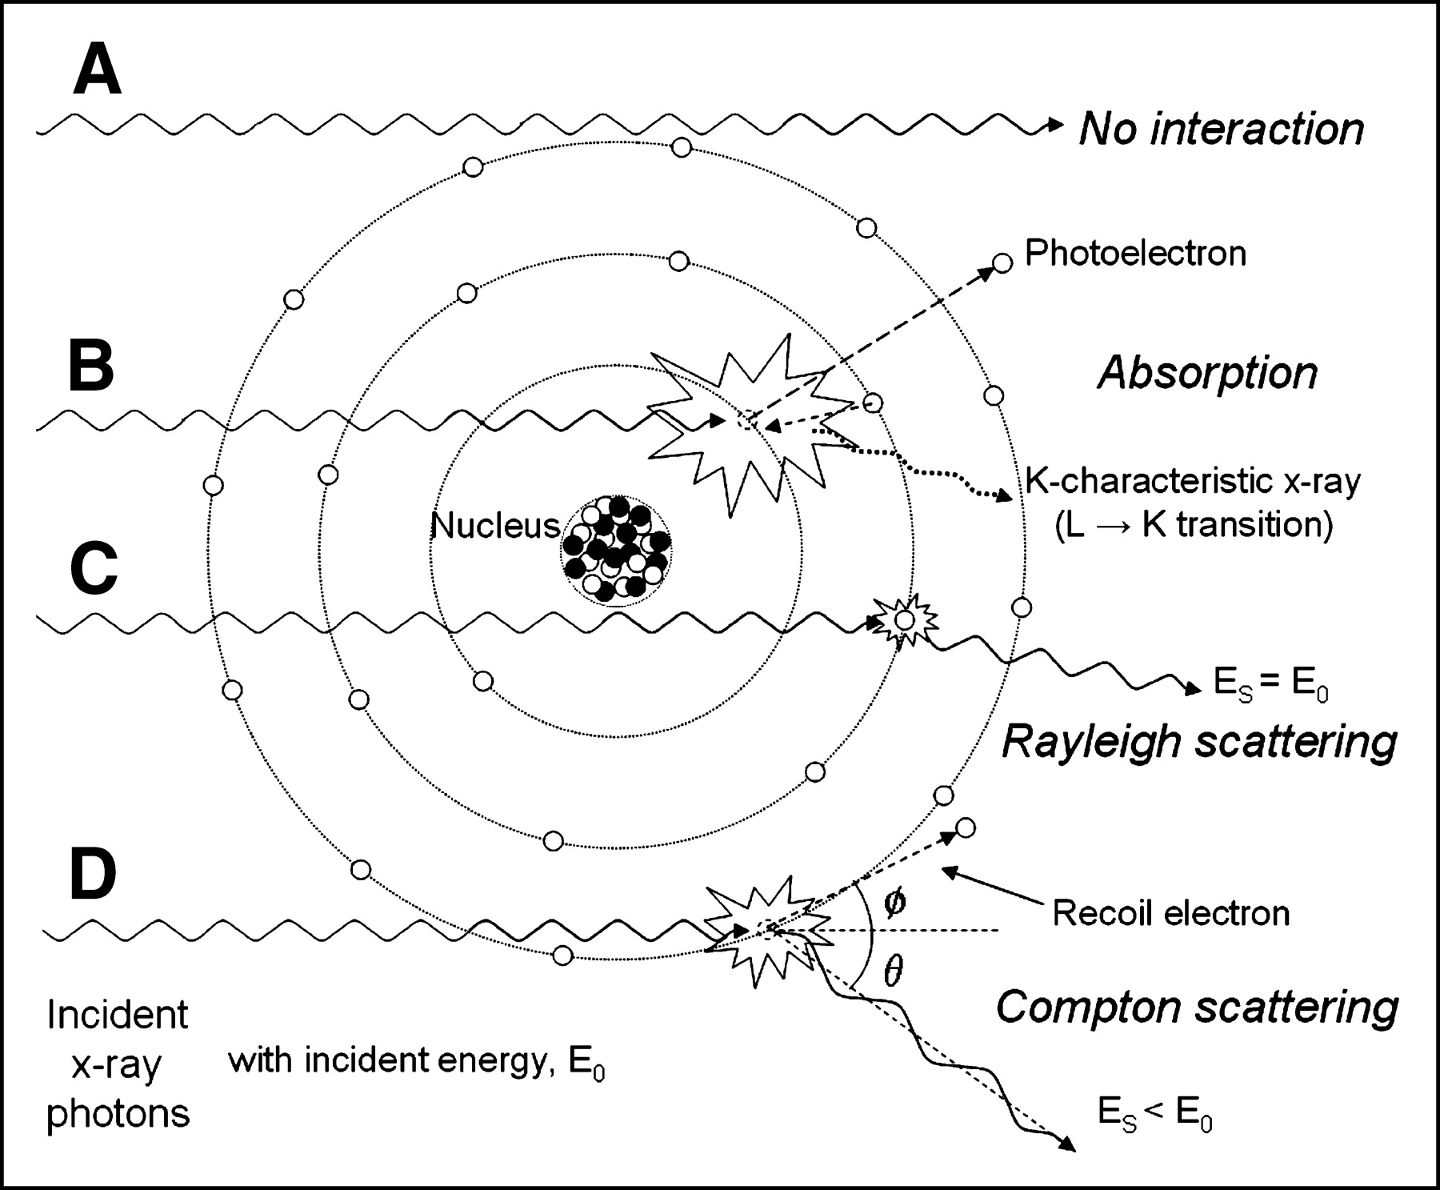
Photoelectric absorption
An x-ray photon ____
Probability of interaction___
This effect is the principal effect that makes x-ray useful since different ----- have different ----.
Therefore, x-rays images are -----
Notes:
Einstein awarded Nobel price 1921
Draw: (a) x-ray knocks electron out of the shell [creates lower energy photon plus electron]; (b) cascade of photons
Z^3 (atomic number) / E ^3
Tissues, atoms
X-ray attenuation maps.

Slide 11
Compton
Interaction with outer shell, no ____
Weak interaction, X-ray keeps most of ___
But changes___
Probability ____
Tissues in the body have ___ variation in ____
___ useful
Notes:
no shell cascade [output x-ray lower energy plus electron]
Most of its energy [vs previous case that Xray are at random]
A little direction
Proportional to e density
Small variation in electron density
Not____ It is noise

Slide 12
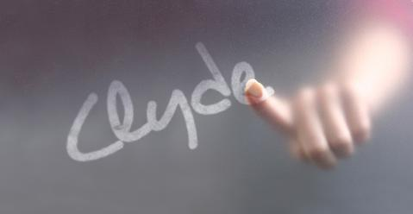
Rayleigh
No change of _____
But Change on ____
This interaction does ___ give us anatomical information
Notes:
Energy
Direction

Slide 13
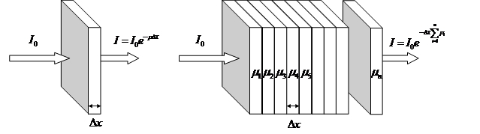
X-Ray attenuation Beer Lambert Law
homogenous
I=____
I= _____
Integral form: ___
Therefore I/Io is a _____
Notes:
i=io e - (mu)d; Berr Lambert law
i1=io e - (mu1)d (intensity that comes out of slab 1)
I2 = i1 e - (mu2)d
I3 = i2 e - (mu3)d
All togheter io e - (mu1)d * e - (mu2)d * e - (mu3)d = Io e – (mu1 + mu2 +mu3)d =Io e –Sum(mu_n)*d
I = Io e Int– mu(x))dx (where mu(x) is the attenuation function)
Ln(I/Io)=Int(mu(x)dx

Slide 14
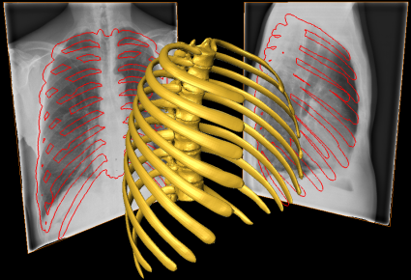
3D Reconstruction
Notes:
So I/io is this
14

Slide 15
The beam intensity (number of x-ray photons) that transmit through the tissue and emerges at the other side of the specimen encodes attenuation information of the matter along its path

Slide 16
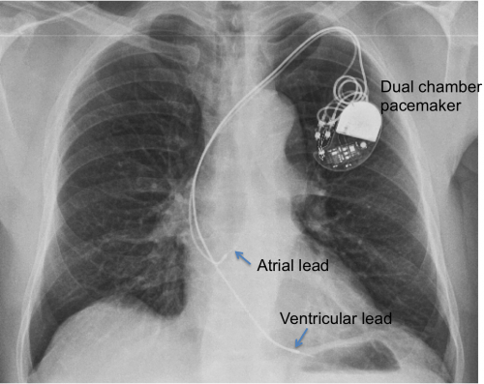
The problem with X-ray is that___
An X-ray is not
Notes:
a) All structures are projected project on top of each other, they are superimposed
b) A slice though the body

