Slide 1
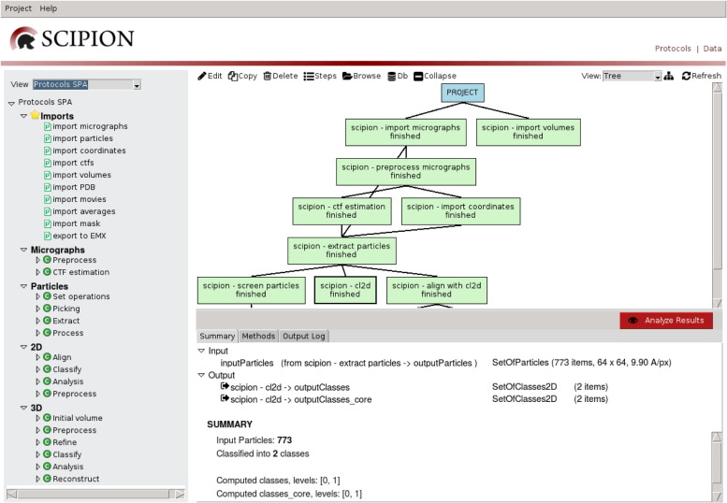

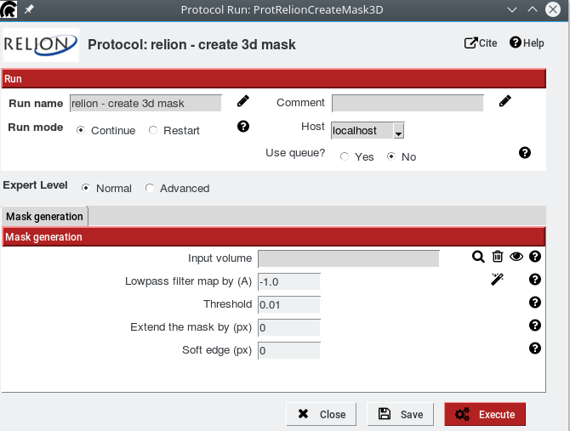
Writing Protocols with Scipion
Roberto Marabini
June 2018

Slide 2

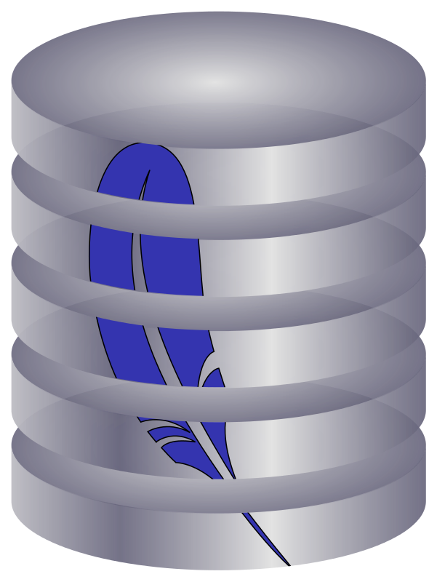
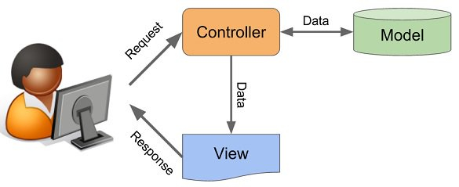
Programing Framework: Paradigm MVC

Slide 3


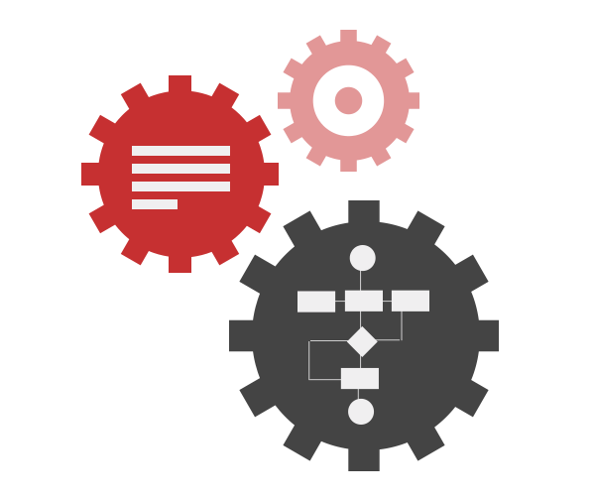
The Controler: workflow + workflow engine

Slide 4
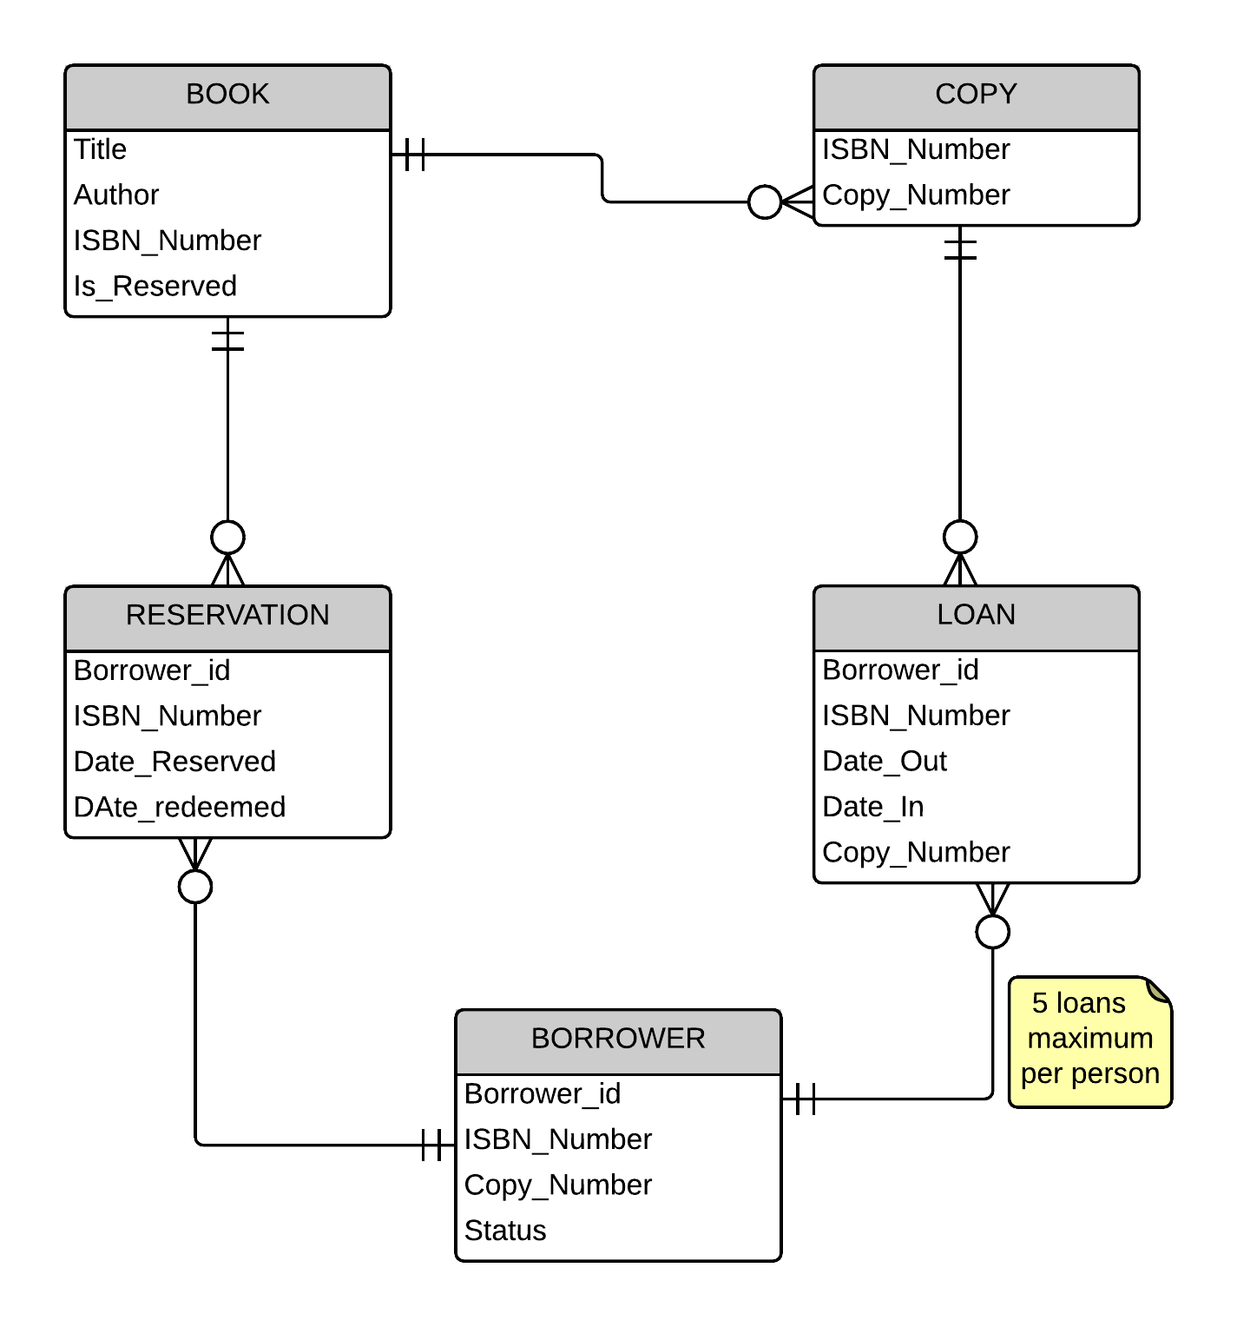
The DataModel
https://github.com/I2PC/scipion/wiki/Scipion-EM-Classes

Slide 5
My very first
Protocol

Slide 6
My very first Protocol-1:
class YYYYYProtXXX(EMProtocol):
""" Help messsage. """
_label = ‘protocolnamegoeshere'
#--------------- DEFINE param functions ---------------
def _defineParams(self, form):
pass
#--------------- INSERT steps functions ----------------
def _insertAllSteps(self): pass
#--------------- STEPS functions -----------------------
def convertInputStep(self):
pass
def runMLStep(self, params):
pass
def createOutputStep(self):
pass
Where:
YYYY = package
XXXX = protocol
name
https://github.com/I2PC/scipion/wiki/Creating-a-Protocol

Slide 7
My very first Protocol-2:
Create a protocol that:
Takes as input a set of particles
Produces as output a set of particles
For each input image create an output image such as I_{o}(x,y)=||I_{i}(x,y)||
Use xmipp_image_operate ->
xmipp_image_operate –i image1 --abs –o image2

Slide 8
Step 1: Create Gui
Download auxiliary files: git clone https://github.com/rmarabini/scipioncourseprotocols.git
Place file template_0.py in directory $SCIPION_HOME/pyworkflow/em/packages/xmipp3
Call it myprotocol.py. Edit file myprotocol.py
Add Class XmippProtABS to $SCIPION_HOME/pyworkflow/em/packages/xmipp3/__init__.py
From myprotocol import XmippProtABS
Start scipion. Search for new protocol CTRL-F (abs)
Protocol_0.py
Add IntParam

Slide 9
Step 2: Prepare Data
In function _insertAllSteps:
Self._insertFunctionStep(‘convertInputStep’)
Tip_1: $SCIPION_HOME/pyworkflow/em/packages/xmipp3/protocol_break_symmetry.py
from pyworkflow.em.packages.xmipp3.convert
import (writeSetOfParticles)
WriteSetOfParticles(
self.inputParticles.get(),
self.inputFn)

Slide 10
def _defineFilenames(self):
self.inputFn =
self._getTmpPath('input_particles.xmd')
self.outputMd =
self._getExtraPath('output_images.xmd')
self.outputStk =
self._getExtraPath('output_images.stk')
Test:
Export SCIPION_DEBUG_NOCLEAN=1
Import Data
Browse tmp directory
Protocol_1.py

Slide 11
Step 3: Add runOperateStep
Edit file myprotocol.py
Edit functioninsertAllSteps
xmipp_image_operate –i image1.xmd - -–abs –o image2.stk
Tip_1: $SCIPION_HOME/pyworkflow/em/packages/xmipp3/protocol_break_symmetry.py
Tip_2:
self._getExtraPath(‘nameoutputfile.stk’)
Self.runJob(“program_name”, “string with arguments”)
Start scipion and check the log file.
Protocol_2.py

Slide 12
Step 4: Create OutputStep
Tip_1: $SCIPION_HOME/pyworkflow/em/packages/xmipp3/protocol_break_symmetry.py
See protocol_3.py

Slide 13
Step 5: citation, methods, summary
Bbitex.py
_citations
protocol_4.py

Slide 14
Step 6: Do it yourself ***
Use xmipp_image_operate to sum two sets of images
Input 2 set of images
Output a single set of images

Slide 15
Step 6: Do it yourself ***
Add validate

Slide 16
Step 7: your turn, xmipp_transform_filter ***

