Slide 1
MPI Usage: Fused Collectives
R. Marshall

Slide 2
Goals
Find “fused” collectives in the wild (collectives used in combinations)
Look for patterns in the way they are used

Slide 3
Overview
Query
Seeder
(build URL list)
CorpusBuilder
(uses git)
MPI Usage script
(run for items in corpus)
Report

Slide 4
Data Sources
Data sources generate lists of repositories
Main sources
  Github
  Google code search

Slide 5
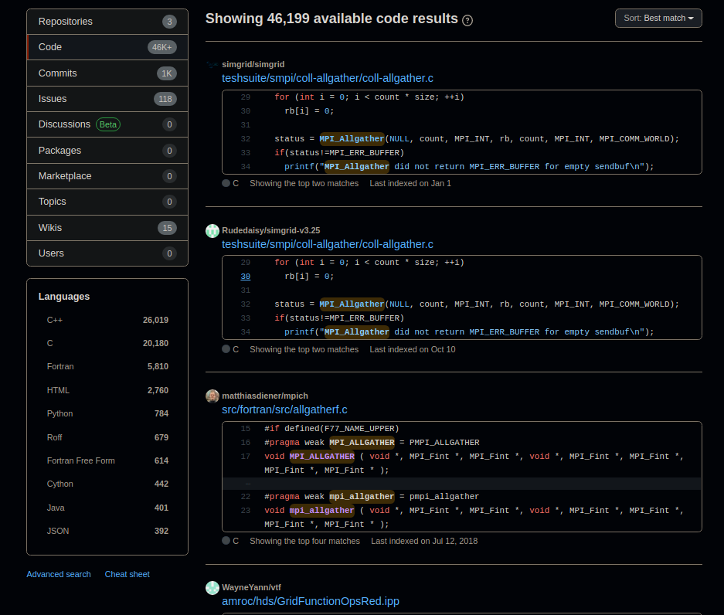
Github Search (human friendly)

Slide 6
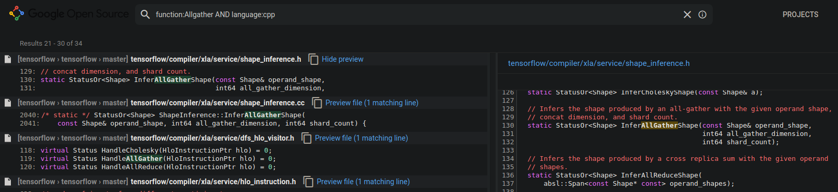
Google Code Search (human friendly)

Slide 7
Query
Query defines the search to find a list of repositories matching the criteria
Currently can search by
  Function name
  Language
  New Regex patterns for complex usage (experimental)
    Example: “^*(Coll1\(*\).(Coll2\(*\)*){2}).Coll1\(*\)*$” (find 2 uses of Coll2 between a pair of calls to Coll1)

Slide 8
Seeder
Manage the URL list
Do pre-checks (duplicates, etc.)

Slide 9
BuildCorpus
Run git on the URL list
Manage corpus

Slide 10
MPI Usage Script
We use Ignacio’s script to analyze each member of the corpus
TODO: add support for custom Regexes to find specific combinations of collectives

Slide 11
Known Issues
URL list needs to be checked manually for relevance
To solve, the Seeder needs to maintain a blacklist

