Slide 1
THE CONTROL PLANE MET
THE FAILURE FIRST
LIVE RUN · DECODE WORKER
A100
40 GB SXM4
Serving a tool-using agent on one scarce A100
3B
BF16 model
A measured deployment story: capacity math, admission, placement, KV handoff, and the failure boundary.
20.02
decode KV ceiling
@ 2,048 tok/request
41,008 KV-cache tokens ÷ 2,048
≈ 20 full-length decode sequences.
Outcome
Transfer failure surfaced
before HBM exhaustion.
Measured on Lambda A100; per-worker vLLM KV estimate, not throughput.
01

Slide 2
APPLICATION SHAPE
An agent turn is a chain of prefill and decode phases.
The conversation grows after every tool result; the system/tool schema is the shared prefix, the conversation is unique.
USER TURN
→
THINK
→
TOOL
→
OBSERVE
→
ANSWER
system + schema
unique tokens
fake tool call
tool result
final decode
SHARED PREFIX
UNIQUE CONTEXT
system prompt + tool schema → prefix cache candidate
user + thought + tool observations → KV grows
Application: app/crew_flood.py; prompt shape matches the live load generator.
02

Slide 3
CAPACITY BOUNDARY
The paper limit was KV, but the live engine exposed a smaller usable boundary.
Qwen 2.5 3B BF16 on the observed A100 configuration.
KV BYTES / TOKEN
FROM 40 GB PHYSICAL TO KV
36 × 2 × 128 × 2 × 2
40 GB physical A100
→ HAMi visible slices: 22,528 / 27,648 MiB
layers × KV heads × head dim × K/V × BF16 bytes
→ vLLM gpu-memory-utilization=0.50
≈ 11.0 / 13.5 GiB allocation targets
− BF16 weights + activations + CUDA graph/runtime
→ measured KV remainder: 1.43 GiB / 1.41 GiB
36,864 bytes = 36 KiB / token
→ 41,744 prefill / 41,008 decode KV tokens
The 40 GB figure is physical capacity—not per-engine KV.
Request caps
Input: 8,000 chars / ≈2,048 prompt tokens · output: 512 new tokens · agent default: 32
Pressure client requested 1,024 output tokens; gateway clamped it to 512.
Measured boundary
At full context length, the decode worker—not the paper estimate—sets the practical KV ceiling.
Source: final_run_decode.log + final_run_prefill.log + app/guardrails.py; capacity is per worker.
03

Slide 4
ENGINE KNOBS
The asymmetry protects different parts of the agent loop.
Prefill is input-heavy and bursty; decode is interactive and slot-sensitive.
PREFILL · MOVE INPUT
DECODE · PROTECT INTERACTION
max_num_seqs = 32
batch tokens = 1,024
max_num_seqs = 64
batch tokens = 512
More tokens per scheduling step
helps process long prompts and tool observations efficiently. Fewer active sequences limit memory contention while chunked prefill runs.
More sequence slots give continuous batching room for agent turns. Smaller token batches reduce per-step monopolization and help protect ITL.
IMPORTANT
These are scheduler ceilings—not a promise of 64 full-length requests. KV admission remains the safety boundary.
Engine config: k8s-config/hami/hami-lambda.yaml; max_model_len=2,048 on both workers.
04

Slide 5
CLUSTER DESIGN
Prefill and decode are disaggregated into two separate vLLM engines.
One physical A100 is split by HAMi; Mooncake transfers the produced KV state from the prefill engine to the decode engine.
CLIENT / AGENT
GATEWAY
PREFILL ENGINE
DECODE ENGINE
guardrails
app/crew_flood.py
→
admit · place · queue
429 / 503 / 529
→
vLLM producer
22,528 MiB · 55% cores
chunked prefill + prefix cache
KV →
vLLM consumer
27,648 MiB · 55% cores
continuous batching + decode
ENGINE OPTIMIZATION
STAGE-SPECIFIC BUDGETS
prefix caching · chunked prefill
continuous batching = vLLM default
priority scheduling · KV events
MooncakeConnector · max_model_len=2048
HAMi gpucores=55 for both engines
prefill: seqs 32 · batch 1024
decode: seqs 64 · batch 512
gpu-memory-utilization=0.50
Disaggregation/config: hami-lambda.yaml · prefill=kv_producer · decode=kv_consumer · MooncakeConnector.
05

Slide 6
ROUTER DECISION METRICS
The router makes decisions from a worker snapshot, not from every dashboard metric.
The live decision loop is: scrape → snapshot() → filter → admit/place.
SNAPSHOT()
ADMISSION + RESPONSE
PLACEMENT
vLLM metrics
waiting requests
running requests
KV cache usage
prefix-cache state
waiting by reason
Uses snapshot + request
Live default: p2c
Prefill:
prefix score + sticky
affinity, then p2c
Decode:
active-request + KV
score, then p2c
Explicit option: least_loaded
429 tenant_tokens
→
local policy rejection · no overflow
→
503 timeout / KV / no pod
overflow eligible if approved
503 slice_oom
hard local refusal · no overflow
529 upstream overload
overflow eligible if approved
Live code: router/pools.py snapshot() · router/router.py filtering/scoring · gateway/admission.py.
06

Slide 7
OPERATIONAL EVIDENCE
Other metrics prove what happened; they do not yet steer the router.
These are essential for RCA, dashboards, and the next control-loop iteration.
ENGINE OUTCOMES
KV / GPU EVIDENCE
FUTURE FEEDBACK
TTFT
inter-token latency
preemptions
restart count
Purpose: validate SLOs,
explain queue pressure,
and prove failure impact.
Mooncake hops
transfer tokens
KV-event residency
DCGM util / memory / power
Purpose: prove handoff
behavior and HBM headroom.
TTFT / ITL p99
preemption rate
DCGM health
Could drive:
p99 shedding
ramp-up
KEDA feedback
Not active thresholds today.
Live evidence: Prometheus/Grafana/DCGM snapshots · Mooncake proof · deployment logs.
07

Slide 8
CODE PATH
The gateway owns the boundary; vLLM owns the schedule.
The important distinction is where a decision is made—and what evidence it uses.
01
GUARD
bad model · empty prompt
prompt too long → 400
app/guardrails.py
NOT GATEWAY LOGIC
FCFS
continuous batching
chunked prefill
preemption
block-table management
02
ADMIT
tenant cap · timeout_queue
kv_free · no eligible pod
gateway/admission.py
03
PLACE
remove stale / unhealthy workers
prefer warm prefix, then load
router/router.py
HANDOFF
These remain inside
the vLLM engine.
04
Mooncake transfer
handoff success/failure bookkeeping
gateway/queue.py
Implementation anchors: app/guardrails.py · gateway/admission.py · router/router.py · gateway/queue.py
08

Slide 9
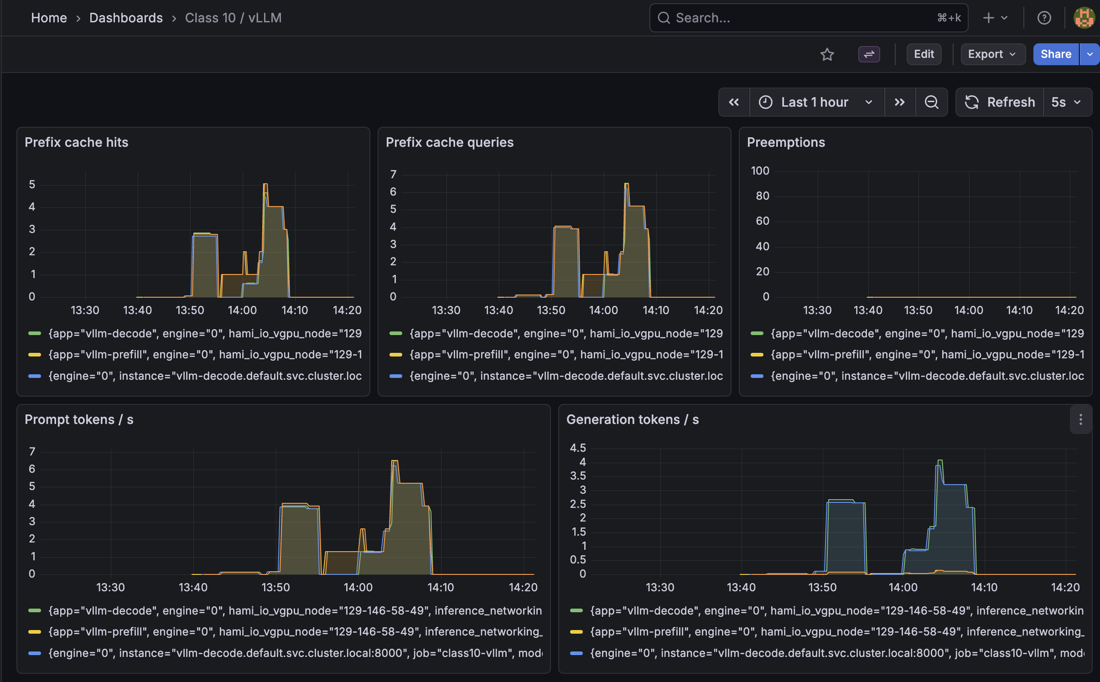
TEST 1 · BASELINE
First we established a healthy local path.
Low-load agent turns confirmed that the gateway, two vLLM engines, and metrics pipeline were connected before pressure was added.
WHAT WE RAN
Baseline agent requests
• short multi-step turns
• normal prompt and output caps
• prefill → Mooncake handoff → decode
• Prometheus scrape during the run
FINDING
The path was live: requests completed, prefix-cache activity appeared, and no preemptions or KV exhaustion were observed.
Dashboard capture: prefix cache hits / queries, prompt and generation tokens, preemptions.
Evidence: before-test Grafana capture + baseline request logs.
09

Slide 10
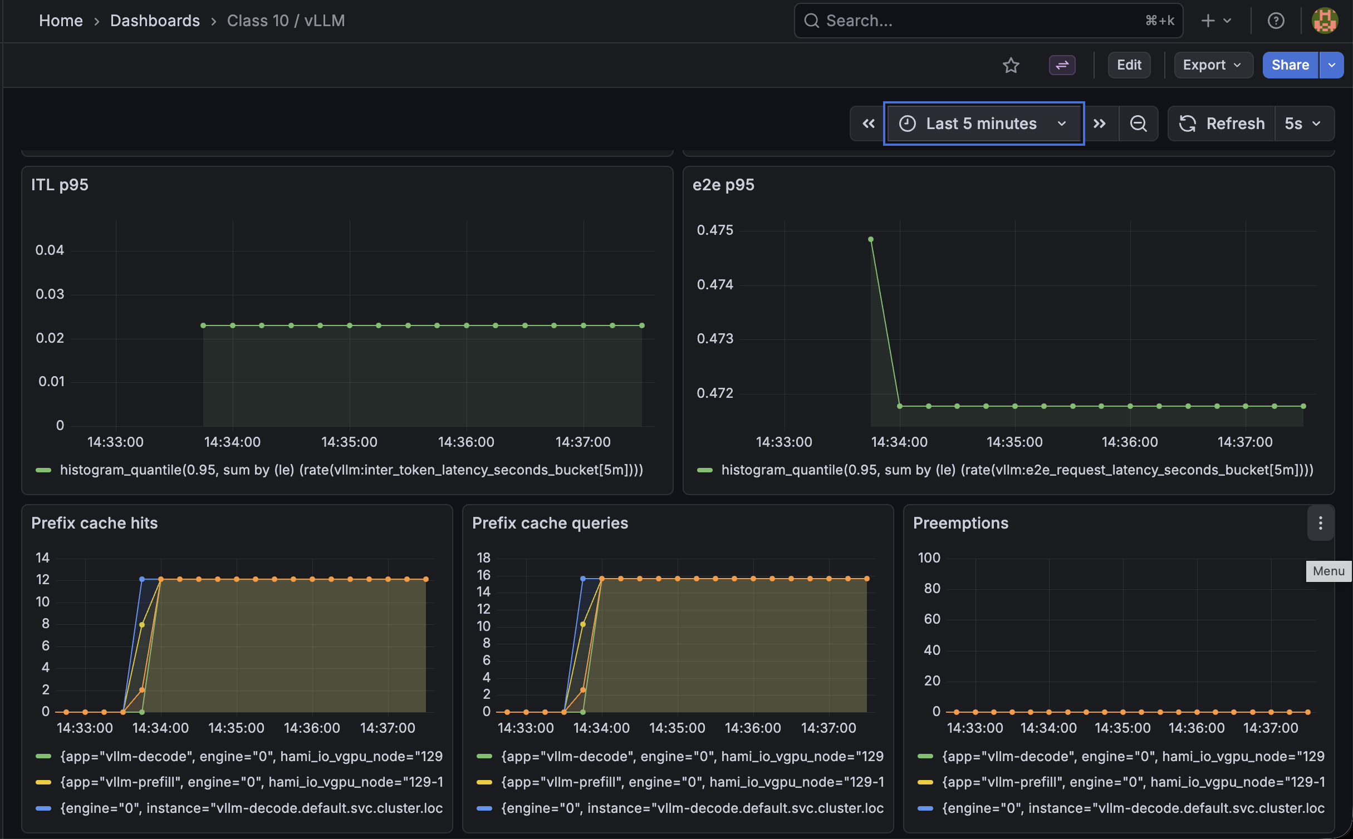
TEST 2 · HIGH-PRESSURE BURST
The burst failed at the KV handoff before HBM filled.
This was the test of the original hypothesis: would decode capacity or KV memory be the first practical limiter?
LOAD PROFILE
96 in-flight requests
1,500-token prompts
1,024 output requested → gateway clamped to 512
Mooncake prefill → decode transfer enabled
RESULT
12 completed · 18 kv_transfer_failed
66 no_eligible_pod
GPU memory was only ~8.3 GiB in the fail-policy run; this was not slice OOM.
Dashboard capture: ITL p95, end-to-end p95, prefix activity, and preemptions.
Evidence: extended burst logs + Grafana burst capture + gateway outcome counters.
10

Slide 11
HANDOFF RCA · 1
Issue 1: the gateway request was not enough for a real KV handoff.
The OpenAI-compatible request had to carry the connector’s per-request producer/consumer metadata.
ROOT CAUSE
CHANGE
WHAT IT PROVED
Generic request path
Final request adapter
A real handoff path
The gateway knew the phase, but Mooncake needed explicit transfer identity, engine identity, and producer/consumer direction.
Builds `kv_transfer_params` for both engines, shares a transfer id, discovers the producer engine id, and sends prefill with `max_tokens=1`.
The request reached the actual MooncakeConnector path and produced transfer metrics. It did not eliminate connector-side transfer failures under pressure.
Result: decode could receive a request without an accepted remote-KV contract.
The connector remains inside vLLM/Mooncake; the gateway supplies the handoff metadata.
Evidence: `gateway/queue.py` + `router/kv/mooncake_connector.py`.
RCA boundary: adapter-owned metadata vs engine-owned KV movement.
11

Slide 12
HANDOFF RCA · 2
Issue 2: asynchronous handoffs could outlive the request lifecycle.
A late Mooncake callback can arrive after vLLM has removed the request; overlapping transfers made that race more likely on one decode slice.
ROOT CAUSE
MITIGATION
LIMIT
Producer / consumer race
Serialize the real handoff
Mitigation, not atomicity
Prefill, decode, callback, cleanup, and retry were not one atomic transaction. A failed or late callback could surface as `kv_transfer_failed` or restart risk.
A lock keeps producer and consumer submissions together. The consumer acceptance is used as the local handoff barrier before the gateway commits the request.
The full fix would require an engine/connector lifecycle state such as WAITING_FOR_REMOTE_KV with idempotent completion and safe late-event handling.
This reduces overlap; it does not rewrite vLLM’s internal scheduler.
That boundary remains inside vLLM/Mooncake.
Evidence: `gateway/queue.py` handoff lock + burst failure/restart behavior.
12

Slide 13
HANDOFF RCA · 3
Issue 3: a remote-KV failure needed a safe local fallback.
The first pressure run showed transfer failures before HBM exhaustion; the system needed to contain that failure instead of destabilizing decode.
ROOT CAUSE
CHANGE
MEASURED EFFECT
Remote load failed
Recompute + contain
Blast radius reduced
The consumer could not load remote KV for every request. In the fail-policy run: 18 `kv_transfer_failed`, 66 `no_eligible_pod`, and decode restart risk—while GPU memory was only ~8.3 GiB.
Decode uses `kv_load_failure_policy=recompute`; the gateway records transfer failure, reports it to the worker, and can circuit-break the failed handoff path.
The recompute run completed local work and avoided a new decode restart during the run, but transfer failures still occurred. It is resilience—not a repaired remote-KV protocol.
This trades extra compute for a safer failure mode.
Evidence: hami-lambda.yaml + recompute run.
Conclusion: gateway mitigations contain failure; engine-level synchronization remains future work.
13

Slide 14
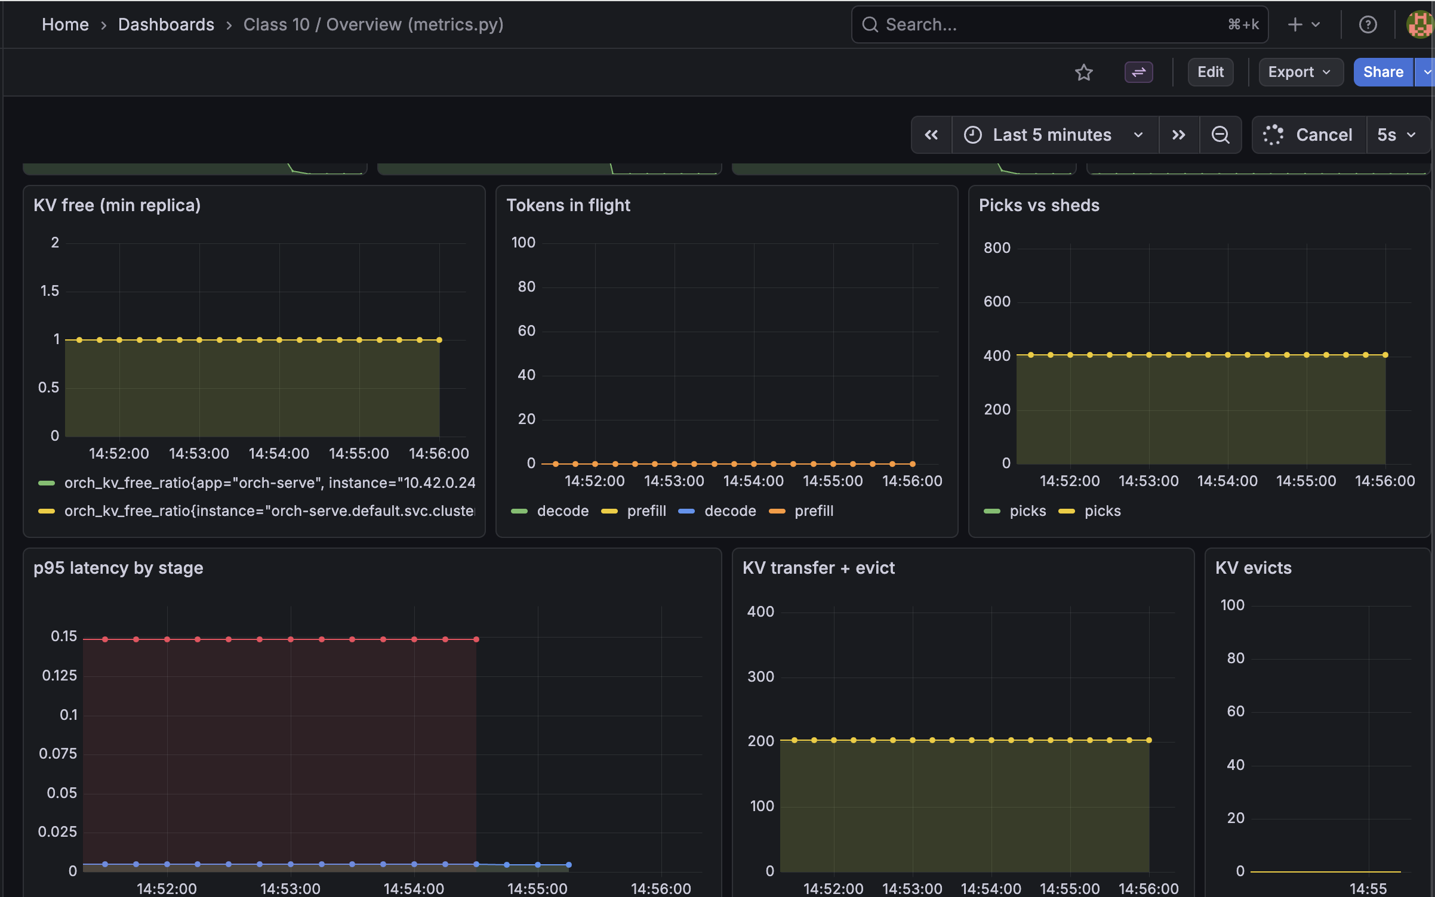
TEST 3 · EXTENDED SOAK
The longer run stayed below the KV ceiling.
After the handoff mitigations, repeated waves exercised the router and transfer path without consuming the engine’s full KV budget.
LOAD PROFILE
10-minute repeated waves
16-request waves with the tenant cap raised
router picks and sheds observed continuously
KV transfer + eviction metrics scraped
FINDING
KV free stayed healthy; no KV evictions or HBM exhaustion appeared. The soak validated stability, not saturation.
The measured bottleneck remained handoff coordination, not raw KV capacity.
Dashboard capture: KV free, tokens in flight, picks vs sheds, p95 by stage, transfer + evict.
Evidence: extended soak metrics + Grafana overview capture.
14

Slide 15
CONCLUSION
The live run changed the hypothesis.
We expected raw decode/KV capacity to fail first; the measured boundary was the prefill-to-decode handoff.
WHAT WE PROVED
WHAT REMAINS
A working control plane
Engine-level synchronization
• real Lambda A100 hardware
• separate vLLM prefill and decode engines
• real MooncakeConnector path
• gateway decisions explained by Prometheus/Grafana
• transfer failures observed before HBM exhaustion
The gateway mitigations—metadata adaptation, serialized handoff, and recompute—reduced risk and made failures visible. They did not make remote KV completion atomic inside vLLM.
Next step: an engine/connector lifecycle barrier for remote KV acknowledgement and safe late events.
Final takeaway: capacity math identified the boundary; live metrics showed which subsystem actually failed.
Measured deployment evidence: finalproj/evidence/final-run/ and dashboard-screenshots/.
15

Slide 16
OPERATING CONTRACT · 1
The request and KV boundaries are explicit.
These are the lines between application context, gateway policy, and engine-owned KV state.
REQUEST BOUNDARY
KV LIFECYCLE
Shared vs unique tokens
What crosses the hop?
Shared: system / tool-schema prefix
Unique: user turn, thoughts, and tool observations
Gateway copies metadata only:
transfer id, engine id, direction.
Mooncake moves the KV blocks.
Timeout protection
queue wait > timeout / 2 → shed as timeout_queue
Eviction / ghost state
Tenant isolation
evict() removes router residency metadata;
skip it and the router may stick to KV that is gone.
per-tenant token window → 429, no overflow
Pointers: app/crew_flood.py · router/router.py · gateway/admission.py · gateway/queue.py · router/kv/kvbus.py.
16

Slide 17
OPERATING CONTRACT · 2
At 10× traffic, scale the consumed resource—not every limit.
The current run gives us a defensible alert set and a conservative next move.
FOUR PRODUCTION ALERTS
SCALE DECISION
WRONG NEXT MOVES
1 KV transfer failures
2 decode restarts / preemptions
3 KV usage + waiting capacity
4 DCGM memory / power / utilization
Decode pool first
Do not blindly:
The agent repeatedly generates and holds context, so decode slots are the first scale target. Add prefill capacity when uncached prompt tokens become the dominant load.
• raise max_num_seqs
• raise max_model_len
• add replicas without KV lifecycle / affinity
Evidence: gateway counters, vLLM metrics,
DCGM scrape, and Grafana dashboards.
p99_spread is instrumented but not an active shed threshold in this run.
First add the missing engine-level
remote-KV acknowledgement barrier.
Pointers: gateway/metrics.py · router/router.py · observability/dashboards.py · final-run metrics and Grafana captures.
17

