Slide 1

Optimizing a Transportation Company’s Chauffeur Schedules
Utilizing 2016 NYC Yellow Cab Trip Record Data
Rona Masab
September 03 2020

Slide 2
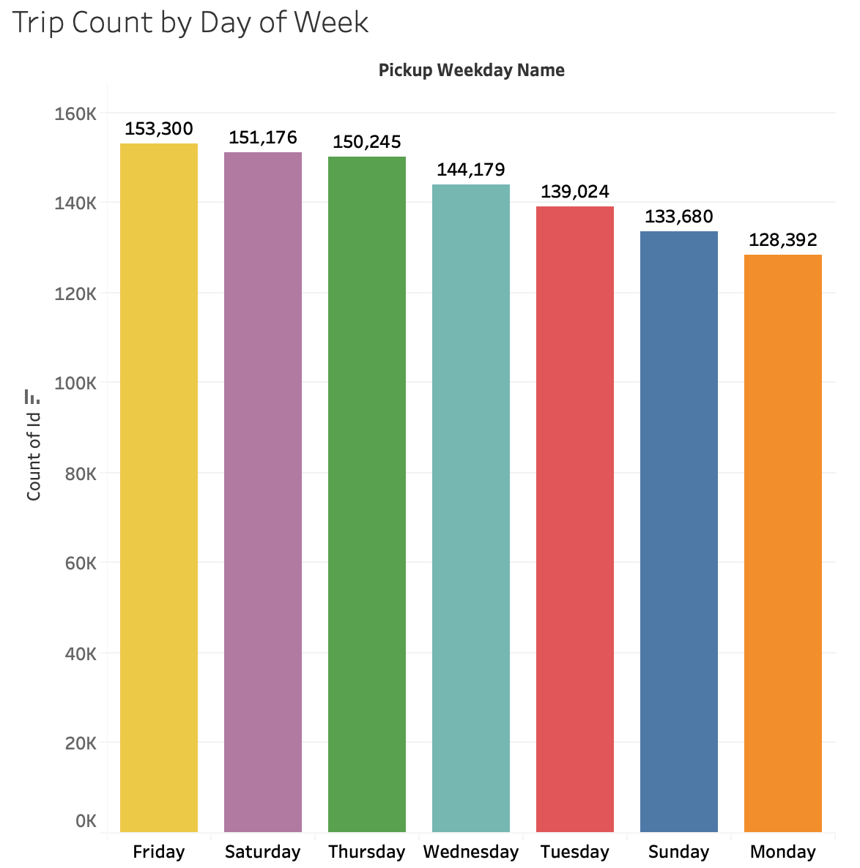
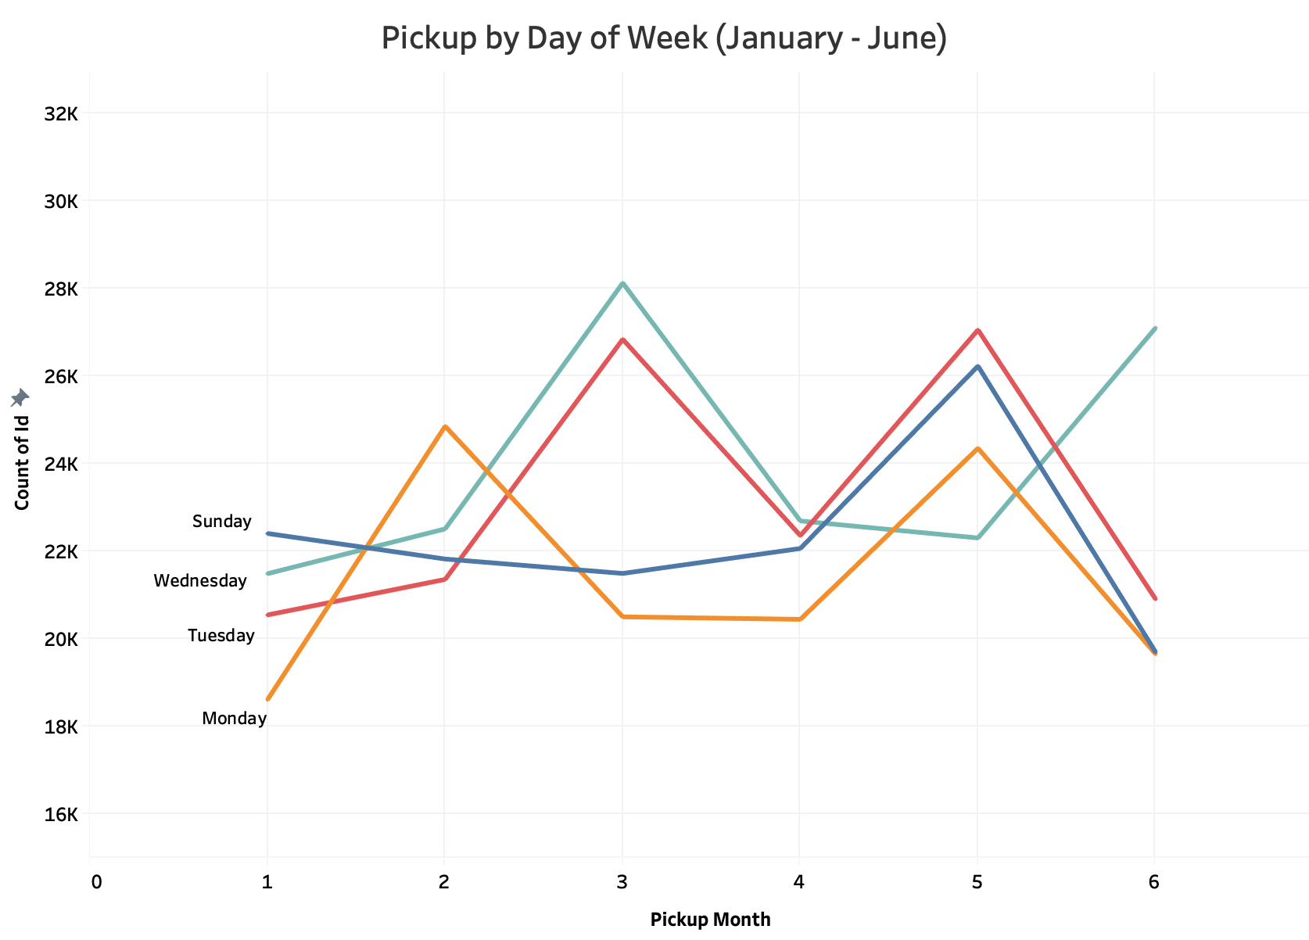
What Days Should Chauffeurs Take Off?

Slide 3
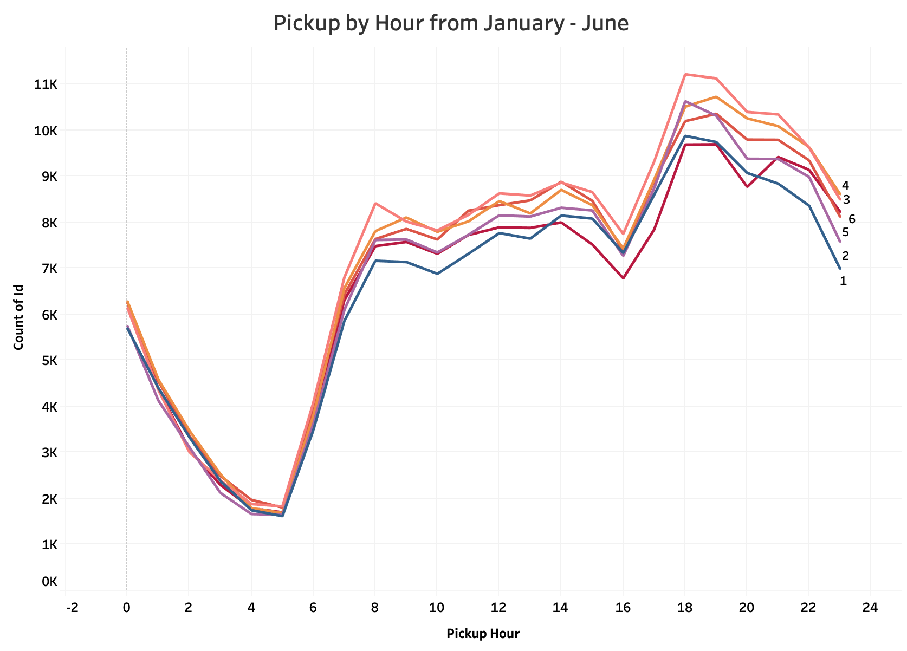
What Time Should Chauffeurs Change Shifts?
2 Chauffeurs per Vehicle
12 hour shifts
5:00 AM - 4:00 PM
4:00 PM
Morning Shift (AM)
5:00 PM - 4:00 AM
Evening Shift (PM)
5:00 AM

Slide 4
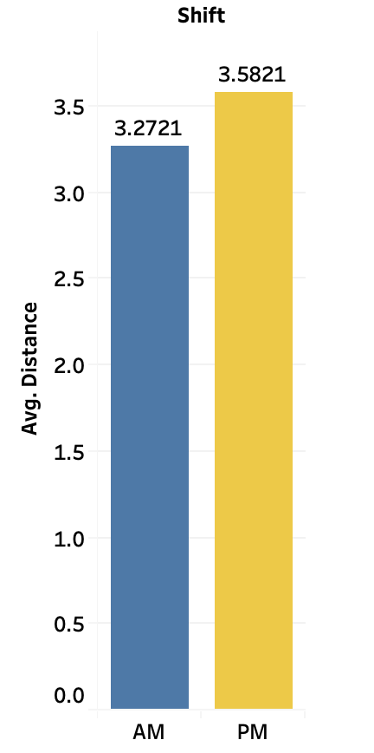

Are There Differences in Quality Between Shifts?
H0 - There is NO difference in the distance traveled between AM and PM shifts
H1 - There IS A difference in the distance traveled between AM and PM shifts
Results of the independent samples t-test with threshold of (p = 0.05):
(t=-36.12, p = 1.39e-285)
Reject H0! There are significant differences between AM and PM shifts
Suggestion : Rotating Shifts
Quality = Distance Traveled

Slide 5

Takeaways for Optimizing Chauffeur Schedules
Sunday or Monday are ideal days for chauffeurs to take off
Implement morning and evening shifts at:
Morning - 5:00AM - 4:00PM
Evening - 5:00PM - 4:00AM
Introduce idea of shift rotations so that both chauffeurs can reap benefits equally

Slide 6

Next Steps
Compare NYC Taxi data against rideshare companies like Uber or Lyft
Analyze taxi data in other states such as California
Analyze FHV data from 2020 from TLC since it is more inline with this company’s operations of pre-arranged trips

Slide 7

THANK YOU!
Contact Me
Email: Rmasab@gmail.com
Linkedin: linkedin.com/in/rmasab
Github: https://github.com/rmasab

