Slide 1
Rental Property Investments in the Windy City
Rona Masab
August 17 2020
Inside Airbnb Chicago, US dataset

Slide 2
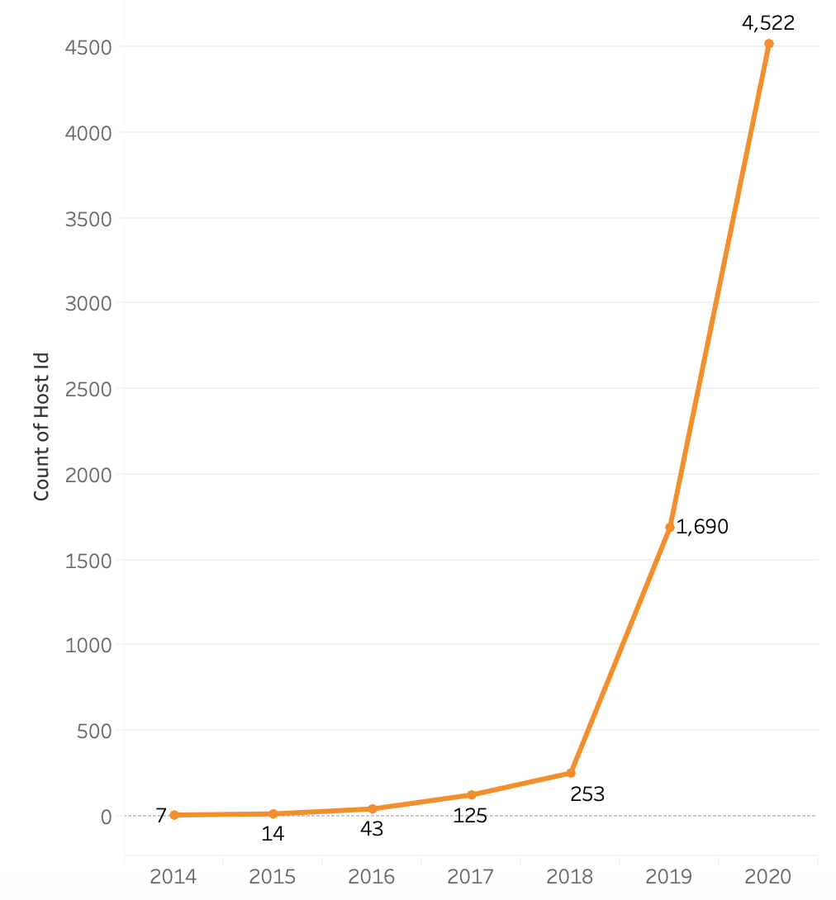
Airbnb Activity Over the Years
42%
*1,235 listings not displayed

Slide 3
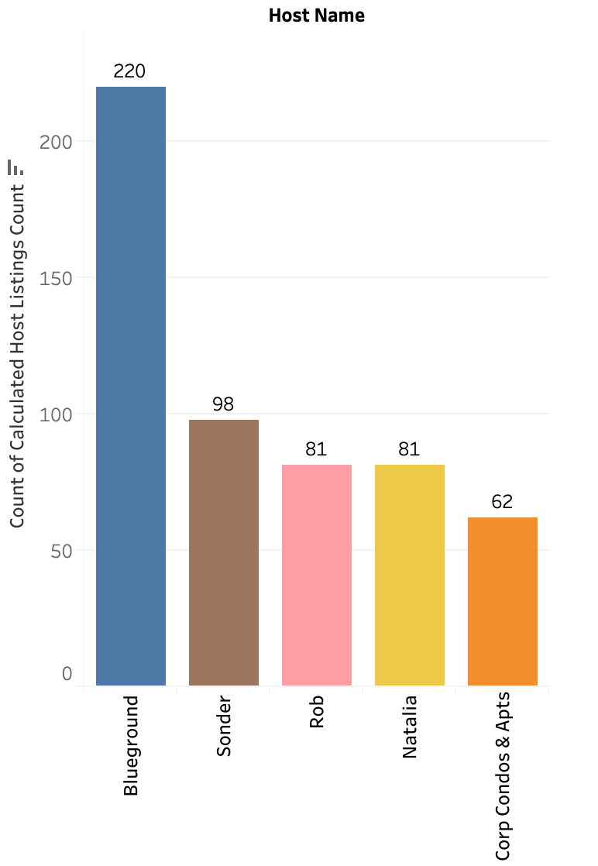
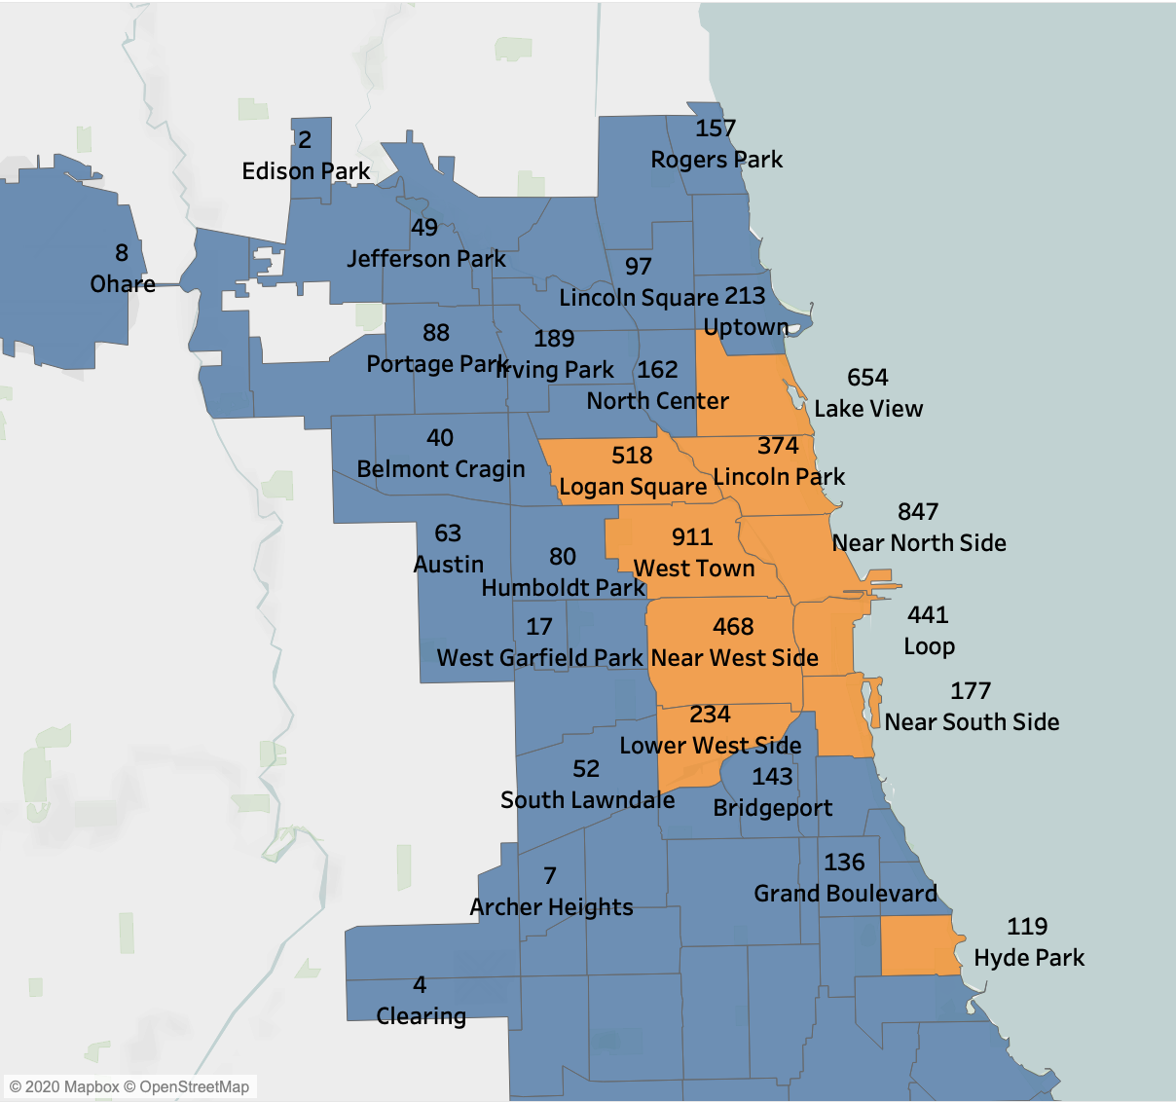
Who are the top hosts? Where are they located?

Slide 4
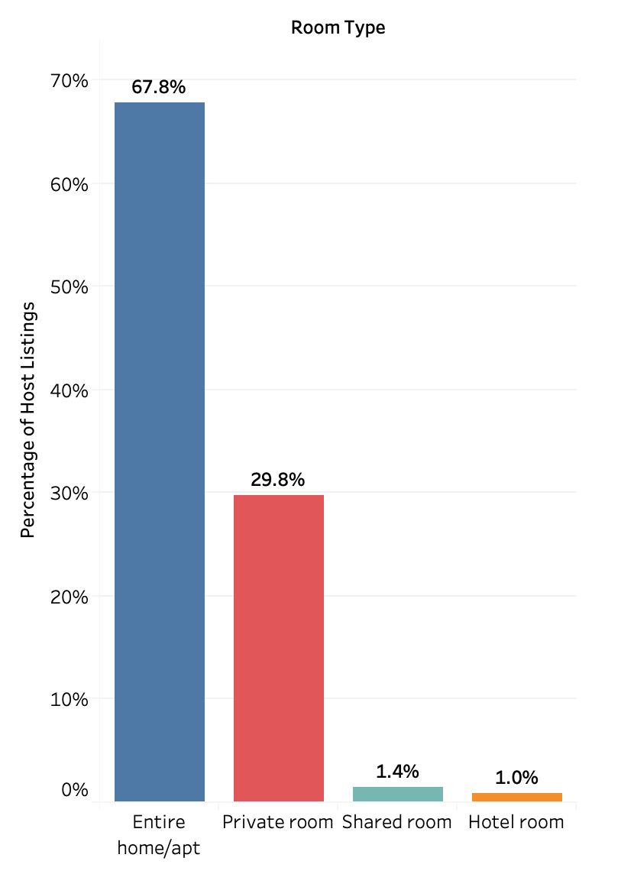
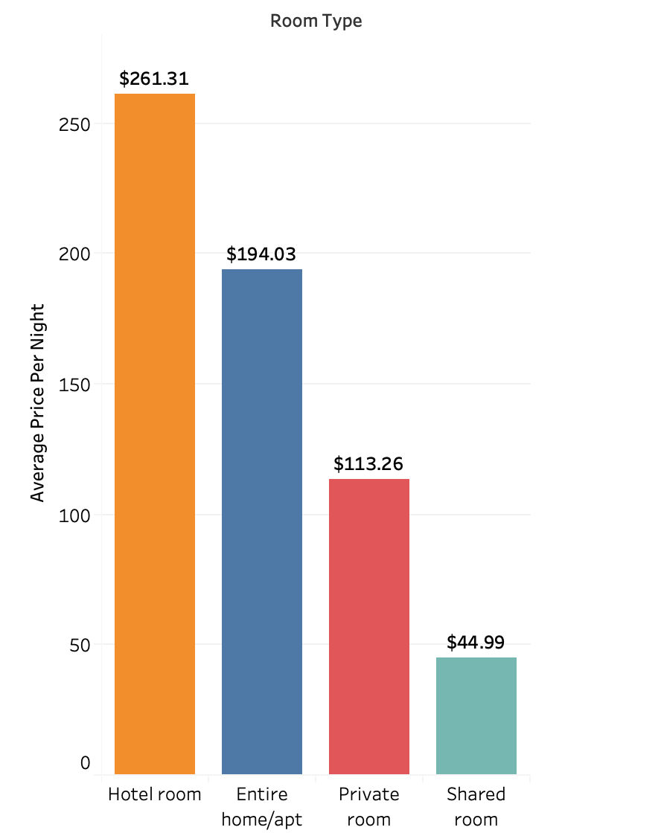
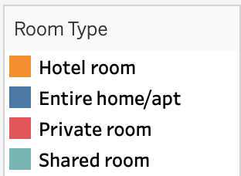
What Room Types are the most popular?

Slide 5
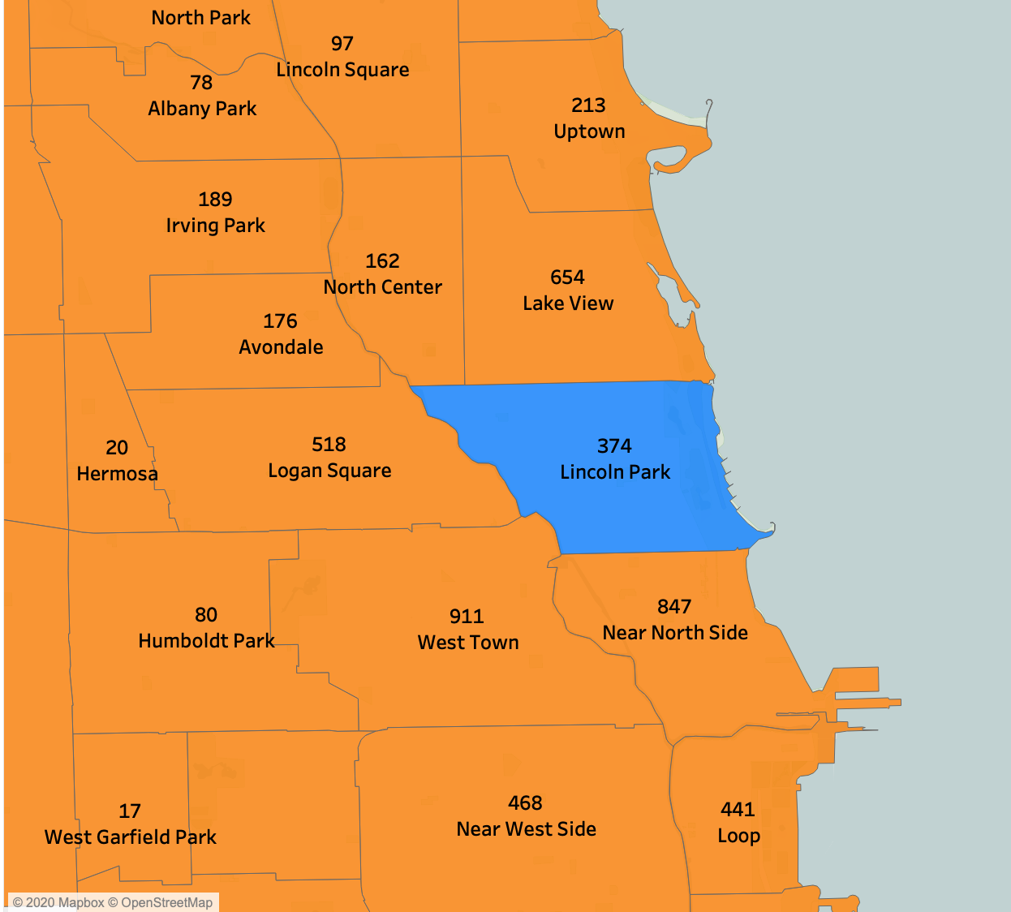
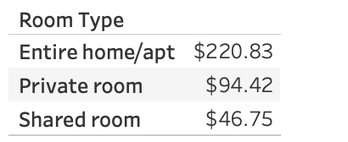
Let’s take a look at Lincoln Park
374
$220.83
$6,624.90
Attractions
Lincoln Park Zoo
Chicago History Museum
Nature Museum
Lake Michigan
Total Listings
Average “Entire home/apt” per night
Potential Per Month (30 Days)

Slide 6
Takeaways
Yes! Invest in rental properties in Chicago
Go for properties in less saturated neighborhoods
Look at property types that are entire homes or apartments

Slide 7
Next Steps
What amenities are most popular in these listings?
Conduct an analysis on the renters demographics
How can I apply this analysis to other cities in the US?

Slide 8
Thank You!
Contact Me
Rmasab@gmail.com
linkedin.com/in/rmasab
https://github.com/rmasab

