Slide 1


Rodgers
Home
Problem
Objective
Others
Churn Rate Analisys
A Case study of SyriaTel

Slide 2
Rodgers
Home
Problem
Objective
Others
Business Problem
The main of this project is to predict which customers are going to switch their mobile telephone carrier. What is the chance that a customer will switch to anoither provider
Customer churn is the loss of clients. Telephone companies use customer churn rates to as abusiness metric to since the cost of retaining an existing customer is less than acquiring a new customer.

Slide 3


Rodgers
Home
Introduction
Objective
Others
Business Objective
1
Which customer has the highest probability of switching to another provider?
2
What is the reason why people are switching to other providers?
3
How sure are we that the prediction is perfect, reliable.

Slide 4

Rodgers
Home
About
Content
Others
Data understanding
1
Dataset Summary
The data contained 3333 records with 21 features
No missing values recorded
Categorical and numerical data noticed
2
Observations
The target feature “churn” is imbalaned
Other imbalaned data include number of voice mail messages

Slide 5
Rodgers
Home
About
Content
Others
Data Cleaning
Dropped Features
1
Phone number, had no predictive implications
Label encoding for categorical features
Transformation of the Target Variable to 0 and 1
Other colums droped include total day charge, total eve charge, total night charge, total intl charge as they had a perfect correlation that would lead to multicollenearity
2

Slide 6
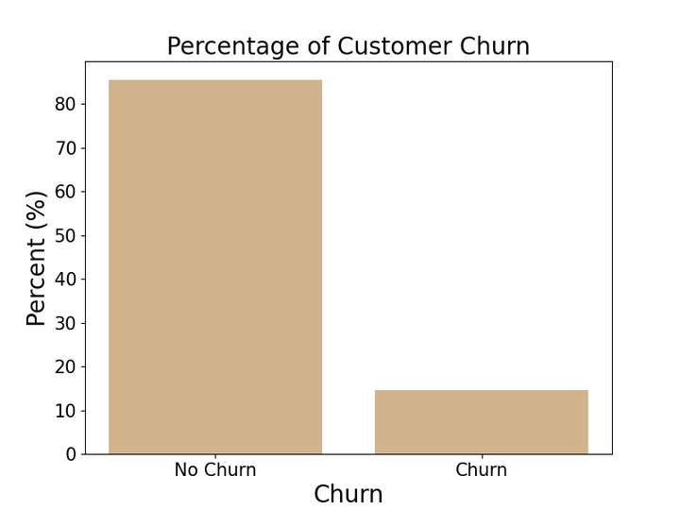
Rodgers
Home
About
Content
Others
EDA
Distribution of the target Vriable
No-Churn= 85.5%
Churn = 14.5%

Slide 7
Rodgers
Home
About
Content
Others
1
Gradient Boost Classifier
Highest sCore 97%
Precission: 90%
Recall: 73%
At -0.5 Threshold Recall is 82%
Comparison of best Models
2
Support Vector Machine
Highest score: 92%
Precission: 87%
Recall: 49%
At -0.5 threshold Recall: 73%
3
Random Forest
Highest score : 97%
Precision: 94%
Recall: 65%
At -0.5 threshold Recall : 73%

Slide 8
Rodgers
Home
About
Content
Others
Recommendation
Group Discussion
Implement retention campaign like giving customers incentives and giving discount on recharges and offering more talk time.

Slide 9

Rodgers
Home
About
Content
Others
Limitation
The data was imabalnced so the most of the models were imabalanced towards the majority class
Next Steps
Model performance optimization (fine tuning threshold) base don business requirements
Use |SMOTE to address class imbalance

Slide 10



Rodgers
Home
About
Content
Others
Thank You
+254 710 780 851
rodgers@rodgersotieno.com
www.rodgersotien.com

