Slide 1
RMatcher
Recommendation Engine
on the Yelp Dataset
Ameen Askar
Joon-Sub Chung
April 22, 2013

Slide 2
Motivation / Background
Users searching for businesses and restaurants:
IR systems help narrow down results
Users want places they would like
Users may have similar tastes
Methods to generate similarity scores:
Jaccard's Index (Binary Data)
Pearson Correlation (Non-Binary Data)
Yelp Dataset is provided for academic research

Slide 3
The Problem
RMatcher, a recommendation engine:
Input:
Users' ratings and reviews
Business categories
Check-Ins data
Output:
a set of recommendations for each user
Benchmarks:
Precision
Recall
Validity
Notes:
Jc penny macy's apple store

Slide 4
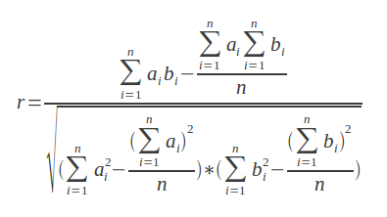
Baseline Solution
Pearson Correlation Coefficient based on users' ratings:
Will find how similar two users are
Recommendations obtained from high rated businesses from similar users
https://www.bionicspirit.com/blog/2012/01/16/cosine-similarity-euclidean-distance.html

Slide 5
A Smarter Recommendation Engine
Will use Pearson Correlation as well.
But, will investigate using more parameters:
Sentiment Scoring of the reviews to enhance the stars ratings
Different weights for different users
Check-Ins data for each business
Categories

Slide 6
Simulation Data
Yelp DataSet sample from Phoenix, AZ:
11,537 businesses
8,282 checkin sets
43,873 users
229,907 reviews
A quick look reveals the importance of user weighting:
Max user ratings: 5807
Average reviews: 38 per user
One user has 17 ratings with average stars of 0

Slide 7
Testing
Select an initial set of user ratings:
Compare with baseline method
Check for:
Precision
Recall
Some recommendation will be valid but the user never reviewed:
Will be subjectively reviewed and included as:
Validity rate

Slide 8
Milestones
4/26 Parse Yelp JSON data into relational DB
Identify a testing set
More Research
5/3 Basic pearson correlation Implementation
Sentiment scoring for reviews
5/10 Implement our recommendation engine based
on Pearson correlation of ratings,
sentiment scoring, categories, and check-ins data
5/17 Compare results to baseline method
Optimize weights for higher accuracy
5/24 Cleanup code and results output
Final Report & Presentation

Slide 9
References
Pearson Correlation:
https://www.bionicspirit.com/blog/2012/01/16/cosine-similarity-euclidean-distance.html
Learning content similarity for music recommendation:
http://cosmal.ucsd.edu/cal/pubs/simopt.pdf
SentiWorld:
http://sentiwordnet.isti.cnr.it/
Yelp Data Set:
https://www.yelp.com/dataset_challenge/

Slide 10
Questions?

