Slide 1
US Presidential Election Result Shifts From 2016 to 2020
Data Analytics Boot Camp Project 1 – August 2024
Roy Mathena

Slide 2





Questions for the Data
How did votes for non-major candidates (anyone but Trump, Clinton, or Biden) shift from 2016 to 2020?
How does that shift relate to the overall change in election outcome, from Republican in 2016 to Democrat in 2020?
How does that shift relate to county size?
How much variation was there in that shift, at a county level?
Did "swing states" show a significant difference in shift compared to the country as a whole?

Slide 3

Data Sources
MIT Election Data and Science Lab (MEDSL)
Two slightly different data sets, one for each election
Also got some simple information from the FEC and Ballotpedia

Slide 4
Data Exploration and Cleanup
The data sets had slightly different standards and slightly different problems:
Capitalization and Place Names: “Jefferson” vs ”JEFFERSON COUNTY”
Candidate Names: "biden, joe", "joseph biden", and "joseph r biden“
“Statistical Adjustments”, Write-Ins, and Straight Ticket Voting
Extra Data
Negative votes
Other “offices” that are apparently redundant votes
How to Group Results
There’s “the Democrat” (Clinton in 2016, Biden in 2020), “the Republican” (Trump), and “Other” (people like Gary Johnson, and unserious entries like Donald Duck)

Slide 5
Challenge: Are My Numbers Actually Right?
My early “clean” data had some pretty weird results, including about 4 million extra votes for “other” candidates
I compared my final clean data to the official counts from the FEC. I’m within 0.8% for the national numbers, which feels barely adequate. I’d like to improve this, especially the imprecise “other” votes which probably impact my results.
Candidate | 2016 (FEC) | 2016 (Me) | 2020 (FEC) | 2020 (Me)
The Democrat | 65,853,514 | 65,851,734 (99.997%) | 81,283,501 | 80,973,327 (99.618%)
The Republican | 62,984,828 | 62,980,405 (99.993%) | 74,223,975 | 73,662,011 (99.243%)
Total | 136,669,276 | 137,103,464 (100.318%%) | 158,429,631 | 157,750,726 (99.571%)

Slide 6
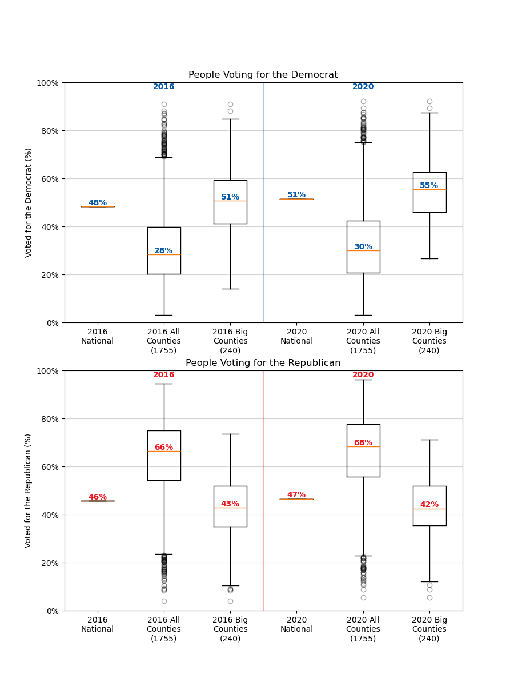
Why It Looks Weird
I’m mostly looking at changes in percentages among counties, not actual vote counts.
Looking at county-level results across the whole country is very different from what we see watching election results on the news.
There are more small counties (<100K votes) that influence the distribution, but big counties have much more impact on actual election results.
I did not consider Electoral College counts.
I was interested to see that BOTH major candidates got a higher percentage of votes in 2020 than they did in 2016.

Slide 7
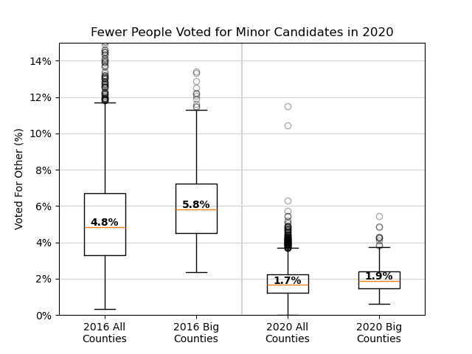
Where’d Those Votes Come From?
Votes for “minor candidates” dropped from 2016 to 2020.
The median percent going to minor candidates dropped by about 3% across the country, or 4% for big counties.

Slide 8
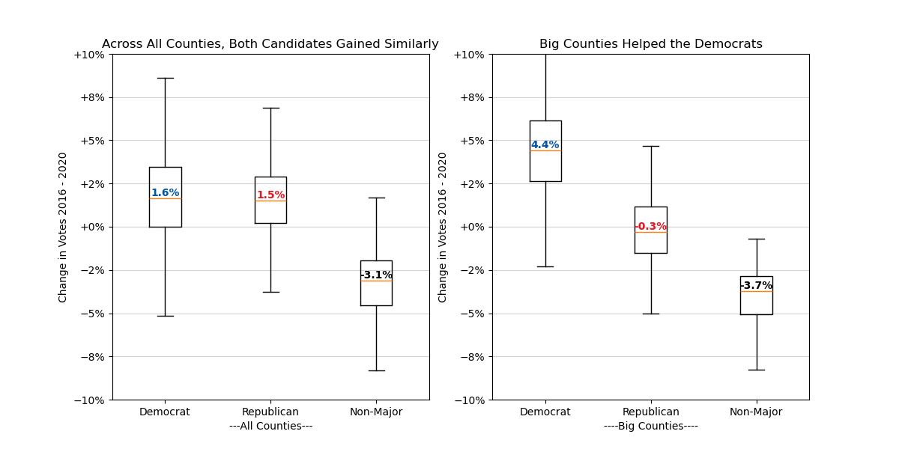
…and Where Did They Go?
When looking at all counties in the US, about 3% fewer votes for “other” in 2020, and the gains were spread evenly between Democrat and Republican. But among big counties, only the Democrat benefitted.

Slide 9
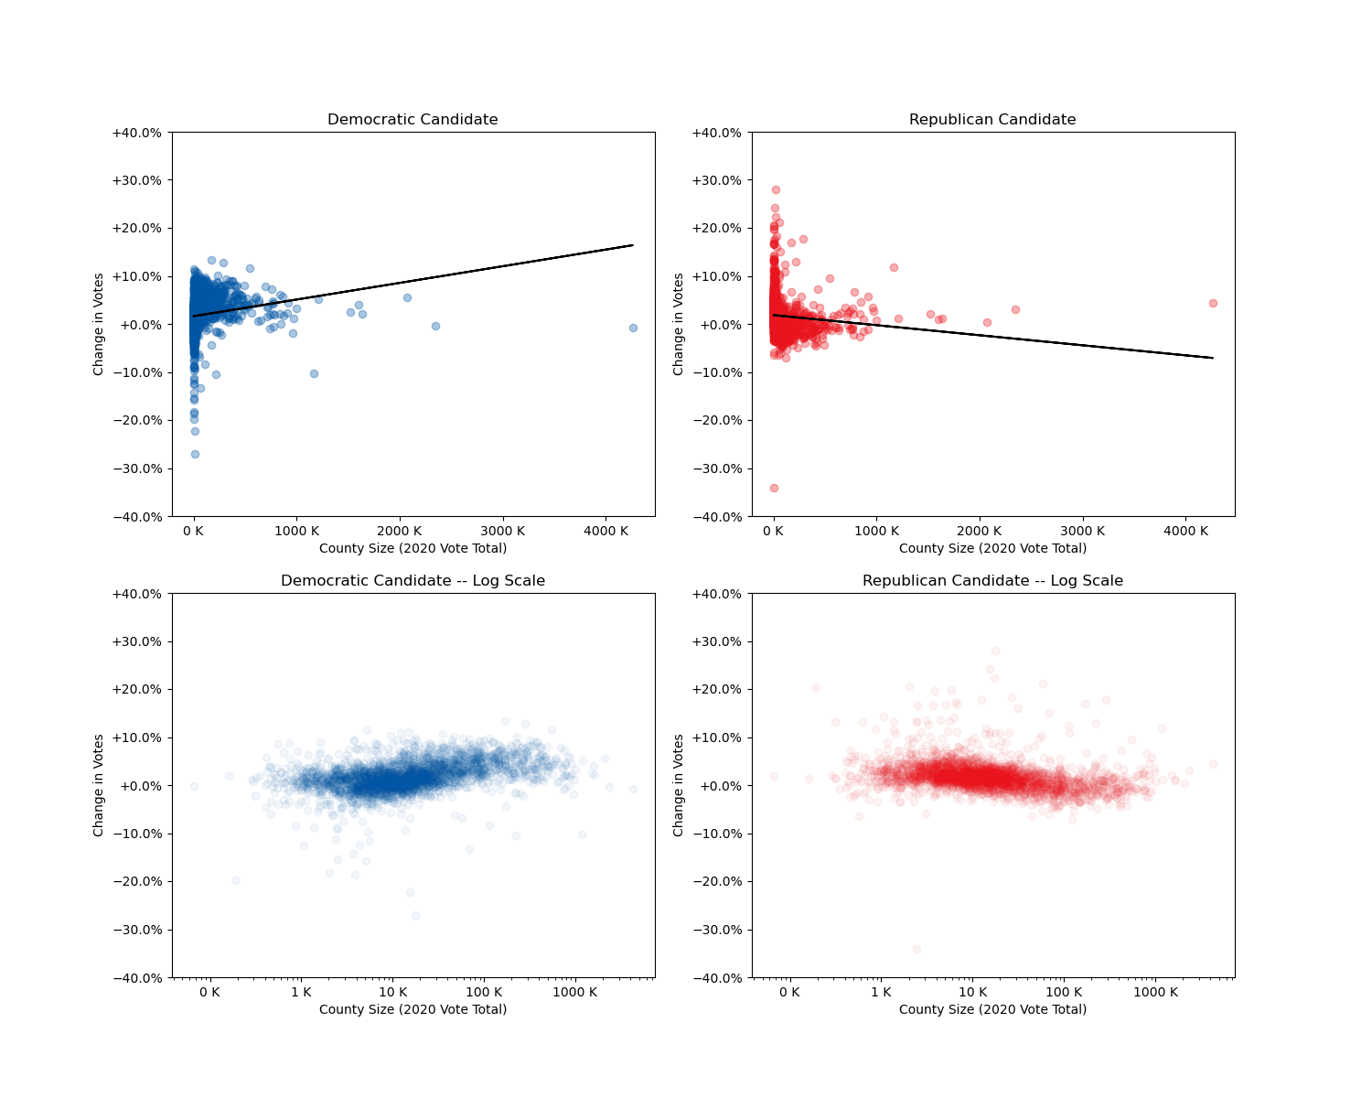
County Size and Party Shift
With counties clustered at the small end, it’s hard to visualize the trend.
A logarithmic scale shows it, but it’s hard to understand the exact values.
Interestingly, the two largest counties defy the trend.

Slide 10
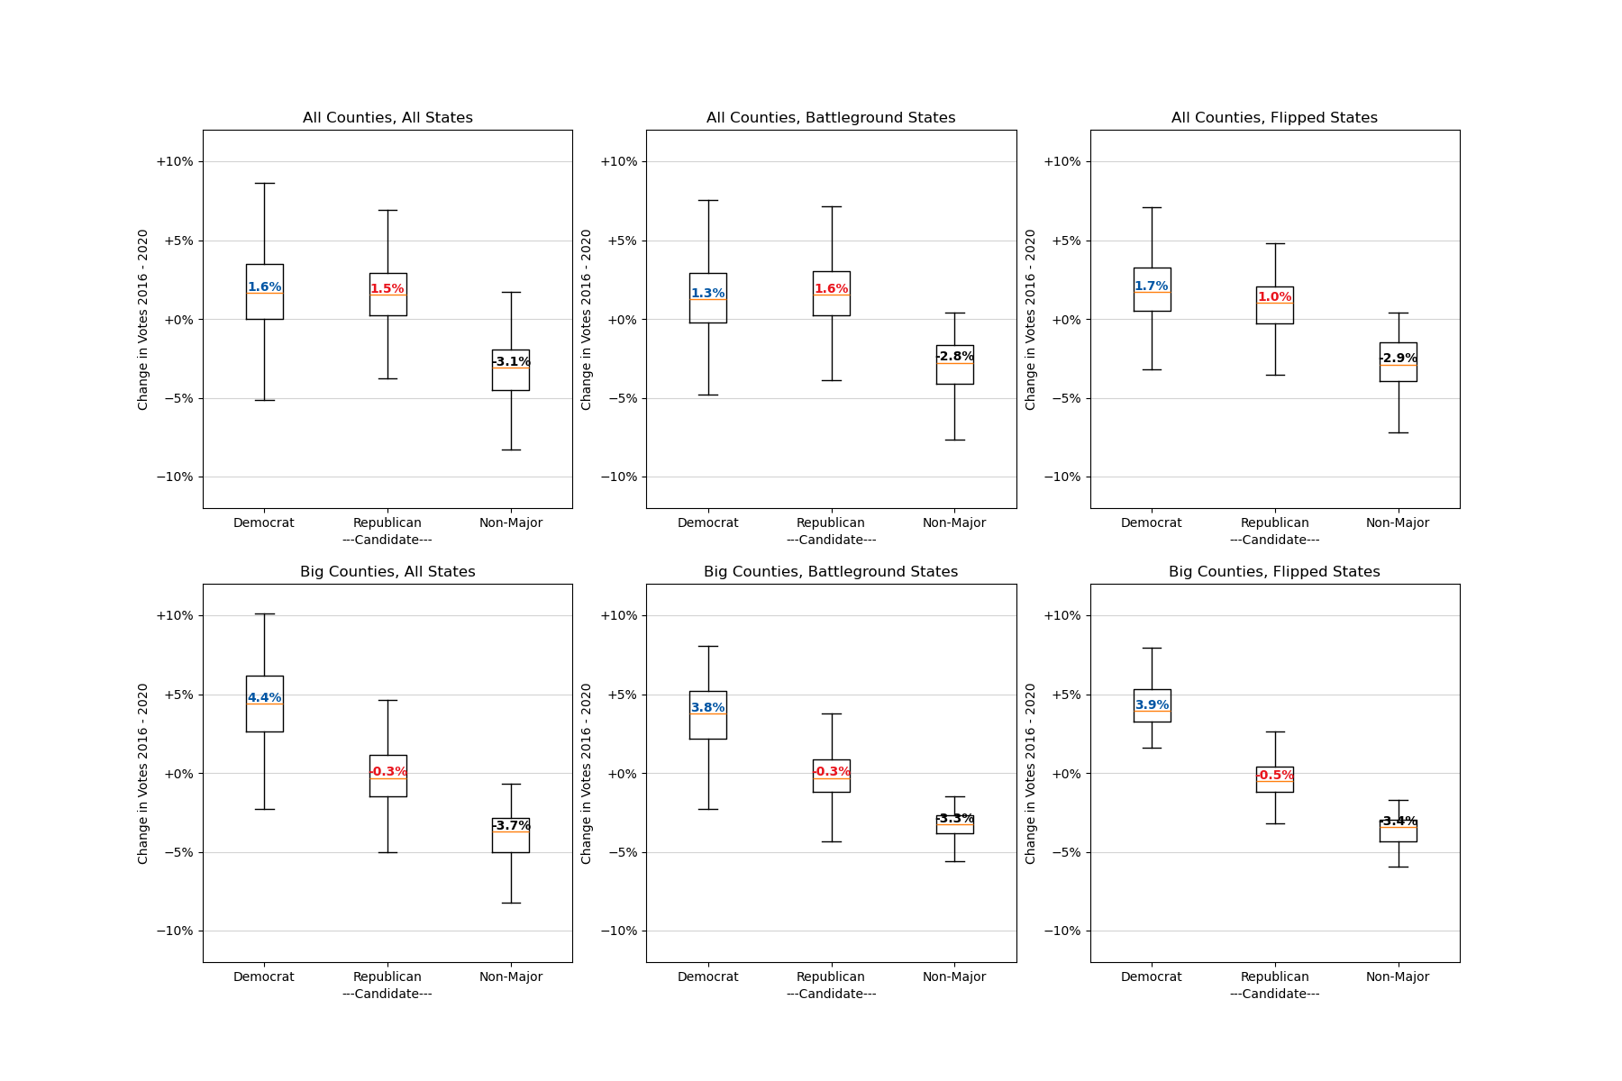
What About Swing States
“Battleground” states are those widely considered competitive for 2020: AZ, FL, GA, IA, MI, MN, NV, NH, NC, OH, PA, TX, and WI
“Flipped” states are those which went to the Republican in 2016 and the Democrat in 2020: AZ, GA, PA, WI, and MI
Counties in either category followed the same trend as the whole country. Both parties gained about equally across all counties unless you consider county size, in which case you see that big counties heavily favored the Democrat.
One notable exception: in flipped states, across all counties (big and small), the Democrat did a bit better than the Republican. This suggests the Democrat had some extra success among smaller counties in those states.
The charts don’t really fit well on a slide with any text.

Slide 11
