Slide 1
fairtix.
Tickets with a resale cap.
For student events and small venues.
WHU Solana MVP · 2 October 2026
Notes:
Source: Fairtix PRD & Design Guide; implementation in https://github.com/rmazz05/fairtix. Program verification: docs/chain-verification.json. Screenshots show genuine devnet transactions through public and local browser interfaces. Both programs are publicly deployed on devnet.

Slide 2
A resale policy stops at the checkout.
A club can set a resale price in its own app.
Once a ticket moves elsewhere, that policy
needs a way to travel with it.
The test case
€25.00 face price
€27.50 allowed resale
€60.00 asking price refused
Notes:
Source: Fairtix PRD & Design Guide; implementation in https://github.com/rmazz05/fairtix. Program verification: docs/chain-verification.json. Screenshots show genuine devnet transactions through public and local browser interfaces. Both programs are publicly deployed on devnet. Problem framing is a product hypothesis, not a quantified market claim. €25 / €60 is the demonstration scenario supplied in the brief.

Slide 3
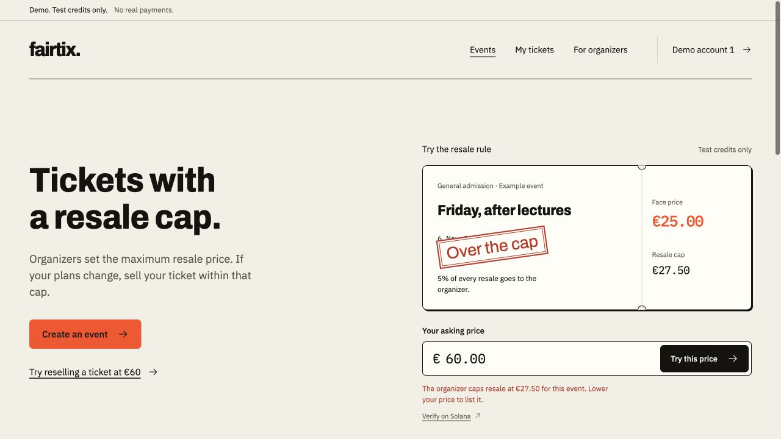
Buy it. Resell it within the cap.
The organizer sets
the cap and royalty.
A fan buys, lists or
cancels a listing.
The ticket and payment
move together.
Actual Solana devnet transaction. The €60 listing fails; the seller keeps the ticket.
Notes:
Source: Fairtix PRD & Design Guide; implementation in https://github.com/rmazz05/fairtix. Program verification: docs/chain-verification.json. Screenshots show genuine devnet transactions through public and local browser interfaces. Both programs are publicly deployed on devnet.

Slide 4
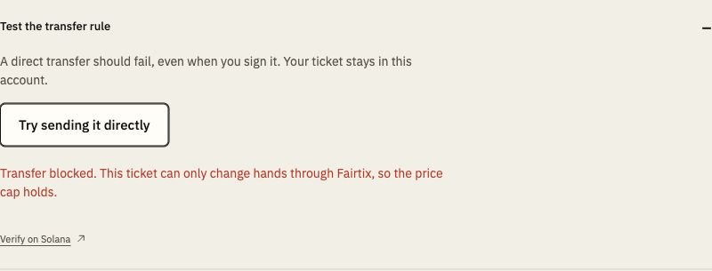
The rule is checked outside our website.
Token-2022 calls the hook when a ticket moves.
A direct send is refused, even if its holder signs it.
The marketplace owns escrow.
It checks the asking price, then
splits payment and delivers the
ticket in one transaction.
A failed payment rolls it all back.
Software upgrades and cash side deals remain possible. The demo claims neither immutability nor perfect anti-scalping.
Notes:
Source: Fairtix PRD & Design Guide; implementation in https://github.com/rmazz05/fairtix. Program verification: docs/chain-verification.json. Screenshots show genuine devnet transactions through public and local browser interfaces. Both programs are publicly deployed on devnet. The hook enforces Token-2022 transfers, including direct signed transfers. ImmutableOwner closes the token-account-owner-change route. The programs retain a development upgrade authority.

Slide 5
3% on primary sales. 2% on resales.
The organizer chooses a resale royalty of up to 10%.
Buyers pay the displayed price, with no added buyer fee.
Example event | Volume | Fairtix | Resale royalty
Primary sales | 400 × €15.00 | €180.00 | —
Resales | 80 × €18.00 | €28.80 | €72.00
Total |  | €208.80 | €72.00
Assumptions: one 400-ticket event; 20% resale rate; 20% price cap; 5% organizer royalty. No observed revenue.
Notes:
Source: Fairtix PRD & Design Guide; implementation in https://github.com/rmazz05/fairtix. Program verification: docs/chain-verification.json. Screenshots show genuine devnet transactions through public and local browser interfaces. Both programs are publicly deployed on devnet. Illustrative business model only. 400 primary tickets × €15; 80 resales × €18; organizer sets a 20% cap and 5% royalty. 3% primary fee = €180; 2% resale fee = €28.80; 5% resale royalty = €72. No revenue or customer traction is claimed.

Slide 6
One club event before a public rollout.
First pilot to seek
Questions for the organizer
A WHU student club with
a general-admission event.
How do you handle resales today?
Which price cap would you set?
What must work at the door
before you use this?
Use one event to check whether fans
complete a resale and organizers find
the cap and royalty worth adopting.
No organizer quote, interview or commitment is claimed yet.
Notes:
Source: Fairtix PRD & Design Guide; implementation in https://github.com/rmazz05/fairtix. Program verification: docs/chain-verification.json. Screenshots show genuine devnet transactions through public and local browser interfaces. Both programs are publicly deployed on devnet. First customer plan is prospective. No club interview, testimonial, letter of intent or commitment has been obtained. The quote suggested by the product brief is optional for the bounty submission.

Slide 7
Next: use it at an actual door.
Working now
Before a real pilot
Marketplace and transfer hook.
Four product screens.
Sponsored test transactions.
13 devnet chain checks.
Door check-in and refunds.
Euro payments and identity checks.
Independent program review.
Then a real organizer trial.
Deployed on devnet. Email sign-in and wallet signing confirmed.
Cash side deals remain possible; development upgrade authority is retained.
Notes:
Source: Fairtix PRD & Design Guide; implementation in https://github.com/rmazz05/fairtix. Program verification: docs/chain-verification.json. Screenshots show genuine devnet transactions through public and local browser interfaces. Both programs are publicly deployed on devnet. The two programs are deployed on devnet. The project owner confirmed email login and an embedded-wallet transaction. Mainnet, real-money payments, check-in, seats, refunds and identity checks are not in this MVP. Future programs need independent security review.

