Slide 1
NOPEEK
One secret. Nobody gets to peek.
A multiplayer browser game with a secret generated
and checked inside confidential computation.
Solana + Arcium · WHU 2026 · Superteam Germany
Notes:
A devnet-oriented hackathon prototype. No wallet extension or token purchase is needed for players. Confidentiality is subject to the Arcium cluster assumptions and retained prototype upgrade authority.

Slide 2
NOPEEK
Hidden games need a secret keeper
A conventional puzzle server knows the answer.
Players trust its operator to hide it and apply the rules.
NOPEEK puts the secret inside encrypted computation.
The published game program applies the same rules to every player.
WHU 2026 · Superteam Germany
Notes:
NOPEEK hackathon prototype. Product behavior is supported by the source code and local Solana/Arcium integration tests in the public repository.

Slide 3
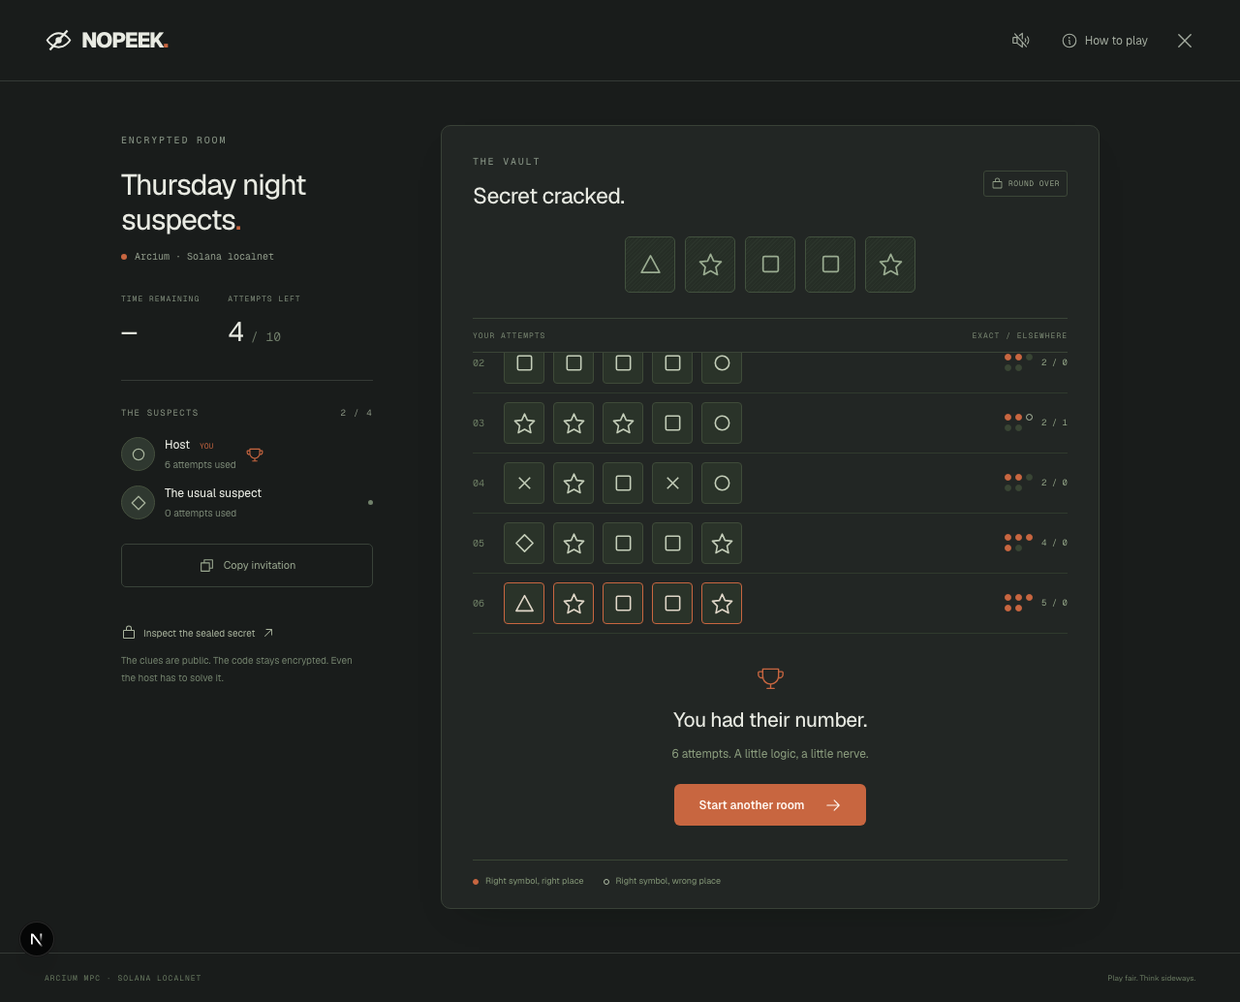
NOPEEK
Five symbols. Ten attempts. One winner.
Create a room. Share a link.
Race with up to four friends.
Each clue counts correct positions
and symbols that belong elsewhere.
Browser player keys sign actions.
The app sponsors network fees.
WHU 2026 · Superteam Germany
Notes:
NOPEEK hackathon prototype. Product behavior is supported by the source code and local Solana/Arcium integration tests in the public repository.

Slide 4
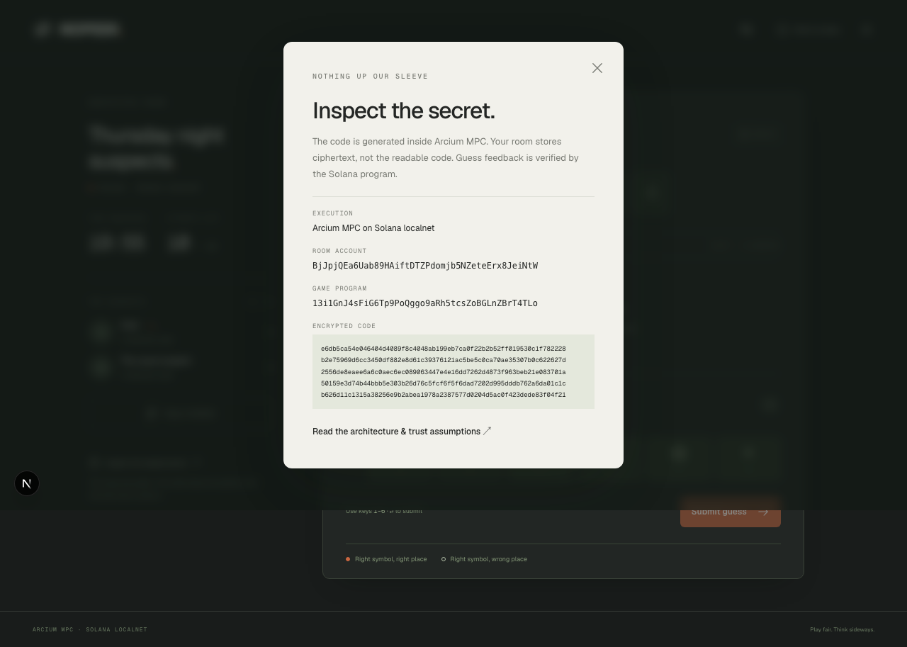
NOPEEK
The secret has no readable copy on our server
Arcium creates the code in MPC
and returns ciphertext.
Each guess reveals only two counts.
Even the host has to solve it.
Anyone can inspect the room account.
WHU 2026 · Superteam Germany
Notes:
Actual localnet inspection screenshot. Arcium MXE-owned encryption: https://docs.arcium.com/developers/arcis/encryption. Official examples: https://github.com/arcium-hq/examples. Guesses and feedback are public; deductions may reveal the secret. Arcium confidentiality relies on its cluster security assumptions.

Slide 5
NOPEEK
Solana is the game’s referee
The program locks the player roster when the race starts.
It enforces ten attempts per player and one pending guess at a time.
It accepts verified Arcium callbacks and records the first correct result.
A database can store scores. This integration makes the rules and
encrypted game state inspectable without giving our server the code.
WHU 2026 · Superteam Germany
Notes:
Sources: NOPEEK Anchor program and successful localnet integration tests; https://github.com/arcium-hq/examples. The prototype retains its upgrade authority, so immutability is not claimed. Winner order follows callback execution on Solana, not client wall-clock order.

Slide 6
NOPEEK
First users and growth
Start with WHU participants and student groups who play browser games.
One host can bring three friends through an invitation link.
Validate comprehension, completed rounds and requests to play again.
No traction or retention figures are claimed before observing users.
Potential revenue: themed room packs and event hosting.
Compute latency and sponsored costs need measurement.
WHU 2026 · Superteam Germany
Notes:
NOPEEK hackathon prototype. Product behavior is supported by the source code and local Solana/Arcium integration tests in the public repository.

Slide 7
NOPEEK
A complete prototype, with clear limits
Working loop: room → players → guesses → clues → winner.
Mobile layout, keyboard controls and stalled-attempt recovery.
Local practice teaches the rules with its privacy limit clearly disclosed.
Prototype assumptions: Arcium cluster confidentiality; retained program
upgrade authority; public clues; browser identity stored on the device.
Next: external security review, latency testing and identity recovery.
WHU 2026 · Superteam Germany
Notes:
The local prototype is verified with two browser contexts and actual local Solana/Arcium nodes. Deployment network and status must be checked at the live demo; do not describe localnet evidence as a devnet transaction.

Slide 8
NOPEEK
Play it. Inspect it. Try to beat it.
Demo: nopeek-whu.vercel.app
Pitch: nopeek-whu.vercel.app/pitch
Source: github.com/rmazz05/nopeek
Open two browsers, join one room and start the race.
Inspect the ciphertext, submit a guess and follow the verified clues.
One secret. The host has to solve it too.
WHU 2026 · Superteam Germany
Notes:
NOPEEK hackathon prototype. Product behavior is supported by the source code and local Solana/Arcium integration tests in the public repository.

