Slide 1
Intro

Slide 2
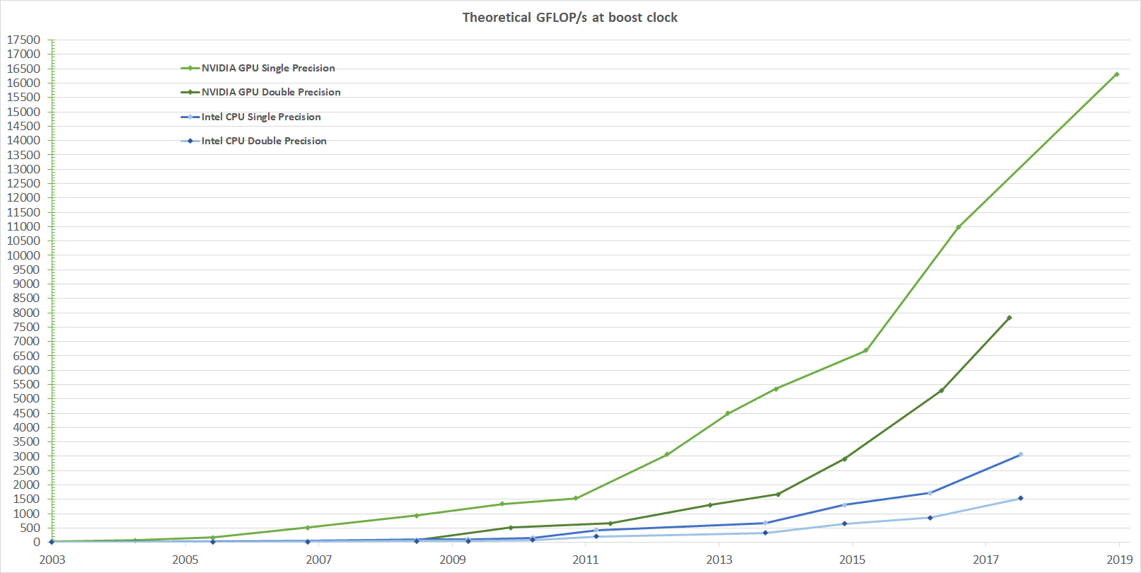
GPU programming enables state of the art performance
https://docs.nvidia.com/cuda/cuda-c-programming-guide/
Notes:
Performance of GPU is order of magnitude above CPU

Slide 3
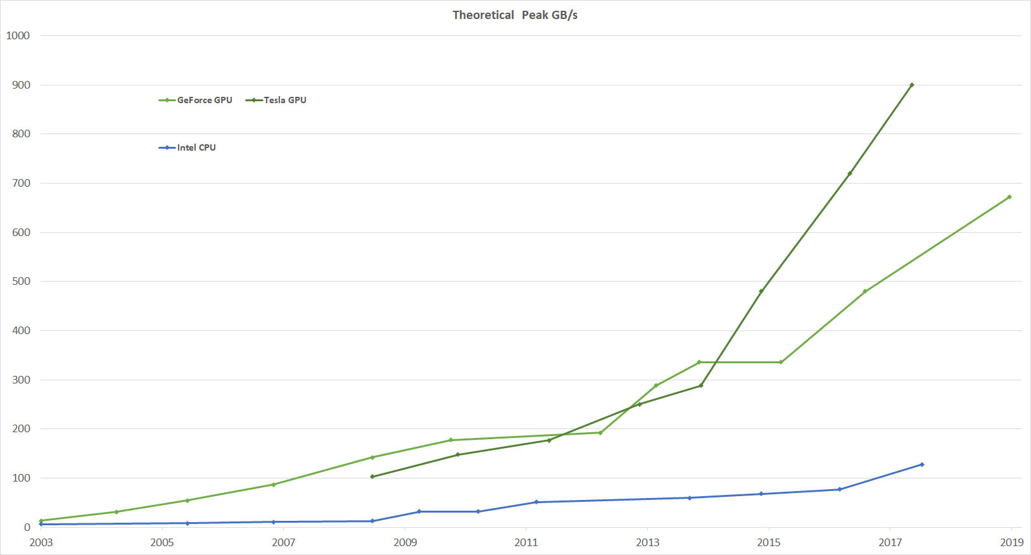
https://docs.nvidia.com/cuda/cuda-c-programming-guide/
Notes:
Data transfer rate is also significantly higher

Slide 4
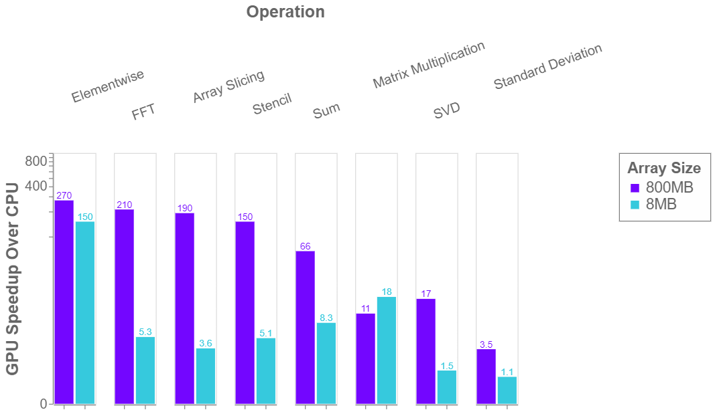
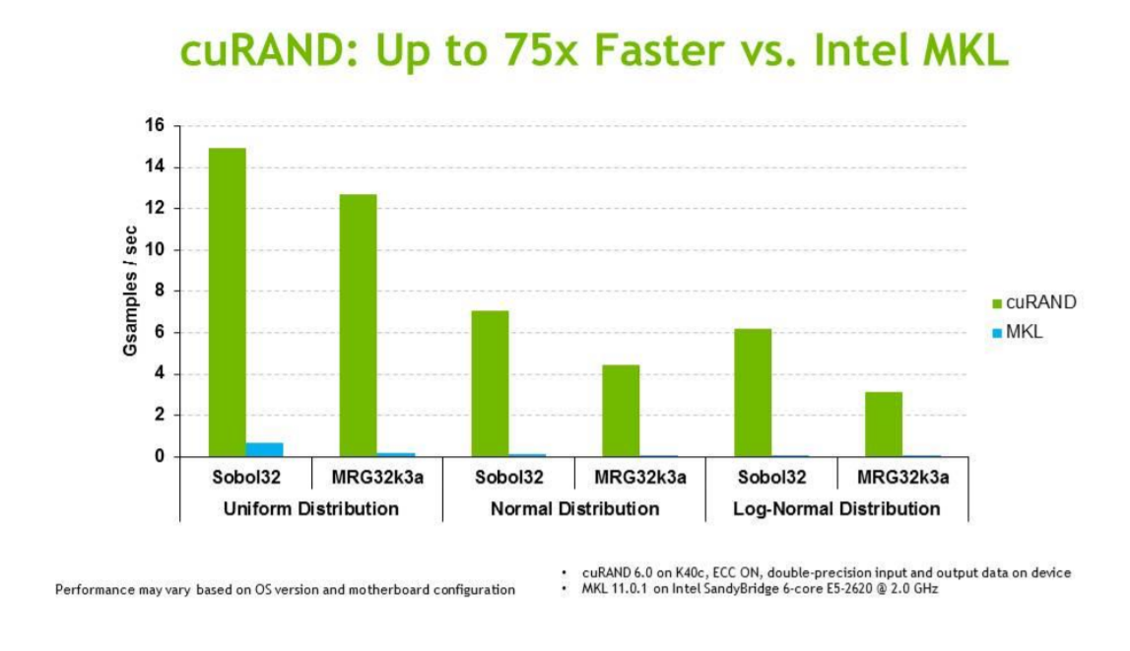
Different protocol for RNG
Comparison between cuRAND library (GPU optimize) and MKL library (CPU optimize)
Single GPU using CuPy library (GPU optimized library) compared to numpy
https://blog.dask.org/2019/06/27/single-gpu-cupy-benchmarks
http://www.eurorisksystems.com/documents/speed_up_of_numeric_calculations_using_GPU.pdf
Notes:
Nicely GPU optimized libraries already exist and can already outperform state of the art CPU optimized libraries on many basic/ day to day operations.

Slide 5
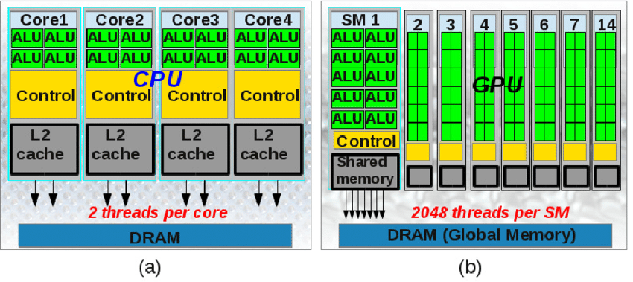
Why is it more powerful for some operations
Arithmetic Logic Unit : brick component of processing unit
Streaming Multiprocessor : GPU equivalent of a CPU core
Development of a convex polyhedral discrete element simulation framework for
NVIDIA Kepler based GPUs.
DOI: 10.1016/j.cam.2013.12.032.
Shared memory is L1 cache memory, each SM contains many of ALU
Notes:
Architecture is obviously different

Slide 6
Why is it more powerful for some operations
Streaming Multiprocessor : GPU equivalent of a CPU core
At hierarchy equivalent (Core), CPU has more transistors allocated to memory and flow control
GPU focus on more ALUs and so has a raw compute power which is higher than CPU. But to do so it has traded off memory capacity and flow control.
Development of a convex polyhedral discrete element simulation framework for
NVIDIA Kepler based GPUs.
DOI: 10.1016/j.cam.2013.12.032.
Shared memory is L1 cache memory, each SM contains many of ALU
Notes:
And that difference can be summarized by focus on raw computing power rather memory capacity and flow control for GPU. This will have incidence on the type of operations and overall parallelization type that really suit GPU rather than CPU.

Slide 7
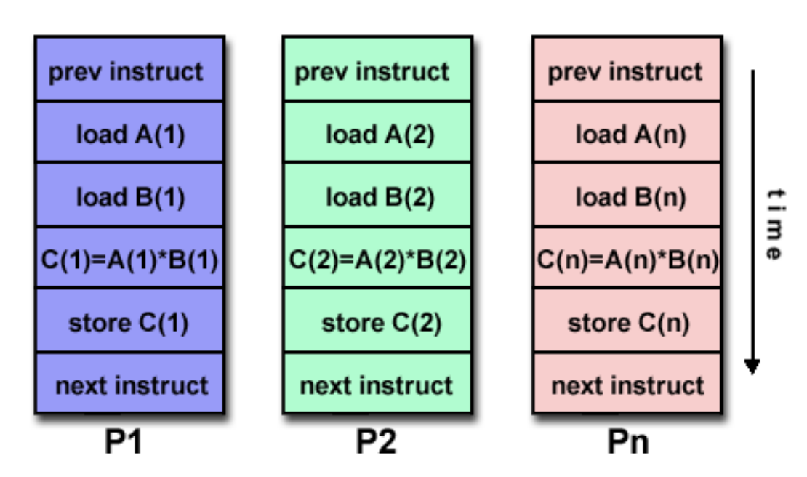
GPU : A SIMD oriented architecture
Those architecture differences make the GPU highly optimized for a certain kind of problem:
SIMD : Single Instruction Multiple Data
Element 1 of Array X
Element 2 of Array X
Element n of Array X
One instruction at time t (here load)
Different instructions sequentially happening
https://www.cvg.ethz.ch/teaching/2011spring/gpgpu/Lec1-intro.pdf
Same instruction happening in parallel for different elements
Notes:
Could you guys help making the link with what I said before? Why this architecture with smaller memory and flow control is particularly adapted to SIMD. I have the intuition that if the same instruction is parralelly executed and different instructions are then run sequentially you would have less to do concerning the flow of memory and calcul within one shared memory. But Why the smaller memory?

Slide 8
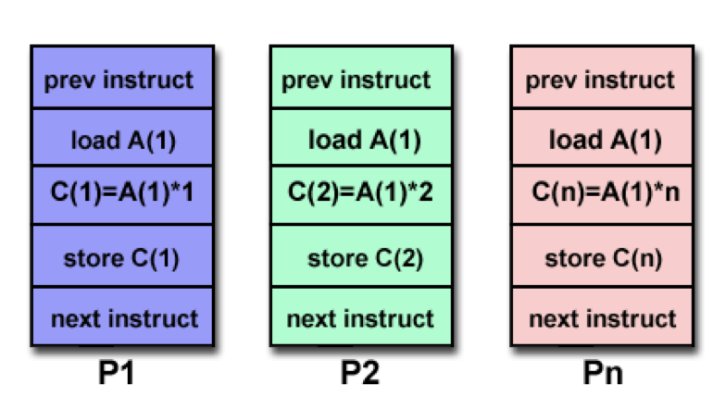
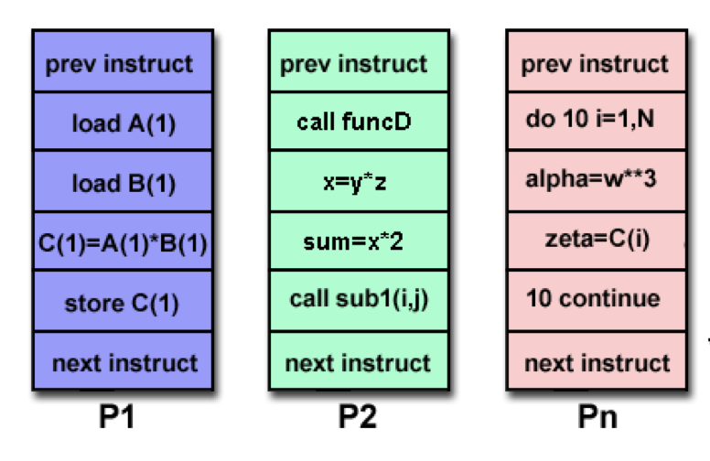
GPU : Not MISD or MIMD oriented architecture
MISD : Multiple Instructions Single Data
MISD : Multiple Instructions Multiple Data
https://www.cvg.ethz.ch/teaching/2011spring/gpgpu/Lec1-intro.pdf

Slide 9
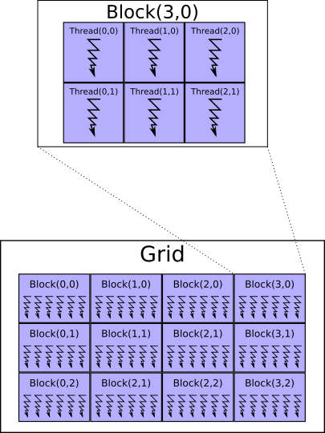
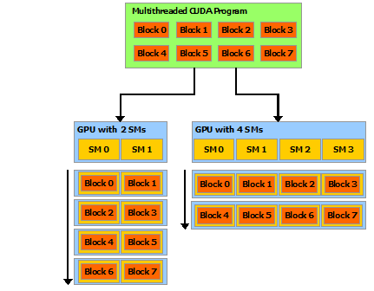
Mapping the hardware architecture to the programming architecture
As a GPU programmer you will define an arithmetic instruction applied on an element of an array: thread.
You will run many threads in parallel within a shared memory environment called blocks ( A block is then you doing the same operation parallelly on a subset of elements of your array ).
You will manage many blocks parallelly (if many blocks can sit on the same SM, or if you have many SM), or sequentially if your array exceed your GPU capacity.
As a GPU programmer you will :
* define an arithmetic instruction applied on an element of an array : thread.
* run many threads in parallel within a shared memory environment : blocks.
( block = doing the same operation in parallel on a subset of elements of your array ).
* manage many blocks in parallel (many blocks on the same SM, or many SM),
or sequentially if your array exceed your GPU capacity.
Time
http://developer.download.nvidia.com/compute/cuda/3_1/toolkit/docs/NVIDIA_CUDA_C_ProgrammingGuide_3.1.pdf
Notes:
Understanding that the structure of the hardware is going to be directly translated into the way we are going to code

Slide 10
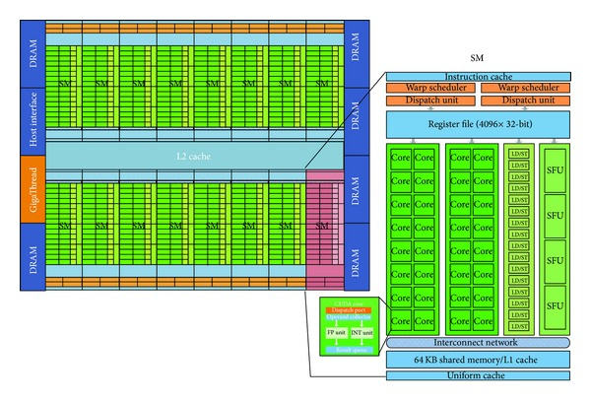
On a real Real architecture
Nvidia Fermi GPU (2011)
Here it is not a core, it is a "CUDA core" so not directly comparable to the CPU core
3D Data Denoising via Nonlocal Means Filter by Using Parallel GPU Strategies
DOI: 10.1155/2014/523862
Notes:
Just gonna insist on the affirmation said before about how threads, block and grid can be distributed, but this time on a "real" architecture rather than on a scheme. Could be remove since it is a bit redundant.

Slide 11
On a real Real architecture : one possible topology
Nvidia Fermi GPU (2011)
Here it is not a core, it is a "CUDA core" so not directly comparable to the CPU core
Grid
Block
3D Data Denoising via Nonlocal Means Filter by Using Parallel GPU Strategies
DOI: 10.1155/2014/523862

Slide 12
On a real Real architecture : one possible topology
Nvidia Fermi GPU (2011)
Here it is not a core, it is a "CUDA core" so not directly comparable to the CPU core
Grid
Block
3D Data Denoising via Nonlocal Means Filter by Using Parallel GPU Strategies
DOI: 10.1155/2014/523862

Slide 13
On a real Real architecture : one possible topology
Nvidia Fermi GPU (2011)
Here it is not a core, it is a "CUDA core" so not directly comparable to the CPU core
Grid
Block
A grid can encompass many SM but a block can not be larger than a SM since a block is a shared memory space.
You can also set the number of threads per block:
but this number is not easily linkable to the number of CUDA core. Yet a block size (number of threads per block) should be a multiple of 32 (warping : not the focus of this course)
3D Data Denoising via Nonlocal Means Filter by Using Parallel GPU Strategies
DOI: 10.1155/2014/523862

Slide 14
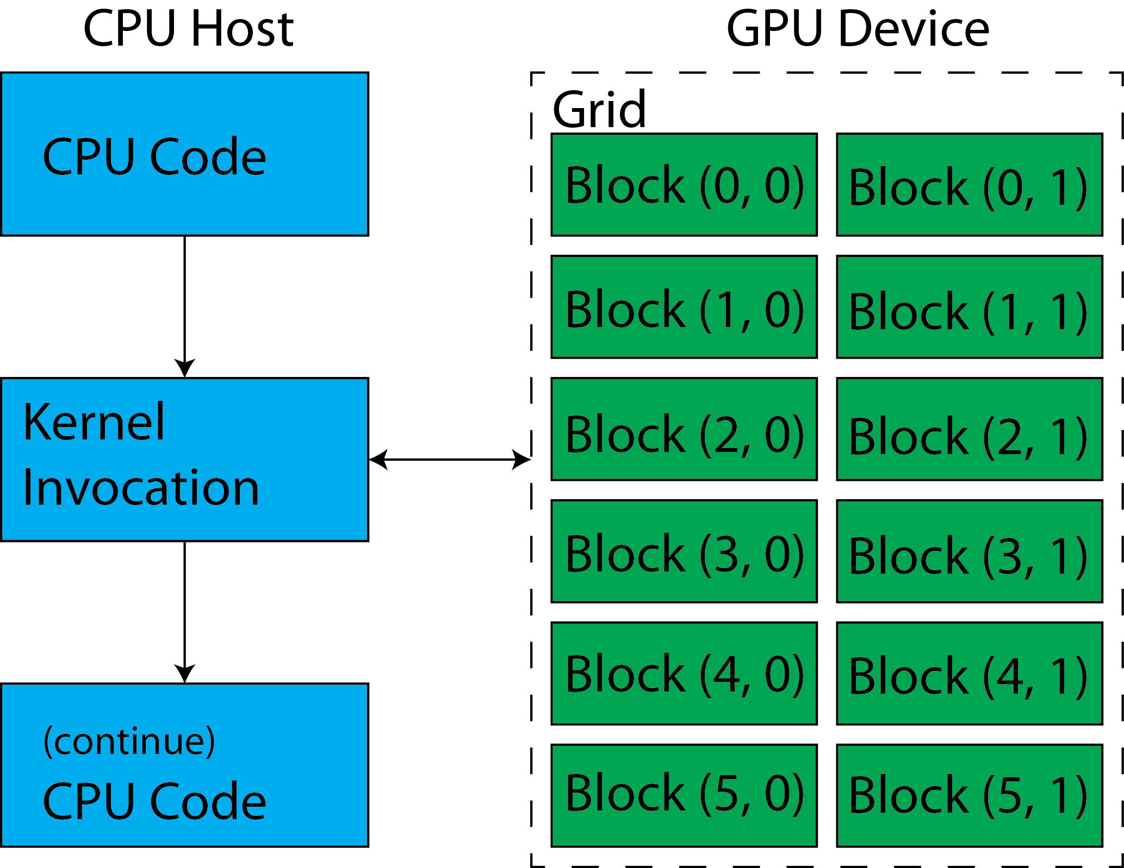
A mapping at the core of CPU/GPU communication: the kernel
https://cvw.cac.cornell.edu/GPU/structure
Notes:
Realize that you still need to make the interface between the CPU and the GPU, understand where what you are going to learn in this course sit in the writing of your program, introduce some vocabulary and open to next slides where technology allowing to write kernel are going to be presented.

Slide 15




Writing your kernel : GPU technologies programming
AMD GPU
numba.roc
CUDA C++
pycuda
numba.cuda
HIP C++
openACC

Slide 16
Writing your kernel : GPU technologies programming
AMD GPU
numba.roc
CUDA C++
pycuda
numba.cuda
HIP C++
openACC
covered in this course

Slide 17
GPU computing at SCICORE

