Slide 1
Execution and Divergence

Slide 2
Example: matrix multiplication
Sub-optimal memory access will kill the performance…
The less efficient way (column-major):
for(int i=0; i<n; ++i)
for(int j=0; j<n; ++j)
for(int k=0; k<n; ++k)
c[i*n+j] += a[i*n+k] * b[k*n+j];
b00 | b01 | b02
b10 | b11 | b12
b20 | b21 | b22
The better way (row-major):
Here, the most inner loop can be executed in parallel (without write conflicts on matrix c)
for(int i=0; i<n; ++i)
for(int k=0; k<n; ++k)
for(int j=0; j<n; ++j)
c[i*n+j] += a[i*n+k] * b[k*n+j];
b00 | b01 | b02
b10 | b11 | b12
b20 | b21 | b22

Slide 3
Example: matrix multiplication with CUDA
__global__ void cuda_mul(float* a, float* b, float* c, int size) {
int row = blockIdx.y*blockDim.y+threadIdx.y;
int col = blockIdx.x*blockDim.x+threadIdx.x;
for (int i = 0; i < size; i++)
c[row*size+col] += a[row*size+i] * b[i*size+col];
}
We create as many kernel instances as we need!
In this case, we divide the problems into 2D blocks of 16*16 threads each
The grid of blocks is large enough to accommodate all the blocks
CUDA Kernel
cudaMemcpy(dm1, a, sizeof(float)*size*size, cudaMemcpyHostToDevice);
cudaMemcpy(dm2, b, sizeof(float)*size*size, cudaMemcpyHostToDevice);
cudaMemcpy(dm3, c, sizeof(float)*size*size, cudaMemcpyHostToDevice);
dim3 blockSize = dim3(16, 16);
dim3 gridSize = dim3(size / blockSize.x, size/ blockSize.y);
cuda_mul<<<gridSize, blockSize>>>(dm1, dm2, dm3, size);
cudaMemcpy(c, dm3, sizeof(float)*size*size, cudaMemcpyDeviceToHost);
Kernel Call

Slide 4
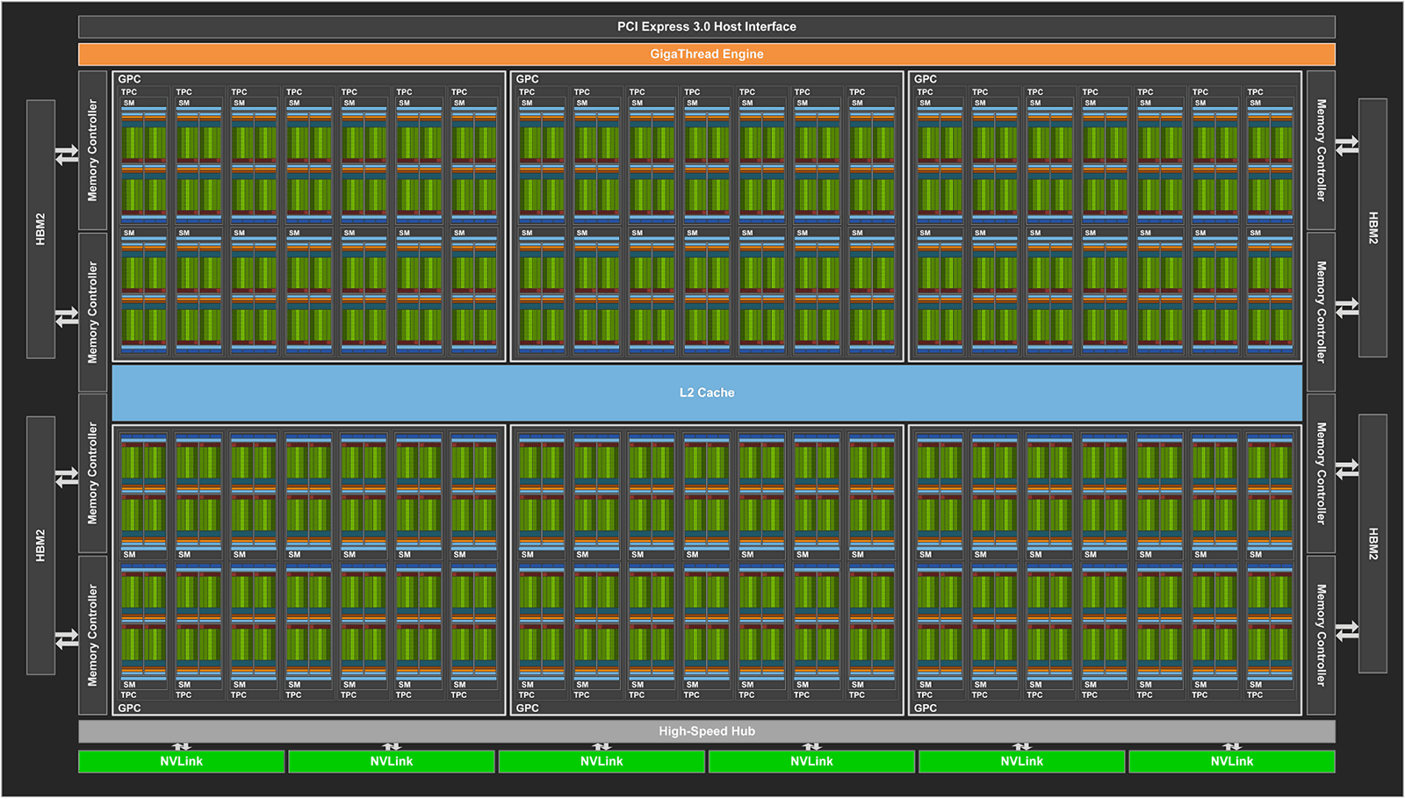
Full example: matrix multiplication with CUDA
Each thread inside a 2D block receives:
  blockidx.x, blockidx.y
  threadidx.x, threadidx.y
This information is used to retrieve the row and col indices (formerly I and j).
This is the only information that differs between threads!
Remember, the data is not sent to individual threads
Instead, the data is mapped onto the grid of blocks
And threads know which data to access thanks to the block and thread ids.
__global__ void cuda_mul(float* a, float* b, float* c, int size) {
int row = blockIdx.y*blockDim.y+threadIdx.y;
int col = blockIdx.x*blockDim.x+threadIdx.x;
for (int i = 0; i < size; i++)
c[row*size+col] += a[row*size+i] * b[i*size+col];
}
CUDA Kernel

Slide 5
Full example: matrix multiplication with CUDA
__global__ void cuda_mul(float* a, float* b, float* c, int size) {
int row = blockIdx.y*blockDim.y+threadIdx.y;
int col = blockIdx.x*blockDim.x+threadIdx.x;
for (int i = 0; i < size; i++)
c[row*size+col] += a[row*size+i] * b[i*size+col];
}
CUDA Kernel
Map the data to the GPU a grid of kernel functions
Launch one kernel function per grid point
You can have as many kernel functions as you need!

Slide 6
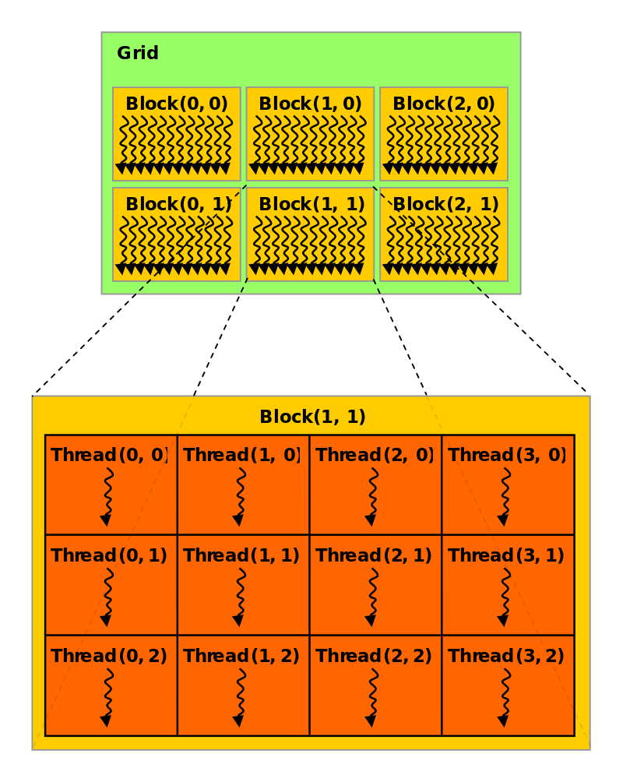
Grids, blocks, threads and warps
Grid: has 1 to as many blocks as you want in 1D, 2D, or 3D
Block: has 1 to 1024 threads
Blocks are mapped to 1 or more warps.
Warps always execute 32 threads inside a SM.
All the 32 threads in a warp execute the same instruction

Slide 7
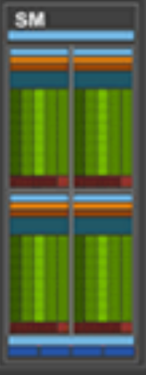
All the 32 threads in a warp execute the same instruction
All the warps inside a SM must execute the same instruction.
Example 1: A block with 32 threads fits in a single warp. The SM can execute up to 64 CUDA cores. No other block/warp can execute inside that SM. Max occupancy is 50%.
Example 2: A block with 64 threads fits in a single warp. The SM can execute both warps simultaneously. Max occupancy is 100%!
84 Streaming Multiprocessors (SMs)
64 CUDA cores per SM

Slide 8
Grids, blocks, threads and warps
The threads inside a block are selected serially by the Streaming Multiprocessor.
When you launch a grid containing a single block with one thread, you launch 1 warp. This warp contains 31 "dummy" threads which are masked off, and a single live thread. If you launch a single block with two threads, you still launch 1 warp, but now the single warp contains 2 active threads.
When you launch two blocks containing a single thread each, it results in two warps, each of which contains 1 active thread. Because all scheduling and execution is done on a per warp basis, you now have two separate entities (warps) which the hardware can schedule and execute independently. This allows more latency hiding and less instruction pipeline stalls, and the code runs faster as a result.

Slide 9
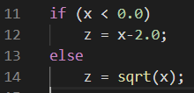
Warp Divergence (Execution Divergence)
Threads are executed in warps of 32, with all threads in the warp executing the same instruction at the same time.
What happens if different threads in a warp need to do different things?
This is called warp divergence. CUDA will generate correct code to handle this, but to understand the performance you need to understand what CUDA does with it.
All the threads in a warp execute both conditional branches
If the condition evaluate to false for a given thread, it will remain idle and wait for the other threads to finish.
=> potentially large loss of performance.

Slide 10
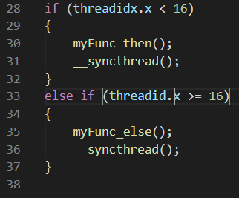
Deadlock
Again, all the threads in a warp execute both branches of the condition.
Example: a single block of 32 threads is mapped to a single warp, where the 32 threads will execute the same instruction.
50% of the threads (with threaded.x < 16) execute the first branch, the other 50% are idle.
The first 50% reach the __syncthread() instruction. It will never return because the other threads cannot execute the second branch yet.

