Slide 1
Simulation of an evolving population with selection
We want to implement an evolving population, to be exact their genomes (four letters), with N members/cells, genome length L (a multiple of 64), mutation rate mu and selection coeffiecent s.
The fitness of each strain is set by s^(#SNPs). A SNP is difference as a difference to the initial reference genome. This reference genome is a random sequence.
We are interested in only a subsample of size S of those genomes.
We evolve the population for N*8 generations. The reproduction is strictly asexual.

Slide 2
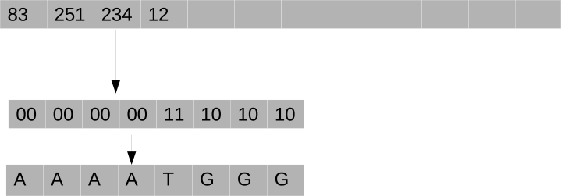
Basic schema to efficiently store large genomes
All operations are directly done on the first array of integers. We will use bit-wise operations.

Slide 3
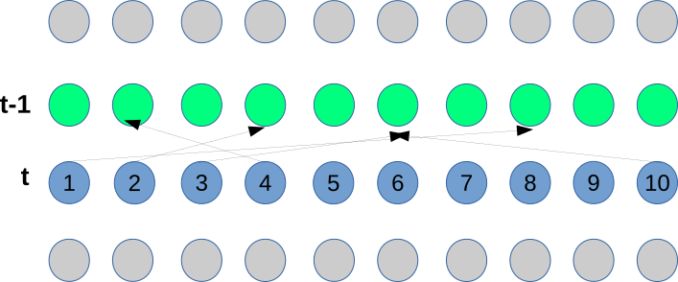
Forward simulation of cells
In generation t we sample a single parent for every cell from generation t-1

Slide 4
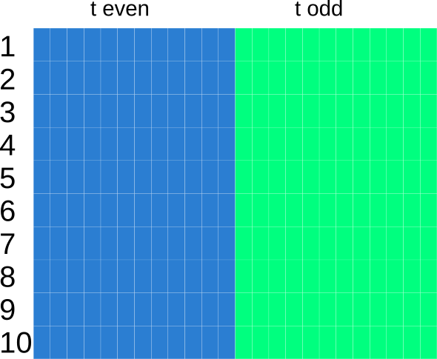
Memory management
In even generation we use the first half of our memory (blue) to copy the parent (second half, green) genomes to.
In odd generations we do it the other way round.
After copying we add random mutations.

Slide 5
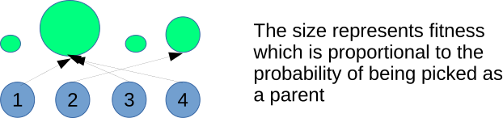
Adding selection
We will define the fitness as a function of the number of SNPs in each genome.

