Slide 1
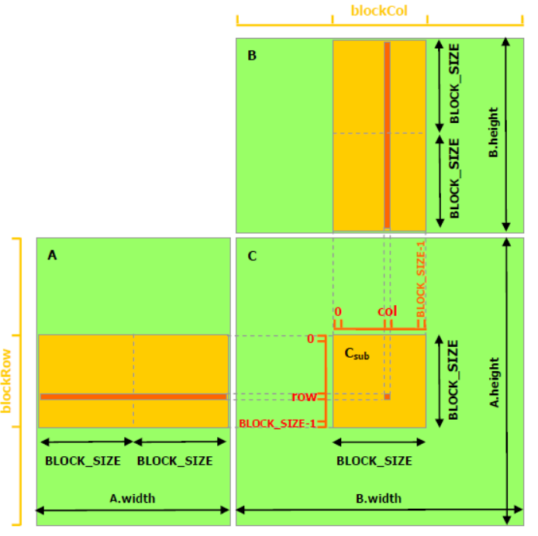
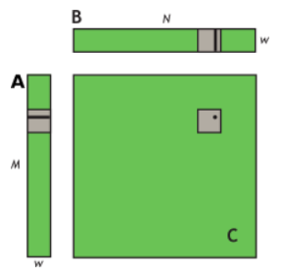
Up to now we have linearized the 2D matrices and mapped the multiplication onto the GPU.
Now we are going to perform the multiplication by blocks:
Each block computes a sub-matrix C_{sub}
Each thread within the block computes one element of C_{sub}
BLOCK_SIZE = 16 (or 32), so that the # of threads/block is a multiple of the warp size (w) and remains below the max # of threads/block.
__global__ void simpleMultiply(float *a, float* b, float *c, int N)
{
int row = blockIdx.y * blockDim.y + threadIdx.y;
int col = blockIdx.x * blockDim.x + threadIdx.x;
float sum = 0.0f;
for (int i = 0; i < TILE_DIM; i++) {
sum += a[row*TILE_DIM+i] * b[i*N+col];
}
c[row*N+col] = sum;
}
blockDim.x, blockDim.y, and TILE_DIM = w
Effective BW: 119,9 GB/s on Tesla V100
Source: Nvidia CUDA documentation

Slide 2
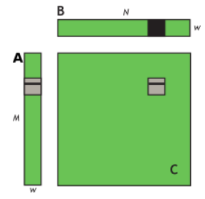
Let’s analyze how data is accessed by the warps:
Each row of C_{sub} needs a row of the A tile and all the columns of the B tile.
For each iteration of i, the warp reads a full row of the B tile (Good), but all threads in the warp read the same value from global memory from the A tile (Bad): wasted memory BW and likely cache miss.
Source: Nvidia CUDA documentation
It would be better to read the A tile into shared memory:
__global__ void coalescedMultiply(float *a, float* b, float *c, int N)
{
__shared__ float aTile[TILE_DIM][TILE_DIM];
int row = blockIdx.y * blockDim.y + threadIdx.y;
int col = blockIdx.x * blockDim.x + threadIdx.x;
float sum = 0.0f;
aTile[threadIdx.y][threadIdx.x] = a[row*TILE_DIM+threadIdx.x];
__syncwarp();
for (int i = 0; i < TILE_DIM; i++) {
sum += aTile[threadIdx.y][i]* b[i*N+col];
}
c[row*N+col] = sum;
}
__global__ void simpleMultiply(float *a, float* b, float *c, int N)
{
int row = blockIdx.y * blockDim.y + threadIdx.y;
int col = blockIdx.x * blockDim.x + threadIdx.x;
float sum = 0.0f;
for (int i = 0; i < TILE_DIM; i++) {
sum += a[row*TILE_DIM+i] * b[i*N+col];
}
c[row*N+col] = sum;
}
Effective BW: 119,9 GB/s on Tesla V100
Effective BW: 144,4 GB/s on Tesla V100
Each element of tile A is read once w/o BW waste to shared memory.

Slide 3
You can optimize further if you load additional data into the shared memory:
__global__ void simpleMultiply(float *a, float* b, float *c, int N)
{
int row = blockIdx.y * blockDim.y + threadIdx.y;
int col = blockIdx.x * blockDim.x + threadIdx.x;
float sum = 0.0f;
for (int i = 0; i < TILE_DIM; i++) {
sum += a[row*TILE_DIM+i] * b[i*N+col];
}
c[row*N+col] = sum;
}
Effective BW: 119,9 GB/s on Tesla V100
__global__ void coalescedMultiply(float *a, float* b, float *c, int N)
{
__shared__ float aTile[TILE_DIM][TILE_DIM];
int row = blockIdx.y * blockDim.y + threadIdx.y;
int col = blockIdx.x * blockDim.x + threadIdx.x;
float sum = 0.0f;
aTile[threadIdx.y][threadIdx.x] = a[row*TILE_DIM+threadIdx.x];
__syncwarp();
for (int i = 0; i < TILE_DIM; i++) {
sum += aTile[threadIdx.y][i]* b[i*N+col];
}
c[row*N+col] = sum;
}
Source: Nvidia CUDA documentation
Effective BW: 144,4 GB/s on Tesla V100
__global__ void sharedABMultiply(float *a, float* b, float *c, int N)
{
__shared__ float aTile[TILE_DIM][TILE_DIM],
bTile[TILE_DIM][TILE_DIM];
int row = blockIdx.y * blockDim.y + threadIdx.y;
int col = blockIdx.x * blockDim.x + threadIdx.x;
float sum = 0.0f;
aTile[threadIdx.y][threadIdx.x] = a[row*TILE_DIM+threadIdx.x];
bTile[threadIdx.y][threadIdx.x] = b[threadIdx.y*N+col];
__syncthreads();
for (int i = 0; i < TILE_DIM; i++) {
sum += aTile[threadIdx.y][i]* bTile[i][threadIdx.x];
}
c[row*N+col] = sum;
}
Effective BW: 195,5 GB/s on Tesla V100

