Slide 1
Maximized Hustle ROI
By: Reese McCoy
https://mtmercy-my.sharepoint.com/:v:/g/personal/rmccoy1887_mtmercy_edu/ET2fb4bYYYpMhwzgJHO6iqMBnARB5HQgBdj37OiUgldcoQ?e=yf8b59

Slide 2

General Problem
Based on a list of tasks, create a schedule that maximizes the reward
Maximizing return on investment (ROI)
Notes:
So for my project, I wanted to optimize my schedule because one of the issues I encounter is running out of time to complete all the tasks. All of which are working towards an end goal of some kind.
The goal of this program is to find the optimal schedule that maximized the total reward at the end.

Slide 3
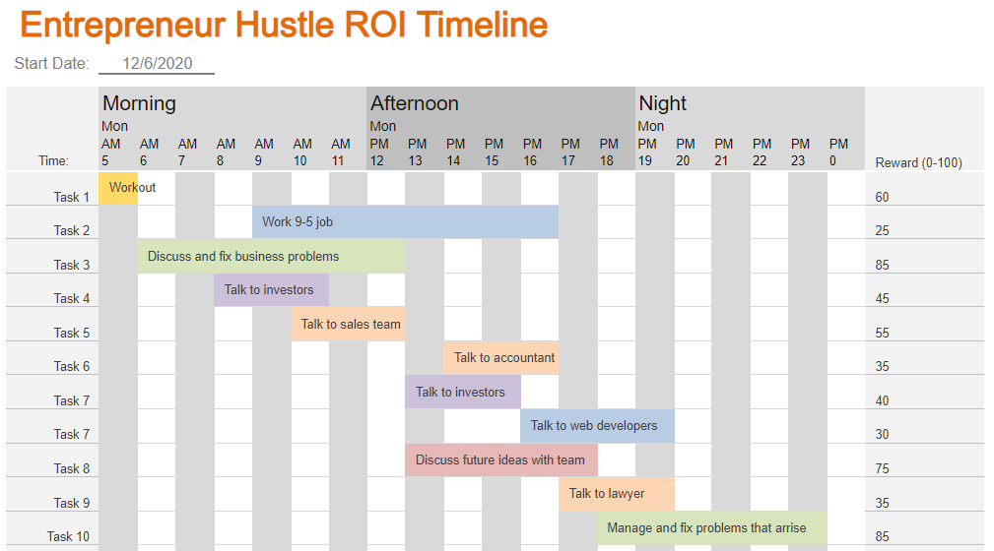
Example
Notes:
For example, you have some daily schedule with the end reward if completed.
The program would weigh the start and end time of each task, with the end reward in order maximize the schedule with the highest reward.

Slide 4


Dynamic Programming Algorithm
Stores and solves the subproblems, then combine their solutions to solve original problem
Loop through the tasks, storing the non-conflicting tasks that have the highest reward
Sort of like Longest Common Subsequence
Time complexity is O(n²)
Notes:
The book's definition is solving a problem by combing the solutions to subproblems.
More or less, its finds all compatible schedules, then weighs the total end reward, finding the maximized return on investment schedule.

Slide 5
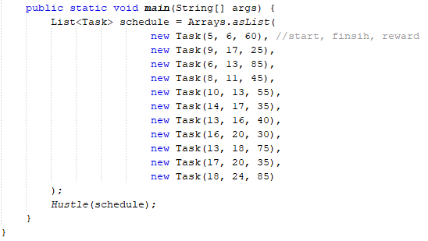
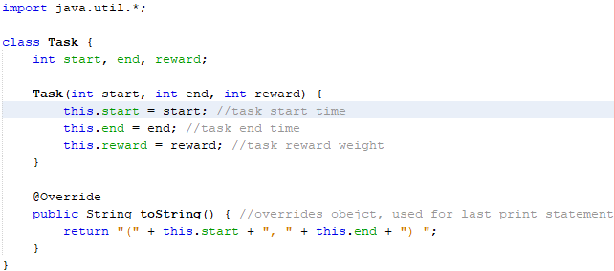
How It Was Done?
Notes:
Here we have a constructor for each Task, so we can use each of the start, finish and reward in the algorithm

Slide 6
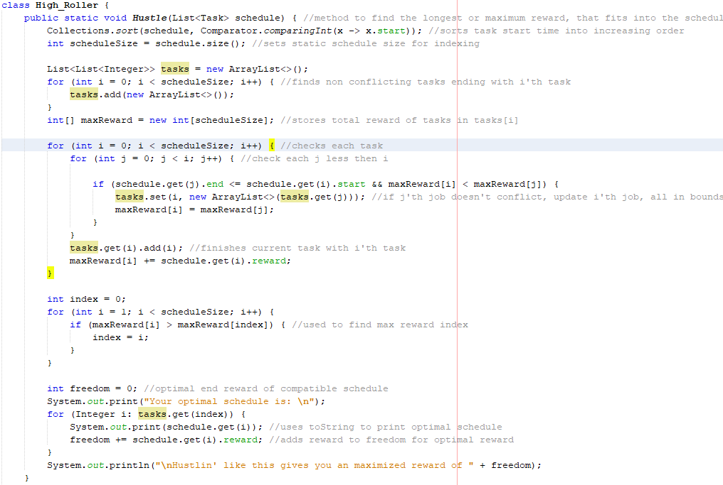
Ya good luck seeing...
Notes:
So the idea is to sort the given tasks in increasing order of their start time, so we can check everything from earliest tasks to last tasks.
More less what its doing is storing the nonconflicting tasks with the highest reward, all ending with the i'th job.

Slide 7
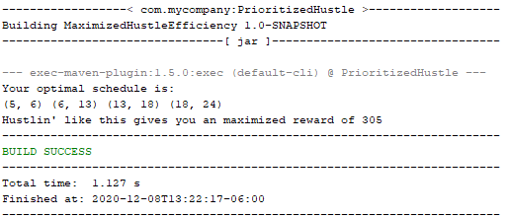
$$$
Notes:
So that's the optimal schedule that maximized the total reward in the end.
Not terribly difficult.

