Slide 1

CSCI E-96 Data Mining, Exploration and Discovery Introduction to Dimensionality Reduction
Steve Elston
Copyright 2020,2021, 2022, 2023, Stephen F Elston. All rights reserved.

Slide 2
Lesson Overview
Dimensionality reduction is widely used in data mining
Introduction to dimensionality reduction
Review of eigenvalues and eigenvectors
Principle component analysis (PCA)
Singular value decomposition (SVD)
Kernel principle component analysis

Slide 3
Introduction to Dimensionality Reduction
Dimensionality reduction is widely used in data mining
Human understanding of high dimensional spaces is difficult at best
For most people, perception of data relationships starts to dimension beyond 4 or dimensions
Exploration of complex spaces can be aided by projection into lower dimensional space
Most algorithms converge better in lower dimensional spaces
High dimensional spaces can lead to over-fitting of data mining algorithms
For example, clustering in high dimensional spaces can lead to fragmentation
Dimensionality reduction can improve results
Example; spectral clustering uses projection to lower dimensional space

Slide 4
Introduction to Dimensionality Reduction
Why is dimensionality reduction possible?
Consider the information content of each feature
Information of a feature is only unique if it is independent of all other features
Dependent features have redundant information
Dimensionality can be reduced if features are dependent
Almost always the case in real-world data
Linear dependency
Nonlinear dependency
Dependency implies effective dimensionality less than number of features

Slide 5
Introduction to Dimensionality Reduction
What are the properties good dimensionality reduction algorithms?
Goal is to find a mapping to the lower dimensional embedding space
Embedding should minimize error with original data
Ideally, reconstruct original data by inverse transformation
Embedding should preserve distances
Distances or similarities should not be distorted by transformation

Slide 6
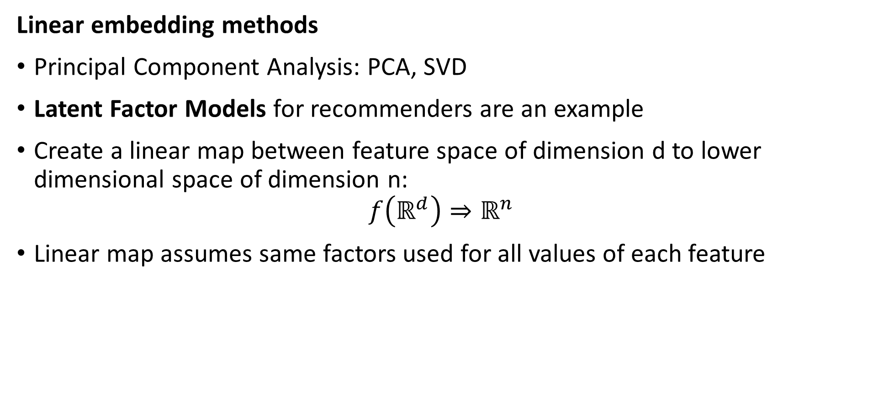
Introduction to Dimensionality Reduction
Linear embedding methods
Principal Component Analysis: PCA, SVD
Latent Factor Models for recommenders are an example
Create a linear map between feature space of dimension d to lower dimensional space of dimension n:
$$f\left(ℝ^{d}\right)⇒ℝ^{n}$$
Linear map assumes same factors used for all values of each feature

Slide 7
Introduction to Dimensionality Reduction
Nonlinear embedding methods
Kernel PCA – topic today
Projection methods for high dimensional spaces – Part 2
Manifold learning for visualization - Part 2
Spectral embedding
T-SNE
Etc……
Deep autoencoders, other NN-based embedding methods – Beyond the scope of this course

Slide 8
Linear Embedding with PCA

Slide 9
Linear Dimensionality Reduction - PCA
PCA applies a linear projection from sample space to an orthogonal space
Start with the original features of the model matrix in the sample space
Compute a linear transformation to an orthogonal space
Principle (1st) axis with highest variance
Each axis is orthogonal to the others, explaining maximum remaining variance
Transform projects data into the new space

Slide 10
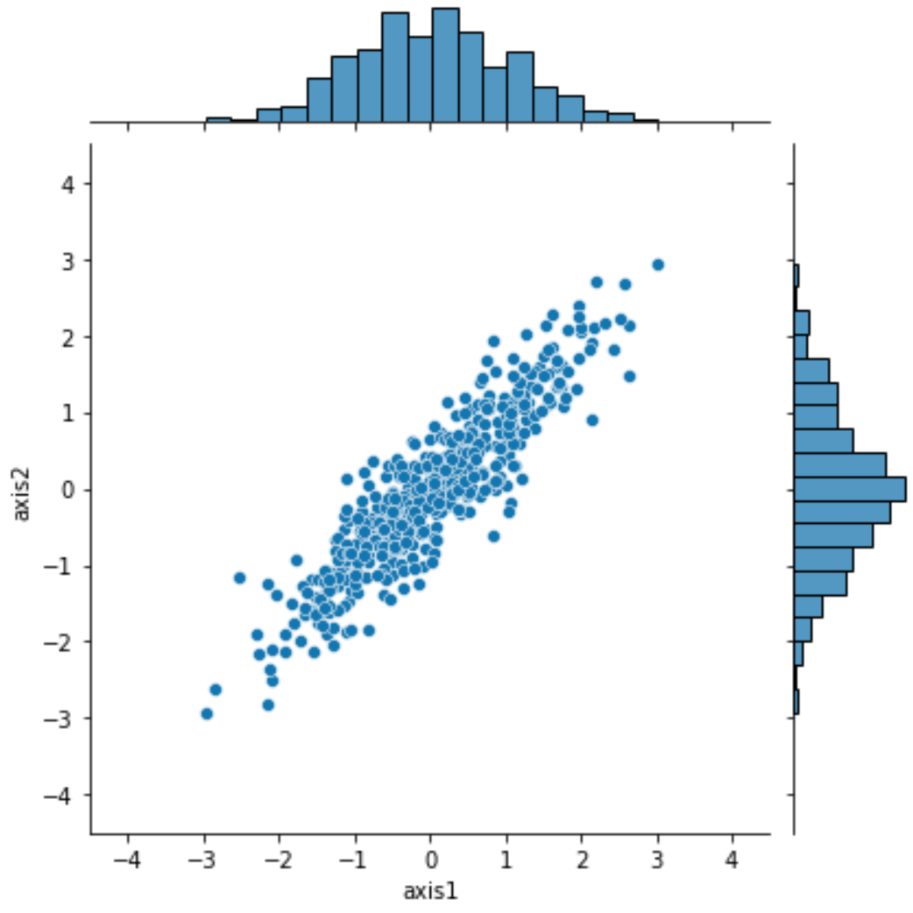
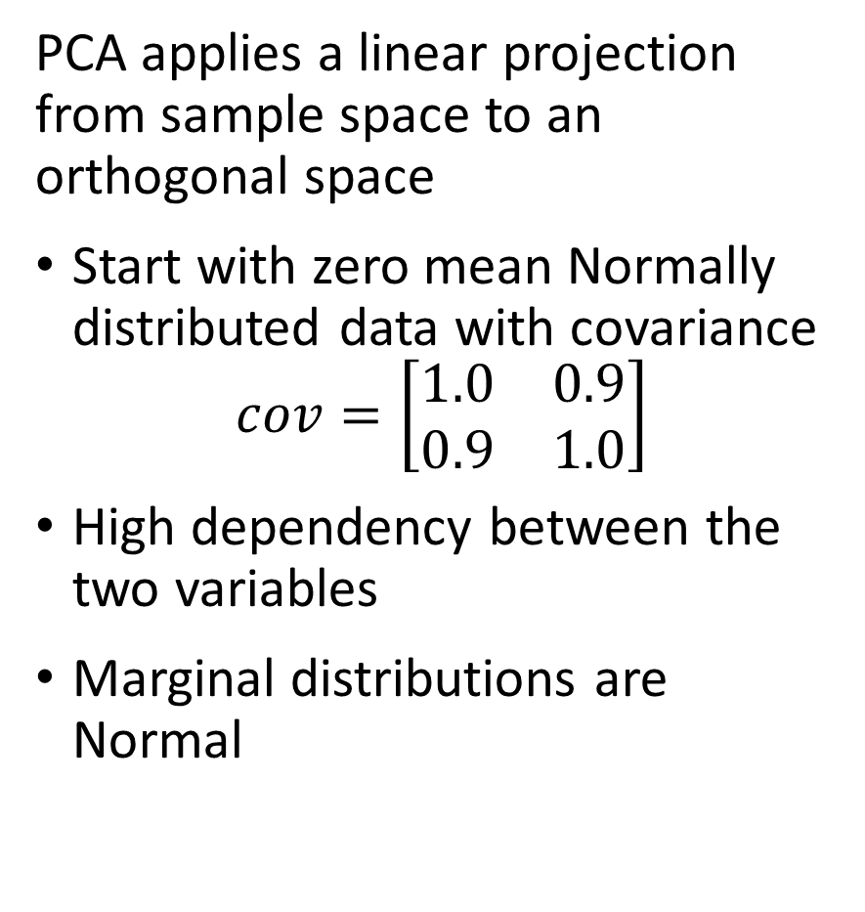
Linear Dimensionality Reduction - PCA
PCA applies a linear projection from sample space to an orthogonal space
Start with zero mean Normally distributed data with covariance
$$cov=\left[\begin{matrix}1.0 & 0.9 \\ 0.9 & 1.0\end{matrix}\right]$$
High dependency between the two variables
Marginal distributions are Normal

Slide 11
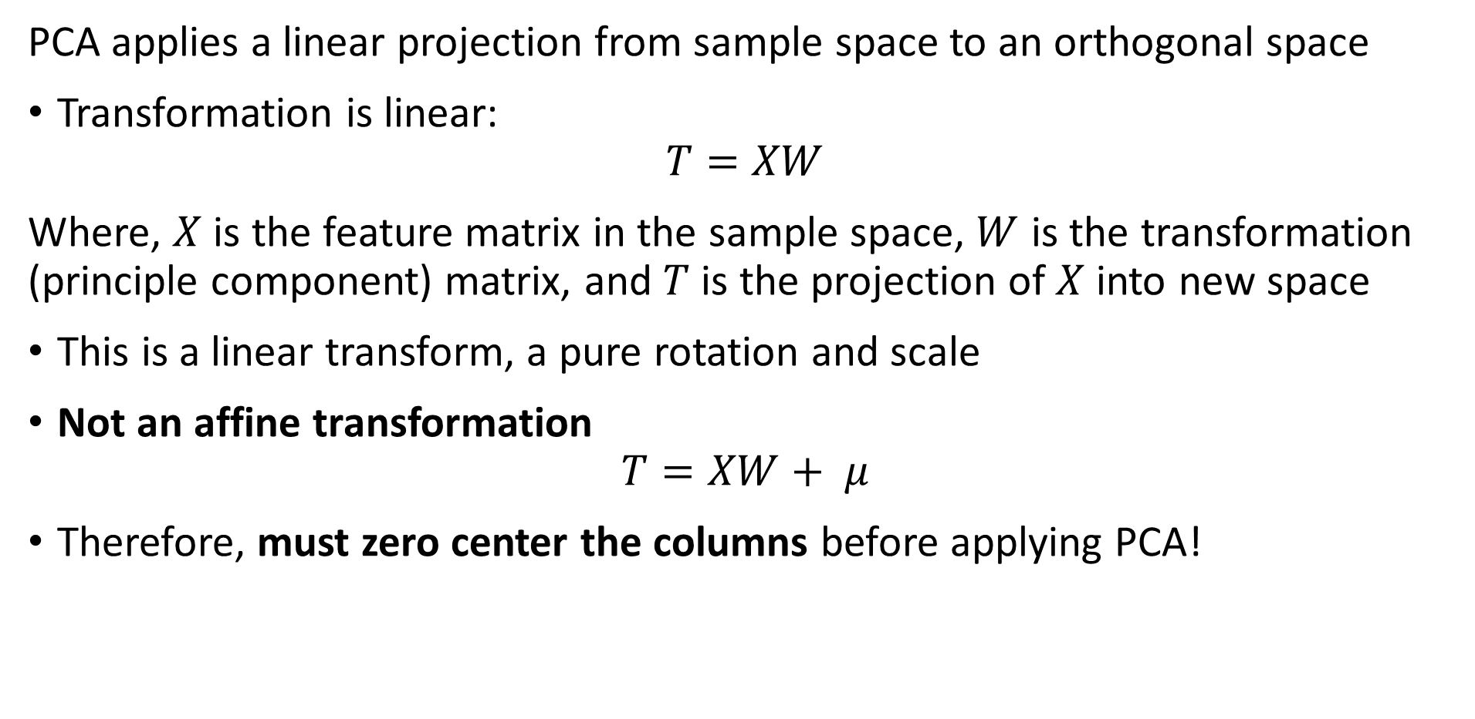
Linear Dimensionality Reduction - PCA
PCA applies a linear projection from sample space to an orthogonal space
Transformation is linear:
$$T=XW$$
Where, $X$ is the feature matrix in the sample space, $W$ is the transformation (principle component) matrix, and $T$ is the projection of $X$ into new space
This is a linear transform, a pure rotation and scale
Not an affine transformation
$$T=XW+ μ$$
Therefore, must zero center the columns before applying PCA!

Slide 12
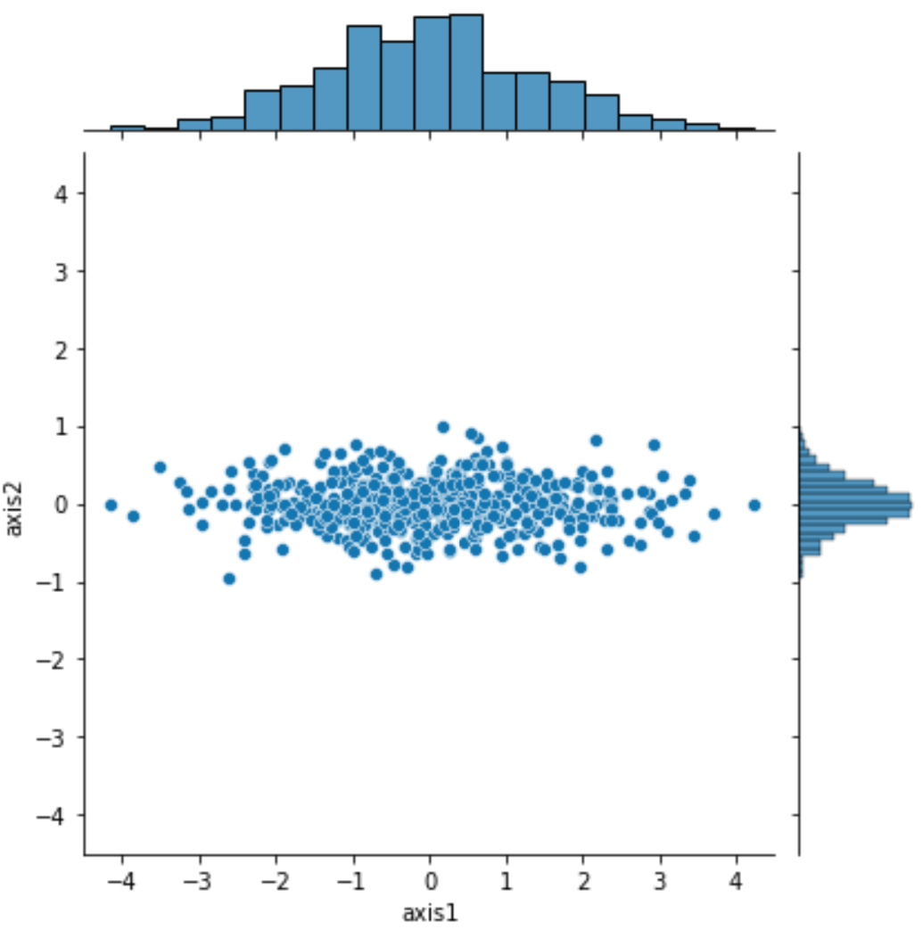
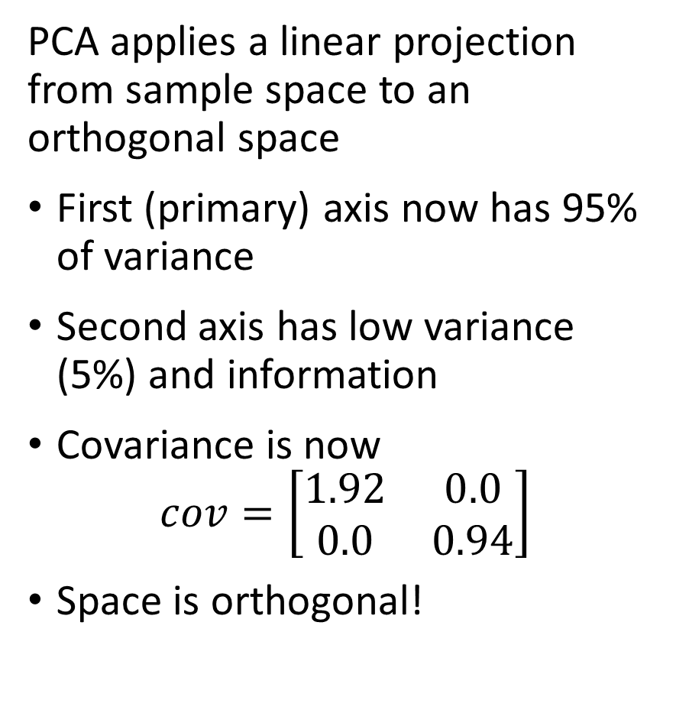
Linear Dimensionality Reduction - PCA
PCA applies a linear projection from sample space to an orthogonal space
First (primary) axis now has 95% of variance
Second axis has low variance (5%) and information
Covariance is now
$$cov=\left[\begin{matrix}1.92 & 0.0 \\ 0.0 & 0.94\end{matrix}\right]$$
Space is orthogonal!

Slide 13
Review of Eigendecomposition

Slide 14

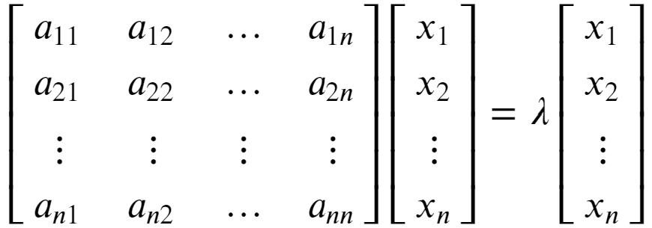


Review of Eigenvalues and Eigenvectors
Eigenvalues are characteristic roots or characteristic values of a linear system
Start with the eigenvalue, eigenvector relationship:
To see that λ is a root of A we can rearrange as follows:

Slide 15
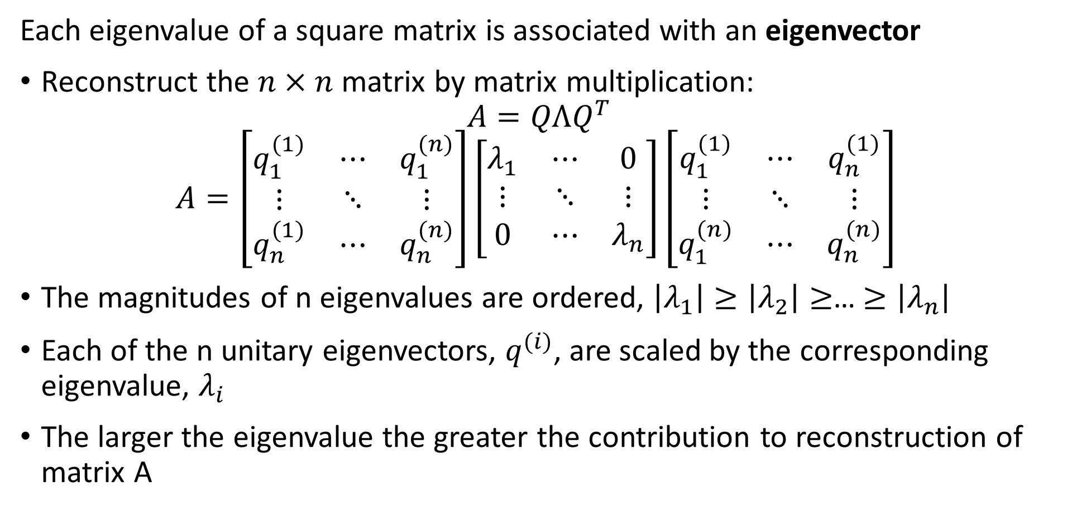
Review of Eigenvalues and Eigenvectors
Each eigenvalue of a square matrix is associated with an eigenvector
Reconstruct the $n×n$ matrix by matrix multiplication:
$$A=QΛQ^{T}$$
$$A=\left[\begin{matrix}q_{1}^{(1)} & ⋯ & q_{1}^{(n)} \\ ⋮ & ⋱ & ⋮ \\ q_{n}^{(1)} & ⋯ & q_{n}^{(n)}\end{matrix}\right]\left[\begin{matrix}λ_{1} & ⋯ & 0 \\ ⋮ & ⋱ & ⋮ \\ 0 & ⋯ & λ_{n}\end{matrix}\right]{\left[\begin{matrix}q_{1}^{(1)} & ⋯ & q_{n}^{(1)} \\ ⋮ & ⋱ & ⋮ \\ q_{1}^{(n)} & ⋯ & q_{n}^{(n)}\end{matrix}\right]}^{ }$$
The magnitudes of n eigenvalues are ordered, $\left|λ_{1}\right|≥\left|λ_{2}\right|≥$… $≥\left|λ_{n}\right|$
Each of the n unitary eigenvectors, $q_{ }^{(i)}$, are scaled by the corresponding eigenvalue, $λ_{i}$
The larger the eigenvalue the greater the contribution to reconstruction of matrix A

Slide 16
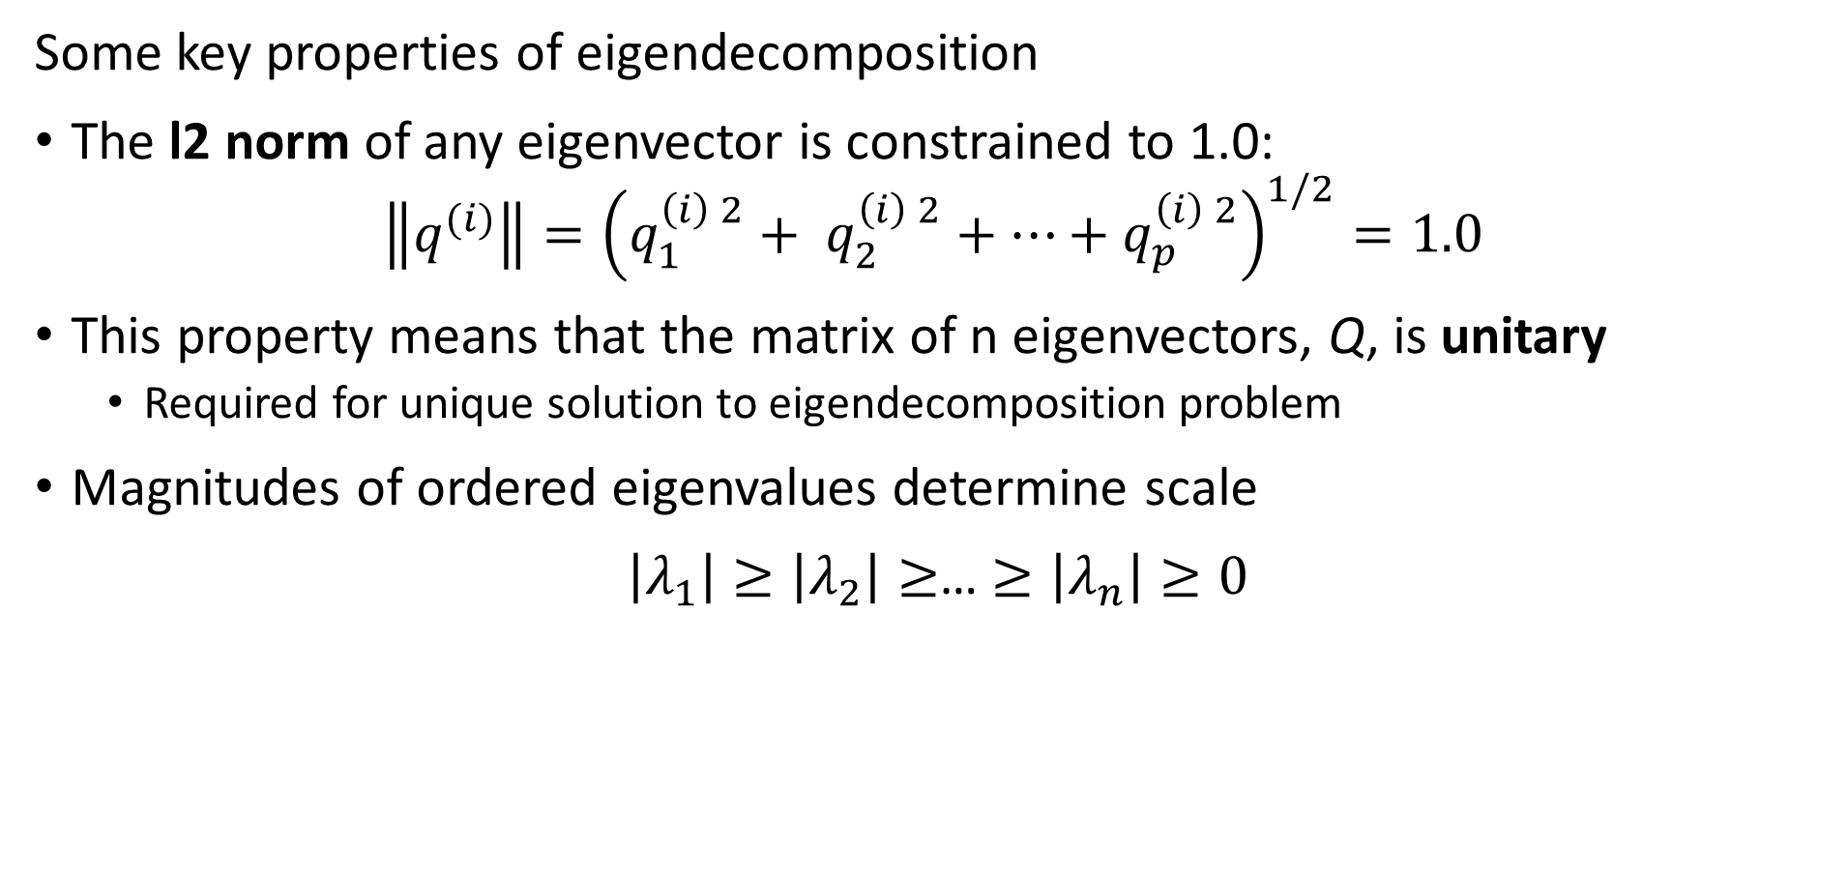
Review of Eigenvalues and Eigenvectors
Some key properties of eigendecomposition
The l2 norm of any eigenvector is constrained to 1.0:
$$\left\|q^{(i)}\right\|={\left(q_{1}^{\left(i\right) 2}+ q_{2}^{\left(i\right) 2}+…+q_{p}^{\left(i\right) 2}\right)}^{1/2}=1.0$$
This property means that the matrix of n eigenvectors, Q, is unitary
Required for unique solution to eigendecomposition problem
Magnitudes of ordered eigenvalues determine scale
$\left|λ_{1}\right|≥\left|λ_{2}\right|≥$… $≥\left|λ_{n}\right|≥0$

Slide 17
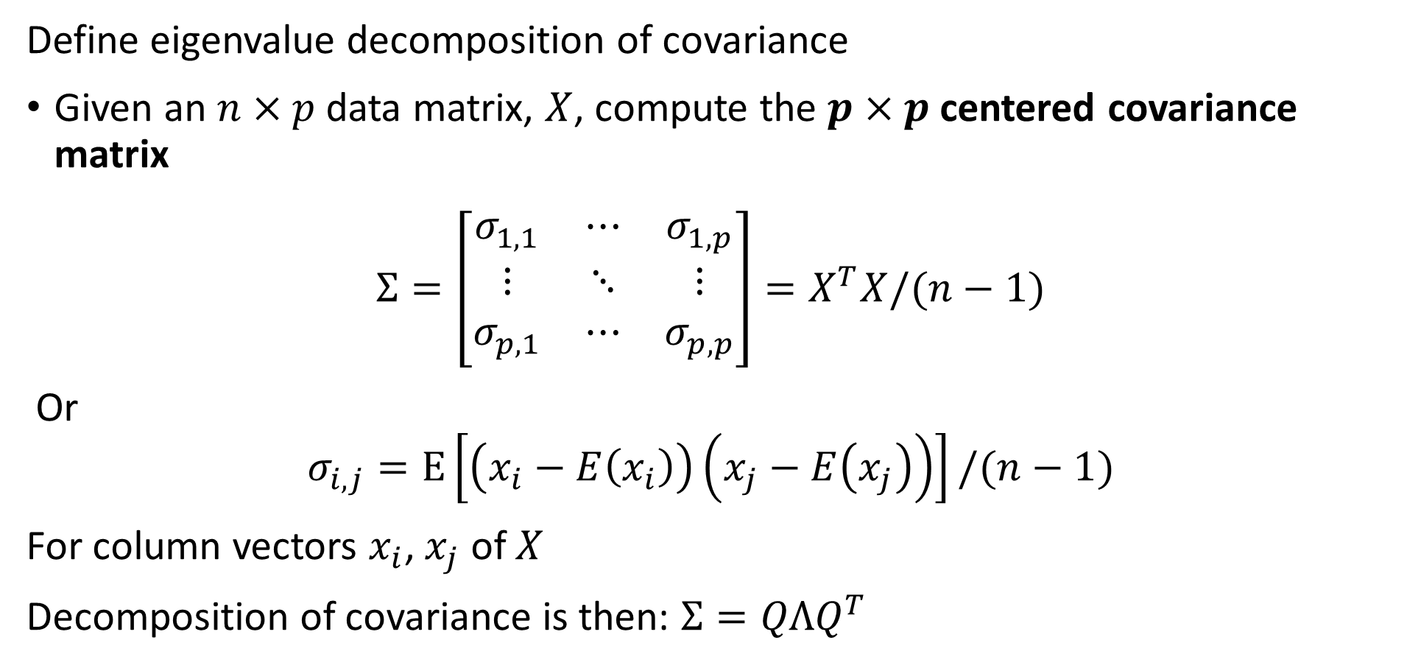
Principle Component Decomposition
Define eigenvalue decomposition of covariance
Given an $n×p$ data matrix, $X$, compute the $p×p$centered covariance matrix
$$Σ=\left[\begin{matrix}σ_{1,1} & ⋯ & σ_{1,p} \\ ⋮ & ⋱ & ⋮ \\ σ_{p,1} & ⋯ & σ_{p,p}\end{matrix}\right]=X^{T}X/(n−1)$$
Or
$$σ_{i,j}=E\left[\left(x_{i}−E\left(x_{i}\right)\right)\left(x_{j}−E\left(x_{j}\right)\right)\right]/(n−1)$$
For column vectors $x_{i}$, $x_{j}$ of $X$
Decomposition of covariance is then: $Σ=QΛQ^{T}$

Slide 18
Principal Component Dimensionality Reduction

Slide 19
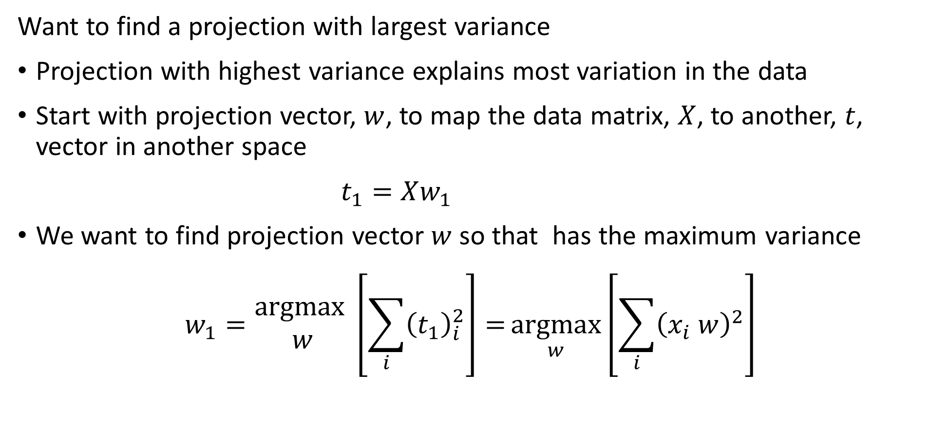
Principle Component Decomposition
Want to find a projection with largest variance
Projection with highest variance explains most variation in the data
Start with projection vector, $w$, to map the data matrix, $X$, to another, $t$, vector in another space
$t_{1}=Xw_{1}$
We want to find projection vector $w$ so that has the maximum variance
$$w_{1}=\underset{ }{\begin{aligned}argmax \\ w\end{aligned}}\left[\sum_{i}{{\left(t_{1}\right)}_{i}^{2}}\right]={\underset{w}{argmax}\left[\sum_{i}{{\left(x_{i} w\right)}_{ }^{2}}\right]}$$

Slide 20
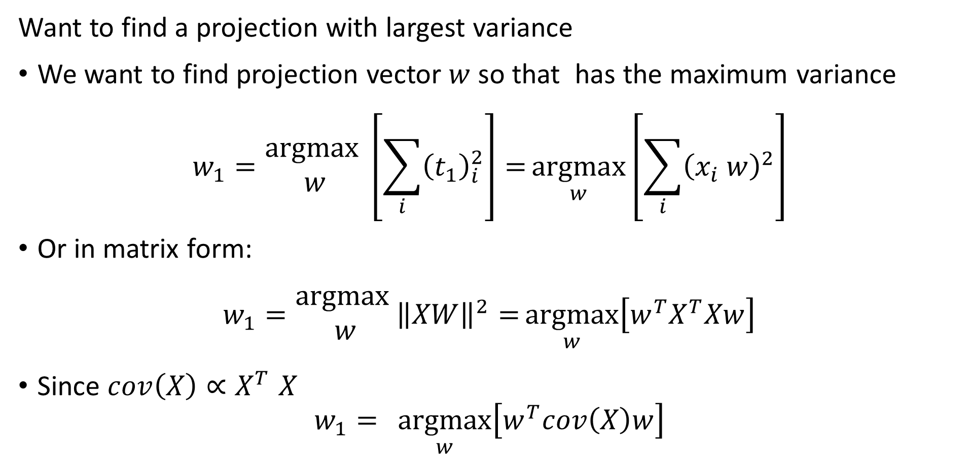
Principle Component Decomposition
Want to find a projection with largest variance
We want to find projection vector $w$ so that has the maximum variance
$$w_{1}=\underset{ }{\begin{aligned}argmax \\ w\end{aligned}}\left[\sum_{i}{{\left(t_{1}\right)}_{i}^{2}}\right]={\underset{w}{argmax}\left[\sum_{i}{{\left(x_{i} w\right)}_{ }^{2}}\right]}$$
Or in matrix form:
$$w_{1}=\underset{ }{\begin{aligned}argmax \\ w\end{aligned}}{\left\|XW\right\|}^{2}={\underset{w}{argmax}\left[w^{T}X^{T}Xw\right]}$$
Since $cov\left(X\right){∝X}^{T}X$
$$w_{1}={\underset{w}{argmax}\left[w^{T}cov\left(X\right)w\right]}$$

Slide 21
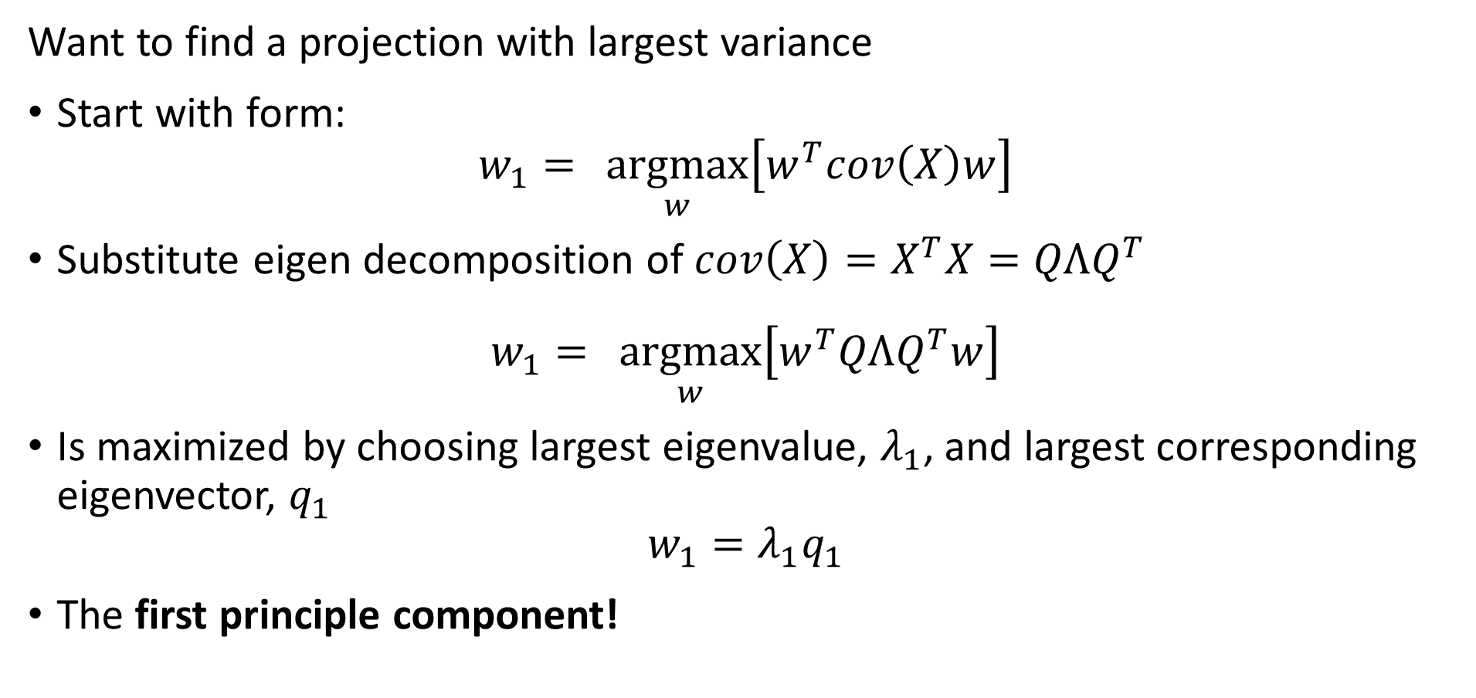
Principle Component Decomposition
Want to find a projection with largest variance
Start with form:
$$w_{1}={\underset{w}{argmax}\left[w^{T}cov\left(X\right)w\right]}$$
Substitute eigen decomposition of $cov\left(X\right)=X^{T}X=QΛQ^{T}$
$$w_{1}={\underset{w}{argmax}\left[w^{T}QΛQ^{T}w\right]}$$
Is maximized by choosing largest eigenvalue, $λ_{1}$, and largest corresponding eigenvector, $q_{1}$
$$w_{1}=λ_{1}q_{1}$$
The first principle component!

Slide 22
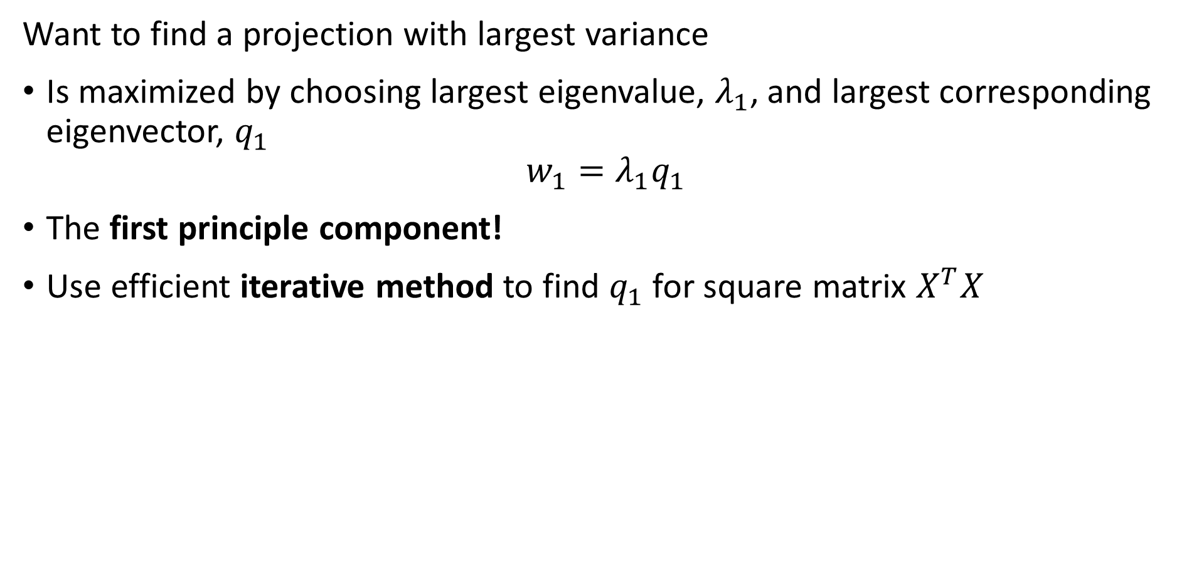
Principle Component Decomposition
Want to find a projection with largest variance
Is maximized by choosing largest eigenvalue, $λ_{1}$, and largest corresponding eigenvector, $q_{1}$
$$w_{1}=λ_{1}q_{1}$$
The first principle component!
Use efficient iterative method to find $q_{1}$ for square matrix $X^{T}X$

Slide 23
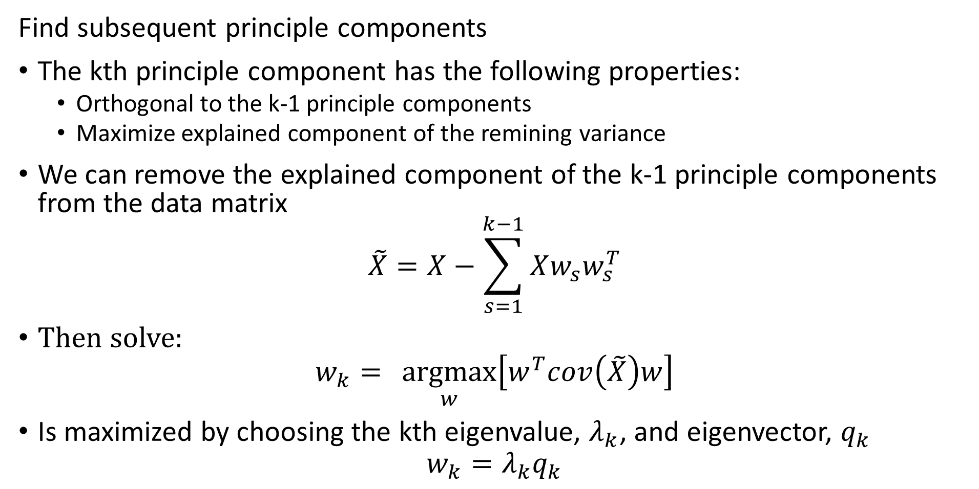
Principle Component Decomposition
Find subsequent principle components
The kth principle component has the following properties:
Orthogonal to the k-1 principle components
Maximize explained component of the remining variance
We can remove the explained component of the k-1 principle components from the data matrix
$$\tilde{X}=X−\sum_{s=1}^{k−1}{Xw_{s}w_{s}^{T}}$$
Then solve:
$$w_{k}={\underset{w}{argmax}\left[w^{T}cov\left(\tilde{X}\right)w\right]}$$
Is maximized by choosing the kth eigenvalue, $λ_{k}$, and eigenvector, $q_{k}$
$$w_{k}=λ_{k}q_{k}$$

Slide 24
Principle Component Decomposition
Properties of principle components
The projection directions are determined by the eigenvectors
Each principle direction scaled by the eigenvalue
Each PC ordered by eigenvalues, projected for decreasing variance (scale)

Slide 25
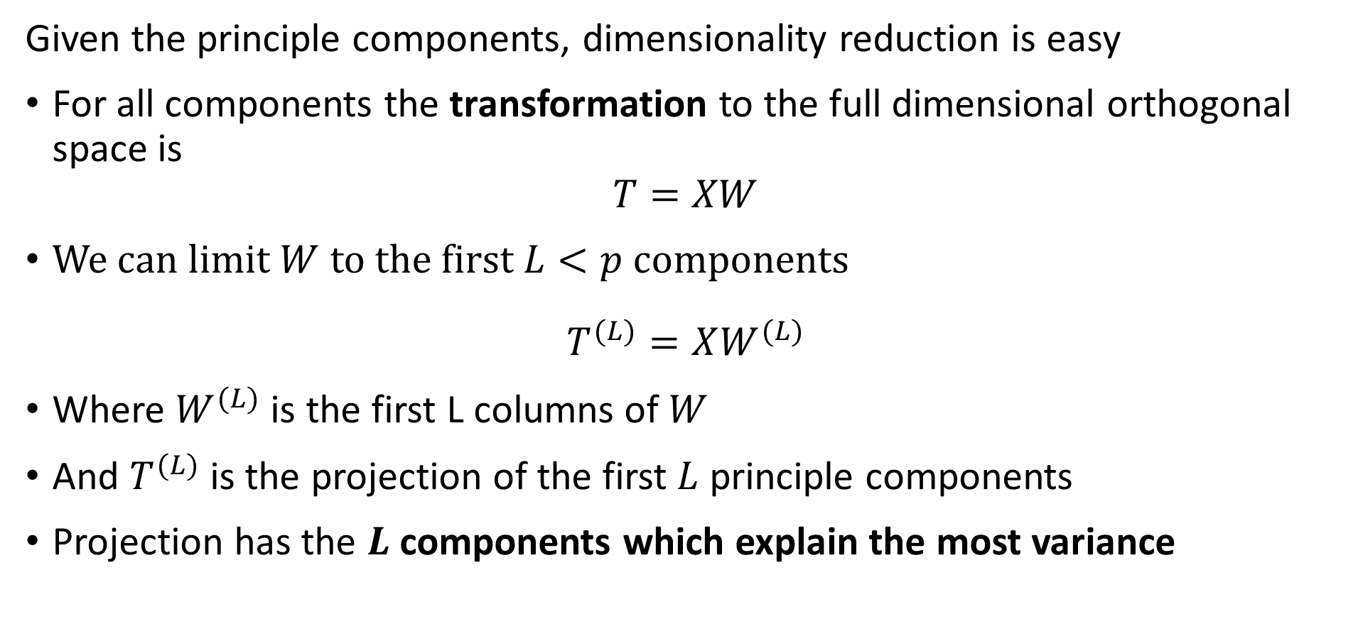
Principle Component Decomposition
Given the principle components, dimensionality reduction is easy
For all components the transformation to the full dimensional orthogonal space is
$$T=XW$$
We can limit $W$ to the first $L<p$ components
$$T^{(L)}=XW^{(L)}$$
Where $W^{(L)}$ is the first L columns of $W$
And $T^{(L)}$ is the projection of the first $L$ principle components
Projection has the $L$ components which explain the most variance

Slide 26
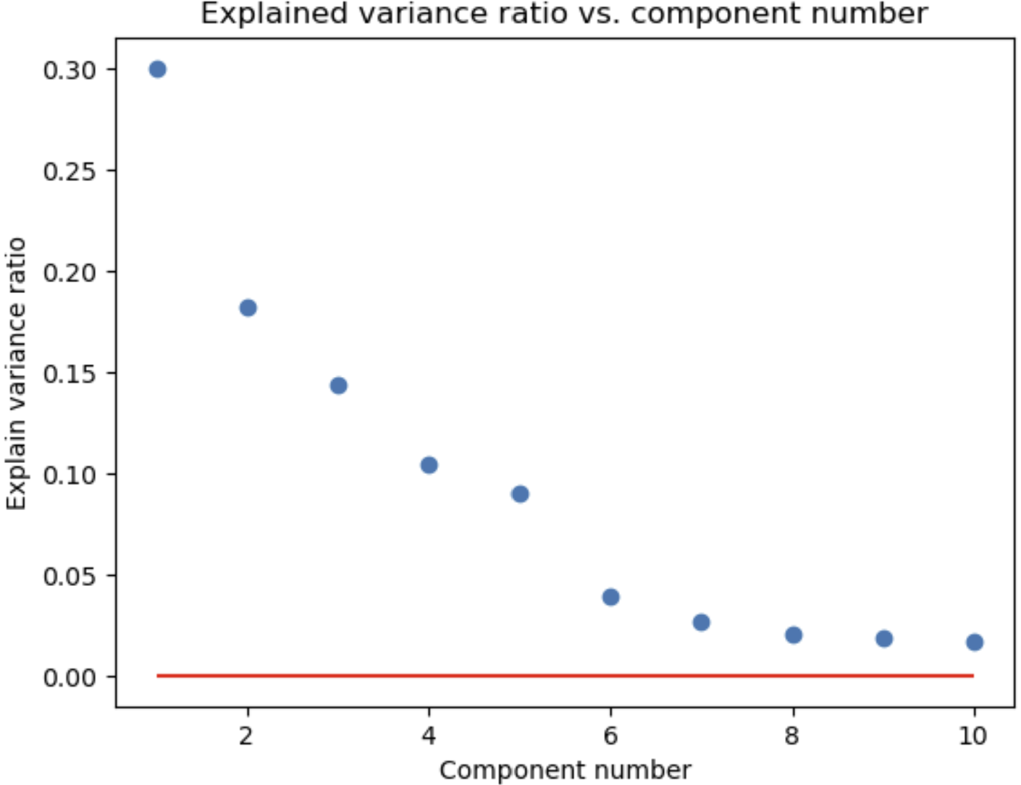
Principle Component Decomposition
How many components do you need?
Need to retain enough components to which explain most of the variance
Components explain most variance
Apparent random variation – irreducible error

Slide 27
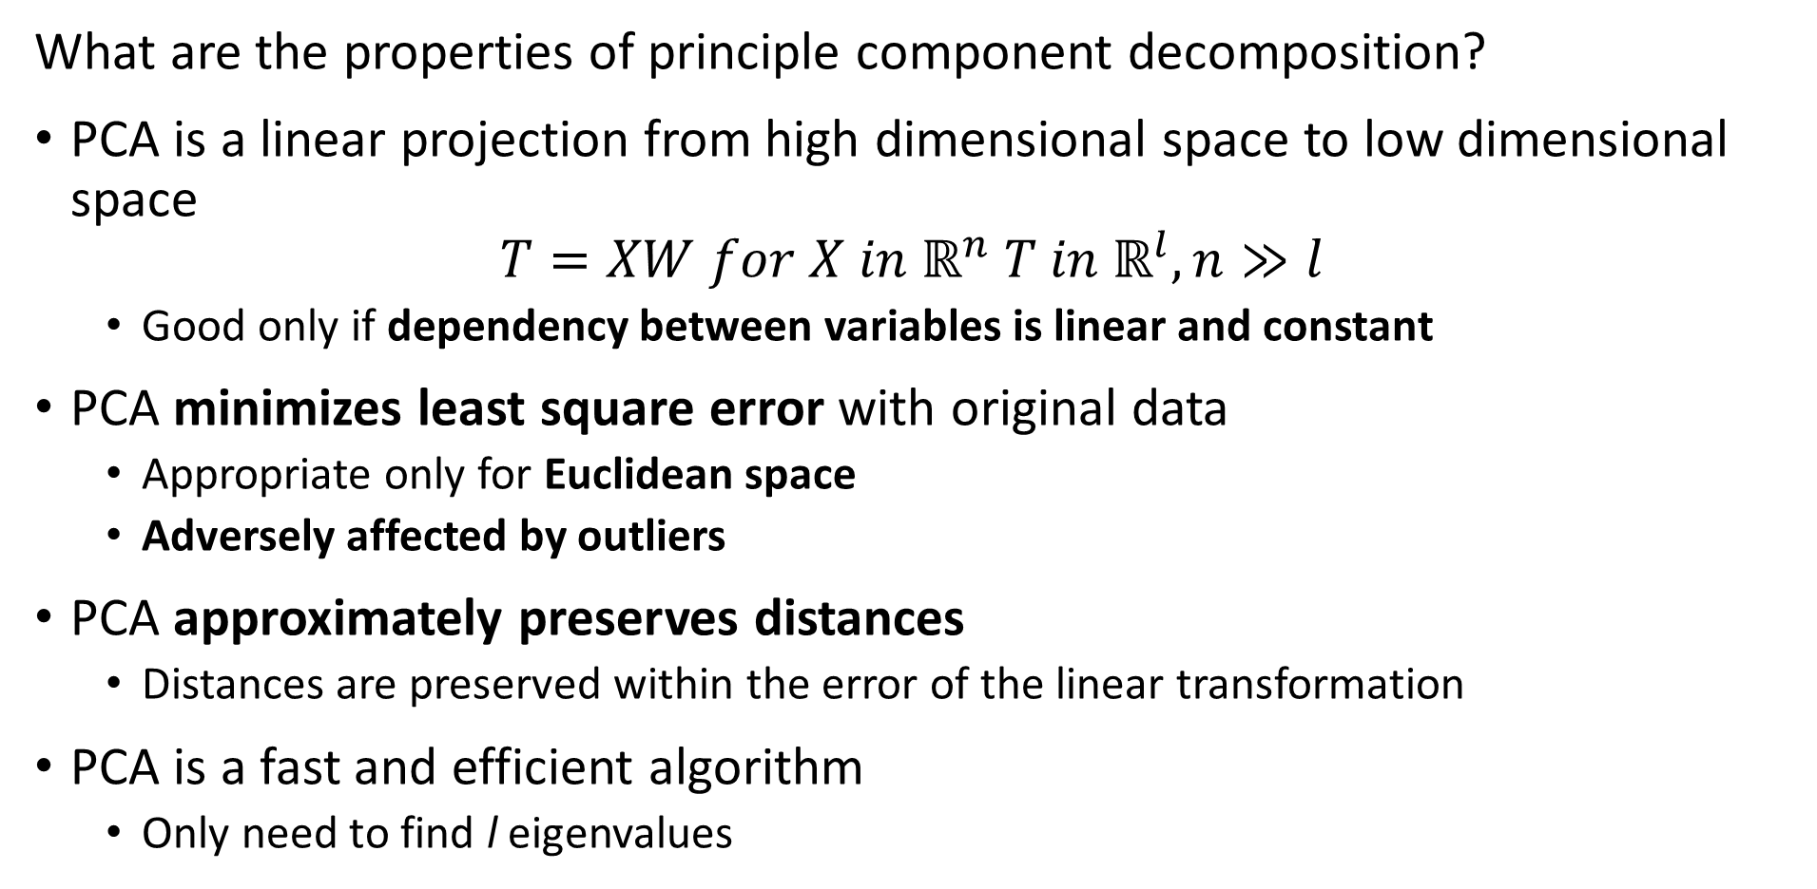
Principle Component Decomposition
What are the properties of principle component decomposition?
PCA is a linear projection from high dimensional space to low dimensional space
$$T=XW for X in ℝ^{n} T in ℝ^{l}, n≫l$$
Good only if dependency between variables is linear and constant
PCA minimizes least square error with original data
Appropriate only for Euclidean space
Adversely affected by outliers
PCA approximately preserves distances
Distances are preserved within the error of the linear transformation
PCA is a fast and efficient algorithm
Only need to find l eigenvalues

Slide 28
Principle Component Decomposition
Data preparation for PCA
Treat outliers since PCA susceptible
Details are problem dependent
If outliers inherent in data, consider nonlinear method like spectral decomposition
Demean the variables
PCA is a linear not affine transformation
Scale
Standardize variance so no variable dominates decomposition

Slide 29
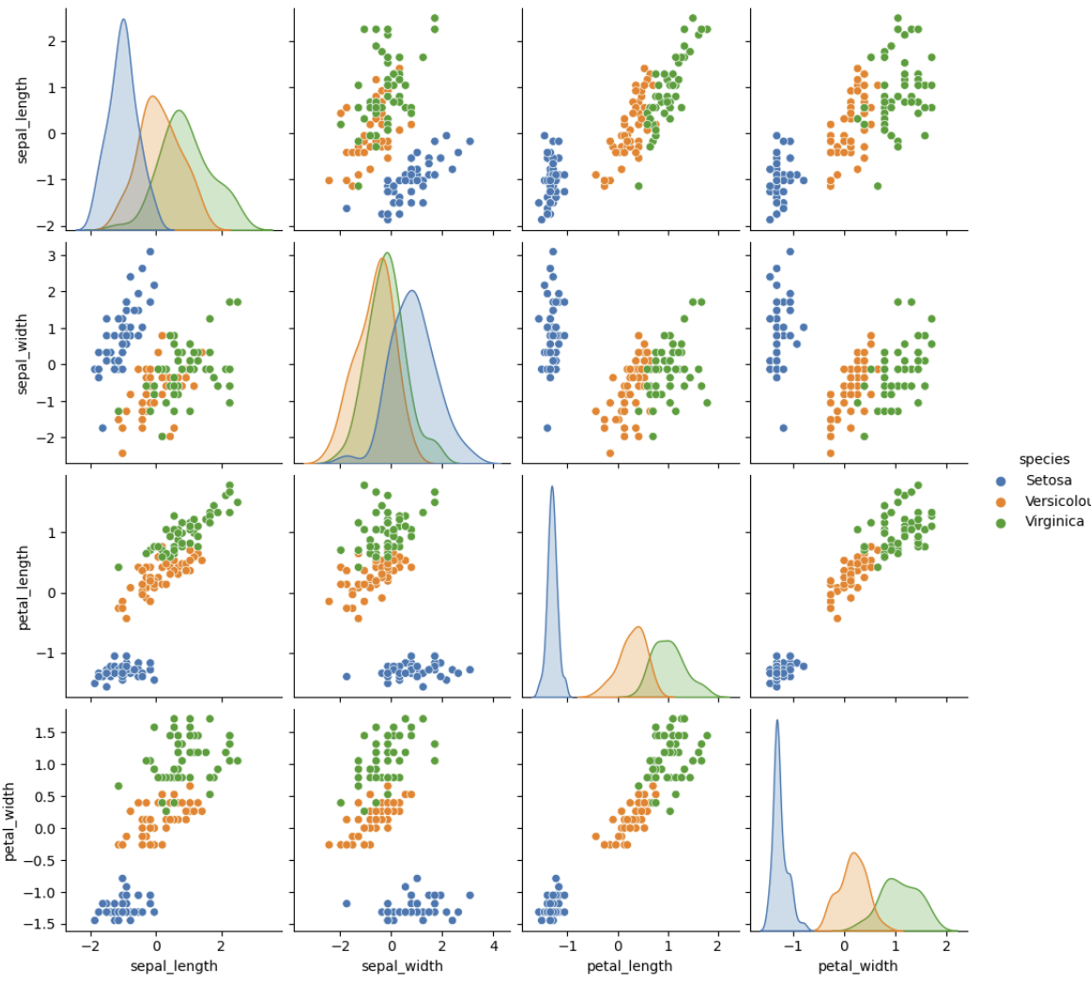
Principle Component Decomposition
Example, Iris dataset
3 spices of iris flowers
4 dimensions of measurements
1 species well separated
2 species overlap in all dimensions

Slide 30
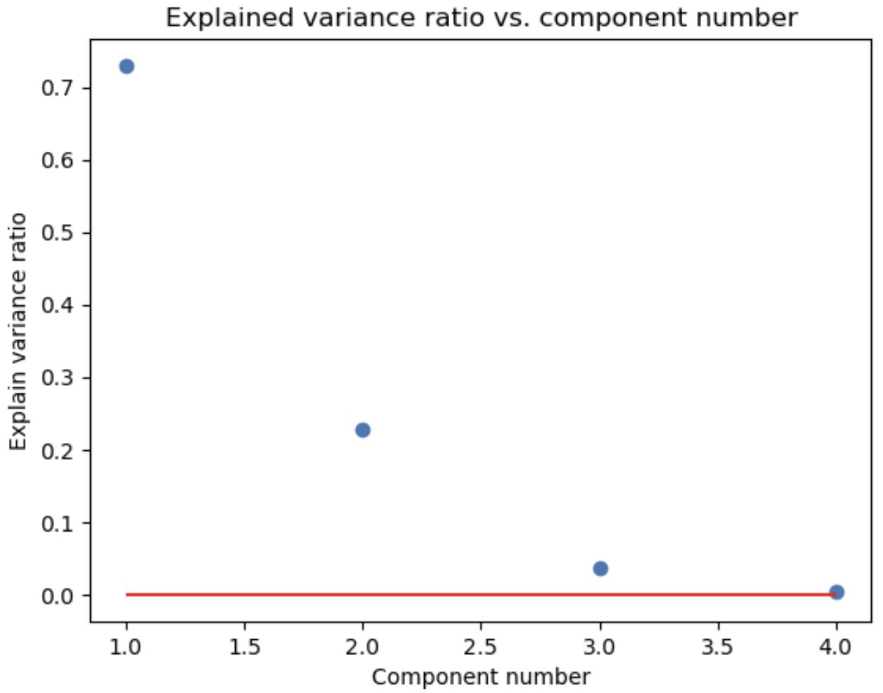
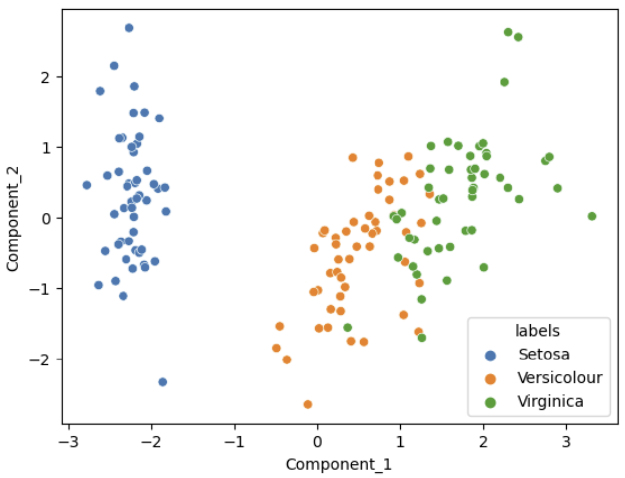
Principle Component Decomposition
Example, Iris dataset
Variance ratio by PCA component
Scatterplot of first 2 PCA Components

Slide 31
Singular Value Decomposition

Slide 32
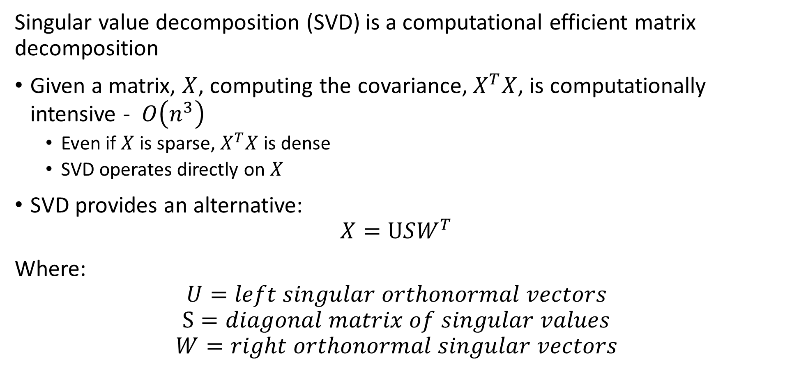
Singular Value Decomposition
Singular value decomposition (SVD) is a computational efficient matrix decomposition
Given a matrix, $X$, computing the covariance, $X^{T}X$, is computationally intensive - $O\left(n^{3}\right)$
Even if $X$ is sparse, $X^{T}X$ is dense
SVD operates directly on $X$
SVD provides an alternative:
$$X=USW^{T}$$
Where:
$$U=left singular orthonormal vectors$$
$$S=diagonal matrix of singular values$$
$$W=right orthonormal singular vectors$$

Slide 33
Singular Value Decomposition
Singular value decomposition (SVD) is a computational efficient matrix decomposition
At scale, can directly apply SVD to massive feature matrices
But SVD is not good for sparse matrices, particularly with many 0s
But, we do not need the full decomposition!
Decompose into low-dimensional embedding factors
Example: factor model for recommenders

Slide 34
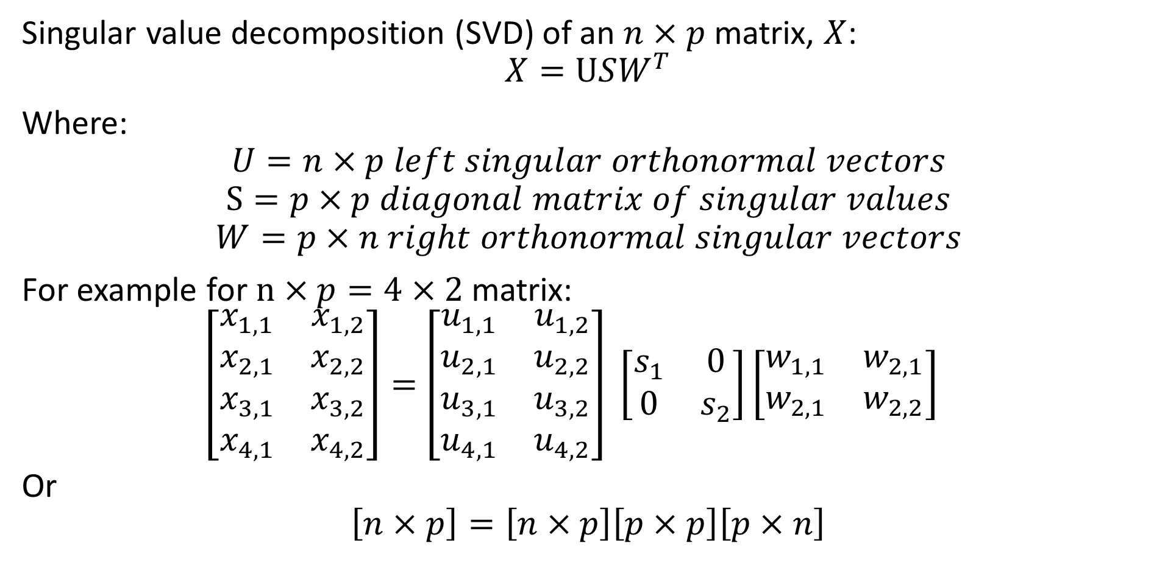
Singular Value Decomposition
Singular value decomposition (SVD) of an $n×p$ matrix, $X$:
$$X=USW^{T}$$
Where:
$$U=n×p left singular orthonormal vectors$$
$$S=p×p diagonal matrix of singular values$$
$$W=p×n right orthonormal singular vectors$$
For example for $n×p=4×2$ matrix:
$\left[\begin{matrix}x_{1,1} & x_{1,2} \\ x_{2,1} & x_{2,2} \\ x_{3,1} & x_{3,2} \\ x_{4,1} & x_{4,2}\end{matrix}\right]=$ $\left[\begin{matrix}u_{1,1} & u_{1,2} \\ u_{2,1} & u_{2,2} \\ u_{3,1} & u_{3,2} \\ u_{4,1} & u_{4,2}\end{matrix}\right] \left[\begin{matrix}s_{1} & 0 \\ 0 & s_{2}\end{matrix}\right]\left[\begin{matrix}w_{1,1} & w_{2,1} \\ w_{2,1} & w_{2,2}\end{matrix}\right]$
Or
$$\left[n×p\right]=\left[n×p\right]\left[p×p\right]\left[p×n\right]$$

Slide 35
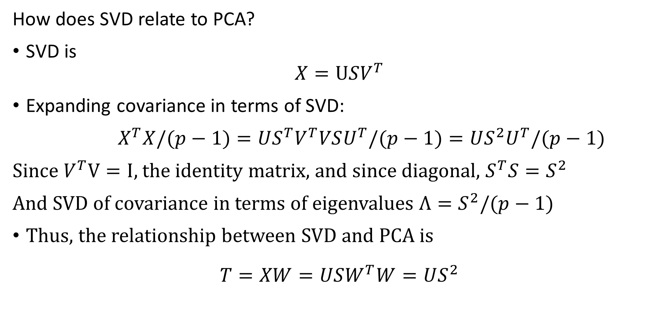
Singular Value Decomposition
How does SVD relate to PCA?
SVD is
$$X=USV^{T}$$
Expanding covariance in terms of SVD:
$X^{T}X/(p−1)=US^{T}V^{T}VSU^{T}/(p−1)=US^{2}U^{T}/(p−1)$
Since $V^{T}V=I$, the identity matrix, and since diagonal, $S^{T}S{=S}^{2}$
And SVD of covariance in terms of eigenvalues ${Λ=S}^{2}/(p−1)$
Thus, the relationship between SVD and PCA is
$$T=XW=USW^{T}W=US^{2}$$

Slide 36
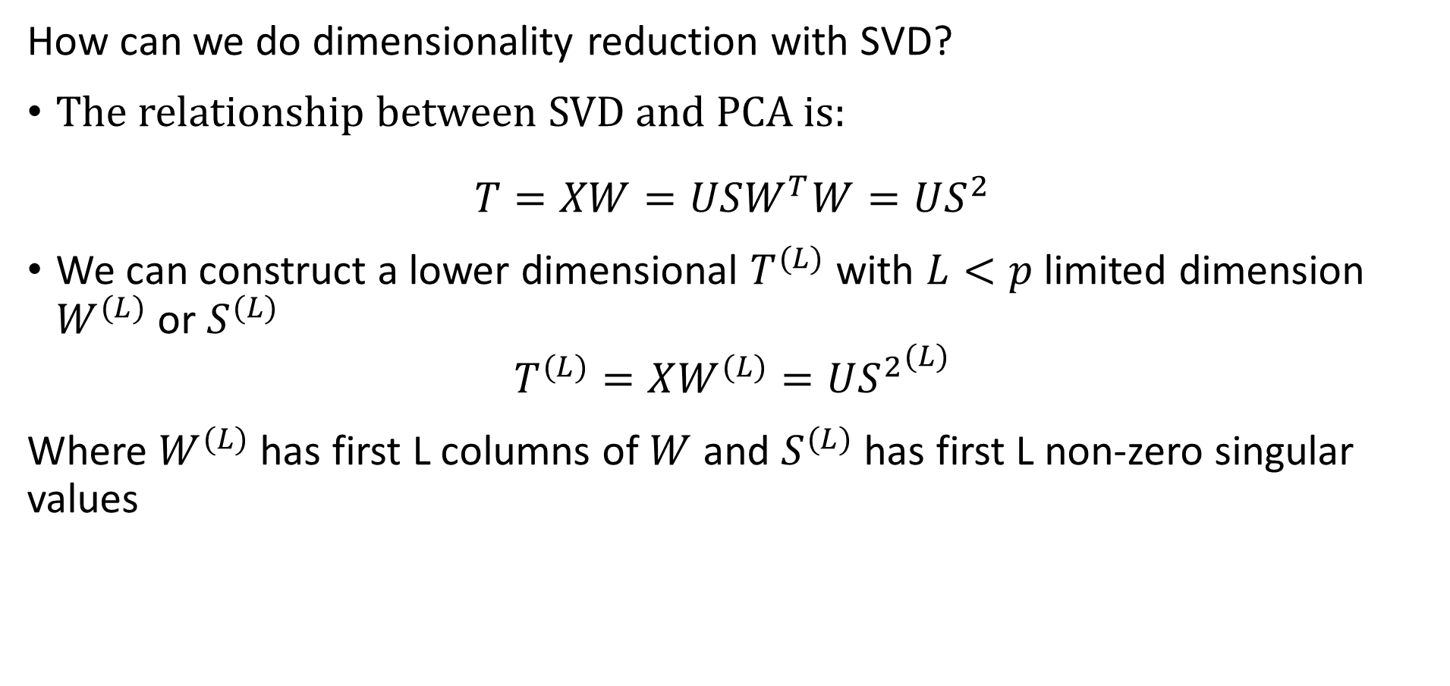
Singular Value Decomposition
How can we do dimensionality reduction with SVD?
The relationship between SVD and PCA is:
$$T=XW=USW^{T}W=US^{2}$$
We can construct a lower dimensional $T^{(L)}$ with $L<p$ limited dimension $W^{(L)}$ or $S^{(L)}$
$$T^{(L)}=XW^{(L)}=U{S^{2}}^{(L)}$$
Where $W^{(L)}$ has first L columns of $W$ and $S^{(L)}$ has first L non-zero singular values

Slide 37
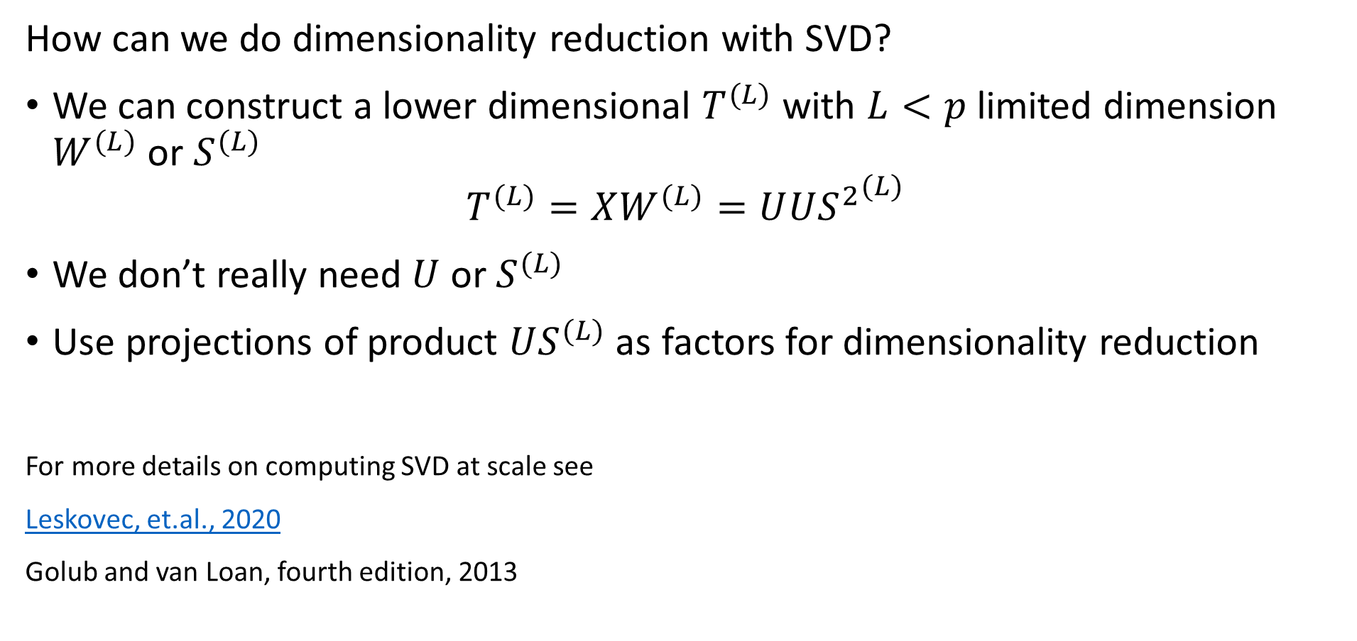
Singular Value Decomposition
How can we do dimensionality reduction with SVD?
We can construct a lower dimensional $T^{(L)}$ with $L<p$ limited dimension $W^{(L)}$ or $S^{(L)}$
$$T^{(L)}=XW^{(L)}=U{US^{2}}^{(L)}$$
We don’t really need $U$ or $S^{(L)}$
Use projections of product $US^{(L)}$ as factors for dimensionality reduction
For more details on computing SVD at scale see
Leskovec, et.al., 2020
Golub and van Loan, fourth edition, 2013

Slide 38
Nonlinear Embedding with Kernel PCA

Slide 39
Nonlinear Kernel PCA
For many problems a linear map does not provide optimal projections!
How can we transform a nonlinear space to a linear space?
Use a kernel transformation
Kernel methods map original nonlinear space to higher dimensional linear space
Perform PCA in the linear space

Slide 40
Understanding nonlinear case
Start with 2-dimensional feature space, X = [x₁,x₂]
2- values = {circle,plus}
Is there any optimal separating hyperplane?
No!
The optimal separator is nonlinear
Feature 2
Feature 1

Slide 41
Understanding nonlinear case
Observations are not linearly separable in the original feature space
Transform problem to a new space where observations are linearly separable
X3
Kernel Transformation to new space
X1
Feature 2
Separating Hyperplane
Feature 1
X2

Slide 42
Kernels for nonlinear separation
What types of functions can we use as basis functions?
Any orthogonal set of functions
Polynomials – supported by Scikit-learn
Radial basis functions – default in Scikit-learn
Hyperbolic tangent functions – supported in Scikit-learn, and used in some neural networks
And many other basis functions –
Dictionary learning
Fourier expansions, Wavelet functions, etc.
Supported in Scikit-learn
We will not discuss this method further here

Slide 43
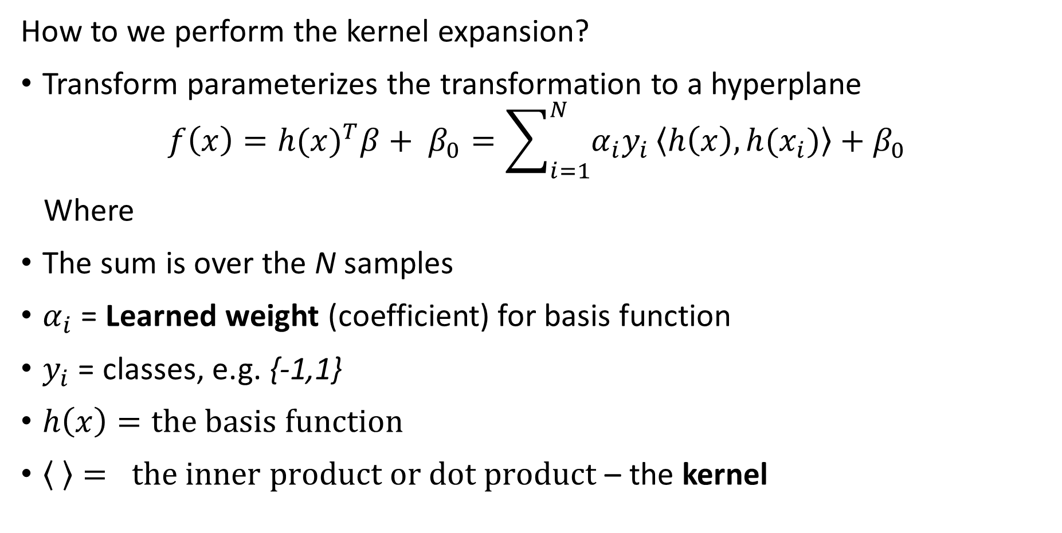
Mapping to Linear Space with a Kernel
How to we perform the kernel expansion?
Transform parameterizes the transformation to a hyperplane
$$f\left(x\right)=h(x)^{T}β+ β_{0}=\sum_{i=1}^{N}{α_{i}y_{i}}\left\langle h\left(x\right),h(x_{i})\right\rangle +β_{0}$$
Where
The sum is over the N samples
$α_{i}$ = Learned weight (coefficient) for basis function
$y_{i}$ = classes, e.g. {-1,1}
$h\left(x\right)=the basis function$
$\left\langle \right\rangle = the inner product or dot product$ – the kernel

Slide 44
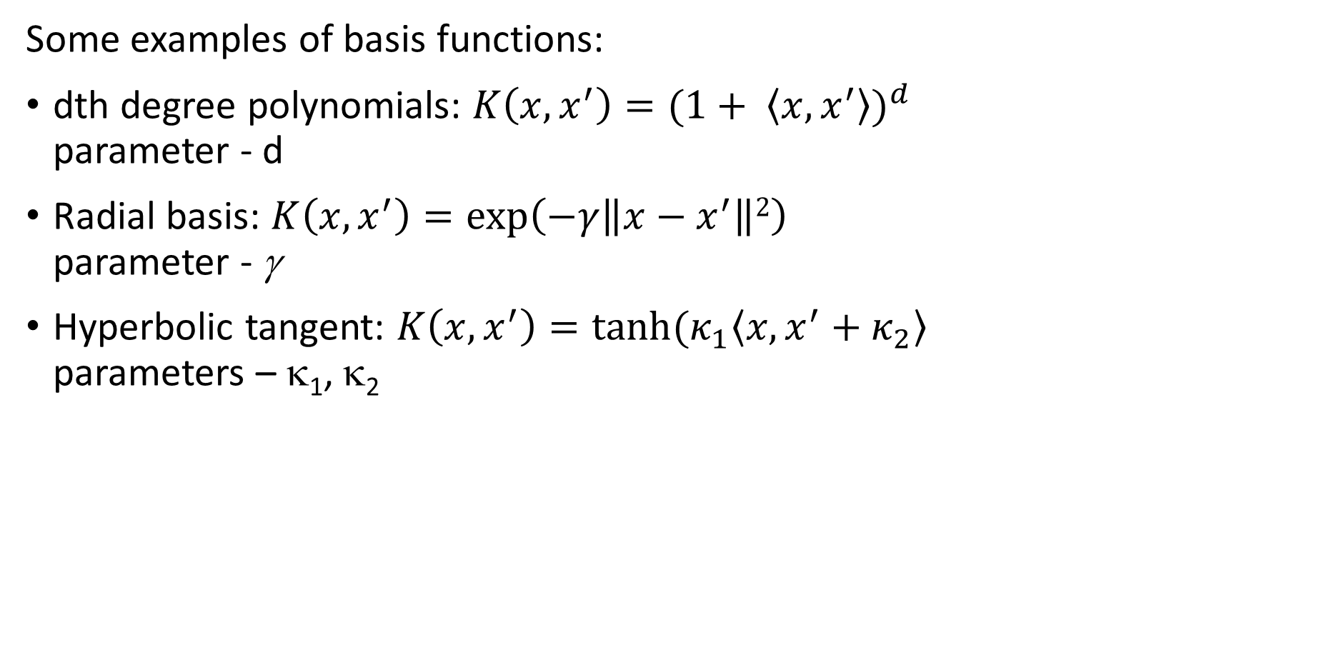
Kernels nonlinear separation
Some examples of basis functions:
dth degree polynomials: $K\left(x,x^{′}\right)=(1+ \left\langle x,x^{′}\right\rangle )^{d}$ parameter - d
Radial basis: $K\left(x,x^{′}\right)=\exp\left(−γ\left\|x−x^{′}\right\|2\right)$ parameter - γ
Hyperbolic tangent: $K\left(x,x^{′}\right)=tanh⁡(κ_{1}\left\langle x,x^{′}+κ_{2}\right\rangle$ parameters – κ₁, κ₂

Slide 45
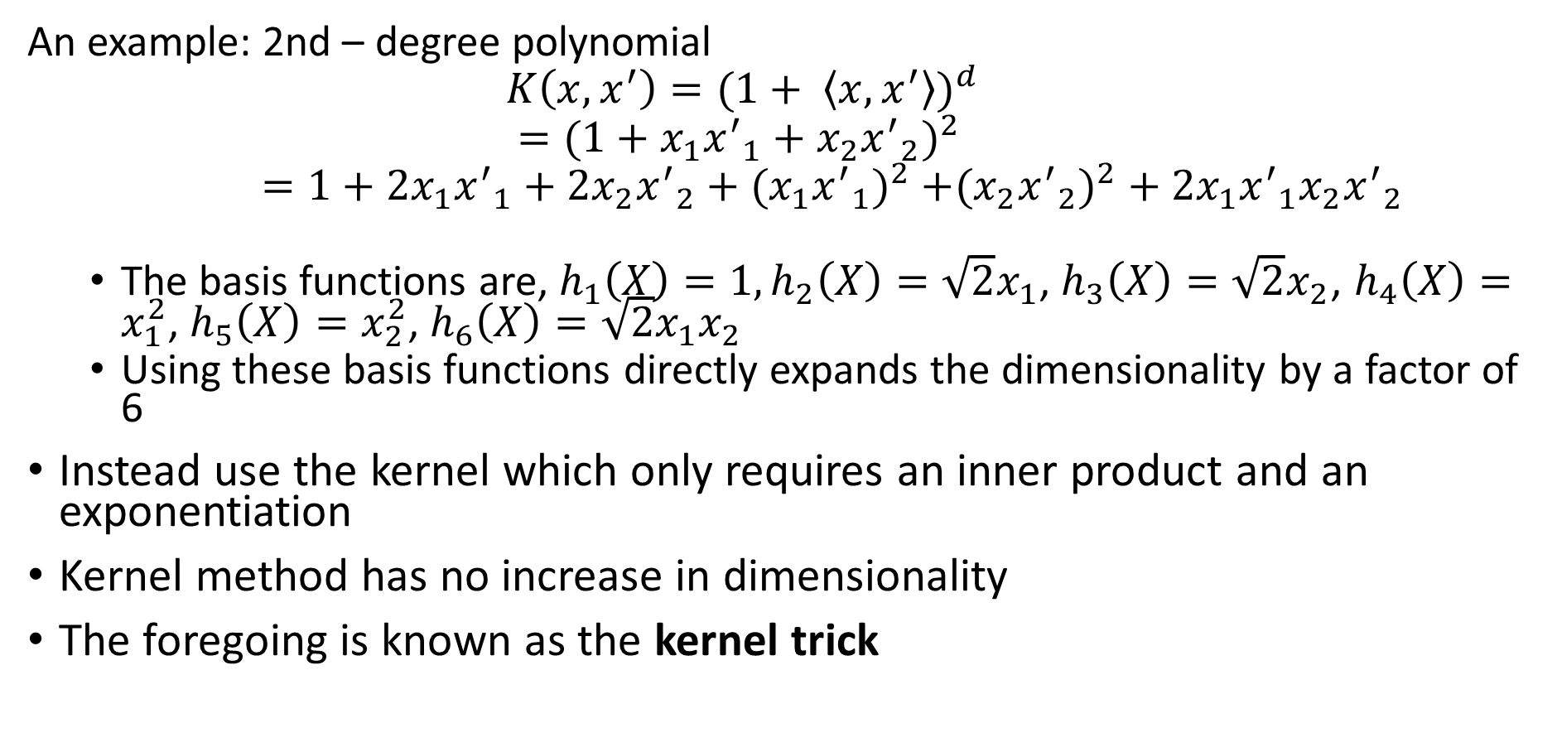
Kernels nonlinear separation
An example: 2nd – degree polynomial
$$K\left(x,x^{′}\right)=(1+ \left\langle x,x^{′}\right\rangle )^{d}$$
$$=(1+x_{1}{x^{′}}_{1}+x_{2}{x^{′}}_{2})^{2 }$$
$=1+2x_{1}{x^{′}}_{1}+{2x}_{2}{x^{′}}_{2}+({x_{1}{x^{′}}_{1})}^{2}$ $+({x_{2}{x^{′}}_{2})}^{2}+2x_{1}{x^{′}}_{1}x_{2}{x^{′}}_{2}$
The basis functions are, $h_{1}\left(X\right)=1, h_{2}\left(X\right)=\sqrt{2}x_{1}$, $h_{3}\left(X\right)=\sqrt{2}x_{2}$, $h_{4}\left(X\right)=x_{1}^{2}$, $h_{5}\left(X\right)=x_{2}^{2}$, $h_{6}\left(X\right)=\sqrt{2}x_{1}x_{2}$
Using these basis functions directly expands the dimensionality by a factor of 6
Instead use the kernel which only requires an inner product and an exponentiation
Kernel method has no increase in dimensionality
The foregoing is known as the kernel trick

Slide 46
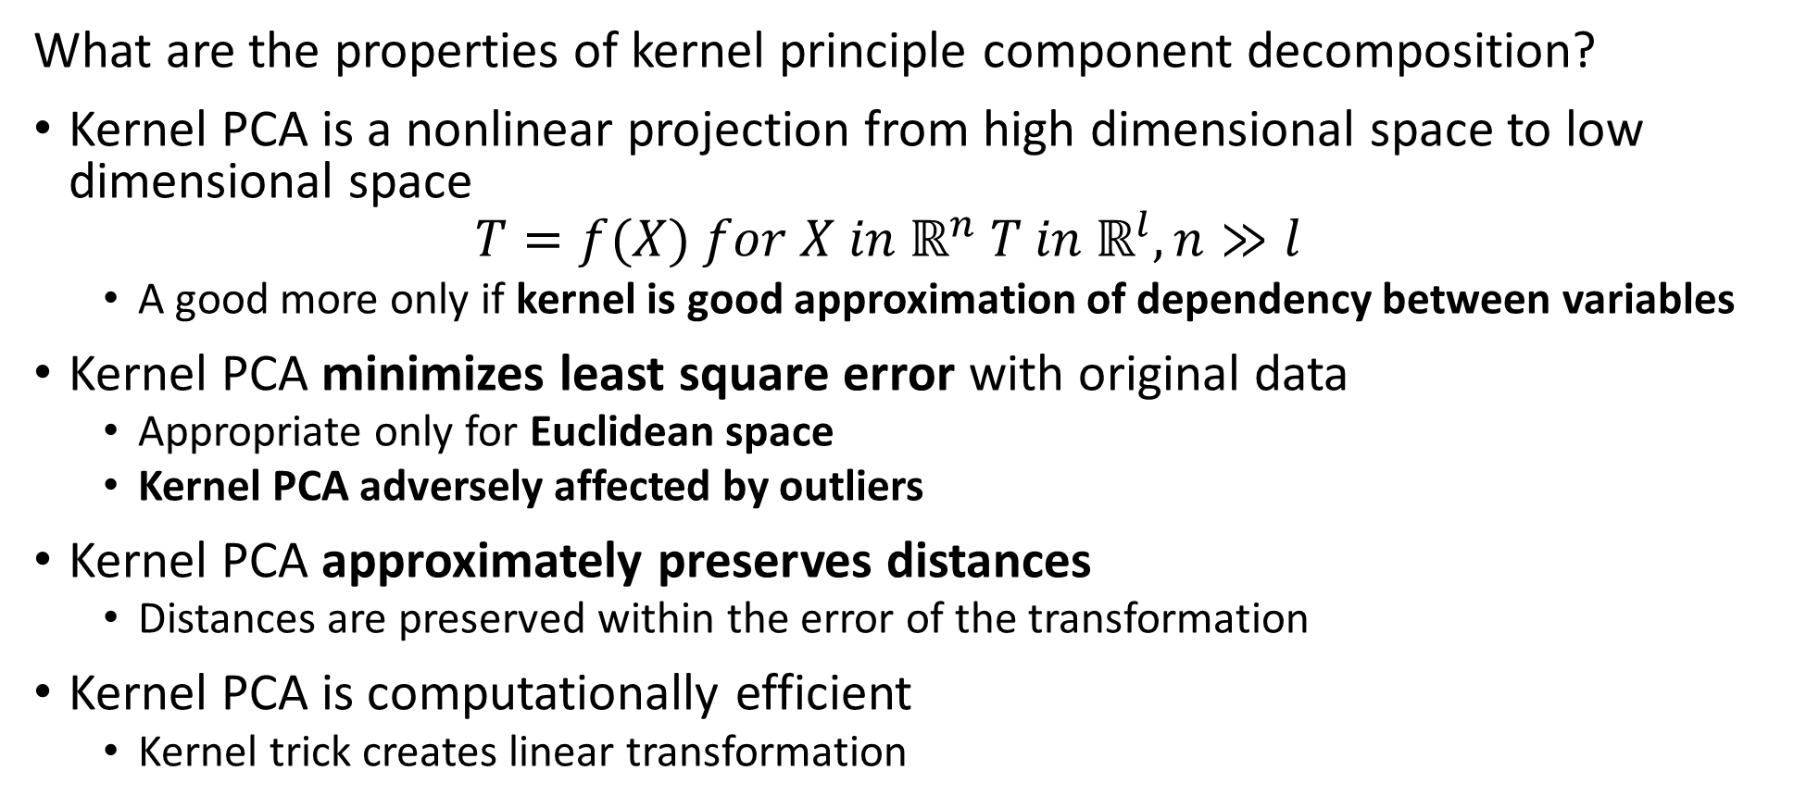
Kernel Principle Component Decomposition
What are the properties of kernel principle component decomposition?
Kernel PCA is a nonlinear projection from high dimensional space to low dimensional space
$$T=f(X) for X in ℝ^{n} T in ℝ^{l}, n≫l$$
A good more only if kernel is good approximation of dependency between variables
Kernel PCA minimizes least square error with original data
Appropriate only for Euclidean space
Kernel PCA adversely affected by outliers
Kernel PCA approximately preserves distances
Distances are preserved within the error of the transformation
Kernel PCA is computationally efficient
Kernel trick creates linear transformation

Slide 47
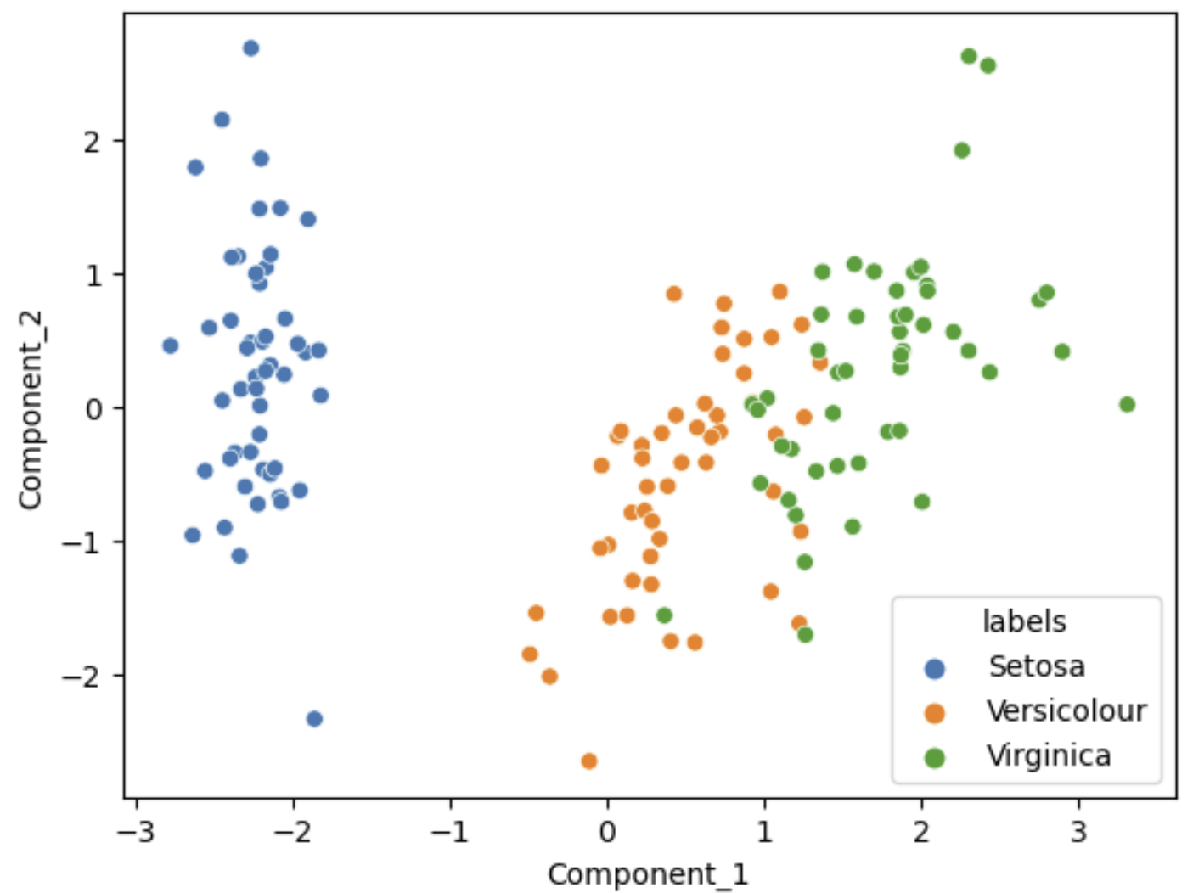
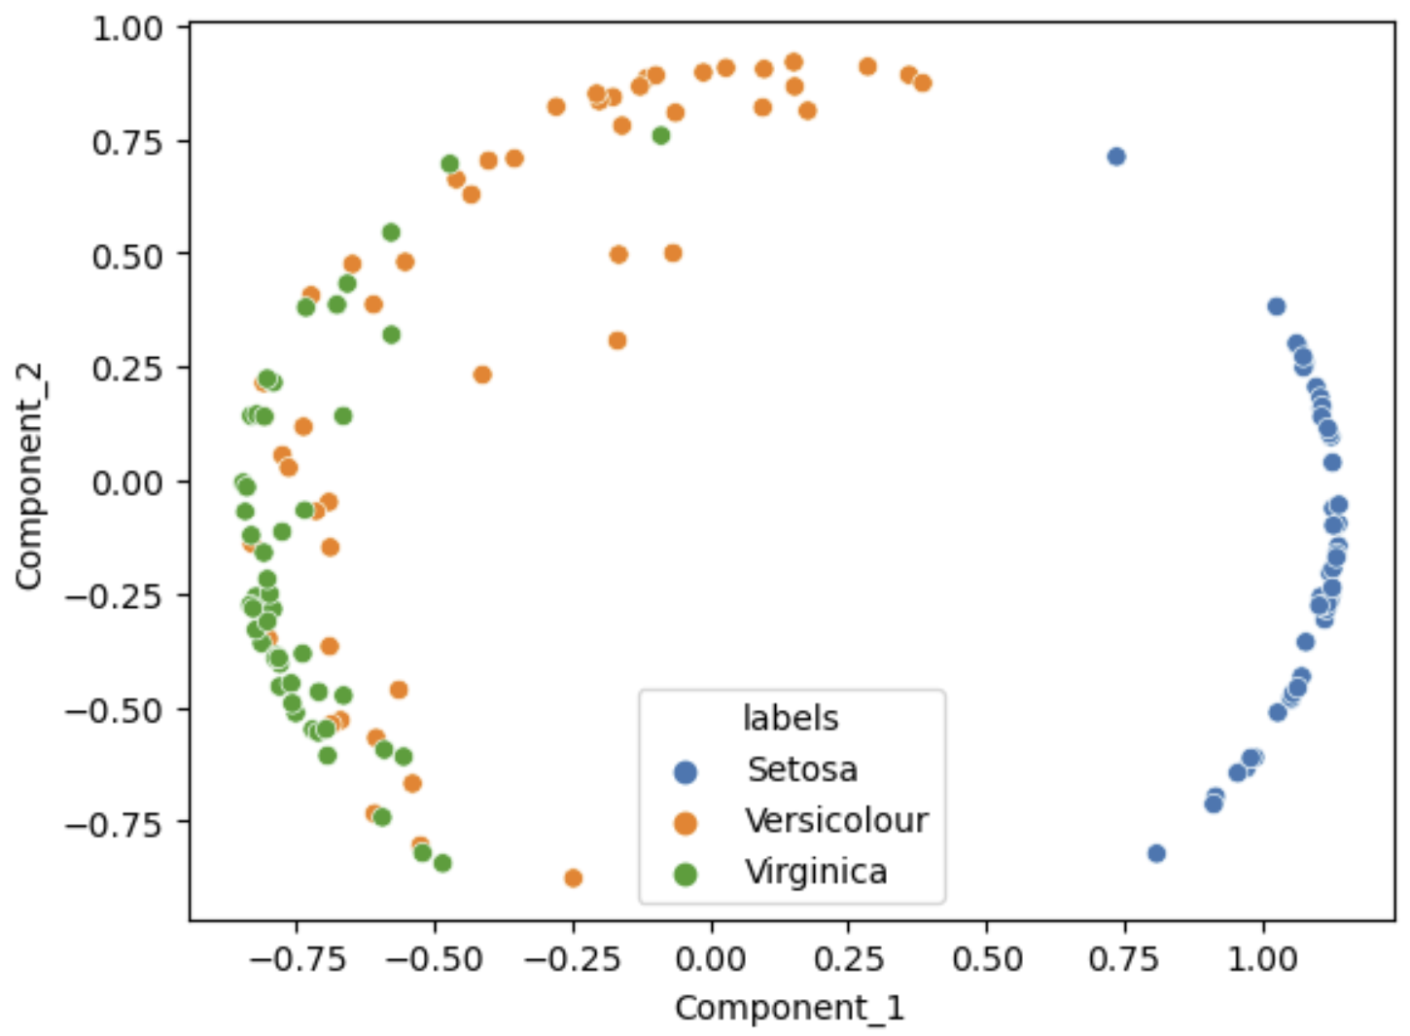
Kernel Principle Component Decomposition
Kernel PCA creates a nonlinear projection
Linear PCA
Kernel PCA, cosine kernel

Slide 48
Summary
Dimensionality reduction is widely used in data mining
Introduction to dimensionality reduction
Review of eigenvalues and eigenvectors
Principle component analysis (PCA)
Singular value decomposition (SVD)
Kernel principle component analysis for non-linear projection

