Slide 1

CSCI E-96 Data Mining, Exploration and Discovery Social Network Analysis
Steve Elston
Copyright 2021, 2022, 2023, Stephen F Elston. All rights reserved.

Slide 2
Introduction to Social Network Analysis
Social networks appear in many forms
Online social media
Networks of collaborating people
People in clubs
Political and business organizations
Organisms in an ecosystem
Citations in research papers
Many more …

Slide 3
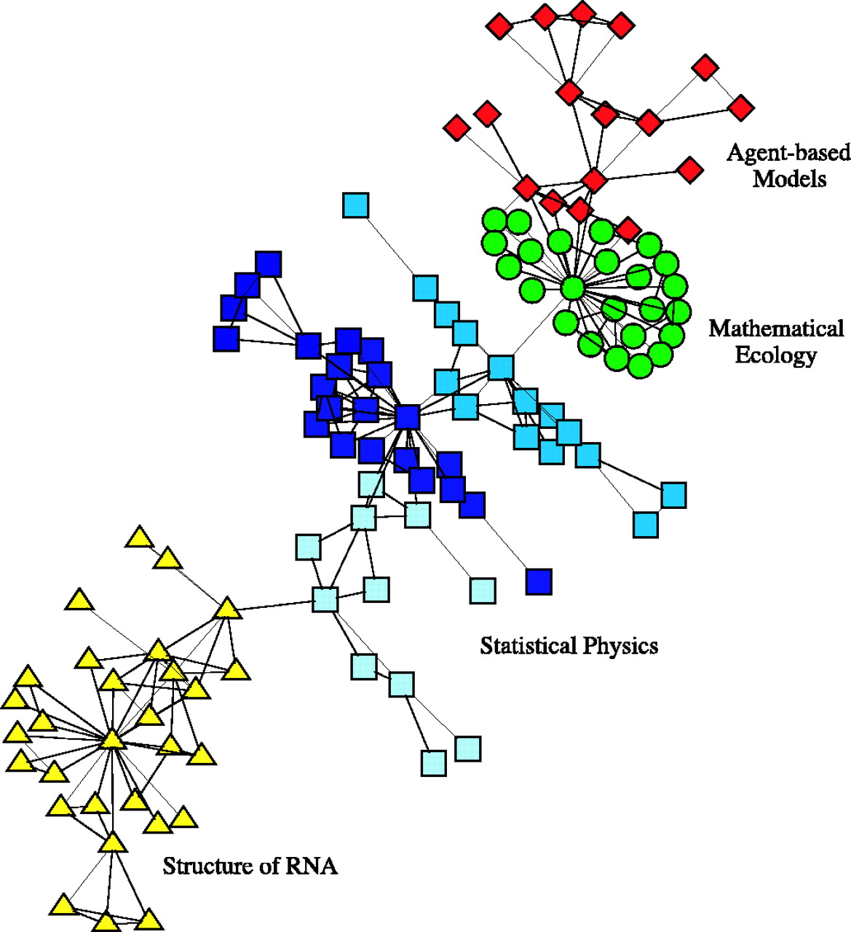
Introduction to Social Network Analysis
Social networks appear in many forms
Example: small network of co-authorship of scientific papers
Relationship communities organize along discipline lines
Credit: Neman, 2004, Proceedings of the National Academy of Sciences

Slide 4
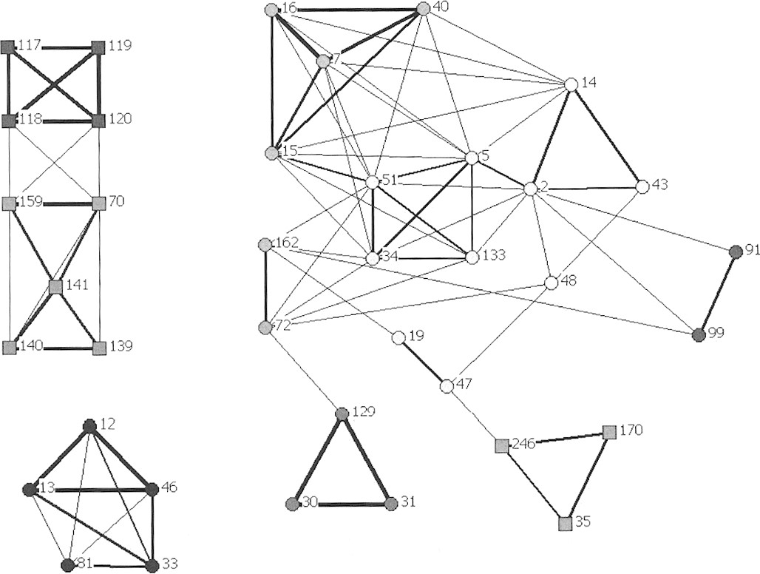
Introduction to Social Network Analysis
Social networks appear in many forms
Example: Association network of Bottlenose Dolphins at Port Stephens NSW Australia
Square = western population
Circle = eastern population
Edge weight = strength of relationship
Credit: Wiszniewksi, Brown and Moller, Journal of Mammalogy, 2012

Slide 5
Introduction to Social Network Analysis
Analysis to determine community structure in networks
Discover regions of dense connections in the network - cores
Discover and partition distinct communities within the networks
Find highly influential nodes in the network
Community analysis is largely unsupervised learning
Rarely know ground truth
Often requires some judgement or domain knowledge
Different models can provide different views and insights

Slide 6
Introduction to Social Network Analysis
Some properties of social networks
Social networks can be partitioned into communities
Communities are assortative
Homophily is tendency of similar entries to interact in a social network
Homophily leads to denser connections within communities
Communities have denser connections between nodes
Fewer connections between nodes of different communities
Nodes in the core components of communities have highest degree

Slide 7
Introduction to Social Network Analysis
Some properties of social networks
Most social networks are undirected
Friends know each other
Work colleagues know each other
Members of a small club are all connected
But, some social networks are directed
I can follow someone on Twitter, but they need not follow me
Organisms in an environment have asymmetric relationship
We focus on undirected social networks here

Slide 8
Introduction to Social Network Analysis
Many methods to find communities in social networks
Communities defined by high connectivity
Can find communities by the centrality or influence of nodes:
Kratz centrality
Closeness centrality
K-Cores
Triangle density and clustering
Partition communities by betweenness
Find communities by modularity of groups of nodes
Greedy algorithms
Spectral modularity decomposition

Slide 9
Pitfalls in Social Network Analysis
Unsupervised learning of community structure has pitfalls
No hard definitions or thresholds
How can you define dense?
How dense is a core?
How many communities are there?
Communities may have subcommunities
Communities may overlap – not independent or unique
Example: members of two clubs
Example: people in occupations and members of political parties
Evaluation is never fully objective

Slide 10
Centrality in Communities
Find highly connected nodes at center or core of communities
These highly connected nodes are influential in the community
Consider the spread of information in a social network
The message with the information travels from node to node
Nodes with stronger connections to the community transmit the message more effectively
These strongly connected nodes are considered influential
We measure a node’s influence in a social network by its centrality

Slide 11
Centrality in Communities
Centrality is the ability of a node to exert influence on the network
Cores are densely connected groups of nodes
Core nodes have high centrality
Kratz centrality is an example of a centrally metric
We worked with Kratz centrality as a basis of web search
Kratz centrality found by random walk on the graph
Closeness centrality is the average inverse distance from a node to all other nodes in a graph component

Slide 12
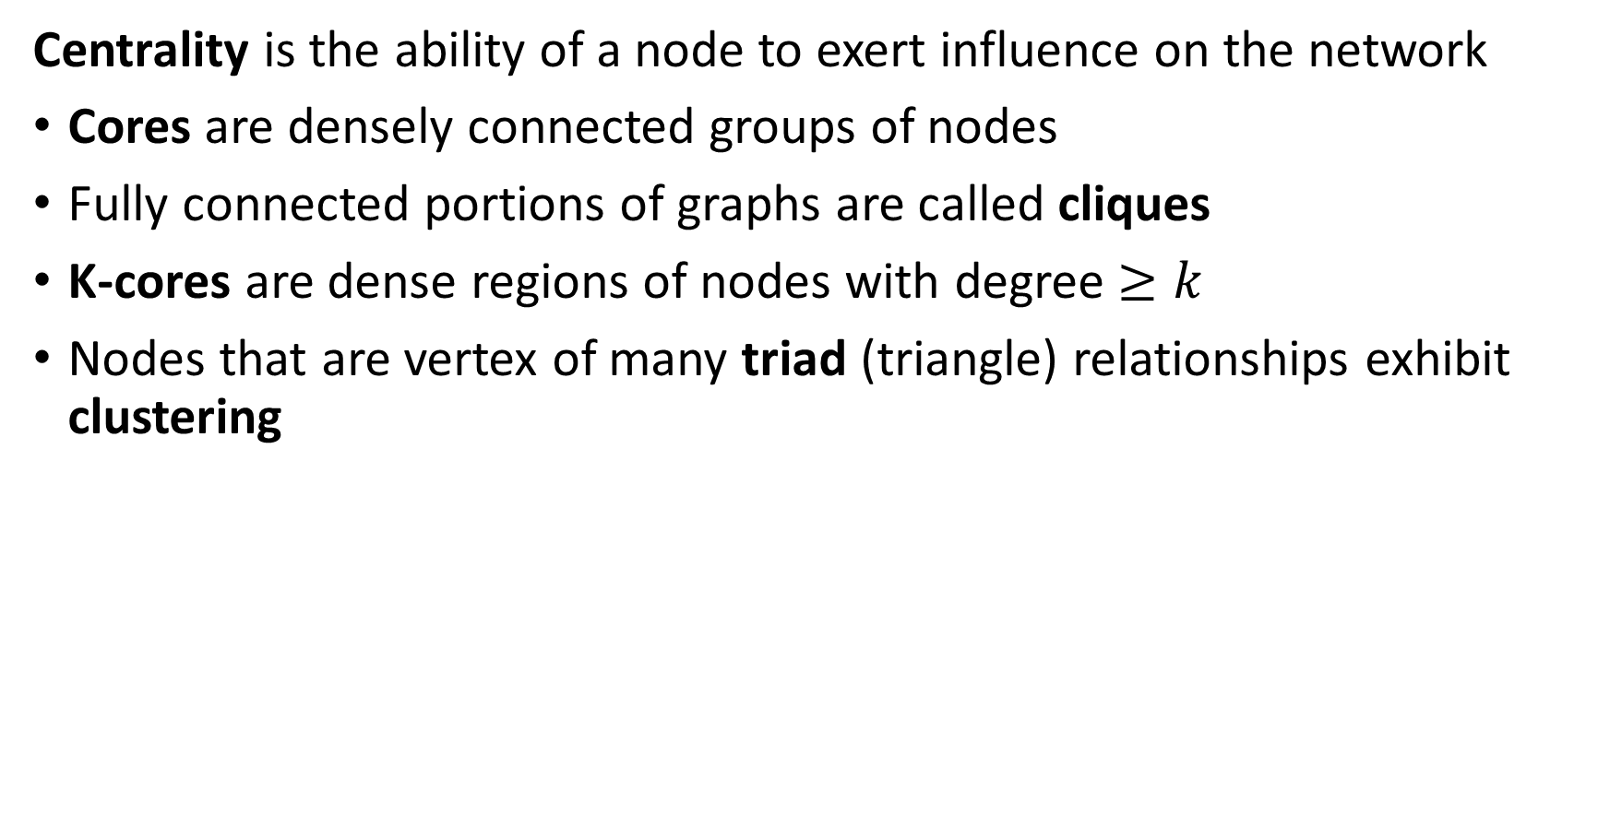
Centrality in Communities
Centrality is the ability of a node to exert influence on the network
Cores are densely connected groups of nodes
Fully connected portions of graphs are called cliques
K-cores are dense regions of nodes with degree $≥k$
Nodes that are vertex of many triad (triangle) relationships exhibit clustering

Slide 13
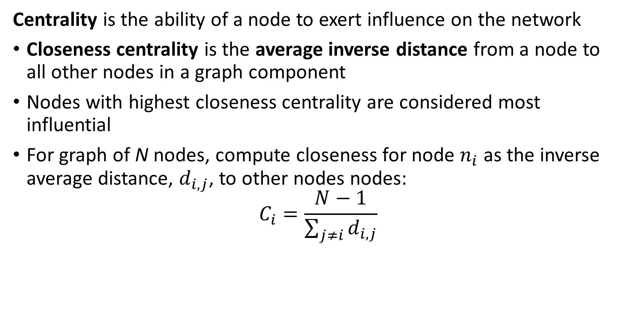
Centrality in Communities
Centrality is the ability of a node to exert influence on the network
Closeness centrality is the average inverse distance from a node to all other nodes in a graph component
Nodes with highest closeness centrality are considered most influential
For graph of N nodes, compute closeness for node $n_{i}$ as the inverse average distance, $d_{i,j}$, to other nodes nodes:
$$C_{i}=\frac{N−1}{\sum_{j≠i}{d_{i,j}}}$$

Slide 14
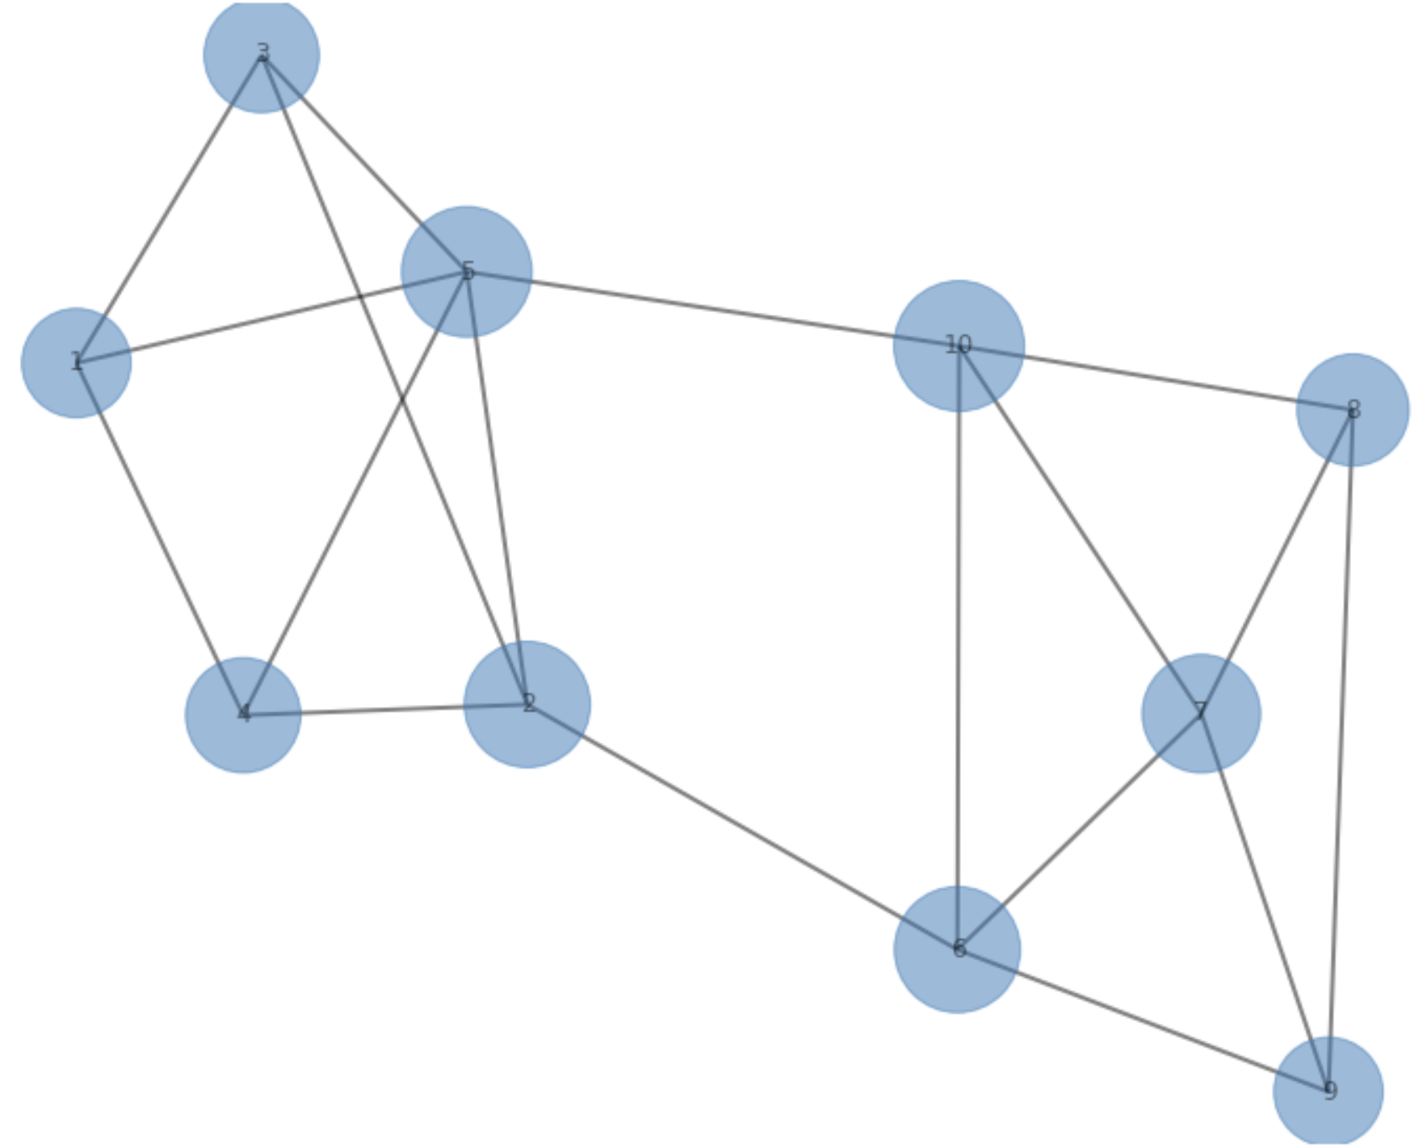
Centrality in Communities
Example: Closeness centrality is the ability of a node to exert influence on the network

Slide 15
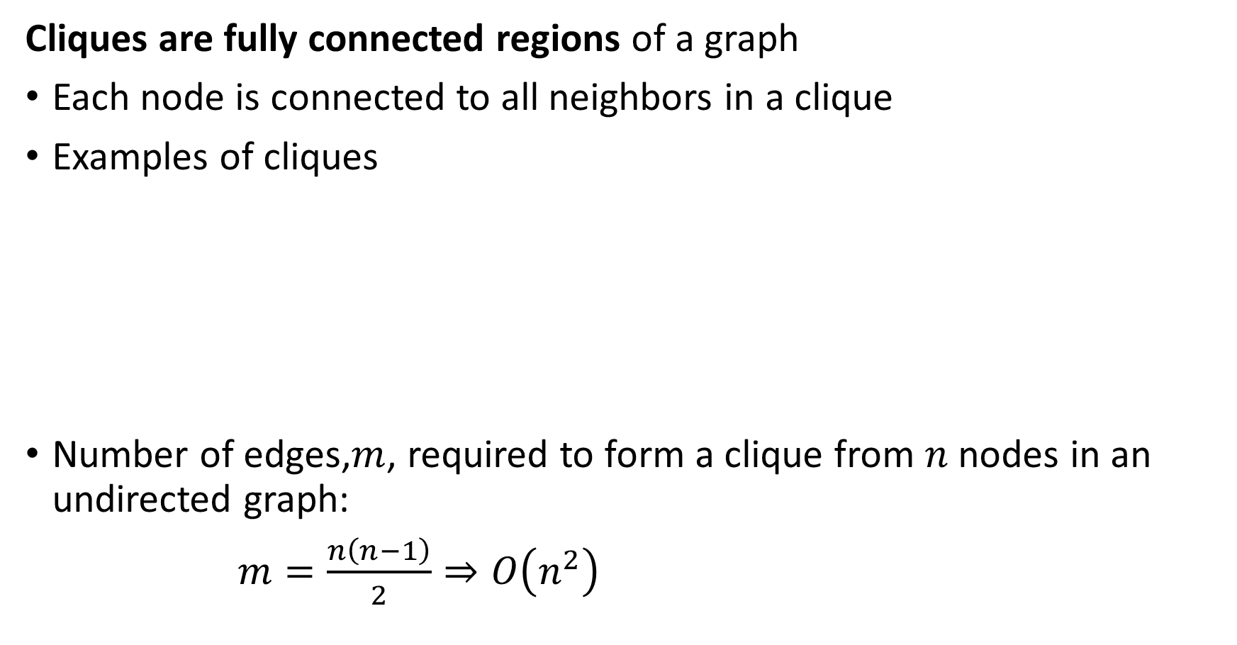
Cliques and K-Cores
Cliques are fully connected regions of a graph
Each node is connected to all neighbors in a clique
Examples of cliques
Number of edges,$m$, required to form a clique from $n$ nodes in an undirected graph:
$m=\frac{n\left(n−1\right)}{2}⇒O\left(n^{2}\right)$
2-Clique
3-Clique
4-Clique
5-Clique

Slide 16
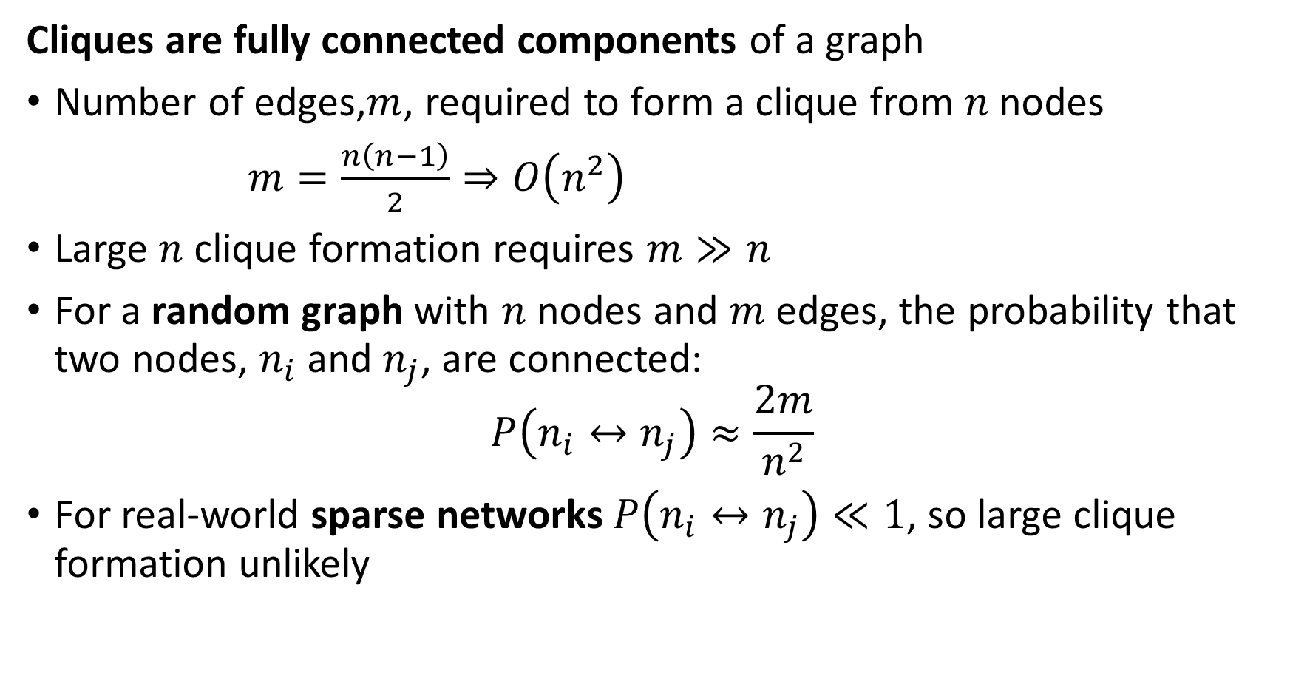
Cliques and K-Cores
Cliques are fully connected components of a graph
Number of edges,$m$, required to form a clique from $n$ nodes
$m=\frac{n\left(n−1\right)}{2}⇒O\left(n^{2}\right)$
Large $n$ clique formation requires $m≫n$
For a random graph with $n$ nodes and $m$ edges, the probability that two nodes, $n_{i}$ and $n_{j}$, are connected:
$$P\left(n_{i}↔n_{j}\right)≈\frac{2m}{n^{2}}$$
For real-world sparse networks$P\left(n_{i}↔n_{j}\right)≪1$, so large clique formation unlikely

Slide 17
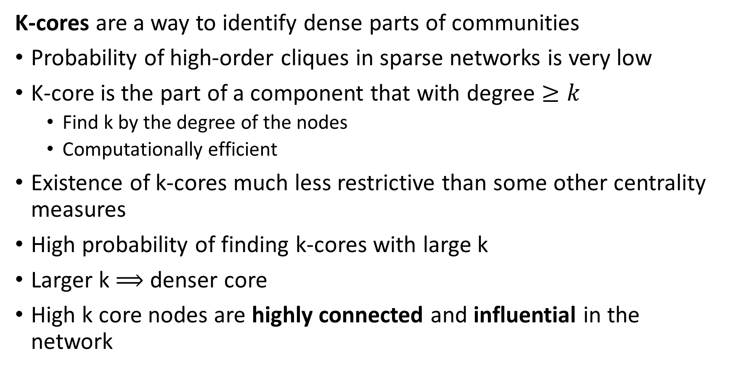
Cliques and K-Cores
K-cores are a way to identify dense parts of communities
Probability of high-order cliques in sparse networks is very low
K-core is the part of a component that with degree $≥k$
Find k by the degree of the nodes
Computationally efficient
Existence of k-cores much less restrictive than some other centrality measures
High probability of finding k-cores with large k
Larger k $⟹$ denser core
High k core nodes are highly connected and influential in the network

Slide 18
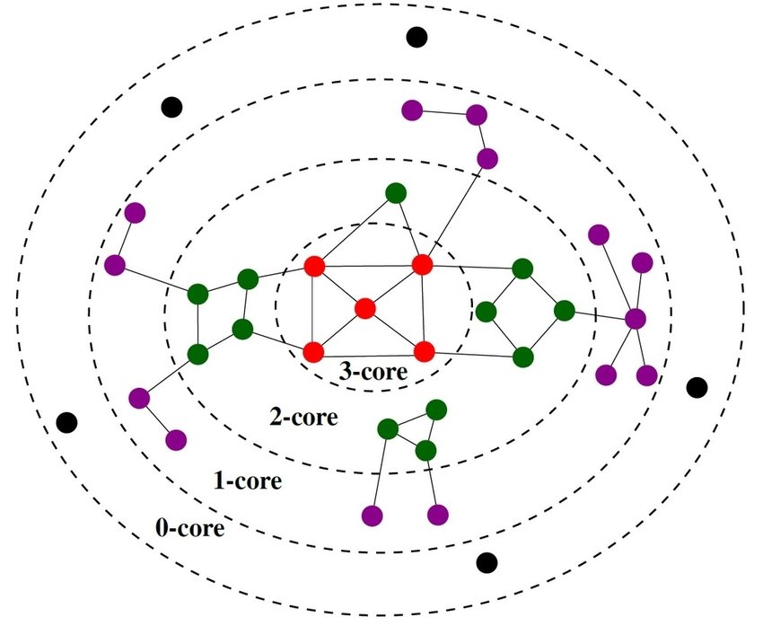
Cliques and K-Cores
K-cores are a way to identify dense parts of communities
Example: k-cores of a simple network
Higher values of k correspond to higher centrality
Credit: Tixier, et. al. 2018

Slide 19
Communities and Triangle Density
Density of triangles is an indicator or community cores
Empirically, we expect when a person is connected to 2 other people, the other people are more likely to be connected to each other
In a random graph, two people connected to a common individual will only be connected to each other by random coincidence:
In a community there is a high probability of completing the triangle of relationships or creating a triad:
Low probability of completing triangle in random graph
High probability of completing triangle in community

Slide 20
Communities and Triangle Density
Density of triangles is an indicator or community cores
A relationship in a graph: if u is connected to w and v is connected to w the relationship is transitive if u is connected to v:
The human version of transitivity: the friend of my friend is my friend
Density of triangle in a social graph is a measure of density
u
v
w

Slide 21
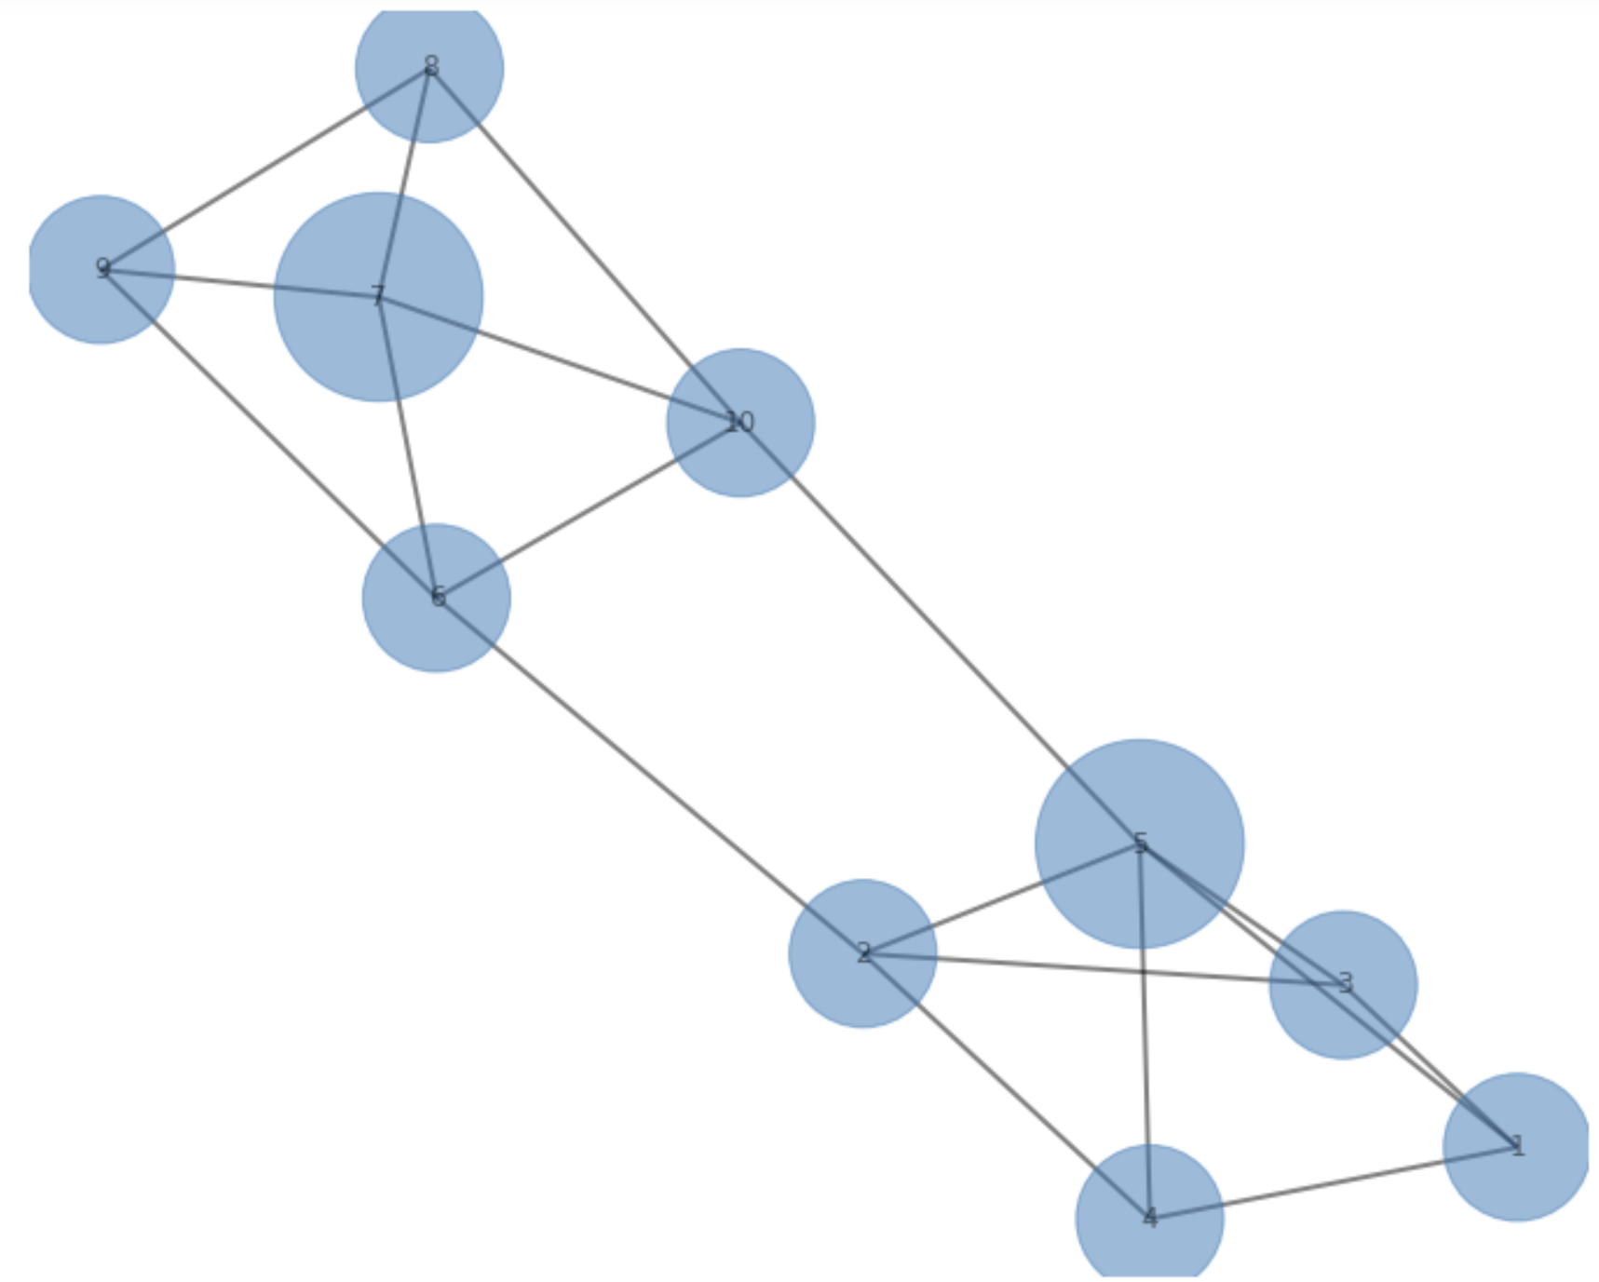
Communities and Triangle Density
Example: Density of triangles is an indicator of community cores, or influential nodes

Slide 22
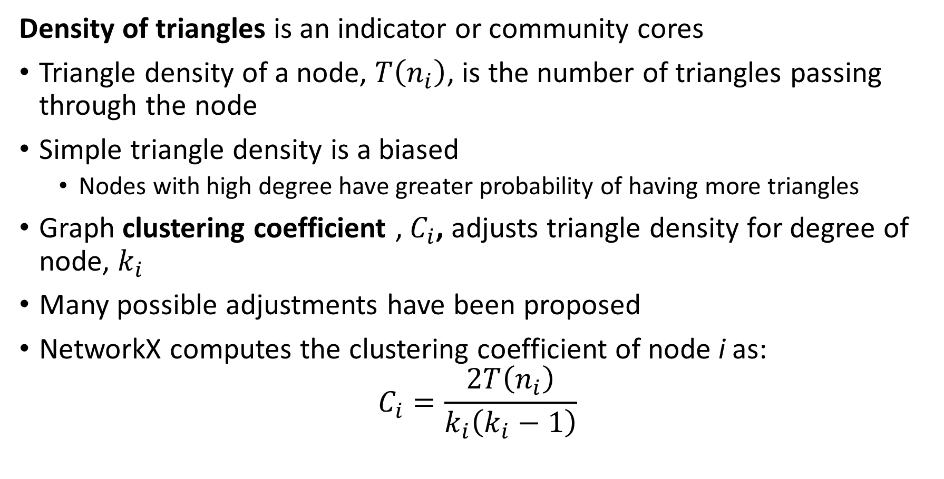
Communities and Triangle Density
Density of triangles is an indicator or community cores
Triangle density of a node, $T\left(n_{i}\right)$, is the number of triangles passing through the node
Simple triangle density is a biased
Nodes with high degree have greater probability of having more triangles
Graph clustering coefficient , $C_{i}$, adjusts triangle density for degree of node, $k_{i}$
Many possible adjustments have been proposed
NetworkX computes the clustering coefficient of node i as:
$$C_{i}=\frac{2T\left(n_{i}\right)}{k_{i}\left(k_{i}−1\right)}$$

Slide 23
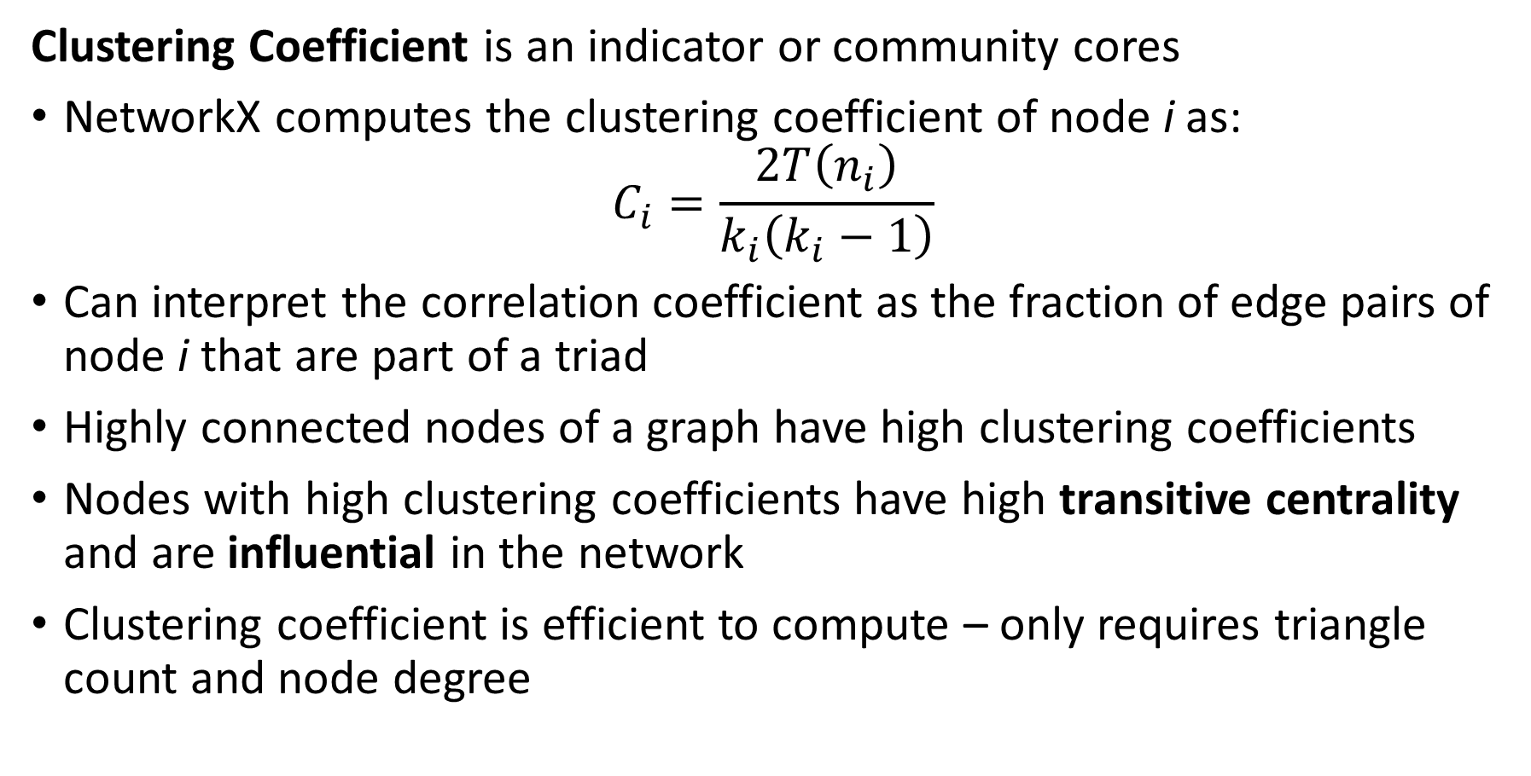
Communities and Triangle Density
Clustering Coefficient is an indicator or community cores
NetworkX computes the clustering coefficient of node i as:
$$C_{i}=\frac{2T\left(n_{i}\right)}{k_{i}\left(k_{i}−1\right)}$$
Can interpret the correlation coefficient as the fraction of edge pairs of node i that are part of a triad
Highly connected nodes of a graph have high clustering coefficients
Nodes with high clustering coefficients have high transitive centrality and are influential in the network
Clustering coefficient is efficient to compute – only requires triangle count and node degree

Slide 24
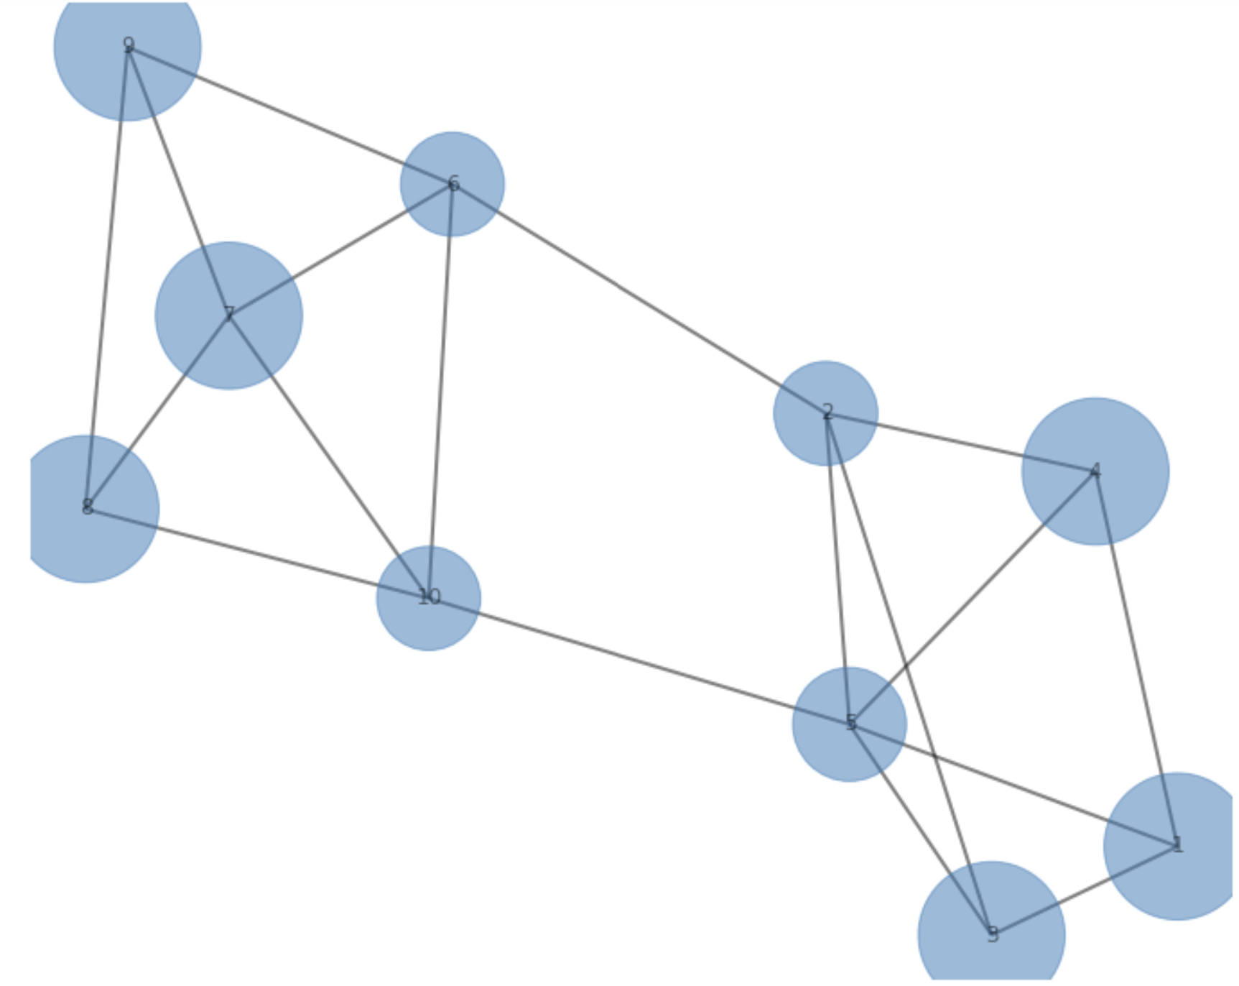
Communities and Triangle Density
Example: Clustering Coefficient as an indicator of community cores or node influence

Slide 25
Finding Communities in Networks
Social networks are organized in communities
Communities are strongly connected
A random graph has uniform distribution of the edges
A graph of communities has regions of dense connections
Betweenness measures the extent certain nodes and edges are on path between other nodes
Betweenness is low within highly connected communities
Betweenness is high between communities
Modularity measures the density of edges compared to random graph
Communities have high modularity
Use modularity to search for communities

Slide 26
Betweenness of Social Network Communities
Betweenness measures the number of paths between parts of a graph
Betweenness is the number of pairwise shortest paths passing though part of a graph
Expect high betweenness between communities – few possible paths
Node betweenness is the number of pairwise shortest paths passing through a given node in the graph
Edge betweenness is the number of pairwise shortest paths passing through a given node in the graph

Slide 27
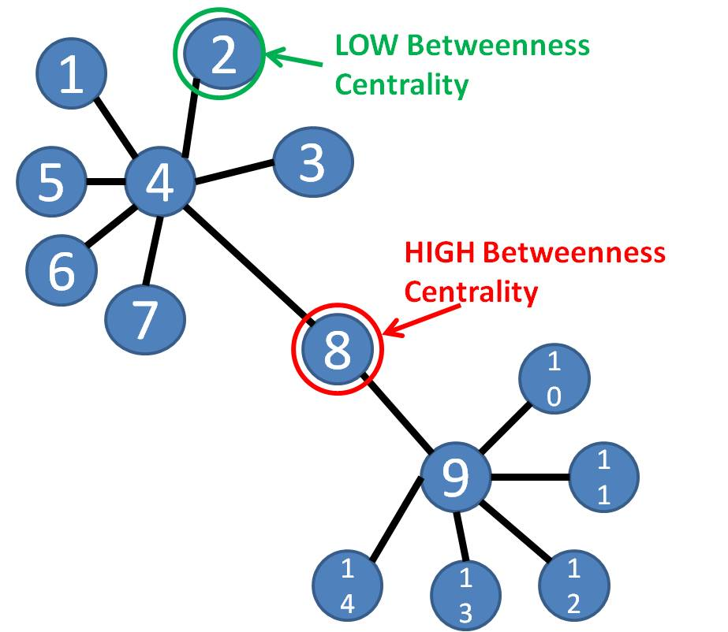
Betweenness Social Network Communities
Betweenness measures the number of paths parts of a graph
Example: a single node is on path between members of two communities
Can use betweenness to identify communities
Source: bsmithactivity3

Slide 28
Betweenness Social Network Communities
How can we find betweenness?
Database searching
e.g. B-tree search
Searching graphs
Find distances
Compute shortest paths
Discover connectivity
Path search is computationally intensive for large graphs!

Slide 29
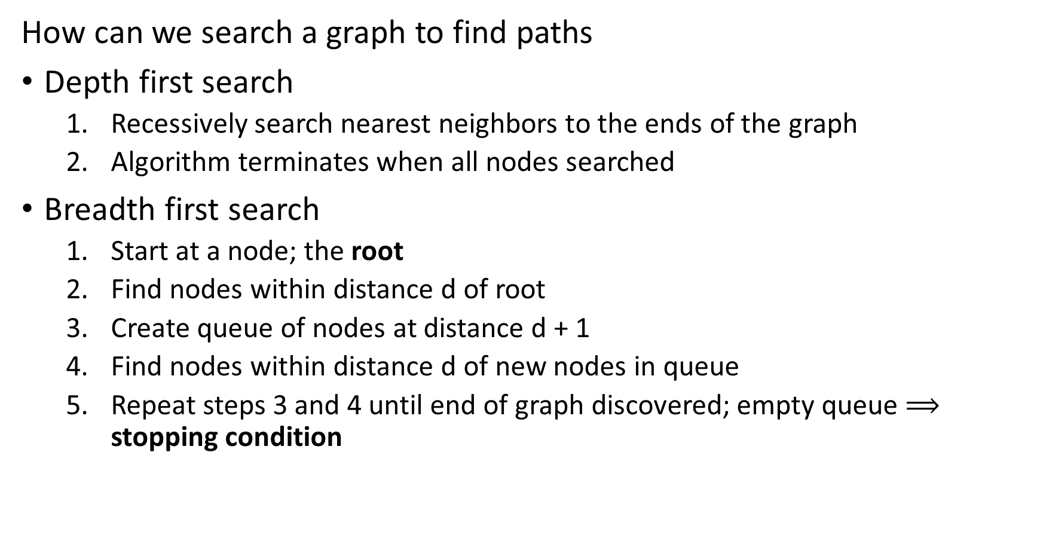
Breadth First Search Algorithm
How can we search a graph to find paths
Depth first search
Recessively search nearest neighbors to the ends of the graph
Algorithm terminates when all nodes searched
Breadth first search
Start at a node; the root
Find nodes within distance d of root
Create queue of nodes at distance d + 1
Find nodes within distance d of new nodes in queue
Repeat steps 3 and 4 until end of graph discovered; empty queue $⟹$ stopping condition

Slide 30
Breadth First Search Algorithm
Basic breadth first search algorithm
Start with root node on graph at distance 0
Find nodes at distance d from the root
Find nodes at distance d = 1
Find nodes at distance d = 2
Continue until the termination condition is reached
0
D=1
D=2

Slide 31
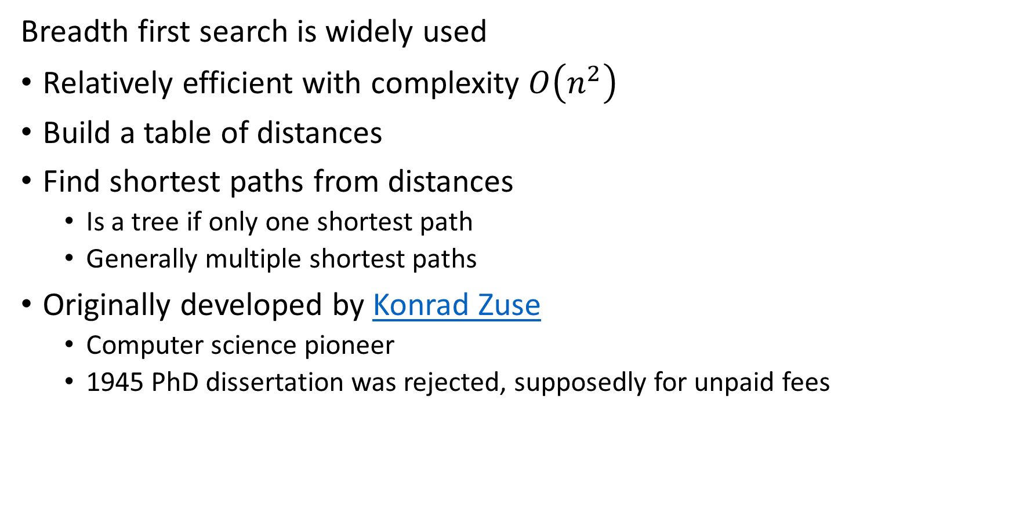
Breadth First Search Algorithm
Breadth first search is widely used
Relatively efficient with complexity $O\left(n^{2}\right)$
Build a table of distances
Find shortest paths from distances
Is a tree if only one shortest path
Generally multiple shortest paths
Originally developed by Konrad Zuse
Computer science pioneer
1945 PhD dissertation was rejected, supposedly for unpaid fees

Slide 32
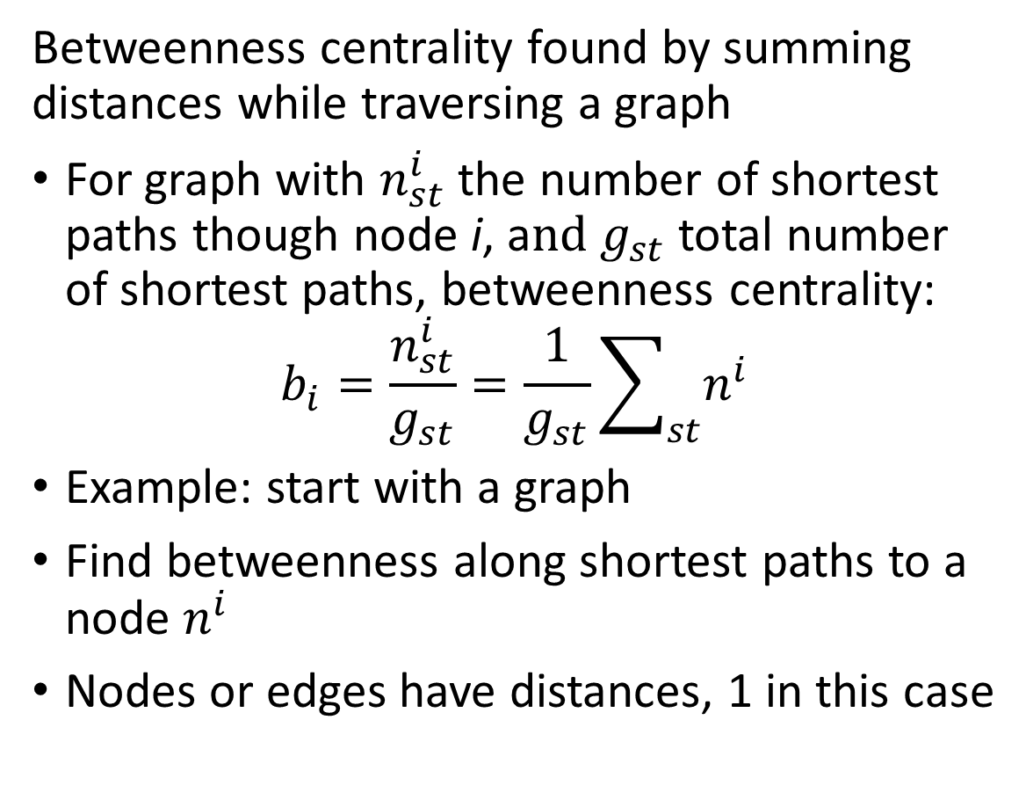
Betweenness of Social Networks
s
Betweenness centrality found by summing distances while traversing a graph
For graph with $n_{st}^{i}$ the number of shortest paths though node i, a$nd g_{st}$total number of shortest paths, betweenness centrality:
$$b_{i}=\frac{n_{st}^{i}}{g_{st}}=\frac{1}{g_{st}}\sum_{st}{n_{ }^{i}}$$
Example: start with a graph
Find betweenness along shortest paths to a node $n_{ }^{i}$
Nodes or edges have distances, 1 in this case
1
1
1
1
1
1

Slide 33




Betweenness of Social Networks
s
Betweenness centrality found by summing distances while traversing a graph
Starting with the most distant nodes
Sum distances
If multiple paths, divide distance (weight) between paths
Continue summing until reaching s
$$\frac{5}{2}$$
$$\frac{7}{2}$$
1
1
$$\frac{3}{2}$$
$$\frac{5}{2}$$
1
1
1
1

Slide 34
Modularity of Communities
Modularity estimates the extent that edges concentrate in communities
Communities are groups of nodes with some common characteristics
Examples:
Members of an organization
Work collaborators
Animals in an ecosystem
…….
Empirically, the density of edges within communities is higher than a random graph
Modularity is a metric comparing the connection in a community to a random network.

Slide 35
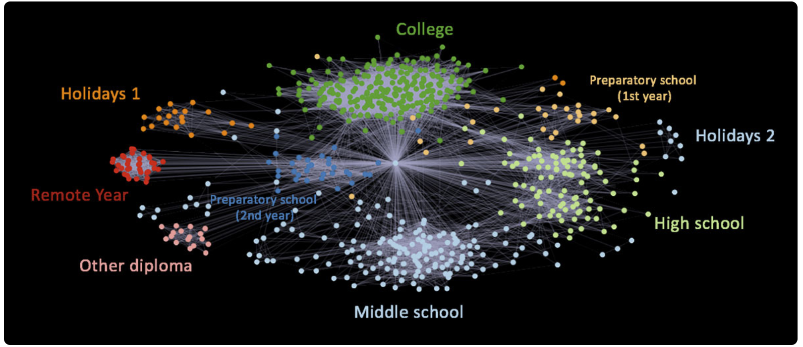
Modularity of Communities
Modularity estimates the extent that edges concentrate in communities
Example from Elliot Anders blog post on visualization of Facebook friends

Slide 36
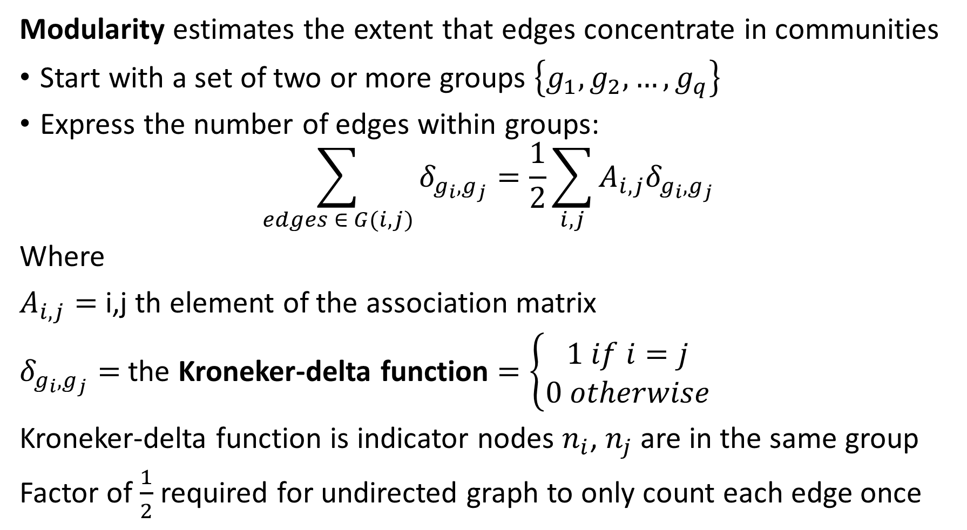
Modularity of Communities
Modularity estimates the extent that edges concentrate in communities
Start with a set of two or more groups $\left\{g_{1},g_{2},…,g_{q}\right\}$
Express the number of edges within groups:
$$\sum_{edges ∈ G(i,j)}{δ_{g_{i},g_{j}}=\frac{1}{2}}\sum_{i,j}{A_{i,j}δ_{g_{i},g_{j}}}$$
Where
$A_{i,j}=$ i,j th element of the association matrix
$δ_{g_{i},g_{j}}=$ the Kroneker-delta function $=\left\{\begin{aligned}1 if i=j \\ 0 otherwise\end{aligned}\right.$
Kroneker-delta function is indicator nodes $n_{i}$, $n_{j}$ are in the same group
Factor of $\frac{1}{2}$ required for undirected graph to only count each edge once

Slide 37
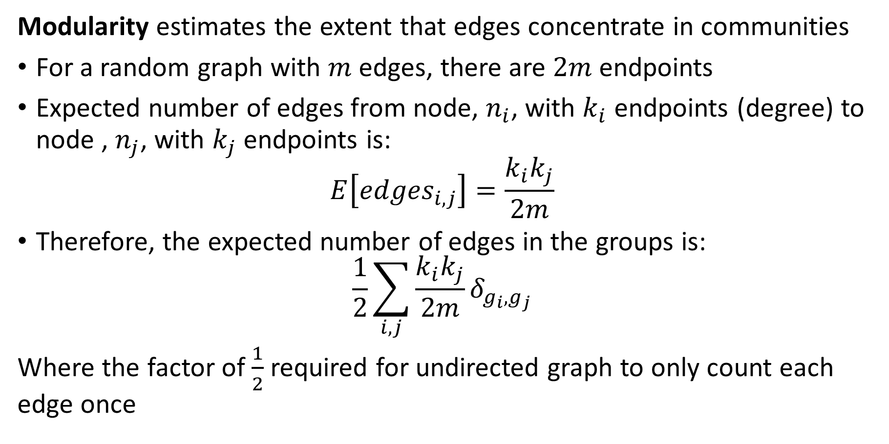
Modularity of Communities
Modularity estimates the extent that edges concentrate in communities
For a random graph with $m$ edges, there are $2m$ endpoints
Expected number of edges from node, $n_{i}$, with $k_{i}$ endpoints (degree) to node , $n_{j}$, with $k_{j}$ endpoints is:
$$E\left[{edges}_{i,j}\right]=\frac{k_{i}k_{j}}{2m}$$
Therefore, the expected number of edges in the groups is:
$$\frac{1}{2}\sum_{i,j}{\frac{k_{i}k_{j}}{2m}δ_{g_{i},g_{j}}}$$
Where the factor of $\frac{1}{2}$ required for undirected graph to only count each edge once

Slide 38
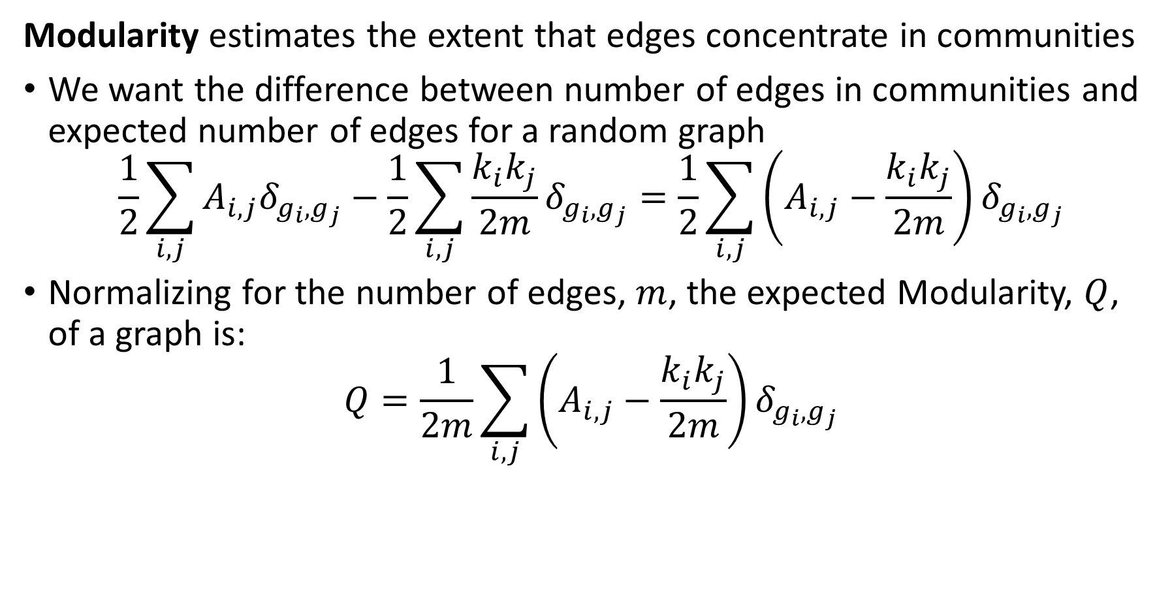
Modularity of Communities
Modularity estimates the extent that edges concentrate in communities
We want the difference between number of edges in communities and expected number of edges for a random graph
$$\frac{1}{2}\sum_{i,j}{A_{i,j}δ_{g_{i},g_{j}}}−\frac{1}{2}\sum_{i,j}{\frac{k_{i}k_{j}}{2m}δ_{g_{i},g_{j}}}=\frac{1}{2}\sum_{i,j}{\left(A_{i,j}−\frac{k_{i}k_{j}}{2m}\right)δ_{g_{i},g_{j}}}$$
Normalizing for the number of edges, $m$, the expected Modularity, $Q$, of a graph is:
$$Q=\frac{1}{2m}\sum_{i,j}{\left(A_{i,j}−\frac{k_{i}k_{j}}{2m}\right)δ_{g_{i},g_{j}}}$$

Slide 39
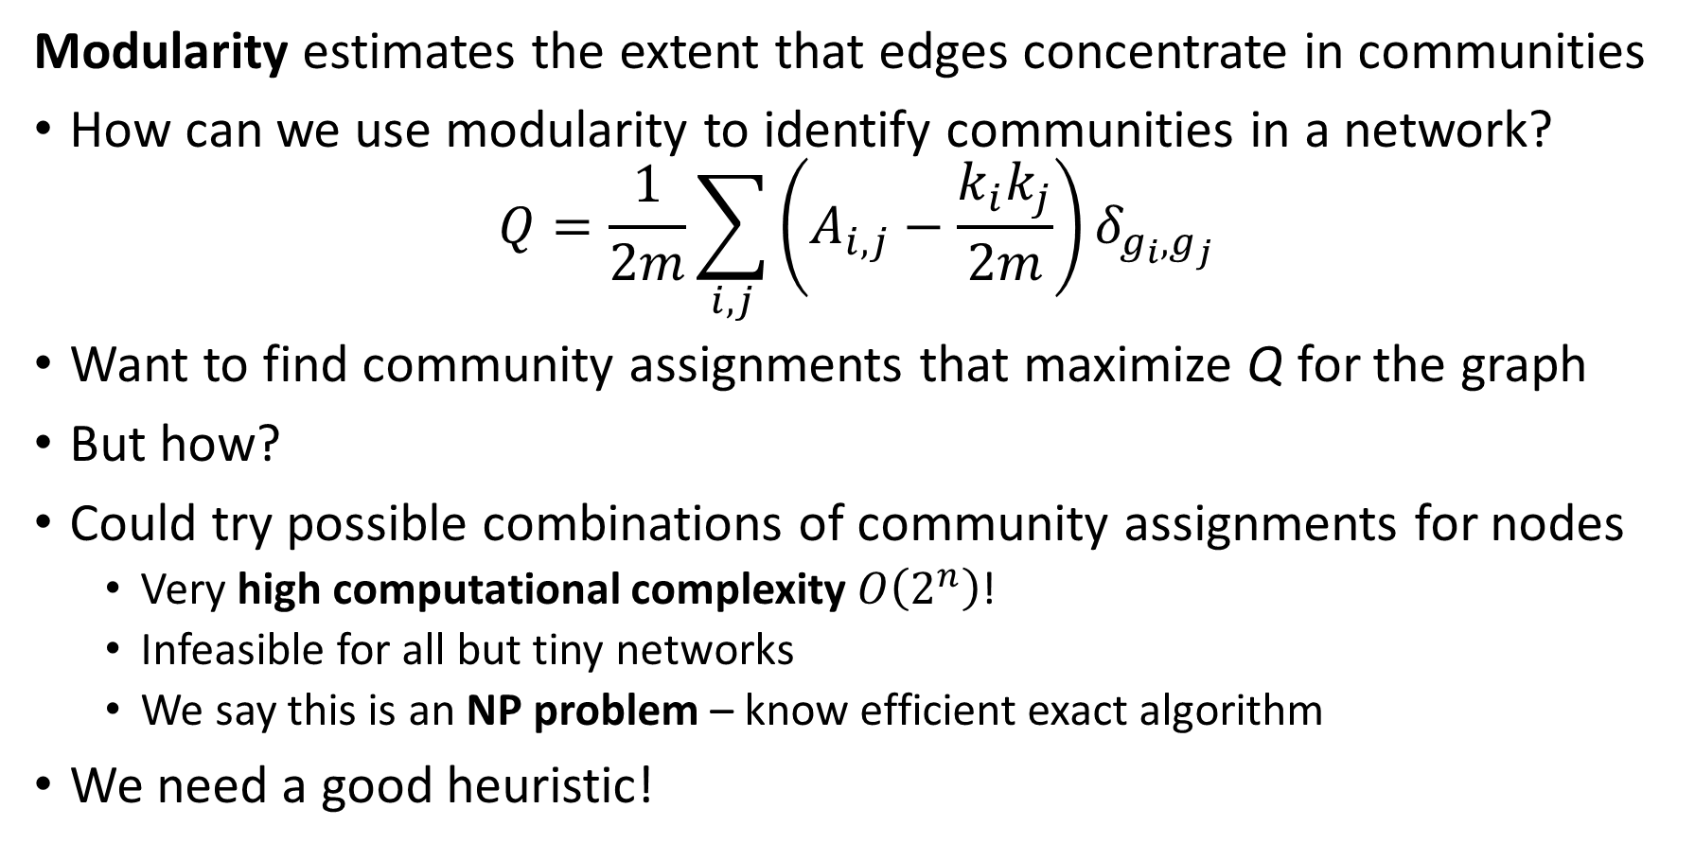
Modularity of Communities
Modularity estimates the extent that edges concentrate in communities
How can we use modularity to identify communities in a network?
$$Q=\frac{1}{2m}\sum_{i,j}{\left(A_{i,j}−\frac{k_{i}k_{j}}{2m}\right)δ_{g_{i},g_{j}}}$$
Want to find community assignments that maximize Q for the graph
But how?
Could try possible combinations of community assignments for nodes
Very high computational complexity $O\left(2^{n}\right)$!
Infeasible for all but tiny networks
We say this is an NP problem – know efficient exact algorithm
We need a good heuristic!

Slide 40
Modularity of Communities
Many heuristics for community search to maximize modularity
Methods that sample possible community assignments
Simulated annealing
Genetic algorithms
Generally require significant computational power
Optimization algorithms
Information theoretic loss function
Maximum likelihood methods
Greedy reallocation of community assignments
Spectral Modularity Maximization

Slide 41
Greedy Modularity Search for Communities
Greedy reallocation of community assignments
Greedy algorithm may never find optimal solution
Accept any allocation that improves modularity
No backtracking – all assignments depend on current state of community assignments
Dependent on initial partition of network

Slide 42
Greedy Modularity Search for Communities
Greedy reallocation of community assignments
Procedure Division(Network):
C1, C2 <- equal_division (Network) # start with equal random division
Network <- community_assignments(C1, C2) # initial community assignments
M <- modularity(Network) # initial modularity
for n steps:
node <- random_sample(Network) # sample node at random
node_temp <- switch_community(node) # change assignment of node
M_temp <- modularity(Network, node_temp # measure modularity of assignment
If M_temp > M: # greedy update of network
Network <- community_assignments(M_temp)
M = M_temp
return(network)

Slide 43
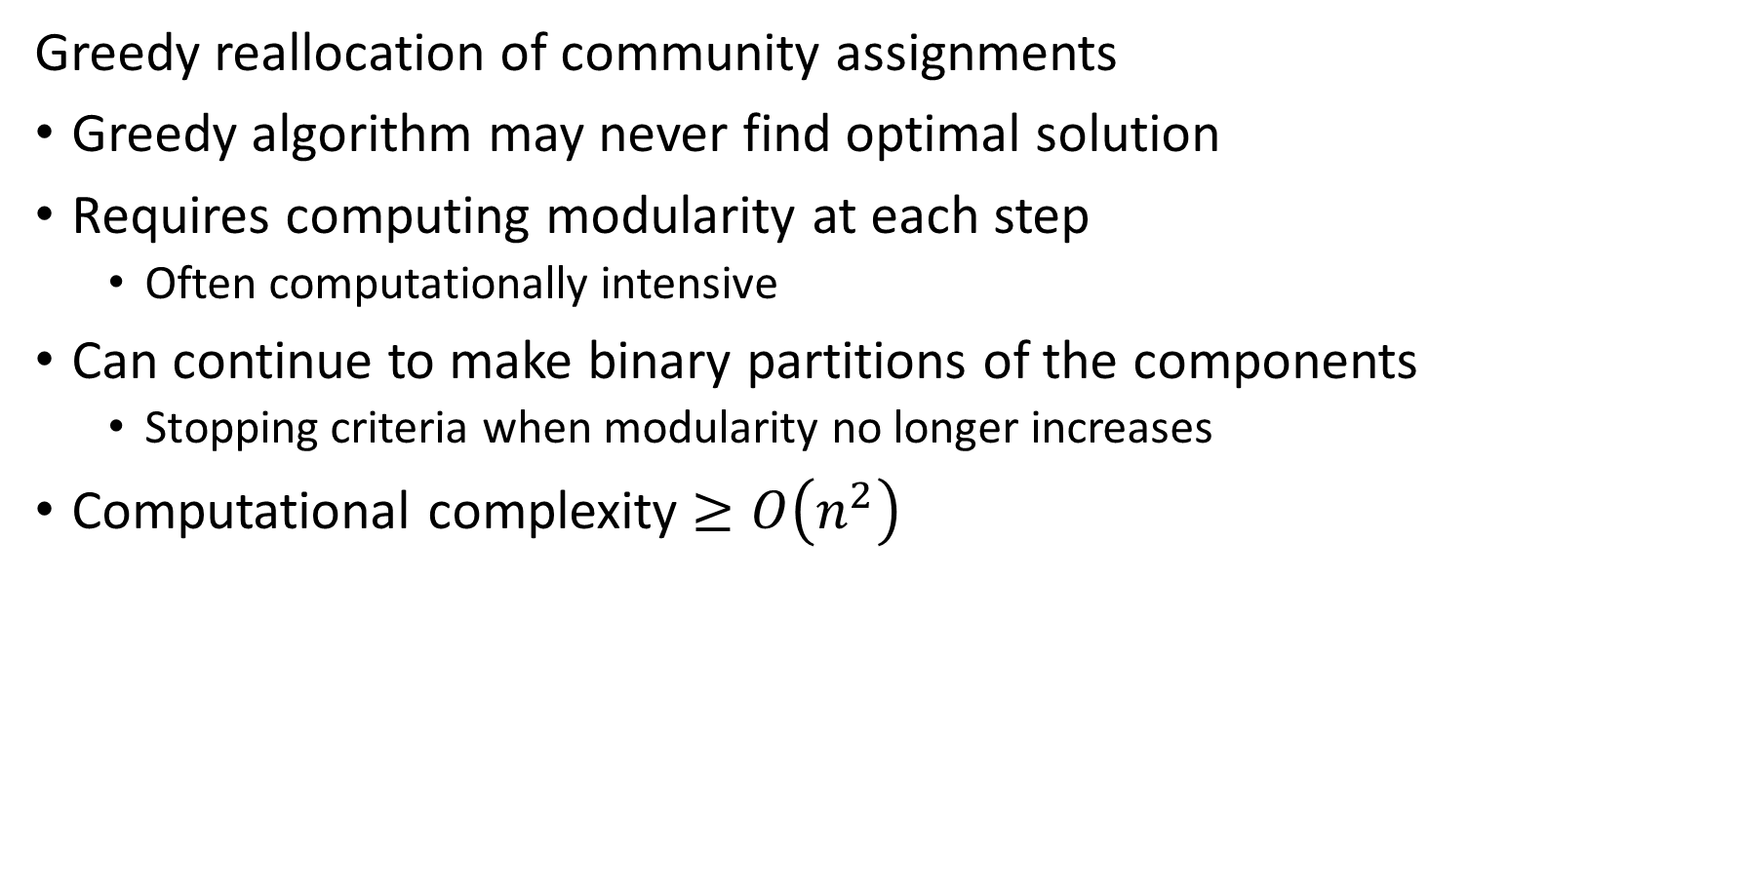
Greedy Modularity Search for Communities
Greedy reallocation of community assignments
Greedy algorithm may never find optimal solution
Requires computing modularity at each step
Often computationally intensive
Can continue to make binary partitions of the components
Stopping criteria when modularity no longer increases
Computational complexity $≥O\left(n^{2}\right)$

Slide 44
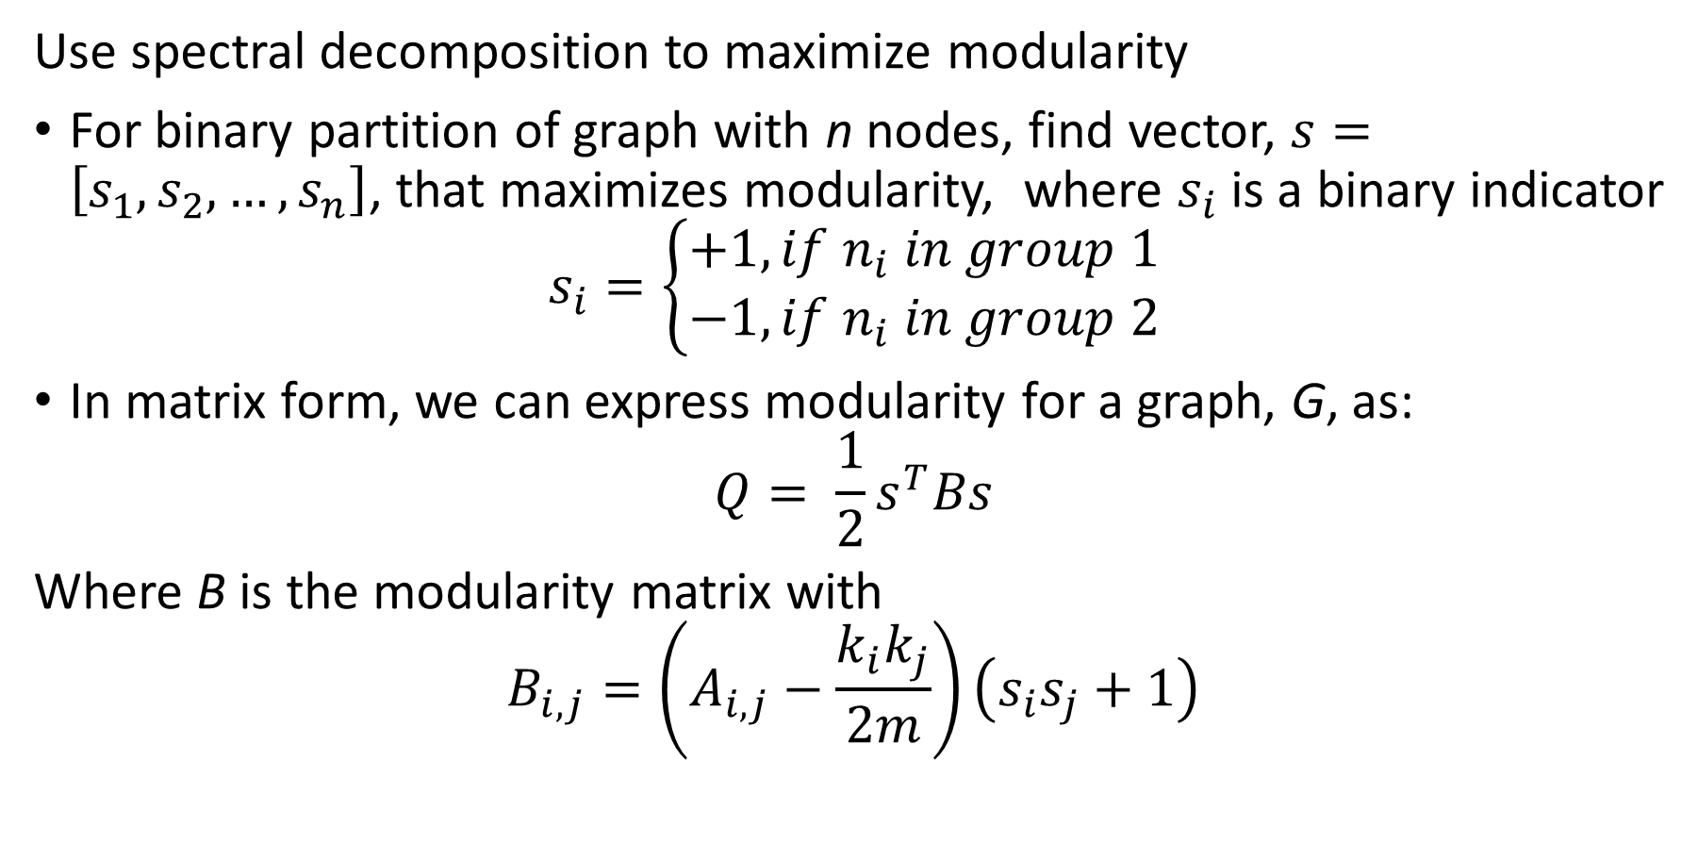
Spectral Modularity Maximization
Use spectral decomposition to maximize modularity
For binary partition of graph with n nodes, find vector, $s=\left[s_{1},s_{2},…, s_{n}\right]$, that maximizes modularity, where $s_{i}$ is a binary indicator
$$s_{i}=\left\{\begin{aligned}+1, if n_{i} in group 1 \\ −1, if n_{i} in group 2\end{aligned}\right.$$
In matrix form, we can express modularity for a graph, G, as:
$$Q= \frac{1}{2}s^{T}Bs$$
Where B is the modularity matrix with
$$B_{i,j}=\left(A_{i,j}−\frac{k_{i}k_{j}}{2m}\right)\left(s_{i}s_{j}+1\right)$$

Slide 45
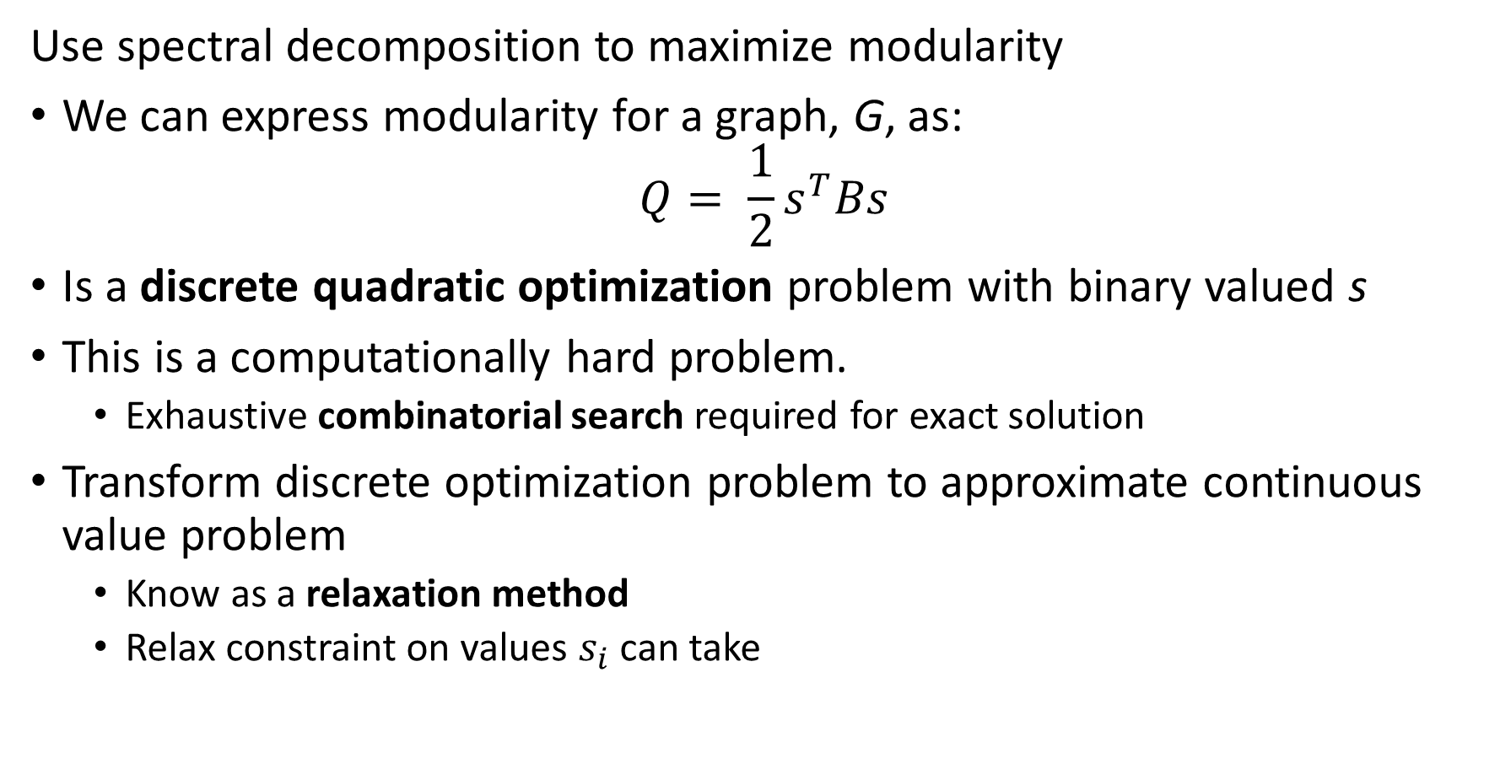
Spectral Modularity Maximization
Use spectral decomposition to maximize modularity
We can express modularity for a graph, G, as:
$$Q= \frac{1}{2}s^{T}Bs$$
Is a discrete quadratic optimization problem with binary valued s
This is a computationally hard problem.
Exhaustive combinatorial search required for exact solution
Transform discrete optimization problem to approximate continuous value problem
Know as a relaxation method
Relax constraint on values $s_{i}$ can take

Slide 46
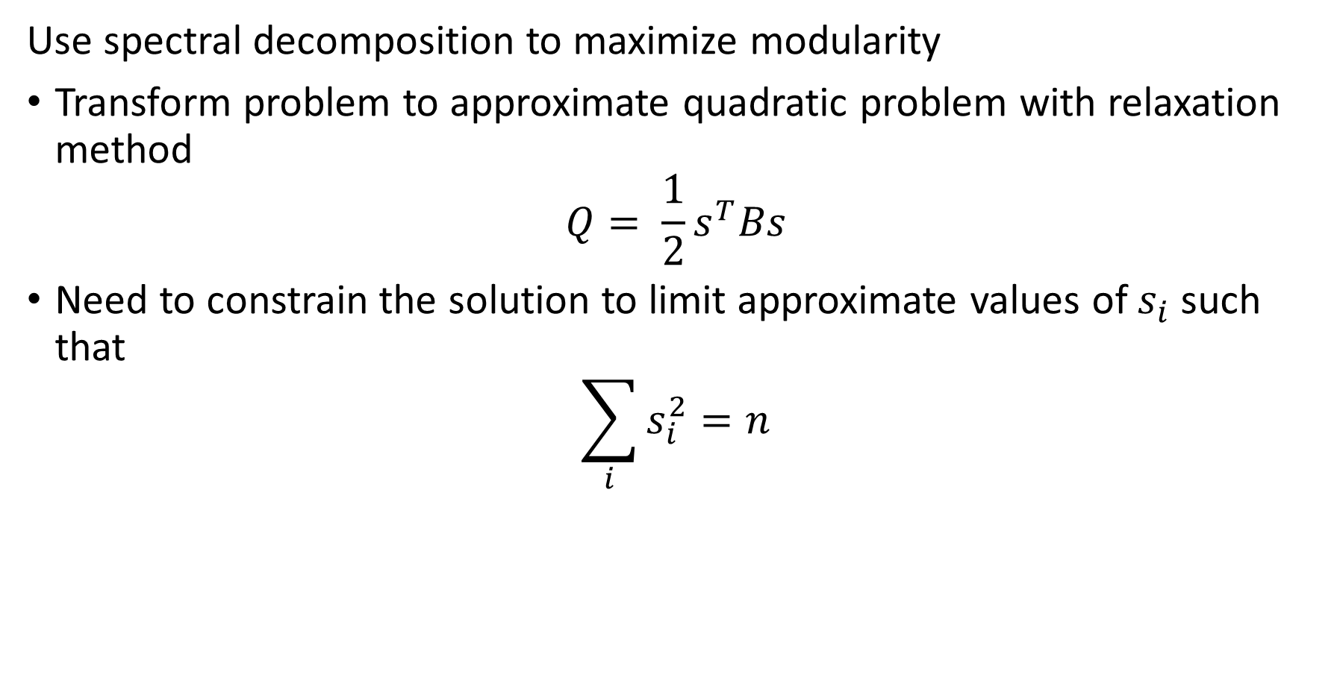
Spectral Modularity Maximization
Use spectral decomposition to maximize modularity
Transform problem to approximate quadratic problem with relaxation method
$$Q= \frac{1}{2}s^{T}Bs$$
Need to constrain the solution to limit approximate values of $s_{i}$ such that
$$\sum_{i}{s_{i}^{2}=n}$$

Slide 47
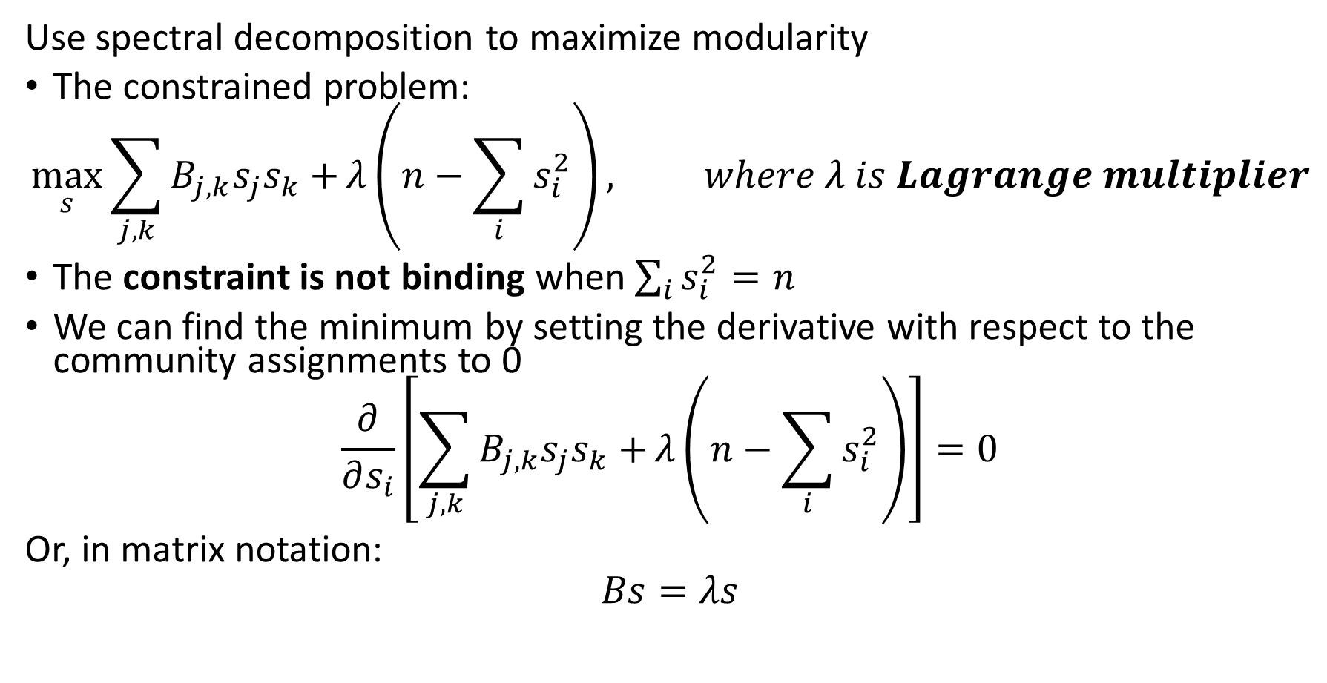
Spectral Modularity Maximization
Use spectral decomposition to maximize modularity
The constrained problem:
$$\max_{s}{\sum_{j,k}{B_{j,k}s_{j}s_{k}+}λ\left(n−\sum_{i}{s_{i}^{2}}\right)}, where λ is Lagrange multiplier$$
The constraint is not binding when $\sum_{i}{s_{i}^{2}=n}$
We can find the minimum by setting the derivative with respect to the community assignments to 0
$$\frac{∂}{∂s_{i}}\left[\sum_{j,k}{B_{j,k}s_{j}s_{k}+}λ\left(n−\sum_{i}{s_{i}^{2}}\right)\right]=0$$
Or, in matrix notation:
$$Bs=λs$$

Slide 48
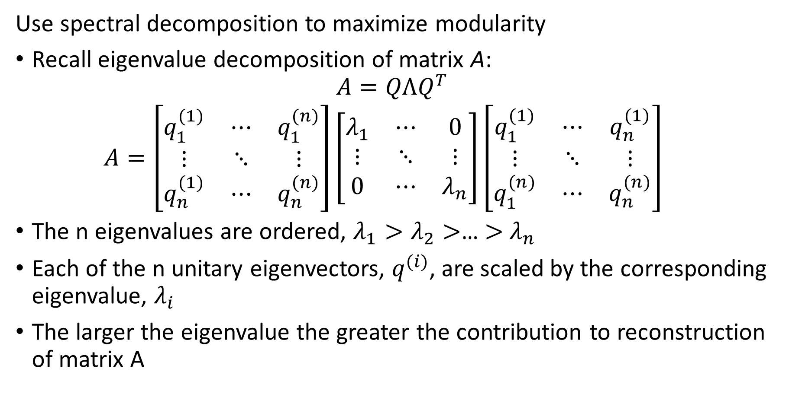
Spectral Modularity Maximization
Use spectral decomposition to maximize modularity
Recall eigenvalue decomposition of matrix A:
$$A=QΛQ^{T}$$
$$A=\left[\begin{matrix}q_{1}^{(1)} & ⋯ & q_{1}^{(n)} \\ ⋮ & ⋱ & ⋮ \\ q_{n}^{(1)} & ⋯ & q_{n}^{(n)}\end{matrix}\right]\left[\begin{matrix}λ_{1} & ⋯ & 0 \\ ⋮ & ⋱ & ⋮ \\ 0 & ⋯ & λ_{n}\end{matrix}\right]{\left[\begin{matrix}q_{1}^{(1)} & ⋯ & q_{n}^{(1)} \\ ⋮ & ⋱ & ⋮ \\ q_{1}^{(n)} & ⋯ & q_{n}^{(n)}\end{matrix}\right]}^{}$$
The n eigenvalues are ordered, $λ_{1}>λ_{2}>$… $>$ $λ_{n}$
Each of the n unitary eigenvectors, $q_{ }^{(i)}$, are scaled by the corresponding eigenvalue, $λ_{i}$
The larger the eigenvalue the greater the contribution to reconstruction of matrix A

Slide 49
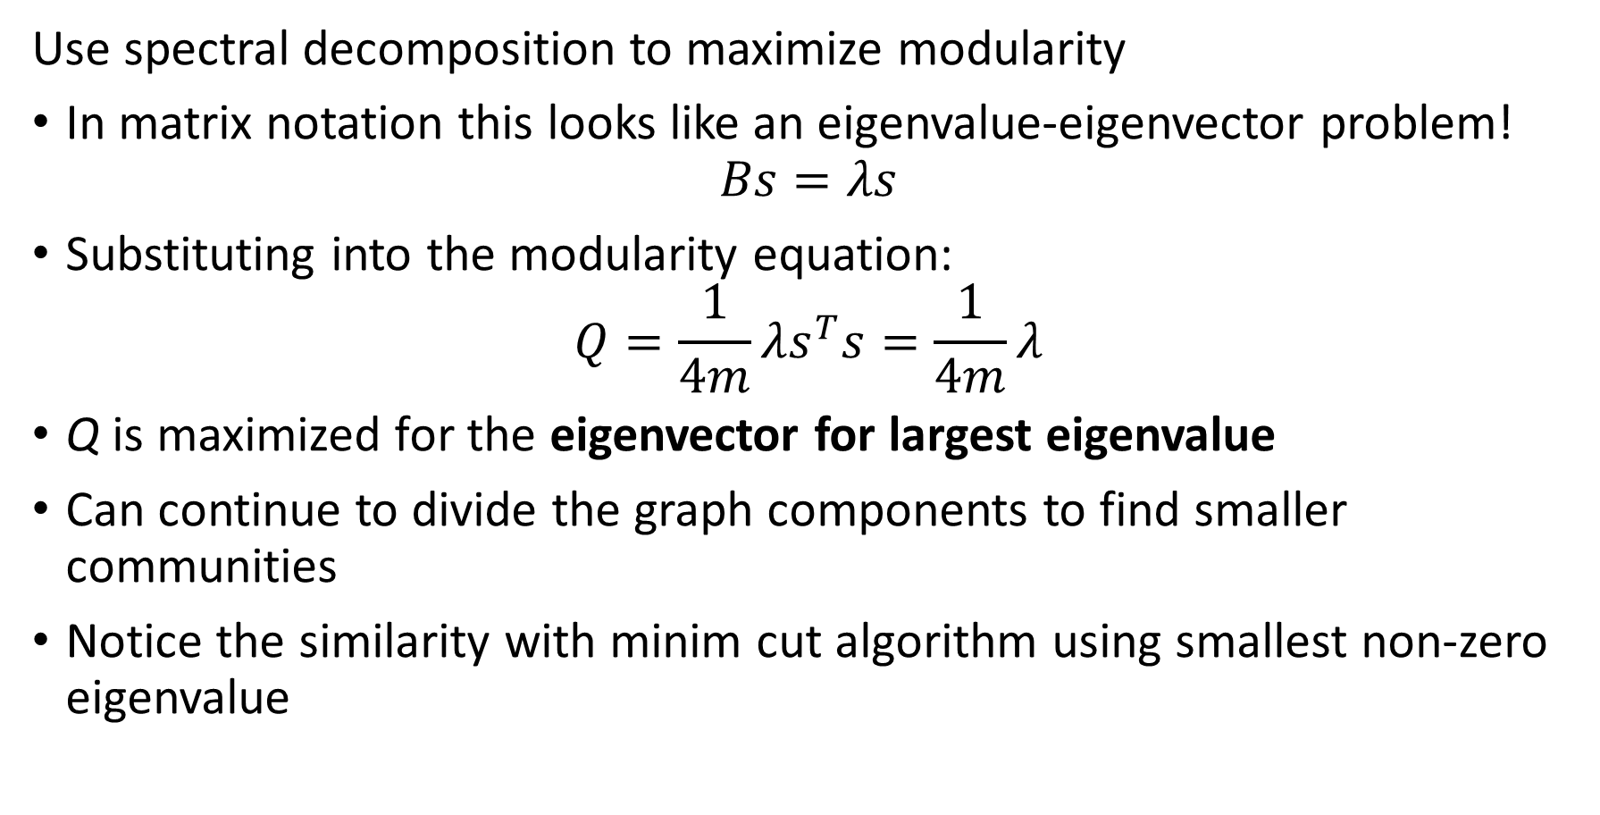
Spectral Modularity Maximization
Use spectral decomposition to maximize modularity
In matrix notation this looks like an eigenvalue-eigenvector problem!
$$Bs=λs$$
Substituting into the modularity equation:
$$Q=\frac{1}{4m}λs^{T}s=\frac{1}{4m}λ$$
Q is maximized for the eigenvector for largest eigenvalue
Can continue to divide the graph components to find smaller communities
Notice the similarity with minim cut algorithm using smallest non-zero eigenvalue

Slide 50
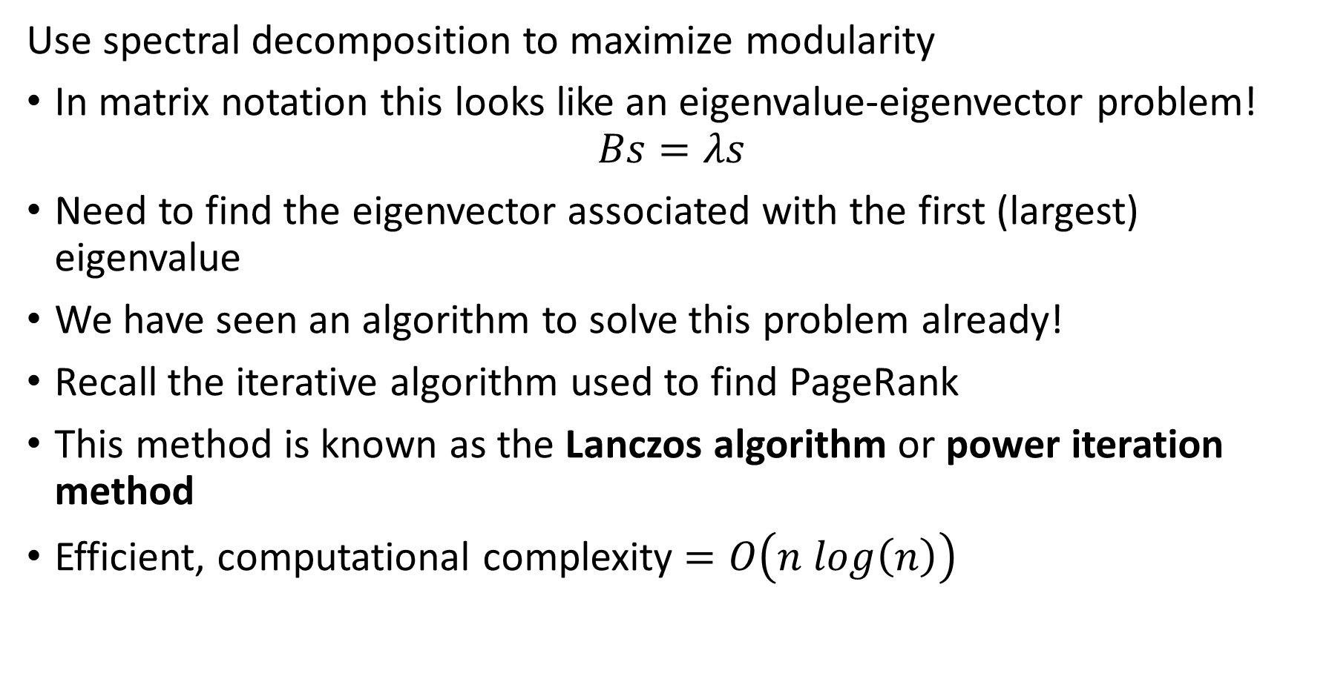
Spectral Modularity Maximization
Use spectral decomposition to maximize modularity
In matrix notation this looks like an eigenvalue-eigenvector problem!
$$Bs=λs$$
Need to find the eigenvector associated with the first (largest) eigenvalue
We have seen an algorithm to solve this problem already!
Recall the iterative algorithm used to find PageRank
This method is known as the Lanczos algorithm or power iteration method
Efficient, computational complexity $=O\left(n log\left(n\right)\right)$

Slide 51
Summary
Many methods to find communities in social networks
Communities defined by high connectivity
Can find communities by the centrality or influence of nodes:
Kratz centrality
Closeness centrality
K-Cores
Triangle density and clustering
Partition communities by betweenness
Find communities by modularity of groups of nodes
Greedy algorithms
Spectral decomposition modularity

