Slide 1
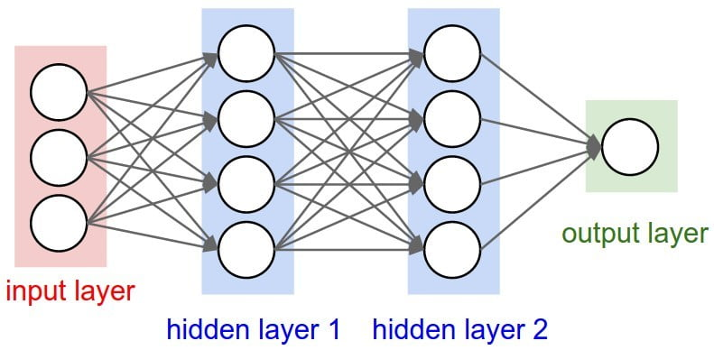
X1 (input 1)
…
f
Y (output)
XN (input N)
Output of neuron: Y = f(w1*X1 + … wN*XN + b

