Slide 1
Movie Recommendation System
Ryan McGuinness

Slide 2
Types of Recommendation Systems
Content-Based Filtering
Collaborative Filtering

Slide 3
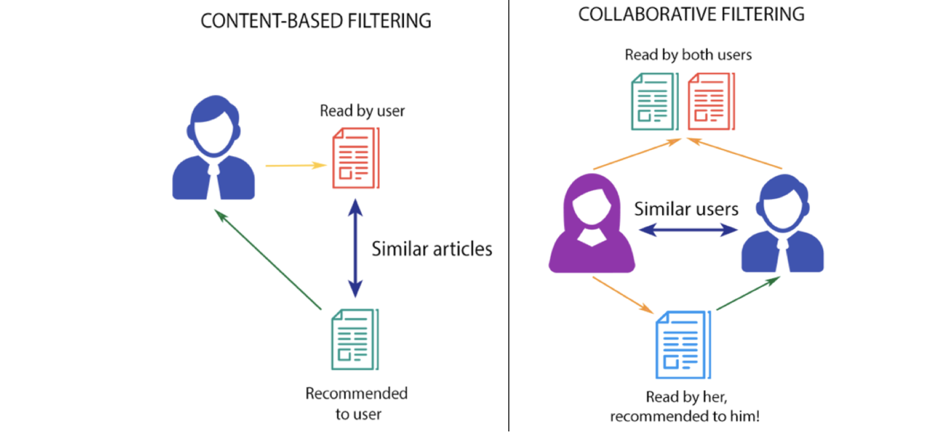
Content-Based Filtering
Content-based filtering uses features of the items directly to find similar items.

Slide 4
Collaborative Filtering
Collaborative filtering uses user ratings to find similar items.

Slide 5
MovieLens
MovieLens is a dataset by GroupLens including 25 million individual ratings across 162 thousand viewers and 62 thousand movies.
MovieLens also includes 1 million user applied tags and the “Tag Genome,” which gives a relevance score that each tag has on each movie.
Genres for each movie are provided as well.

Slide 6
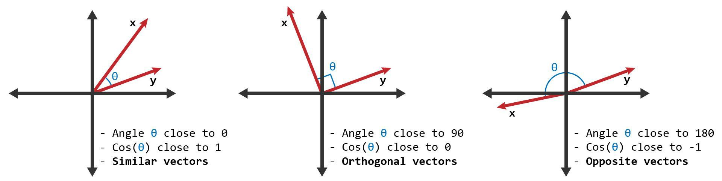
Filtering on Genre
Similarity Metric – Cosine Similarity
Easiest to implement, but ultimately flawed.

Slide 7
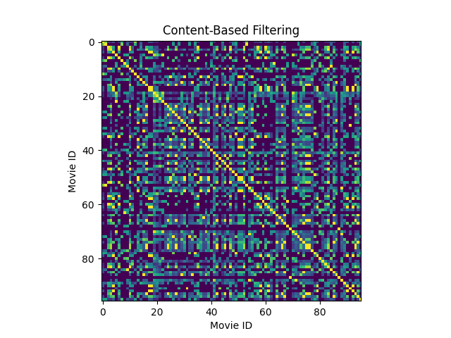
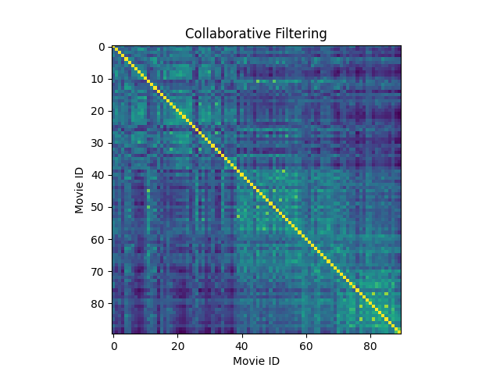
Filtering on User Ratings
Similarity Metric – Pearson correlation coefficient
Works very well with small data sample, but is incredibly difficult to scale

