Slide 1
A Product’s Guide to Finding Your Owner

Slide 2
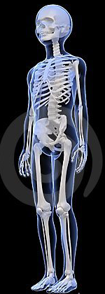
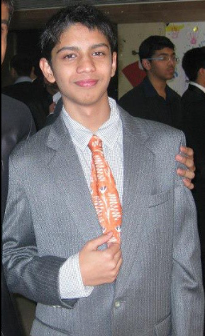

Who is Rohan Chakraborty?
Notes:
I am a rising junior pursuing a Computer Science Degree at USC. As you can see from this completely legitimate x-ray I’m a Trojan at heart.

Slide 3
Predicting success of marketing calls for bank deposits
Challenge
Will your marketing call be successful?
Which factors affect the decision to buy a product the most?
Do these factors affect the decision positively, or negatively?
Solution
Several machine learning classifiers were compared to predict the response to a call given buyer side, seller side and national socio-economic factors.
Benefits
Targeting customers
Timing and frequency of calls
National socio-economic factors
Industry: Advertising, financial services cross-market
Location: Portugal
Tools used: Data Science Experience
Notes:
A bank in Portugal was telemarketing itself to encourage people to deposit money in it. The first question to ask would be, what is going to be the result of my call. Is the customer going to buy my product, or not.
After asking the what, the next question is why. Why is someone buying the product. What factors affect their decision, and how do they they affect the decision.

Slide 4


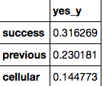
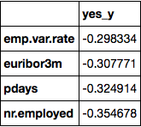
Results
Average call durations
Correlation between duration and result
Top 3 factors with positive correlation
Top 4 factors with negative correlation
Notes:
Success = result of previous call for other campaign
Previous = when previous contact was made (how many days ago)
Cellular = cell phone vs landline
Emp var = variation in whether employed or not
Euribor = avg interest rate at which eurozone banks lend to other banks
Pdays = previous contact for other campaign

Slide 5
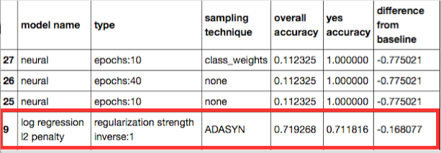
Model chosen
Notes:
Out of 40 different models

Slide 6
Tickets and Questions?
Notes:
People had sent tickets regarding issues they had.

Slide 7
Thank You!
Manager
Martin Dupont
Mentor
Jorge Castanon
ML Hub
Intern Activities
Andrea Garcia
Ryan Brissette

