Slide 1
Finding a Metric to Objectively Evaluate NBA Players
Ryder McMinn, Jose Lara, Ian Brown

Slide 2
Objective
We wanted to find a way to value sports player objectively
(Specifically NBA Players)
Other systems use weighted values that are subjective, and we felt that was too prone to bias.
Through Data Mining Techniques and Data Exploration, we were able to devise a comparative system that rates players using simple regression and tested it with season simulations.
This will allow owners, coaches, and managers to answer important questions about their basketball organization.

Slide 3
Other Work in This Area
First was Baseball – Sabermetrics (Moneyball Movie)
APBRmetrics (Basketball)

Slide 4
Gathering The Data
Where we got the data and why it’s relevant

Slide 5
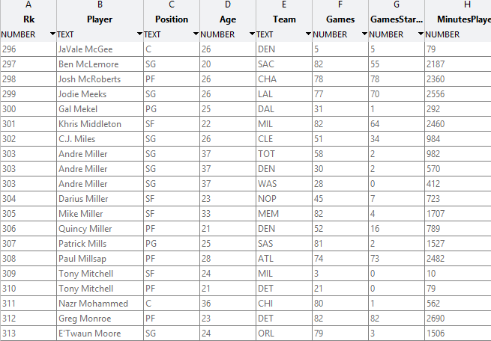
Gathering The Data – NBA.com
Data is pulled straight from NBA.com’s API (nba.com/stats)
This is 2013-2014 Full Season Player Data
NBA goes through a year of review before official stats are released
This is the most up-to date, reviewed dataset

Slide 6
Data Exploration
Exploring data and deciding best way to measure player value

Slide 7
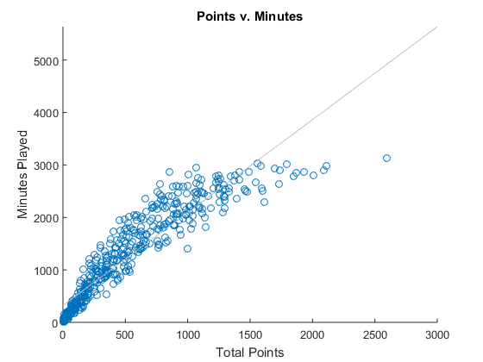
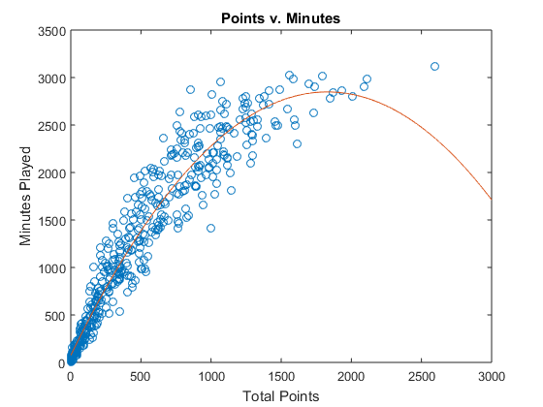
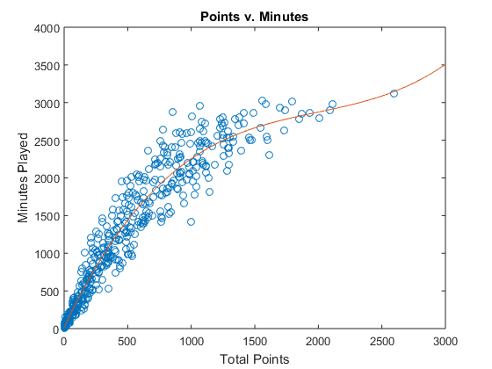
Data Exploration – Linear v. Polynomial
1st Degree
2nd Degree
3rd Degree

Slide 8
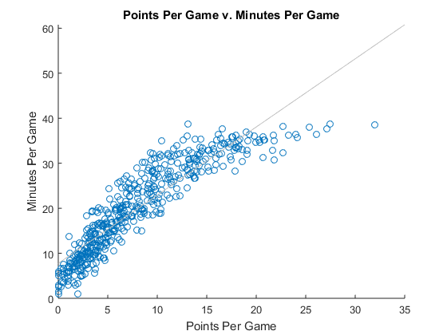
Data Exploration – Season v. Game
Focusing on PPG and MPG, because it focuses on skill rather than consistency

Slide 9
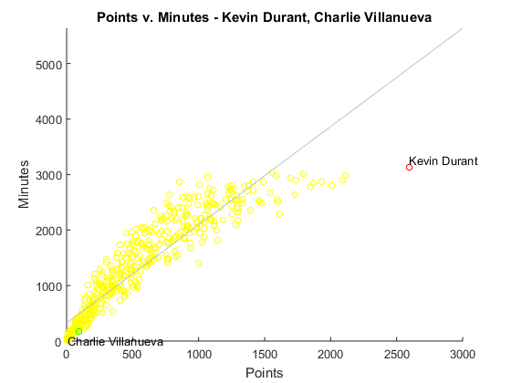
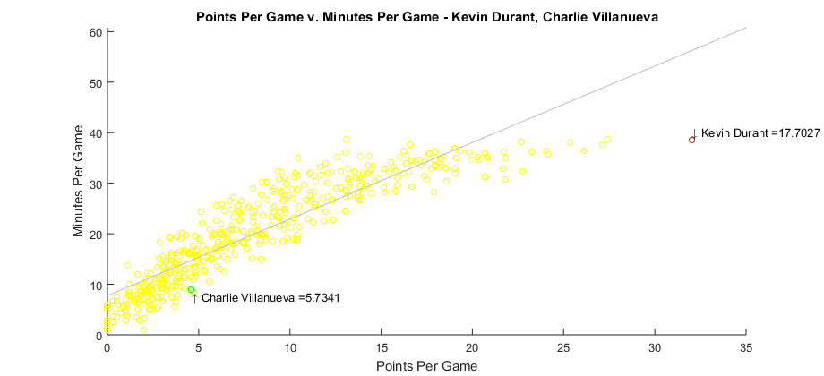
Data Exploration – CV v. KD Example

Slide 10
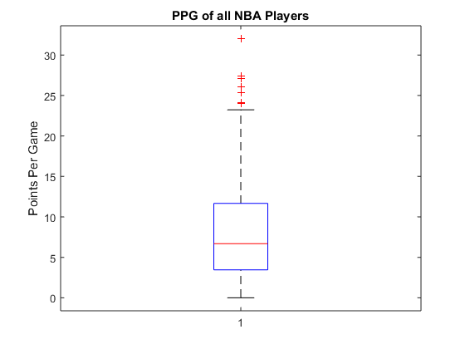
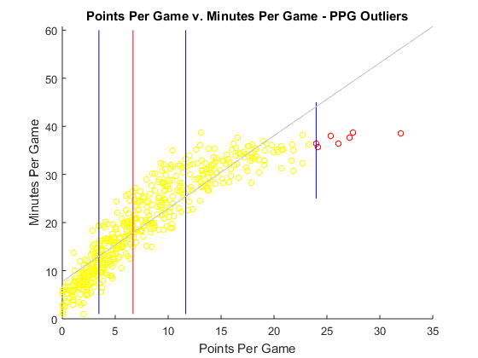
Data Exploration – Box Plot
Kevin Durant
Carmelo Anthony
Lebron James
Kevin Love
James Harden
Blake Griffin
Stephen Curry

Slide 11
Creating the Value Metric
Explaining the algorithm and Finding player values

Slide 12
Creating the Value Metric - Algorithm
Find Linear Regression (Least-Squares Method)
β = (X^{T}X)⁻¹X^{T}y
For every player, calculate distance from regression to player point
d_{Points}
y = β₀x + β₁
Kevin Durant
d_{PointsPlayer}
= (β₀(x_{PPGPlayer}) + β₁) - y_{MPGPlayer}
β₀
β₁
d_{PointsKD} = (1.5143(32.012) + 7.7681) – 38.543 = 17.703
KD’s PPG
KD’s MPG
Essentially an average NBA player would have to play 17.703 minutes more to achieve the same PPG production as KD

Slide 13
Creating the Value Metric - Values for Points
Top Under-Valued Players
Top Over-Valued Players
Kevin Durant – 17.703
Lebron James – 11.164
Kevin Love – 10.974
Carmelo Anthony – 10.577
Russell Westbrook – 10.059
DeAndre Jordan – (-11.424)
Jimmy Butler – (-11.059)
Andre Iguodala – (-10.479)
Ricky Rubio – (-9.9794)
Josh McRoberts – (-9.6552)
*Note: These are relative to points

Slide 14
Creating The Value Metric – Total Value
In order to get a full picture of a players skill, we have to include all major stats.
Repeat algorithm for Points, Assists, Steals, Rebounds, and Blocks while maintaining minutes as value reference
Composite Value Metric
d_{TotalValue} = d_{Points} + d_{Assists} + d_{Steals} + d_{Blocks} + d_{Rebounds}
Kevin Durant =>
17.703 -5.108 -7.6953 -15.625 -8.2336
Kevin Durant = d_{TotalValue} = -3.7919

Slide 15
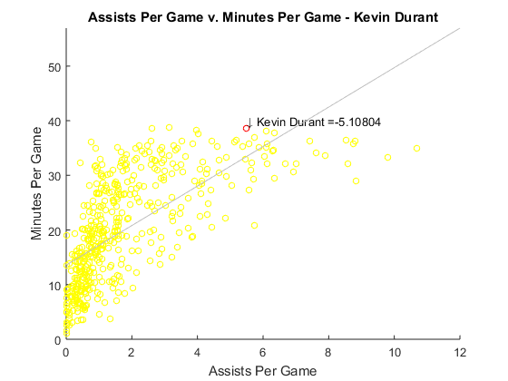
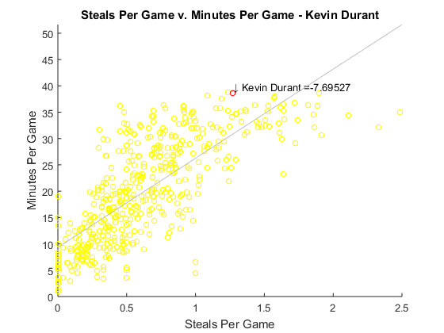
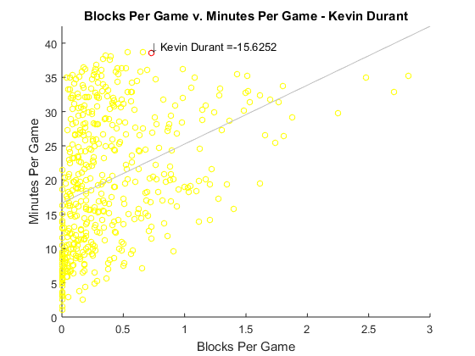
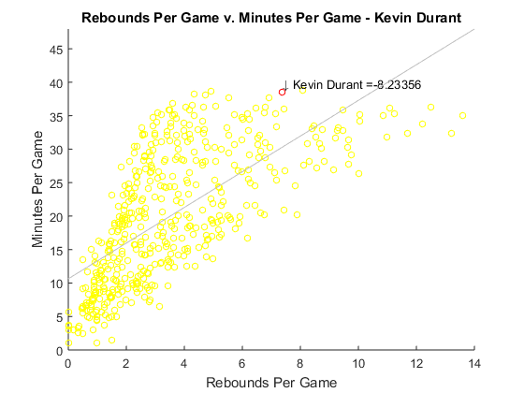
Creating The Value Metric – Visualizing Total Value

Slide 16
Creating the Value Metric – Total Player Values
Top Under-Valued Players
Top Over-Valued Players
Maalik Wayns – 12.0367 (9 Minutes)
DeAndre Liggins – 11.7324 (1 Minute)
Dexter Pittman – 10.8932 (3 Minutes)
Chris Smith – 10.5936 (2 Minutes)
Tony Smith – 10.4127 (89 Minutes)
Ryan Anderson – (-12.4556) (795 Minutes)
Arron Afflalo – (-11.7857) (2552 Minutes)
Jimmy Butler – (-11.2563) (2591 Minutes)
Klay Thompson – (-11.1188) (2868 Minutes)
Kyle Korver – (-10.5434) (2408 Minutes)
PROBLEM!
The “Best” Players barely even played!

Slide 17
Creating the Value Metric – Total Player Values Pruned
We decided to prune the bottom 25 percentile
Hadn’t played enough minutes to have have meaningful impact on games
Players have now played greater than 387 Minutes (~10 games or 11.8% of season)
Top Under-Valued Players (Pruned)
Top Over-Valued Players (Pruned)
Nazr Mohammed – 11.2276 (562)
Garrett Temple – 10.3318 (638)
Ryan Hollins – 10.2652 (482)
Donald Sloan – 10.0432 (392)
Byron Mullens – 10.0241 (414)
Ryan Anderson – (-10.7435) (795)
Jimmy Butler – (-10.5417) (2591)
Arron Afflalo – (-9.7590) (2552)
Chandler Parsons – (-9.6324) (2783)
Klay Thompson – (-9.4723) (2868)

Slide 18
Do these values mean anything?
Validating the Player Metric

Slide 19
Validating the Player Metric – How?
Creating a team score by combining player values of all player for a specific team
D_{TotalValue(team)} = Sum(for each D_{TotalValuePlayer})
Best Teams
Worst Teams
San Antonio Spurs – 2.13191
2013-2014 Champions
Dallas Mavericks – 1.5220
Minnesota Timberwolves – 1.4146
Washington Wizards – 1.2880
L. A. Clippers – 1.1160
Chicago Bulls – (-3.7644)
Milwaukee Bucks – (-1.5436)
L. A. Lakers – (-0.9469)
Boston Celtics – (-0.8852)
Cleveland Cavs – (-0.7196)

Slide 20
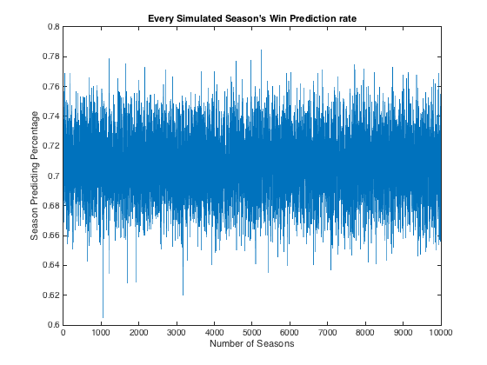
Validating the Player Metric – Using Team Score
We then decided to see if we could use the team score to predict game winners
We ran 10000 mock seasons
Used some variance on team score to try and account for player injuries, tired players, off days, etc.
STD = 1.115
Variance = STD( Sum(for each d_{teamscore})) * 4
Average Game Predicting Percentage
(10000 seasons)
= 70.76%

Slide 21
Validating the Player Metric – Weights Conditioning
Up until now, we’ve valued each stat equally
Tried to find weights for each stat
Ran previous method 1000 times of 1000 seasons using random weights each time
Then recorded max accuracy and its weights
1000
maxAcc =
0.7890
weights =
0.1541 0.4655 0.2833 0.3727 0.5023
maxAcc =
0.8072
weights =
0.2852 0.2856 0.2712 0.3506 0.4258
maxAcc =
0.7656
weights =
0.2208 0.3446 0.3997 0.8352 0.0753

Slide 22
Validating The Player Metric – 10000 Weights
We then ran it 10000 of 1000 seasons
So essentially there was 10000 sets of different weights
…as you can imagine, it took 1.5 hours
Essentially we simulated 900 million games
10000
maxAcc =
0.7969
weights =
0.3012 0.4677 0.8775 0.9797 0.6646

Slide 23
Future Work
Using Salary instead of Minutes
Applying Model to current and future seasons
Analyzing potential trades
Testing weights against different season stats

Slide 24
Conclusion
We found that the player metric is a reasonably accurate prediction of a player's skill
Using our validation technique, we had a decent classifier to predict games only using stats
NBA is often highly variable
Weights improved our classifier accuracy, but were inconsistent
This can be a tool to look at all manner of problems facing NBA teams today

