Slide 1

KIRA LABS / CONFLUENT AI DAY NYC
Robert McMurrer · kiralabs.org
ContextGate
CG
Make changing evidence safe to act on.
Evidence → decision → receipt
ALLOW REVIEW BLOCK
An explainable control layer for AI agents
01
Notes:
Open on the tension: agents are only as safe as the context they act on. ContextGate converts changing evidence into a governed, explainable receipt before an action proceeds.
[Sources]
- C:\Users\robmc\Documents\Codex\2026-09-02\i-x20\outputs\context-gate\README.md
- Brand asset: C:\Users\robmc\AppData\Local\Temp\codex-clipboard-3d8c1838-efbf-4f1e-a60d-ea9e7bd84815.png
- Event and audience framing: user-provided hackathon brief, 2026-09-03
[/Sources]

Slide 2
THE RISK
Changing context breaks agent decisions
Recency, wording, and authority can point in different directions.
35 confirmed
OFFICIAL CONFIRMATION
09:00
?
+78 more
EMAIL UPDATE
09:12
Which fact should the agent use?
78 attending
COPIED LISTING
09:14
A timestamp alone cannot answer that.
Wrong context → wrong action → no defensible audit trail
CONTEXTGATE / KIRA LABS
02
Notes:
Use the three statements as a simple proof of the problem. ContextGate must preserve the source, identify whether a number is a delta or replacement, compare authority, and bind the decision to the evidence available at the time.
[Sources]
- C:\Users\robmc\Documents\Codex\2026-09-02\i-x20\outputs\context-gate\docs\demo_script.md — Judge Q&A: wrong totals and duplicates
- C:\Users\robmc\Documents\Codex\2026-09-02\i-x20\outputs\context-gate\context_gate\data\synthetic_context_events.json — fictional evidence fixtures
- C:\Users\robmc\Documents\Codex\2026-09-02\i-x20\outputs\context-gate\context_gate\source_catalog.py — normalized event identity and count logic
[/Sources]

Slide 3
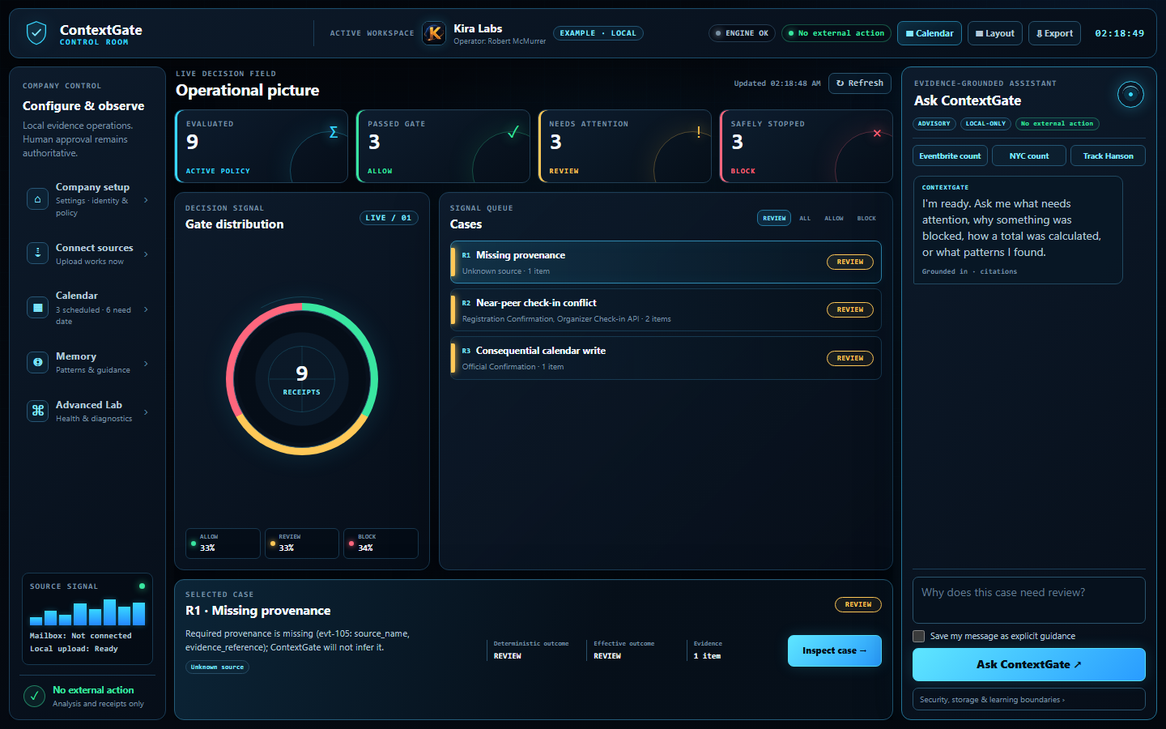
THE PRODUCT
One screen shows what can act—and why
Green previews safely. Amber asks a person. Red stops the action.
SEE IT. ASK IT. CORRECT IT.
Outcome picture
ALLOW / REVIEW / BLOCK at a glance
Evidence queue
Open any case and inspect the receipt
Persistent chat
Ask for totals, sources, and corrections
CONTEXTGATE / KIRA LABS
03
Notes:
This is the main live-demo screen. Point left-to-right: company controls and sources, the operational decision picture, then the evidence-grounded assistant. The screenshot source is isolated in the builder so a refreshed UI capture can be swapped without changing the slide layout.
[Sources]
- Screenshot: C:\Users\robmc\Documents\Codex\2026-09-02\i-x20\outputs\context-gate\docs\screenshots\01-dashboard.png
- C:\Users\robmc\Documents\Codex\2026-09-02\i-x20\outputs\context-gate\README.md — Built-in Pattern Lab and web application behavior
- C:\Users\robmc\Documents\Codex\2026-09-02\i-x20\outputs\context-gate\docs\demo_script.md — 0:46–1:43 decision picture and stopped-action path
[/Sources]

Slide 4
CONFLUENT PATH
The right context, with proof
Retrieve only what the question needs—then attach provenance, authority, time, conflicts, and citations.
KAFKA
FLINK
PACKET
GATE
STREAMING AGENT
Replayable evidence
+ requests
Select · dedupe
authority · conflict
Provenance · time
authority · citations
ALLOW · REVIEW
BLOCK
Explain the fixed
decision receipt
HUMAN CORRECTION → REMEMBERED GUIDANCE
A correction becomes a new receipt and future guidance. It never rewrites the original evidence or silently changes authority.
LOCAL DEMO: DETERMINISTIC PYTHON · REPO PATH: KAFKA + FLINK + STREAMING AGENTS, READY FOR WORKSHOP CREDENTIALS
CONTEXTGATE / KIRA LABS
04
Notes:
Lead with the workshop-aligned point: ContextGate does not dump every record into the model. For each question or proposed action, it selects only relevant records, deduplicates updates, attaches provenance, authority and event time, flags conflicts, and cites the evidence. That compact evidence packet goes through the deterministic gate. A Streaming Agent can explain the fixed receipt, while a human correction becomes remembered guidance plus a new receipt. Be explicit: the Confluent path is bundled and ready for workshop credentials, but it is not yet running against a live Confluent Cloud workspace.
[Sources]
- C:\Users\robmc\Documents\Codex\2026-09-02\i-x20\outputs\context-gate\README.md — How it works and Confluent workshop path
- C:\Users\robmc\Documents\Codex\2026-09-02\i-x20\outputs\context-gate\docs\architecture.md — deterministic enforcement and Flink coverage boundary
- C:\Users\robmc\Documents\Codex\2026-09-02\i-x20\outputs\context-gate\context_gate\confluent_adapter.py
- C:\Users\robmc\Documents\Codex\2026-09-02\i-x20\outputs\context-gate\flink\ — ordered SQL deployment artifacts
- https://docs.confluent.io/cloud/current/flink/reference/queries/deduplication.html
- https://docs.confluent.io/cloud/current/flink/reference/queries/joins.html#temporal-joins
- https://docs.confluent.io/cloud/current/ai/streaming-agents/monitor-streaming-agents.html
[/Sources]

Slide 5
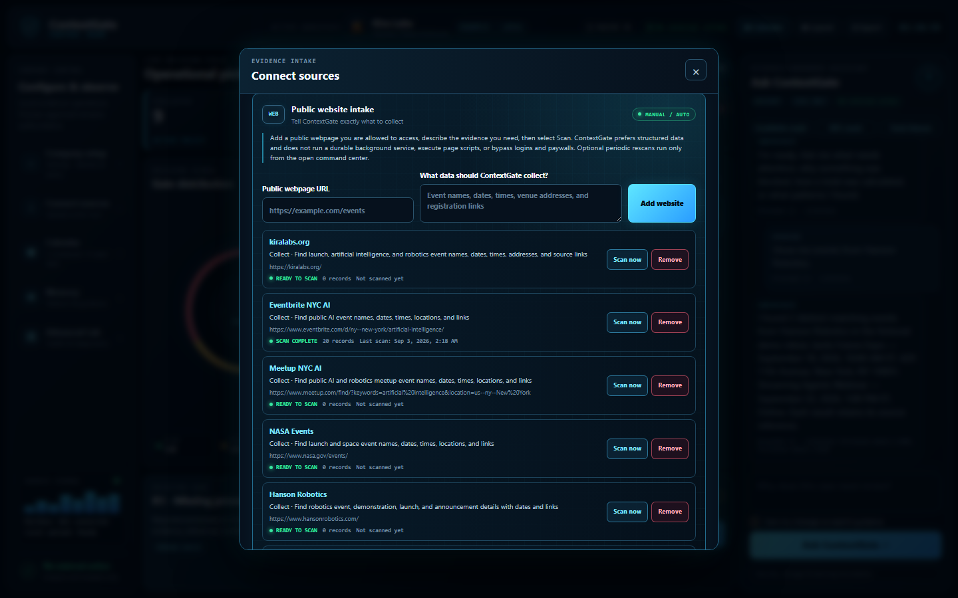
COMPANY VALUE
Sources are self-service—not hard-coded
Configure where evidence comes from, what to collect, and which business signal matters.
Track events, sales, or operations without rebuilding the product.
Public websites
Paste a URL + state the collection goal
Gmail + Microsoft
Real read-only OAuth per email account
Operator control
Add / remove sites · connect / disconnect email
Disconnect stops access. Delete removes local catalog data. They are different controls.
VISIBLE SOURCE CONTROL · URL + COLLECTION GOAL · ADD / SCAN / REMOVE
CONTEXTGATE / KIRA LABS
05
Notes:
Sources are configured by the operator, not hard-coded by a developer. In Connect sources, paste an authorized public URL, describe exactly what to collect, and choose Scan; saved sites can be rescanned or removed. In Settings → Email accounts, connect Gmail or Microsoft/Hotmail through the provider's real read-only OAuth flow and disconnect each account independently. ContextGate never treats a typed email address as authentication. Disconnecting a source stops access; deleting a matching local catalog record is a separate data action. Once configured, the same product can track events, sales, operations, or other company-defined signals in parallel.
[Sources]
- Screenshot: C:\Users\robmc\Documents\Codex\2026-09-02\i-x20\outputs\context-gate\docs\screenshots\05-website-sources.png
- C:\Users\robmc\Documents\Codex\2026-09-02\i-x20\outputs\context-gate\docs\ingestion_connectors.md — source types and provenance
- C:\Users\robmc\Documents\Codex\2026-09-02\i-x20\outputs\context-gate\docs\demo_script.md — public website configuration, Gmail/Microsoft OAuth, disconnect/delete boundary
- C:\Users\robmc\Documents\Codex\2026-09-02\i-x20\outputs\context-gate\docs\company_setup.md — company settings and OAuth configuration
- C:\Users\robmc\Documents\Codex\2026-09-02\i-x20\outputs\context-gate\context_gate\website_sources.py — bounded website scans
- C:\Users\robmc\Documents\Codex\2026-09-02\i-x20\outputs\context-gate\context_gate\email_connectors.py — OAuth-backed mailbox sessions
[/Sources]

Slide 6
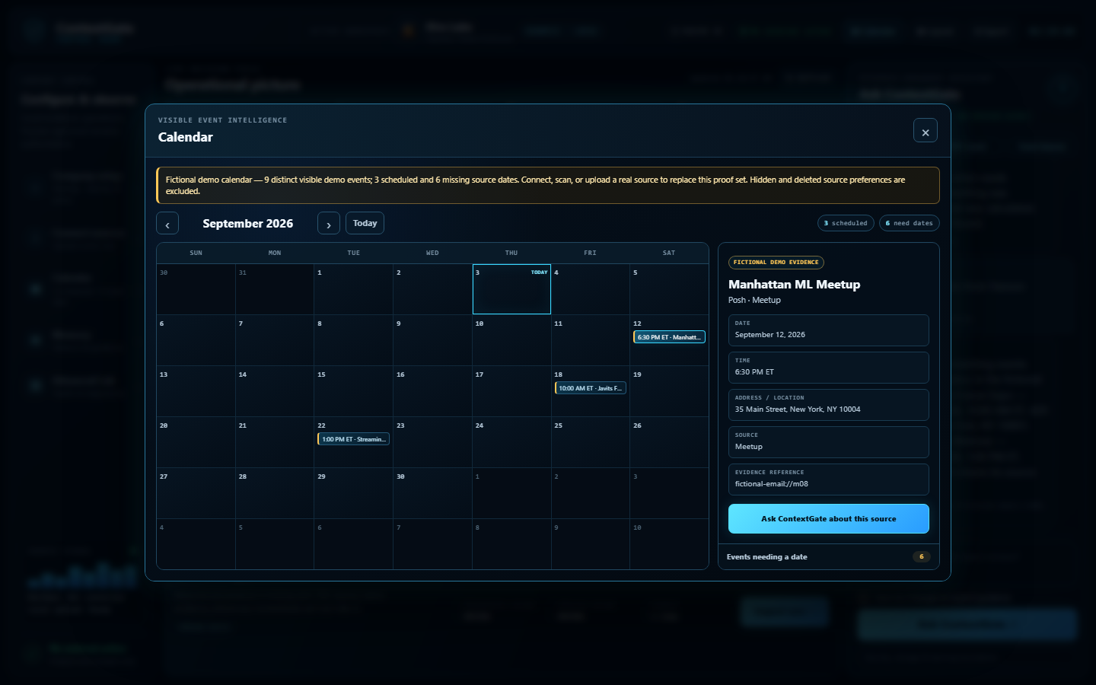
PERSONAL USE
A personal control room for life admin
The same evidence discipline helps one person stay ahead of changing plans.
TRACK WHAT CHANGES
Hackathons + launch parties
AI + robotics events
Receipts + purchases
Reminders + calendar
Corrections with source trail
Ask: “What changed—and where did that answer come from?”
CONTEXTGATE / KIRA LABS
06
Notes:
Make this personal and concrete. A solo user can track hackathons, launch events, AI and robotics meetups, purchases, receipts, reservations, reminders, and venue changes across explicitly authorized sources. The calendar keeps undated evidence separate instead of guessing. Hide is reversible; delete removes the local catalog record but does not erase the upstream source.
[Sources]
- Screenshot: C:\Users\robmc\Documents\Codex\2026-09-02\i-x20\outputs\context-gate\docs\screenshots\06-calendar.png
- C:\Users\robmc\Documents\Codex\2026-09-02\i-x20\outputs\context-gate\docs\demo_script.md — optional personal-use story and calendar behavior
- C:\Users\robmc\Documents\Codex\2026-09-02\i-x20\outputs\context-gate\docs\company_memory.md — tracking topics and operator guidance
- C:\Users\robmc\Documents\Codex\2026-09-02\i-x20\outputs\context-gate\README.md — privacy and provenance boundaries
[/Sources]

Slide 7
LIVE PROOF
Tested like a control layer, not a demo
Chat behavior, deterministic policy, adapters, UI, launchers, packaging, and CI are covered.
57/57
277
4/4
chat scenarios
passed · 2 expected skips
CI matrix jobs
FICTIONAL CATALOG / DEDUPLICATED
REAL CONNECTOR OBSERVATION / 03 SEP 2026
5 Eventbrite events · 6 NYC events
20 Eventbrite records
Counts come from the bundled fictional catalog, after update duplicates are removed.
A time-bound live-site scan result—not a permanent claim about Eventbrite inventory.
CONTEXTGATE / KIRA LABS
07
Notes:
Lead with the verification numbers, then separate fictional demo counts from the time-bound real connector observation. The fictional catalog contains six Eventbrite messages resolving to five distinct Eventbrite events, and seven NYC messages resolving to six distinct NYC events. The real Eventbrite scan returned 20 structured records on September 3, 2026; that number is an observation from one test run, not a durable site statistic.
[Sources]
- Local verification summary supplied for this deck, 2026-09-03: 57/57 chat scenarios; 277 tests passed; 2 expected skips; 4/4 CI matrix jobs
- C:\Users\robmc\Documents\Codex\2026-09-02\i-x20\outputs\context-gate\.github\workflows\ci.yml — Ubuntu/Windows × Python 3.11/3.13 matrix
- C:\Users\robmc\Documents\Codex\2026-09-02\i-x20\outputs\context-gate\tests\test_web_console.py — chat behavior
- C:\Users\robmc\Documents\Codex\2026-09-02\i-x20\outputs\context-gate\tests\test_source_catalog.py — fictional deduplication counts
- C:\Users\robmc\Documents\Codex\2026-09-02\i-x20\outputs\context-gate\docs\demo_script.md — real-site connector test observation and fictional count labels
[/Sources]

Slide 8
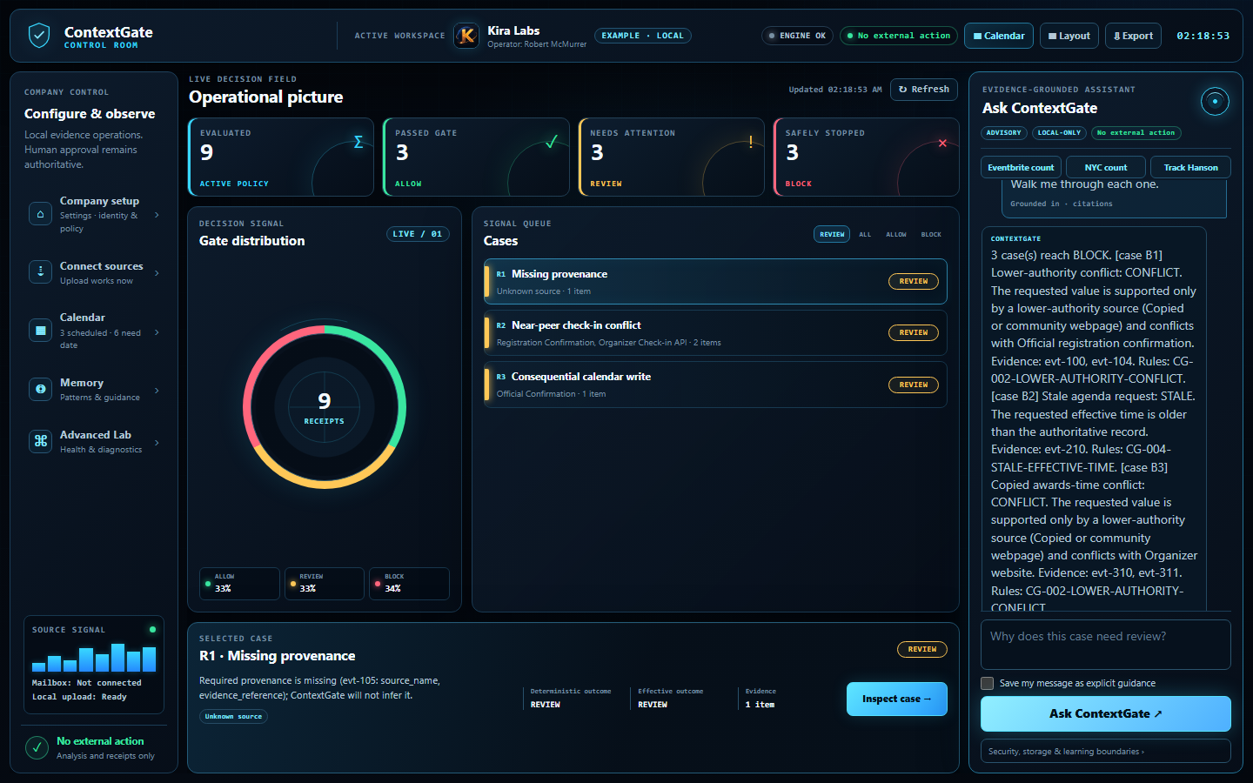
TRUST BOUNDARY
The model explains. The gate decides.
Use AI for useful language—keep policy, identity, and authority deterministic.
DETERMINISTIC CORE
A model can describe a receipt. It cannot rewrite the result.
Source-ranked + time-bound
Human correction appends a receipt
Read-only OAuth; no mailbox passwords
No external action in the judged path
BLOCKED ≠ SILENT / THE RECEIPT SHOWS WHY
CONTEXTGATE / KIRA LABS
08
Notes:
This is the safety differentiator. Source rank, evidence identity, event time, conflicts, and action policy stay in deterministic code. Schema validation prevents model prose from changing the outcome. The local judged path takes no external action. Gmail and Microsoft connections require provider-hosted OAuth and read-only mail scopes; an email address or password is never enough to connect an inbox.
[Sources]
- Screenshot: C:\Users\robmc\Documents\Codex\2026-09-02\i-x20\outputs\context-gate\docs\screenshots\02-red-explanation.png
- C:\Users\robmc\Documents\Codex\2026-09-02\i-x20\outputs\context-gate\README.md — enforcement invariants, privacy and provenance
- C:\Users\robmc\Documents\Codex\2026-09-02\i-x20\outputs\context-gate\docs\architecture.md — decision and audit boundaries
- C:\Users\robmc\Documents\Codex\2026-09-02\i-x20\outputs\context-gate\docs\demo_script.md — Gmail/Hotmail OAuth and security judge Q&A
- C:\Users\robmc\Documents\Codex\2026-09-02\i-x20\outputs\context-gate\context_gate\chat.py — receipt-bounded explanation behavior
[/Sources]

Slide 9
LIVE DEMO
Ask the questions judges care about
Every answer can point back to evidence, policy, or a human correction.
ASK CONTEXTGATE
WHAT JUDGES SEE
A cited explanation
>
Why was this blocked? Show your sources.
A corrected state
>
How many fictional events came from Eventbrite?
An intact original
>
Correct this total—and preserve the original receipt.
A real saved report
>
Create a Kira Labs PDF report and pie chart.
Offline fallback: the deterministic gate and fictional demo require no cloud call or API key.
CONTEXTGATE / KIRA LABS
09
Notes:
Use only the prompts that fit the remaining time. Start with a red explanation, then show the fictional Eventbrite count, one human correction, and a branded export. If Wi-Fi fails, the localhost demo and deterministic gate still work. The report is saved locally; ContextGate does not email or print automatically.
[Sources]
- C:\Users\robmc\Documents\Codex\2026-09-02\i-x20\outputs\context-gate\docs\demo_script.md — exact timed prompts, optional prompts, and offline backup
- C:\Users\robmc\Documents\Codex\2026-09-02\i-x20\outputs\context-gate\tests\test_web_console.py — chat and correction paths
- C:\Users\robmc\Documents\Codex\2026-09-02\i-x20\outputs\context-gate\context_gate\report_exports.py — DOCX/PDF/PNG/HTML exports
- C:\Users\robmc\Documents\Codex\2026-09-02\i-x20\outputs\context-gate\README.md — local fallback boundary
[/Sources]

Slide 10
CONTEXTGATE / KIRA LABS
Give agents context they can defend
Know what is true. Decide what is safe. Prove why.
KNOW
DECIDE
PROVE
Evidence + authority
ALLOW / REVIEW / BLOCK
Explanation + receipt
Next: connect workshop credentials and prove this same path through Kafka + Flink.
Robert McMurrer · Kira Labs · kiralabs.org
10
Notes:
Close by resolving the opening tension. ContextGate makes changing evidence governable: what is known, why it is trusted, what can act, and who approved it. The concrete workshop ask is to connect the assigned credentials and validate the included Kafka/Flink/Streaming Agents path against the live environment.
[Sources]
- C:\Users\robmc\Documents\Codex\2026-09-02\i-x20\outputs\context-gate\README.md — Confluent workshop path and enforcement invariants
- C:\Users\robmc\Documents\Codex\2026-09-02\i-x20\outputs\context-gate\docs\event_day_checklist.md — credentials, topics, Flink, and Streaming Agent steps
- C:\Users\robmc\Documents\Codex\2026-09-02\i-x20\outputs\context-gate\docs\demo_script.md — closing statement
[/Sources]

