Slide 1
Matrix Profile MPI Implementation
Brody Larsen∗ and Richard McNew†
Department of Computer Science
Utah State University
Logan, Utah, USA
∗ a01977457@usu.edu, † a02077329@usu.edu

Slide 2
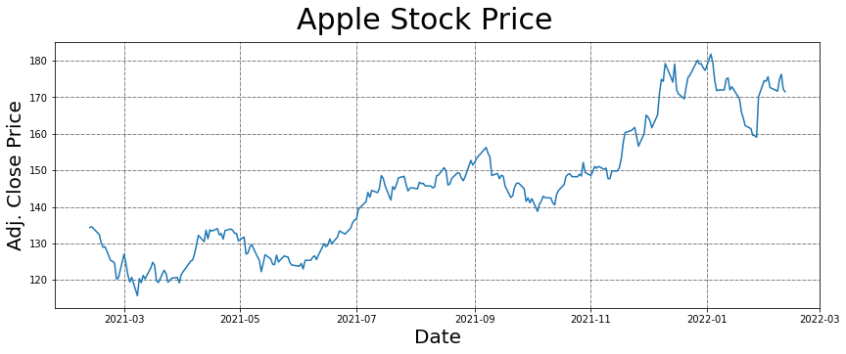
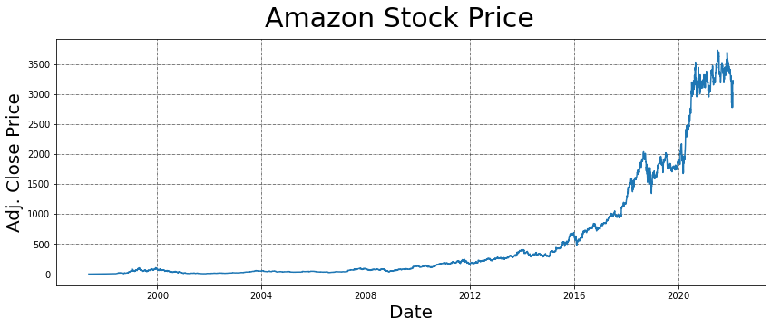
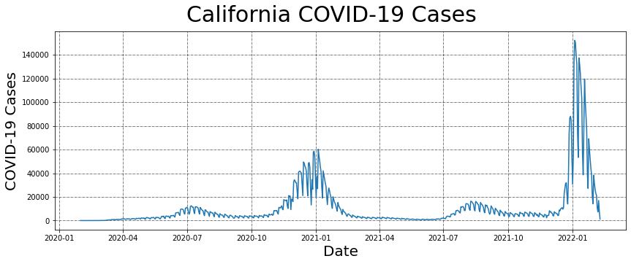
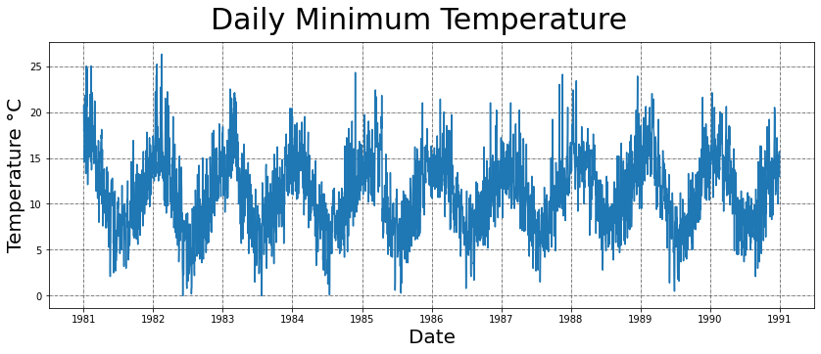
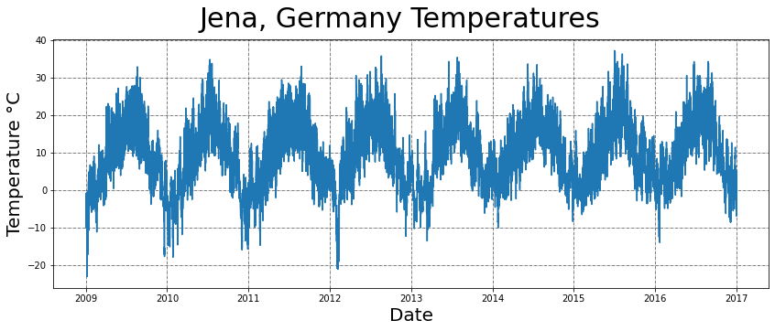
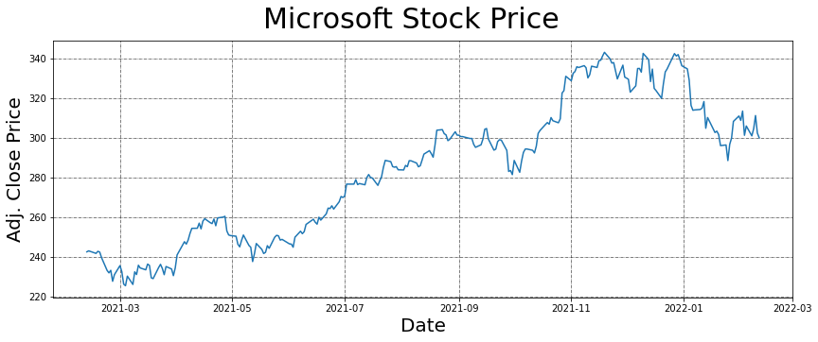
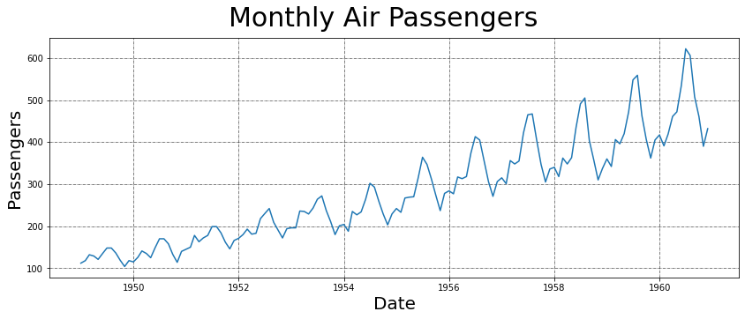
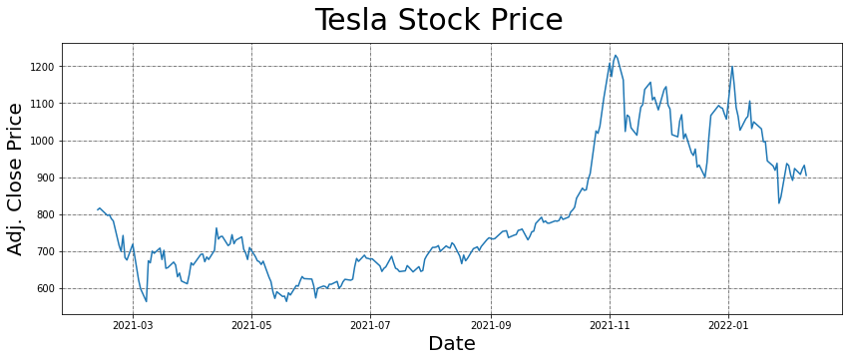
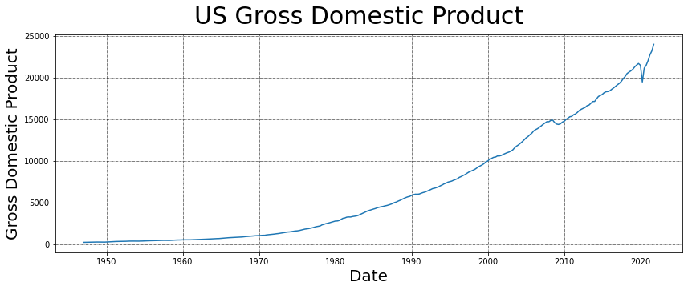
What is Time Series Data?

Slide 3
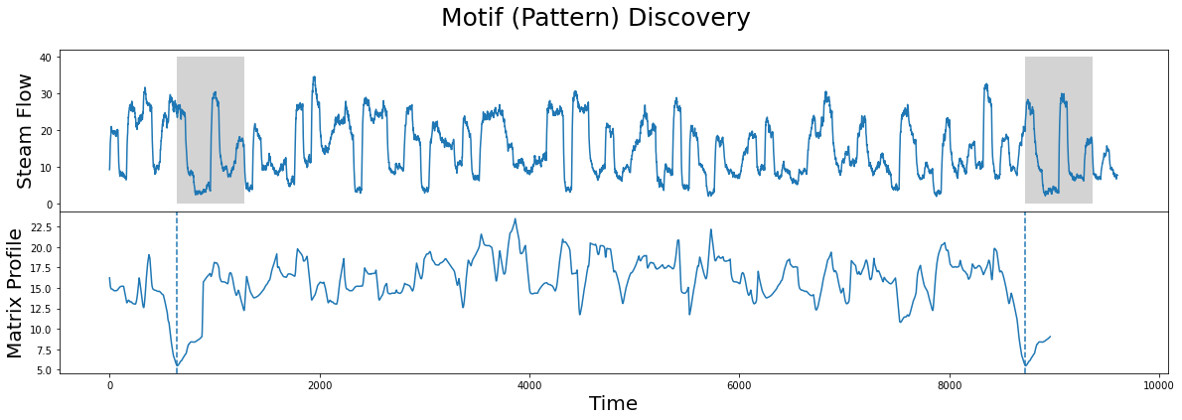
What is the Matrix Profile?
The Matrix Profile is a data structure and set of accompanying algorithms that annotate a time series and make most time series datamining easy to solve.

Slide 4
Matrix Profile vs. Other Tools?
1) exact - it allows for time series analysis without false positives or false negatives
2) parameter-free - unlike many time series data analysis tools, no hyperparameter tuning is needed
3) space efficient - a matrix profile data structure does not require much space, enabling large datasets to be processed in memory
4) parallelizable - it is fast to compute on modern hardware
5) simple - it is easy to use and easy to understand.

Slide 5
Thesis
In this project we created a minimal MPI implementation of the Matrix Profile in C++.

Slide 6
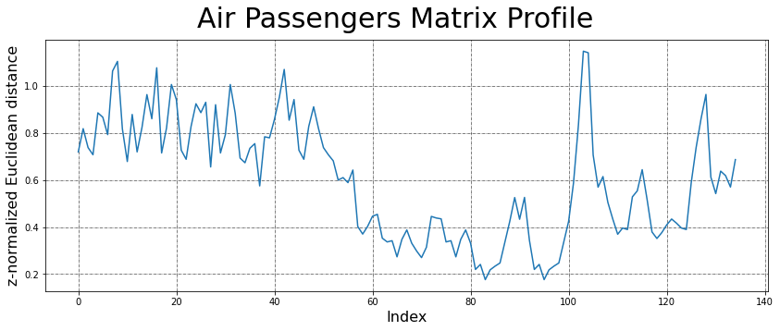
Approach
Rank 1
Command line args
Input
time series
Rank 2
Output Matrix Profile
Rank 0
Rank 0
Rank 3
MPI_Recv
MPI_Bcast
Rank N
MPI_Send
Calculate Matrix Profile for own segment

Slide 7
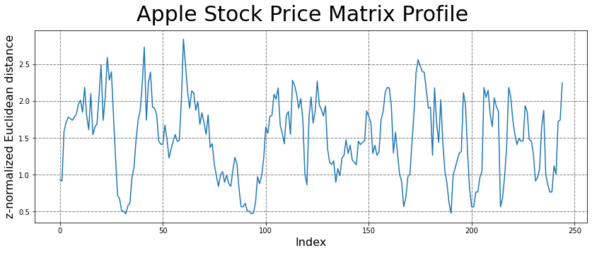
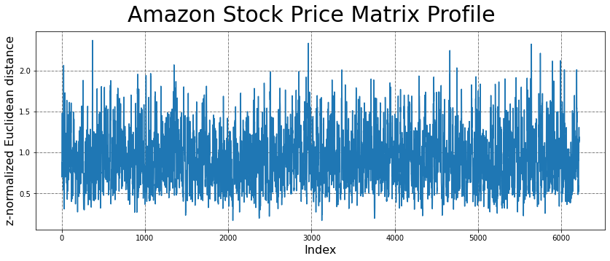
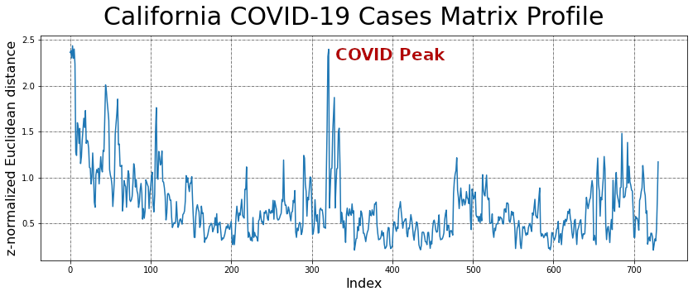
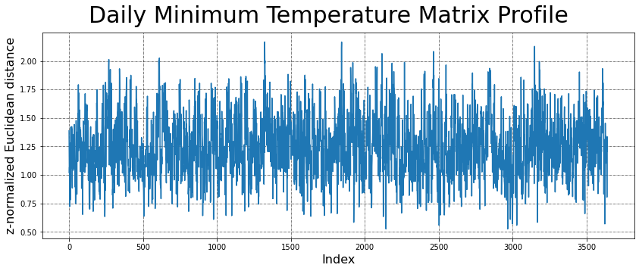
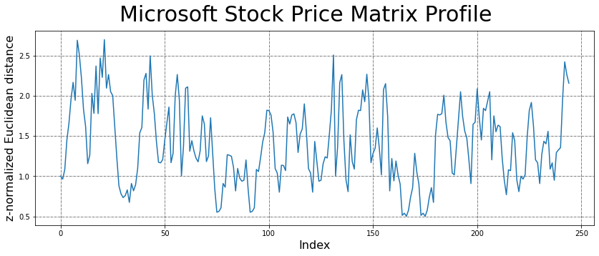
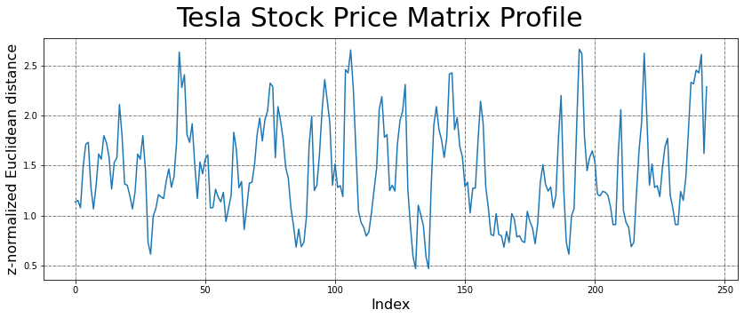
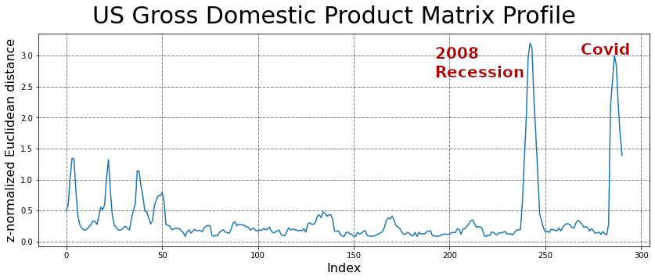
Results
Jena Climate Matrix Profile did not finish in time

Slide 8
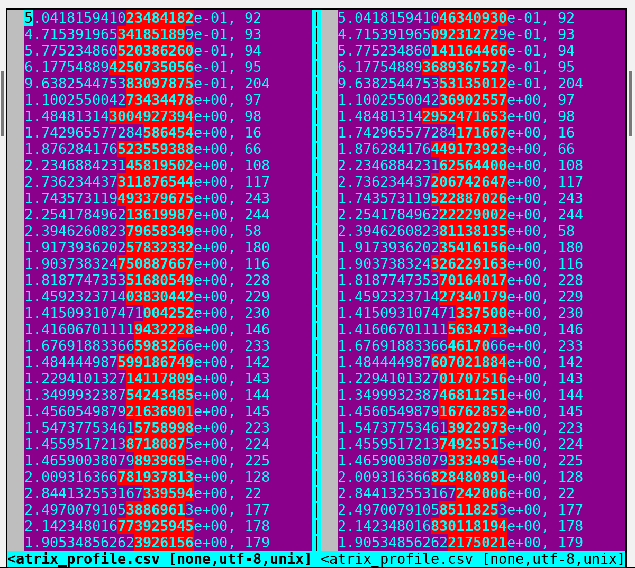
Side-by-Side Diff of Output Matrix Profiles
99.95 %
Similarity

Slide 11
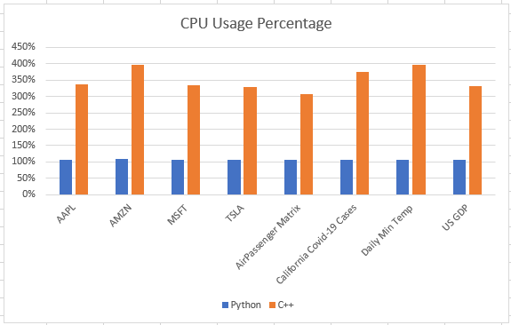
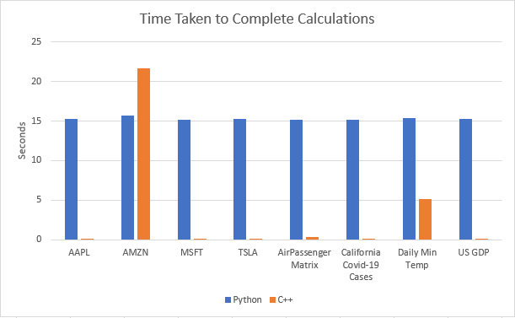
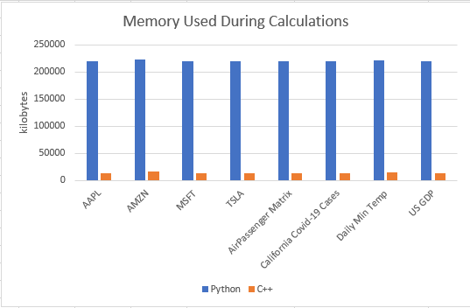
Conclusion
Our MPI C++ implementation worked faster than the Python implementation on smaller datasets.
It used more CPU and less memory than Python. However, since we used a slow algorithm, it took more time when the data set grew in size.

Slide 12
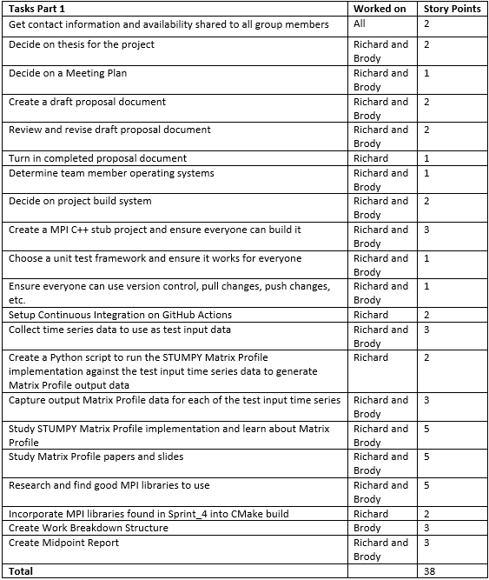
Task List

Slide 13
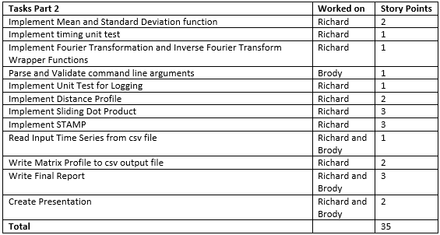
Task List

Slide 14
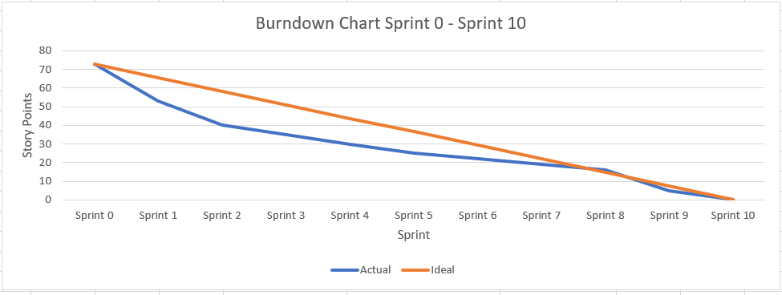

Slide 15
Questions?

