Slide 1
How to use CRC Manifest Processor

Slide 2
CONUS Replacement Center (CRC)
Manifest Processing Timeline
Monday
Tuesday
Wednesday
Pre Manifest Distro
ULN Seat Request
Thursday
ULN Seats Reserved
Friday
Saturday
Final Manifest Distro
Sunday
CRC sends Pre Manifest
CRC sends Final Manifest
CRC flight leaves Atlanta, GA
CRC flight arrives in theater
Pre Manifest
Processing
ARCENT JOPES creates
intra-theater ULN seat reservations
Final Manifest
Processing
Work done by CRC Manifest Processor
CRC flight to theater
Email you send to ARCENT JOPES on SIPR side
Timeline in Charlie (UTC+3) time zone

Slide 3
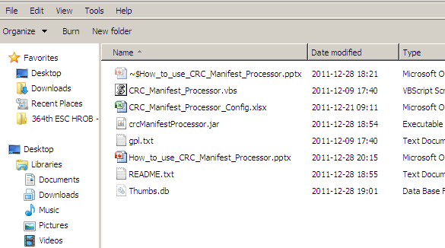
How to start CRC Manifest Processor
Double-click “CRC_Manifest_Processor.vbs”
Your computer must have Java installed to run CRC Manifest Processor. Most computers come with Java pre-installed. If your computer does not have Java, contact your computer support team and ask them to install Java.

Slide 4
CRC Pre Manifest Processing

Slide 5
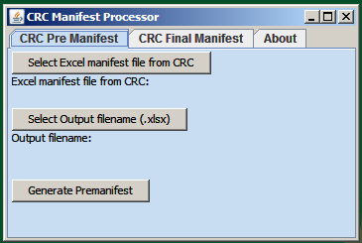
How to operate CRC Manifest Processor: Pre Manifest Processing
Ensure “CRC Pre Manifest” tab is selected.
Click on “Select Excel manifest file from CRC”
Select PreManifest Excel file that the CRC sent using the dialogue box

Slide 6
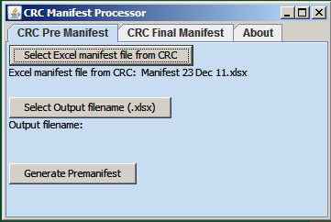
How to operate CRC Manifest Processor: Pre Manifest Processing (2)
Click on “Select Excel Output filename”
Select desired output path and type the filename you want using the dialogue box. A suggested filename is:
Processed CRC Pre Manifest
followed by today’s date.

Slide 7
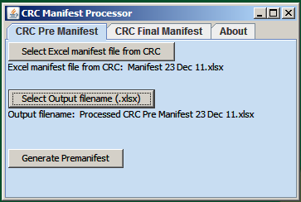
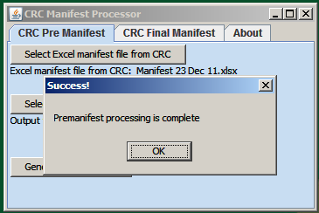
How to operate CRC Manifest Processor: Pre Manifest Processing (3)
Click on “Generate Premanifest”
Processing only takes a few seconds.
If processing is successful,
a pop-up box will let you know. Click OK.

Slide 8
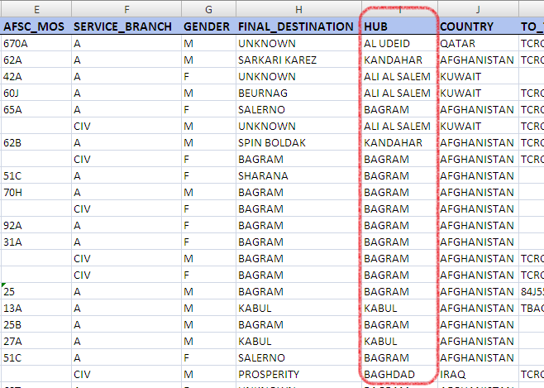
How to operate CRC Manifest Processor: Pre Manifest Processing (4)
Open the output file and check the HUB column of the Pre_Manifest tab.
If you see a row with NOT_FOUND, you will need to add a new entry to the configuration (see later slides).
If you do not see NOT_FOUND, the Pre Manifest is ready to send out to the email distribution list.

Slide 9
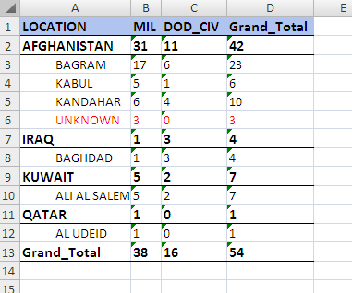
How to operate CRC Manifest Processor: Pre Manifest Processing (5)
Look at the Pre Manifest Counts tab in the output file.
Use the Grand Total for each Hub to create the Intra-theater ULN request email to ARCENT JOPES:
Please reserve ULN seats for this week’s CRC flight:
BAGRAM: 23 seats
KABUL: 6 seats
KANDAHAR: 10 seats
BAGHDAD: 4 seats
AL UDEID: 7 seats
Thank you!
ARCENT JOPES will email back with the ULNs and number of seats (PAX). Keep this email from ARCENT JOPES. You will need it for Final Manifest processing.

Slide 10
How to operate CRC Manifest Processor: Pre Manifest Processing (6)
Send an email to the CRC Pre Manifest email distribution list:
ALCON,
The CRC Pre Manifest for this week is attached.
Please review and prepare for arrival of personnel coming from the CRC.
Thank you!
Do not forget to attach the Pre Manifest output file to the email!

Slide 11
CRC Final Manifest Processing

Slide 12
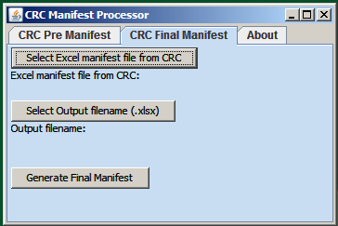
How to operate CRC Manifest Processor: Final Manifest Processing
Ensure “CRC Final Manifest” tab is selected.
Click on “Select Excel manifest file from CRC”
Select Excel file that the CRC sent using the dialogue box

Slide 13
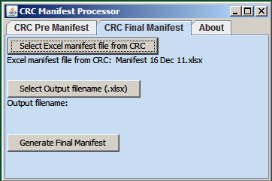
How to operate CRC Manifest Processor: Final Manifest Processing (2)
Click on “Select Excel Output filename”
Select desired output path and type the filename you want using the dialogue box. A suggested filename is:
Processed CRC Final Manifest
followed by today’s date.

Slide 14
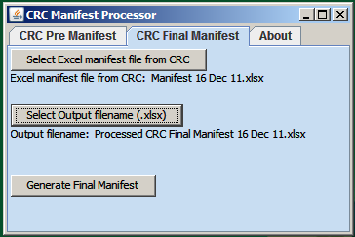
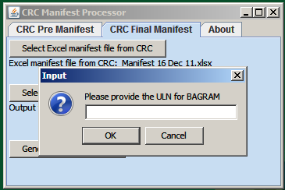
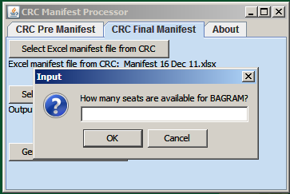
How to operate CRC Manifest Processor: Pre Manifest Processing (3)
Click on “Generate Final Manifest”
Several pop-up dialogue boxes will ask for the ULNs and number of seats. Use the email from ARCENT JOPES to get the ULN and number of seats (PAX) reserved for the intra-theater flights.

Slide 15
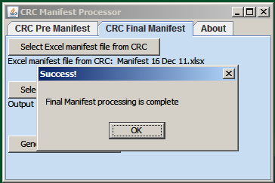
How to operate CRC Manifest Processor: Final Manifest Processing (4)
Processing only takes a few seconds.
If processing is successful,
a pop-up box will let you know. Click OK.

Slide 16
How to operate CRC Manifest Processor: Final Manifest Processing (5)
Open the output file and check the HUB column of the Final_Manifest tab.
If you see a row with NOT_FOUND, you will need to add a new entry to the configuration (see later slides).
If you do not see NOT_FOUND, the Final Manifest is ready to send out to the email distribution list.

Slide 17
How to operate CRC Manifest Processor: Final Manifest Processing (6)
Send an email to the CRC Final Manifest email distribution list:
ALCON,
Attached is the CRC Final Manifest for those flying in this week.
LOCATION Count
------------------
AFGHANISTAN 69
IRAQ 1
KUWAIT 21
QATAR 2
==================
Total 93
Thank you!
Do not forget to attach the Final Manifest output file to the email!

Slide 18
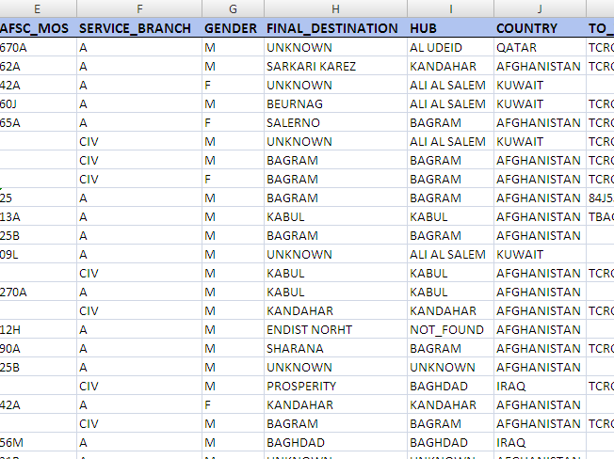
Editing CRC Manifest Processor Configuration (How to fix NOT_FOUND hubs)

Slide 19
Editing CRC Manifest Processor Configuration
Double-click “CRC_Manifest_Processor_Config.xlsx” to open it in Excel.

Slide 20
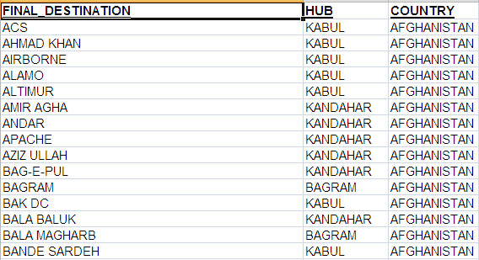
Editing CRC Manifest Processor Configuration (2)
There are several tabs in the Excel workbook. The tab that is used to assign hubs based on final destination is the DestinationHubCountry Tab:

Slide 21
Editing CRC Manifest Processor Configuration (3)
Destination Hub Country Configuration
This sheet has the data that represents final destinations in theater and how passengers get to their destination. Description of the columns:
FINAL_DESTINATION: The camp, FOB, COP, base, or office where the passenger is going. This is used to determine the major air hub that the passenger will travel through and the country where the destination is found. The final destination should be unique so that there is no confusion. Sometimes there are alternate spellings for a final destination. These are found in the LocationAlias sheet.
HUB: The major air hub that is used to reach the final destination. The total number of passengers going to this hub will be used to reserve seats for intra-theater flights from the Theater Gateway to the major air hub.
COUNTRY: The country where the final destination is located.
This sheet should be checked each month against E-Channel updates. If the major air hub to a destination changes, the HUB column should be updated. If there are new final destinations, they should be added to the bottom of the list. The major air hub for new final destinations can be found using Google. Use Google to find the approximate location of the final destination and then find the nearest major air hub.
If you get a NOT_FOUND hub result in the generated manifest, it means that the final destination is not in this list (the Destination Hub Country Configuration) and will need to be added as a new final destination.
For example, suppose we get a new final destination in Jazah, Afghanistan. Search Google for "Jazah, Afghanistan". Many of the results show that Jazah is near Kandahar. Since no other air hubs are closer, put KANDAHAR in the HUB column. This means that the new entry would be:
FINAL_DESTINATION: JAZAH
HUB: KANDAHAR
COUNTRY: AFGHANISTAN
If you get a UNKNOWN hub result in the generated manifest, it means that the passenger put UNKNOWN in their final destination or left their final destination blank. If the final destination is not known, we cannot determine what major air hub, so the HUB column will be UNKNOWN. Passengers with UNKNOWN hubs will not have seats reserved on intra-theater flights and must travel by standby.
The exception to this rule is medical personnel travelling to Afghanistan. Medical personnel with UNKNOWN final destinations in Afghanistan will travel to BAGRAM to get final duty locations assigned.

Slide 22
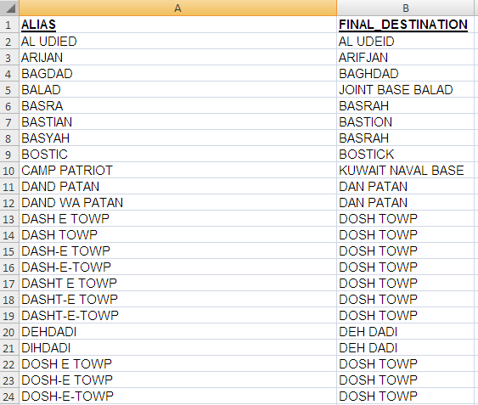
Editing CRC Manifest Processor Configuration (4)
The LocationAlias tab is used to substitute alternate final destination names for the “official” final destination name that is used in the Destination Hub Country tab.

Slide 23
Editing CRC Manifest Processor Configuration (5)
Location Alias Configuration
This sheet has alternate names and alternate spellings for final destinations in theater. There are several reasons for this given below.
Reason #1: Names from other languages: Many of the names of final destinations in theater come from other languages (Arabic, Farsi, Pashtu, Urdu, etc.). Since these languages have non-Roman alphabets, we use the way the name sounds to create an English spelling for the name. In many cases there are multiple correct spellings for a location. For example, see the "other names" from this Wikipedia article: http://en.wikipedia.org/wiki/Khanashin
Reason #2: Multiple names for a destination: Many of the final destinations where we work have more than one name. For example, Camp Patriot, Kuwait is also called Kuwait Naval Base.
Reason #3: Spelling Errors: Sometimes passengers deploying into theater do not know the correct spelling of their destination. Some misspellings are so common that they are worth adding to this list to prevent NOT_FOUND results.
!! IMPORTANT !!
All names in the FINAL_DESTINATION column on this sheet must have corresponding entries in the Destination Hub Country sheet. The spellings in the FINAL_DESTINATION column on this sheet must match the spellings in the FINAL_DESTINATION column of the Destination Hub Country sheet.
All of the location aliases in the manifest provided by the CRC will be replaced with the final destinations in this list.

Slide 24
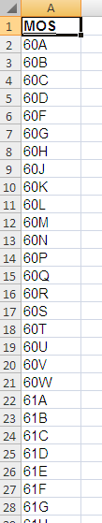
Editing CRC Manifest Processor Configuration (6)
The Priority MOS tab has a list of the MOS’s that are considered high priority. Passengers with high priority MOS’s are given seat reservations before passengers who do not have high priority MOS’s.

Slide 25
Editing CRC Manifest Processor Configuration (7)
Priority MOS Configuration
This sheet has a list of MOS's that are high priority. This is usually medical MOS's, but may include other MOS's as well.
As a rule, many medical service providers (doctors, nurses, etc.) usually have short deployment orders so it is important to get them into theater as quickly as possible. For this reason, passengers with high priority MOS's will be given reserved seats before passengers who do not have a high priority MOS.
On the final manifest, if there are fewer seats available than there are passengers going to a major air hub, passengers with a high priority MOS will get the seats first.
This sheet will only need to be updated if other (non-medical) MOS's are marked as high priority or if the MOS code changes.

Slide 26
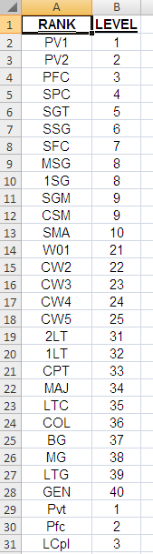
Editing CRC Manifest Processor Configuration (8)
The Rank Comparison tab provides a way to compare ranks of service members of all military branches and civilians against one another.
This allows passengers to be prioritized by their rank / pay grade.

Slide 27
Editing CRC Manifest Processor Configuration (9)
Rank Comparison Configuration
This sheet has a list of all of the rank abbreviations for each branch of the US Armed Forces and also DoD Civilian pay grades.
Each of the ranks / rates / pay grades is mapped to a level that corresponds to a priority for travel. Higher-ranking passengers will be given priority over lower-ranking passengers unless the lower-ranking passengers have a priority MOS. (See the Priority MOS sheet.)
This sheet should not need to be updated unless there are changes in the ranks / rates of an Armed Forces service branch.

Slide 28
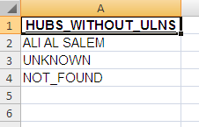
Editing CRC Manifest Processor Configuration (10)
The Hubs Without ULNs tab is used to determine which hubs should *not* have a by-name roster tab created in the CRC Final Manifest.
All hubs not in this list will have their own roster tabs that show all passengers going to the hub and their priority for seats.

Slide 29
Editing CRC Manifest Processor Configuration (11)
Hubs Without ULNs Configuration
This sheet is a list of hubs that should not have their own tab in the generated final manifest. There are two reasons for this:
Reason #1: Hub is the Theater Gateway: Hubs that are the Theater Gateway will not need onward movement intra-theater flights. Passengers whose major air hub is the Theater Gateway will travel by ground transportation to their final destination.
Reason #2: Not really a major air hub: UNKNOWN and NOT_FOUND are not real major air hubs. UNKNOWN is placed in the HUB column for passengers who do not know their final destination in theater, so no air hub lookup is possible. NOT_FOUND is placed in the HUB column when the passenger has a final destination that is not in the Destination Hub Country Configuration. If any passengers have NOT_FOUND in the HUB column, their final destination's hub will need to be found and the Destination Hub Country Configuration will need to be updated. (See the Destination Hub Country Configuration for more details.)

Slide 30
Editing CRC Manifest Processor Configuration (12)
!!! IMPORTANT !!!
The CRC_Manifest_Processor_Config.xlsx file is only read when the program first starts up.
This means that if you edit the CRC_Manifest_Processor_Config.xlsx file, you will need to close the CRC Manifest Processor program and re-launch it for your changes to take effect.
The best way to fix NOT_FOUND hubs is to:
Close the CRC Manifest Processor program
Open CRC_Manifest_Processor_Config.xlsx for editing
Check the Destination Hub Country tab to see if the final destination is already present with a different spelling
If the final destination is present in the Destination Hub Country tab, put the alternate spelling that caused NOT_FOUND in the Location Alias tab.
If the final destination is not present, use Google to determine the hub and country for the final destination that caused NOT_FOUND. Add the final destination, hub, and country to the Destination Hub Country tab.
Save changes to the CRC_Manifest_Processor_Config.xlsx file.
Run the CRC Manifest Processor program
Process the manifest again
Check the output file to ensure that there are no NOT_FOUND hubs

